Slide 1
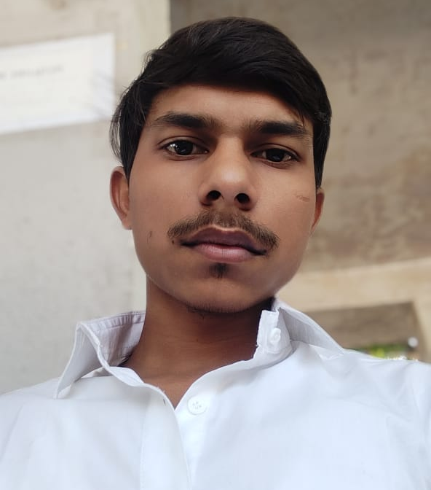
edunet
foundation
Autonomous Driving System
Program Feedback
Engaging with Skills Build has diversified ski;;s and prepared me for future career prospects through interactive modules and supportive mentorship, enhancing my employability and fostering continuous growth
project summary
This project consists of develops self-driving technology using sensors,
GPS, and AI for safe, autonomous vehicle navigation.
Rahul Kumar Verma
rv3781288@gmail.com
Aditya Silver Oak Institute of Technology
#Skillsbuild
Ahmedabad, Gujarat
#2024

