Slide 1

Q4 2024 Business Review
Strategic Performance Analysis

Slide 2
Executive Summary
• Revenue exceeded targets by 23%, reaching $245M
• Customer acquisition increased 35% year-over-year
• Launched 4 new product lines successfully
• Expanded into 3 new international markets
• Employee satisfaction rating improved to 4.7/5
• Operating margin improved to 28%

Slide 3
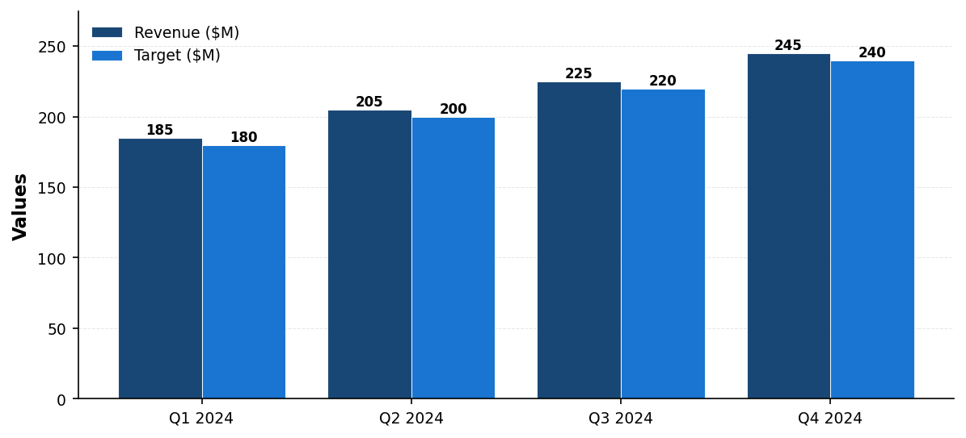
Quarterly Revenue Performance

Slide 4
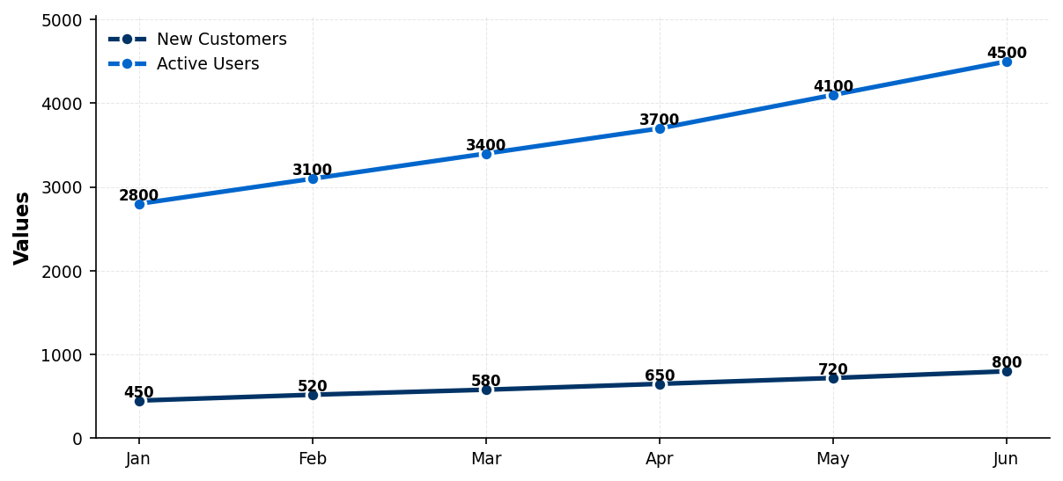
Customer Acquisition Trends

Slide 5
Major Achievements
• Product Innovation: Launched AI-powered analytics platform
• Market Expansion: Entered APAC and EMEA regions
• Partnership: Strategic alliance with Fortune 500 companies
• Team Growth: Hired 150+ talented professionals
• Recognition: Named Industry Leader by Gartner
• Sustainability: Achieved carbon-neutral operations

Slide 6
2025 Strategic Priorities
• Accelerate AI/ML product development
• Scale operations in new markets
• Enhance customer success programs
• Invest in talent development
• Drive operational efficiency
• Strengthen competitive positioning

Slide 7

"Excellence is not a destination; it is a continuous journey that never ends"
— Brian Tracy

