Slide 1

Introducing CloudSync Pro
Next-Generation Cloud Storage Solution

Slide 2
The Problem We're Solving
• Data fragmentation across multiple platforms
• Security concerns with current solutions
• Slow sync speeds affecting productivity
• Limited collaboration features
• High costs for enterprise storage
• Complex user interfaces

Slide 3
CloudSync Pro Solution
• Unified storage platform with AI organization
• Military-grade end-to-end encryption
• 10x faster sync with edge computing
• Real-time collaboration tools built-in
• 60% cost reduction vs. competitors
• Intuitive, award-winning interface

Slide 4
Revolutionary Features
🚀
Lightning Fast
🔒
Ultra Secure
🤖
AI-Powered
10x faster sync speed
Military-grade encryption
Smart file organization
💰
Cost Effective
🌐
Global CDN
👥
Team Ready
60% savings guaranteed
Access from anywhere
Built for collaboration

Slide 5
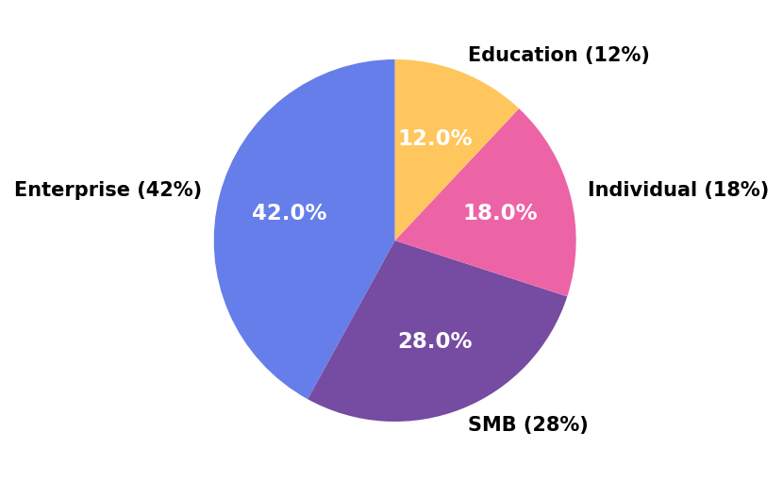
Market Opportunity

Slide 6
Simple, Transparent Pricing
• Starter: $9/month - 100GB, 3 users
• Professional: $29/month - 1TB, 10 users
• Business: $99/month - 10TB, unlimited users
• Enterprise: Custom - Unlimited everything
• All plans include: 24/7 support, 99.9% uptime SLA
• 30-day money-back guarantee

Slide 7

Start Your Free Trial Today
www.cloudsyncpro.com/trial

