Slide 1

2025 Marketing Strategy
Digital-First Growth Plan

Slide 2
Current Market Position
• Market Share: 18% (up from 12% last year)
• Brand Awareness: 67% in target demographic
• Digital Presence: 2.5M social media followers
• Website Traffic: 500K monthly visitors
• Email List: 180K engaged subscribers
• Customer NPS Score: 68 (Industry: 45)

Slide 3
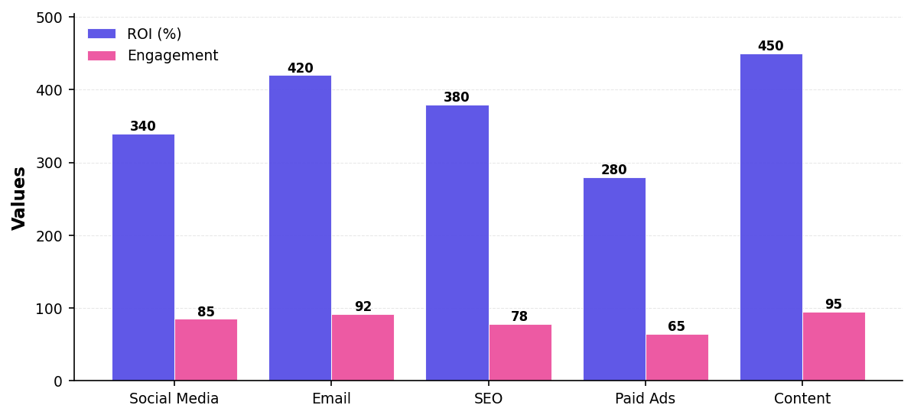
Marketing Channel Performance

Slide 4
2025 Strategic Objectives
• Increase market share to 25% by Q4
• Grow digital audience to 5M followers
• Achieve 1M monthly website visitors
• Launch in 3 new international markets
• Increase customer lifetime value by 40%
• Maintain NPS above 70

Slide 5
Key Marketing Initiatives
• Content Hub: Launch weekly video series and podcast
• Influencer Program: Partner with 50+ micro-influencers
• SEO Expansion: Target 200 new high-value keywords
• Marketing Automation: Implement AI-driven personalization
• Community Building: Create customer advocacy program
• Brand Refresh: Update visual identity and messaging

Slide 6
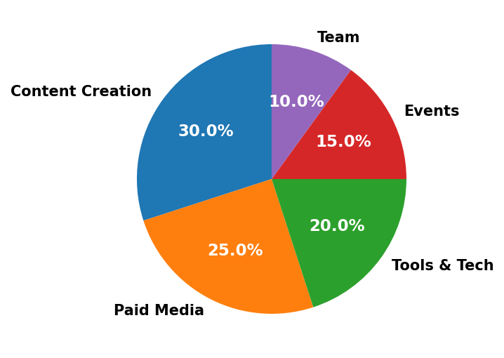
Budget Allocation ($5M Total)

Slide 7

"Marketing is no longer about the stuff you make, but the stories you tell"
— Seth Godin

