Slide 1

AI & Machine Learning
Technology Overview & Implementation Guide

Slide 2
Understanding AI & Machine Learning
• AI: Computer systems that mimic human intelligence
• ML: Algorithms that learn from data patterns
• Deep Learning: Neural networks with multiple layers
• Natural Language Processing: Understanding human language
• Computer Vision: Analyzing and interpreting images
• Reinforcement Learning: Learning through trial and error

Slide 3
Real-World Applications Today
• Healthcare: Disease diagnosis and drug discovery
• Finance: Fraud detection and algorithmic trading
• Retail: Personalized recommendations and inventory
• Transportation: Autonomous vehicles and route optimization
• Manufacturing: Quality control and predictive maintenance
• Entertainment: Content creation and recommendation systems

Slide 4
Core Technology Stack
🐍
Python
🧠
TensorFlow
⚡
PyTorch
Primary language
Deep learning
Research & prod
☁️
AWS/Azure
🗄️
PostgreSQL
📊
Jupyter
Cloud platform
Data storage
Development

Slide 5
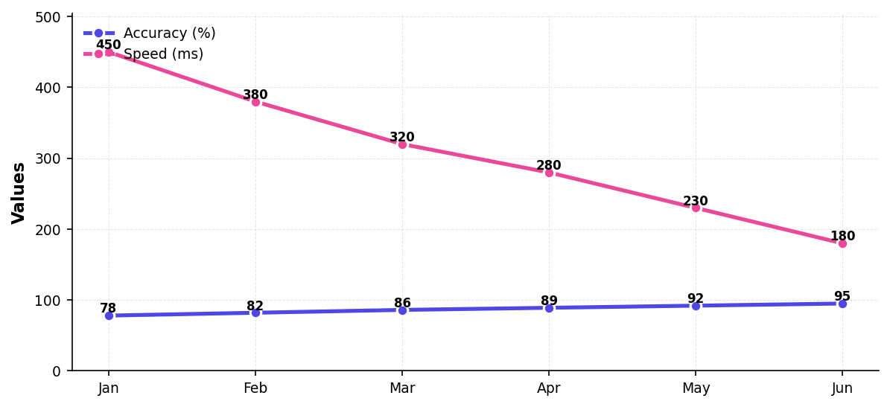
Model Performance Improvements

Slide 6
6-Month Implementation Roadmap
• Month 1-2: Data collection and preprocessing
• Month 2-3: Model architecture design and testing
• Month 3-4: Training and hyperparameter tuning
• Month 4-5: Validation and performance optimization
• Month 5-6: Deployment and monitoring setup
• Month 6+: Continuous improvement and scaling

Slide 7

"Artificial Intelligence is the new electricity"
— Andrew Ng

