Slide 1

Effective Leadership
Essential Skills for Modern Managers

Slide 2
What You'll Learn Today
• Understand core leadership principles and styles
• Develop effective communication strategies
• Master the art of delegation and empowerment
• Build high-performing, motivated teams
• Navigate difficult conversations with confidence
• Create a culture of continuous improvement

Slide 3
Five Leadership Styles
👑
Autocratic
🤝
Democratic
🎯
Transformational
Quick decisions, clear direction
Team input, collaborative
Inspire & innovate
📋
Transactional
🌱
Servant
🚀
Visionary
Structure & rewards
Team-first approach
Future-focused

Slide 4
Essential Communication Skills
• Active Listening: Give full attention, ask clarifying questions
• Clear Messaging: Be concise, specific, and purposeful
• Empathy: Understand perspectives and emotions
• Feedback: Provide constructive, timely input
• Non-Verbal: Master body language and tone
• Adaptability: Adjust style to audience and situation

Slide 5
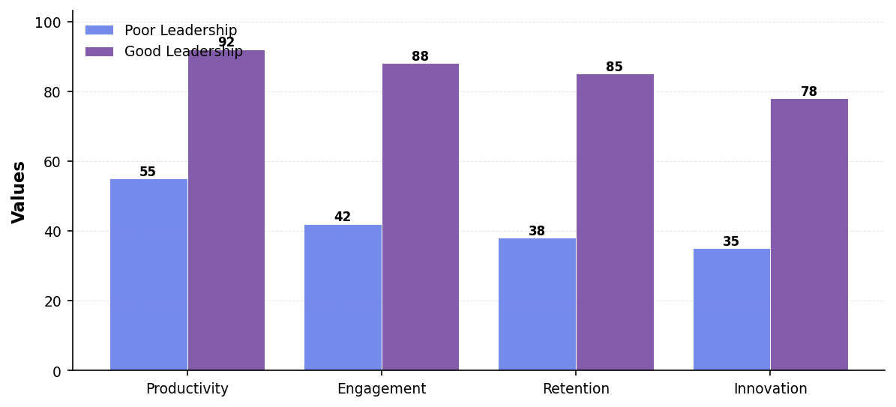
Impact of Leadership on Team Performance

Slide 6
Your 30-Day Action Plan
• Week 1: Schedule 1-on-1s with each team member
• Week 2: Implement daily stand-ups or check-ins
• Week 3: Delegate one major project to develop others
• Week 4: Gather 360-degree feedback on your leadership
• Ongoing: Read one leadership book per month
• Ongoing: Find a mentor or join a leadership community

Slide 7

"Leadership is not about being in charge. It's about taking care of those in your charge"
— Simon Sinek

