Slide 1

Python PowerPoint
Professional Presentations Without Node.js

Slide 2
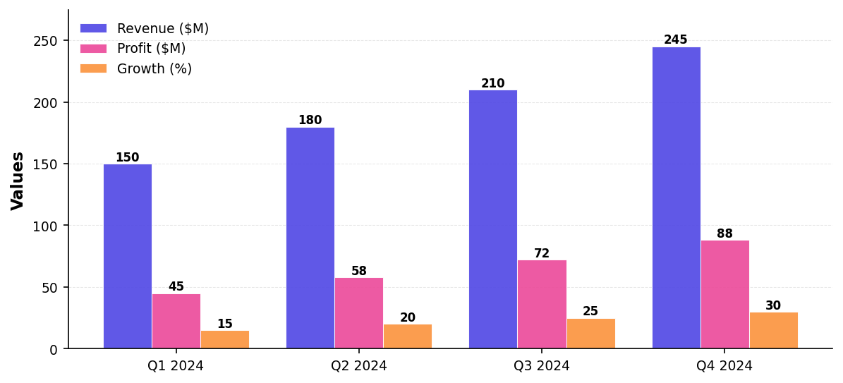
Sales Performance Analysis

Slide 3
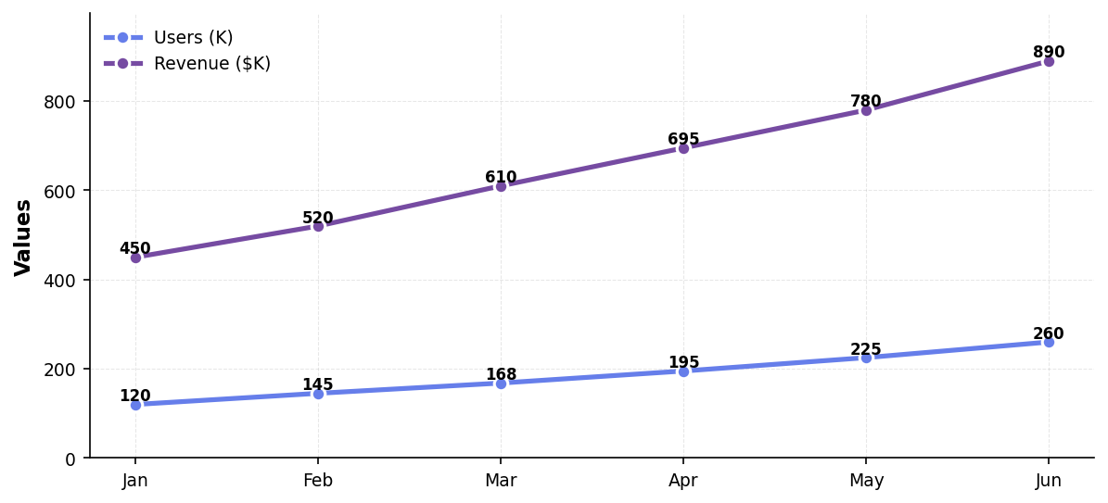
Growth Trends Over Time

Slide 4
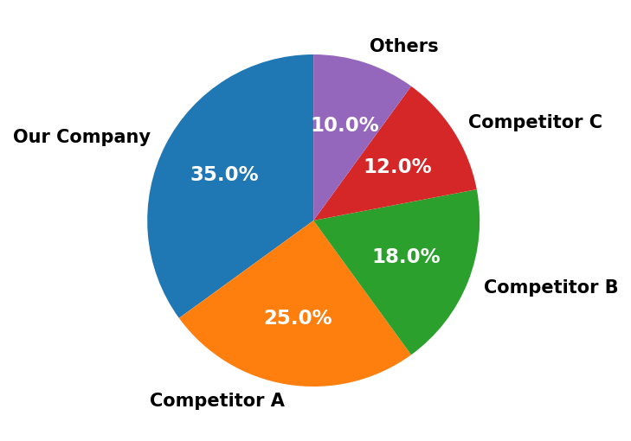
Market Share Distribution

Slide 5
Why Python PowerPoint?
• ✓ No Node.js required - pure Python
• ✓ Beautiful gradients without Chromium
• ✓ Publication-quality charts (FIXED!)
• ✓ 50MB vs 300MB+ (Node.js)
• ✓ Native data science integration
• ✓ Cross-platform compatibility

Slide 6

"Simplicity is the ultimate sophistication"
— Leonardo da Vinci

Slide 7

Thank You!

