Slide 1

Data Visualization
Charts Made Easy

Slide 2
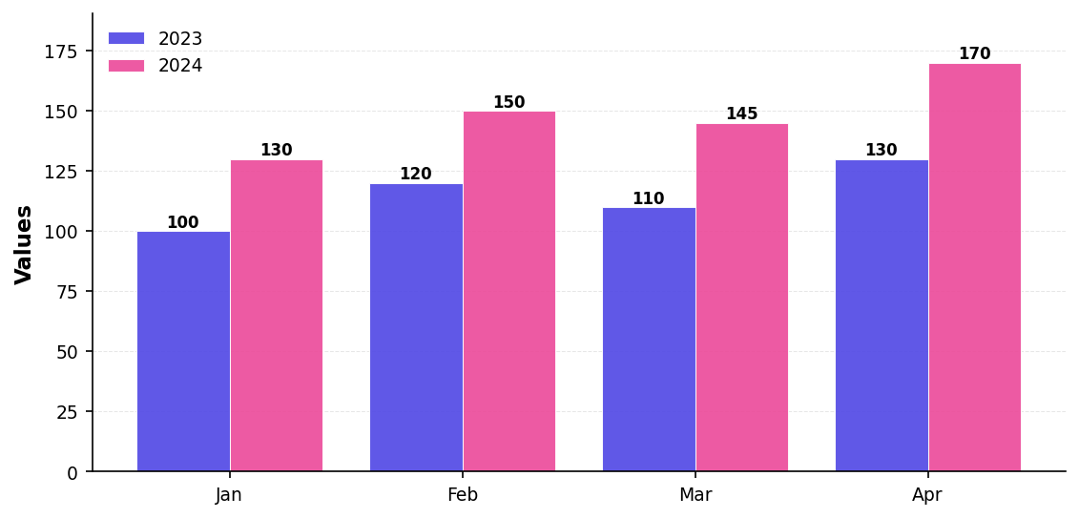
Sales Performance

