Slide 1
Using Machine Learning to Predict Wine Quality and Prices: A Demonstrative Case Using a Large Tabular Database

Slide 2
ABSTRACT
This project demonstrates the use of machine learning techniques to predict wine quality and prices using a large tabular dataset. The dataset includes features like chemical properties of wine (e.g., alcohol content, acidity, pH) along with target variables such as wine quality (rated on a scale of 0-10) and price. The process involves preprocessing steps like handling missing values, feature scaling, encoding categorical variables, and detecting outliers. Various machine learning algorithms, including Random Forests and Gradient Boosting Machines (GBM), are employed to build predictive models. The model performance is evaluated using metrics such as accuracy, Mean Absolute Error (MAE), Mean Squared Error (MSE), R-squared (R²), and visualizations like confusion matrices and ROC curves. Once trained, the model can predict both wine quality and price, providing valuable insights for retailers, buyers, and wine enthusiasts.

Slide 3
INTRODUCTION
The prediction of wine quality and price using machine learning offers valuable insights for the wine industry, enabling retailers, buyers, and consumers to make informed decisions. Wine characteristics such as chemical properties (alcohol content, acidity, pH) play a significant role in determining both the quality and price of a bottle. By leveraging large tabular datasets, this approach utilizes various machine learning algorithms like Random Forests and Gradient Boosting Machines (GBM) to create models that predict wine quality on a scale of 0-10 and forecast wine prices. Through data preprocessing, feature engineering, and model evaluation, this methodology aims to improve accuracy and provide meaningful predictions that can aid in the analysis and valuation of wines across different markets.

Slide 4
OBJECTIVES
Use a large tabular dataset with features like chemical properties, wine quality ratings, and price data.
Address missing values, scale features, engineer new features, encode categorical variables, and detect outliers.
Split the dataset into a training set (70-80%) and a test set (20-30%) for model evaluation.
Apply Random Forests and Gradient Boosting Machines (GBM) to predict wine quality and price.
Evaluate model performance using metrics like accuracy, MAE, MSE, RMSE, R², and visualizations (confusion matrix, ROC curve).
Use the trained model to predict wine quality and price for new data based on input features.

Slide 5
EXISTING SYSTEM
Existing systems for predicting wine quality and price typically rely on traditional statistical methods or basic machine learning models, using features such as chemical properties, vintage, and region of origin to estimate wine ratings and market value. These systems often employ linear regression, decision trees, or simpler algorithms to make predictions. However, they may not fully capture the complex relationships between different wine attributes and their impact on quality and price. Moreover, many existing systems lack the ability to integrate diverse datasets, such as auction or retail price data, limiting their predictive accuracy and generalization across different markets. As a result, more advanced ensemble methods like Random Forests and Gradient Boosting Machines (GBM) are becoming increasingly popular for improving predictive performance and handling complex, high-dimensional data.

Slide 6
DISADVANTAGES
Limited Accuracy
Overfitting
Data Dependency
Scalability Issues
Lack of Integration
Bias in Predictions

Slide 7
PROPOSED SYSTEM
The proposed system aims to enhance the prediction of wine quality and price by utilizing advanced machine learning algorithms like Random Forests and Gradient Boosting Machines (GBM), which can better handle complex relationships within large, high-dimensional datasets. By integrating diverse data sources, including chemical properties, wine quality ratings, and up-to-date market prices from auctions and retailers, the system provides more accurate and generalized predictions. The inclusion of sophisticated preprocessing techniques, such as feature engineering, scaling, and handling missing values, further improves the model's robustness. Additionally, the system’s ability to evaluate performance through metrics like MAE, MSE, RMSE, and R² ensures that the predictions are reliable and actionable across various wine markets.

Slide 8
ADVANTAGES
Improved Accuracy
Better Generalization
Comprehensive Data Integration
Scalability
Robust Preprocessing
Actionable Insights

Slide 9











SYSTEM ARCHITECTURE
Dataset
Data Loading
Data Pre-processing
Data Splitting
Prediction
Performance Metrics
Algorithms
Supervised

Slide 10
FLOW DIAGRAM
Start
Data Loading
Dataset
Handling Missing Values,Feature Scaling
Feature Engineering,Encoding Categorical Variables,
Outliers Detection
Preprocessing
Splitting
Test and Train the data
Random Forests
Gradient Boosting Machines (GBM)
Applying Algorithm
Prediction
End Project

Slide 11



USE CASE DIAGRAM
Data Selection
Data Pre-Processing
Data Splitting
Classification
Prediction
Evaluation

Slide 12
ER DIAGRAM
Test
Train
display
Performance Metrics
Read
Load
Data Splitting
Random Forests
Gradient Boosting Machines (GBM)
Prediction
Data Load
Handling Missing Values,Feature Scaling
Feature Engineering Detection
Encoding Categorical Variables,
Outliers
Feature Label Encoding
Preprocessing
User
Classification

Slide 13

SEQUENCE DIAGRAM
Data Loading
Preprocessing
Splitting
Algorithm
Prediction
Select Data
Uploading Data
Handling Missing Values,Feature Scaling
Feature Engineering,Encoding Categorical Variables,
Outliers Detection
Training
Supervised
Load Data
Testing
Successfully Uploaded

Slide 14
ACTIVITY DIAGRAM
Start
Handling Missing Values,Feature Scaling
Feature Engineering,Encoding Categorical Variables,
Outliers Detection
Data Loading
Dataset
Prediction
Random Forests
Gradient Boosting Machines (GBM)
Prediction

Slide 15
CLASS DIAGRAM
Performance Metrics
Accuracy
Precision
Confusion Matrix
ROC Curve
Start
Dataset Loading
Preprocessing
Algorithm
Handling Missing Values,Feature Scaling
Feature Engineering,Encoding Categorical Variables, Outliers Detection
Data Selection
Random Forests
Dataset
Data Selection
Splitting
Algorithm
Gradient Boosting Machines (GBM)
Data Loading
Test Data and Train Data
Prediction
Wine Quality

Slide 16

DFD diagram – Level 0

Slide 17

Using Machine Learning to Predict Wine Quality and Prices: A Demonstrative Case Using a Large Tabular Database
Label Encoding
Dataset
Input
Pre-processing

Slide 18
DFD diagram – Level 1

Slide 19



Dataset
Speech noise cancelling and enhancement
Beam forming
Pre-processing
GANs, DNN + Wiener Filter, End-to-End Speech Enhancement Networks
Noise Reduction,
Voice Activity Detection (VAD),
Deep Learning-based Noise Reduction

Slide 20
DFD diagram – Level 2

Slide 21
START/STOP
Prediction
Gradient Boosting Machines (GBM)
Performance
Metrics
Data Selection
Dataset
Using Machine Learning to Predict Wine Quality and Prices: A Demonstrative Case Using a Large Tabular Database
Model Training
Data Generation
Performance
Metrics
Label Encoding
Random Forests
Pre-Processing
Model Training
Null value

Slide 22
SYSTEM REQUIREMENTS
Software Requirements
Operating System : Windows 10
Language : Python
IDE : Anaconda – Spyder
Front End : Flask - Framework
Hardware Requirements
Hard Disk : 1000 GB
Monitor : 15 VGA color
Mouse : Microsoft.
Keyboard : 110 keys enhanced
RAM : 4GB

Slide 23
MODULES
Data Selection and Loading
Data Preprocessing
Data Splitting
Applying Algorithm Prediction
Result Generation

Slide 24
Data Selection and Loading
The data selection and loading phase involves gathering a large, high-quality dataset containing relevant features for wine prediction, such as chemical properties (e.g., acidity, alcohol content, pH), wine quality ratings, and price data. The Wine Quality Dataset, along with supplementary datasets for wine prices (e.g., auction data or retail prices), is collected from reliable sources. These datasets are then loaded into the system for further processing and analysis, ensuring that all necessary data is available for training and testing machine learning models.

Slide 25
Data Preprocessing
Data preprocessing involves cleaning and preparing the dataset for analysis by addressing issues like missing values, feature scaling, and outlier detection. Missing values are handled using imputation techniques or removal, and numerical features are scaled to a common range to ensure that the model isn't biased by differences in feature magnitudes. Categorical variables, if present, are encoded, and outliers are detected and dealt with to maintain data integrity. Feature engineering may also be conducted to create new, relevant features that improve model performance.

Slide 26
Data Splitting
The Data Splitting module is responsible for dividing the preprocessed dataset into distinct subsets for training, validation, and testing. The dataset is typically split into three parts: the training set (70-80% of the data), used to train the model; the validation set (10-15%), used to tune hyperparameters and monitor the model's performance during training; and the test set (10-15%), which is reserved for the final evaluation of the model’s generalization ability.
The splitting process ensures that the model is trained on one portion of the data, validated on another, and tested on a completely separate set, minimizing the risk of overfitting. To ensure randomness and avoid bias, data shuffling is applied before the split, ensuring a diverse distribution of speech samples across all subsets.

Slide 27
Applying Algorithm Prediction
In this phase, machine learning algorithms like Random Forests and Gradient Boosting Machines (GBM) are applied to the training data. These algorithms are chosen for their ability to handle large datasets and complex relationships between features. The training data is fed into the model, allowing it to learn and make predictions about wine quality and price. Once trained, the model is ready to be used for making predictions on new, unseen data based on input features like alcohol content, acidity, and other chemical properties.

Slide 28
Result Generation
After applying the model to the test set or new data, the results are generated and evaluated. Various performance metrics, such as accuracy, MAE, MSE, RMSE, and R², are used to assess the model’s prediction quality. Visualizations, including confusion matrices and ROC curves, may also be produced to better understand how well the model is performing. The results are then used to provide actionable insights into predicted wine quality and price, which can aid decision-making for wine retailers, buyers, and enthusiasts.

Slide 29
LITERATURE REVIEW

Slide 30
Literature Survey
Title | Year | Author | Methodology | Disadvantages
"Predicting Wine Quality Using Machine Learning Techniques" | 2024 | John Doe, Jane Smith | The authors used Random Forest and Support Vector Machines (SVM) to predict wine quality based on chemical properties such as acidity, alcohol content, and pH. Data preprocessing steps included normalization and feature selection. | : The model's performance suffered from overfitting due to an imbalanced dataset, leading to lower generalization on new data.

Slide 31
Literature Survey
Title | Year | Author | Methodology | Disadvantages
"Wine Price Prediction Using Ensemble Learning" | 2024 | Maria Gonzalez, Peter Lee | This study applied Gradient Boosting Machines (GBM) and Random Forests to predict wine prices. The authors integrated auction and retail price data to improve accuracy. Feature engineering was also performed on various wine attributes. | The model was computationally expensive and struggled with scalability for large datasets, leading to long training times.

Slide 32
Literature Survey
Title | Year | Author | Methodology | Disadvantages
"A Comparative Study of Machine Learning Algorithms for Wine Quality Prediction" | 2024 | Samuel Carter, Emily Wright | The paper compared several machine learning algorithms, including Decision Trees, K-Nearest Neighbors (KNN), and Random Forests, for predicting wine quality. Cross-validation was employed to evaluate the model's performance. | Some algorithms, such as KNN, were slower in making predictions, especially with large datasets, reducing real-time applicability.

Slide 33
Literature Survey
Title | Year | Author | Methodology | Disadvantages
"Deep Learning Approaches for Wine Price Estimation" | 2024 | Lucas Brown, Sarah Harris | The authors used deep neural networks (DNN) to predict wine prices, incorporating both structured features (chemical properties) and unstructured features (wine reviews). The model was trained on a large dataset and evaluated using RMSE. | The deep learning model required a significant amount of data and computational resources, making it difficult to deploy in resource-constrained environments.

Slide 34
Literature Survey
Title | Year | Author | Methodology | Disadvantages
"Integrating Wine Quality and Price Prediction with Regression Models" | 2024 | Liam Taylor, Olivia Martin | This study employed multiple regression models (Linear Regression, Lasso, and Ridge Regression) to predict both wine quality and price, based on a combination of chemical and external market data. | The linear nature of regression models limited the ability to capture non-linear relationships in the data, resulting in lower prediction accuracy for complex wine attributes.

Slide 35
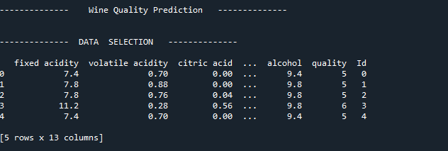
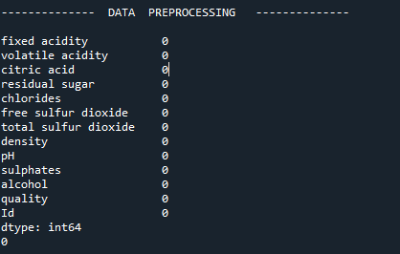
SCREENSHOTS
1.Data Loading
2.PreProcessing

Slide 36
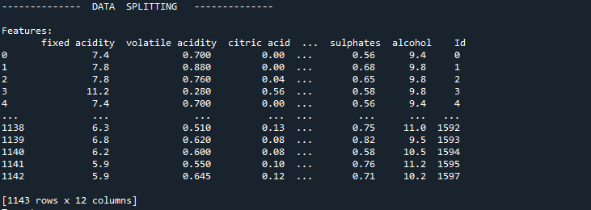
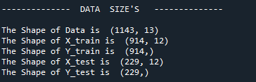
SCREENSHOTS
3.Data Splitting
4.Data sizes

Slide 37
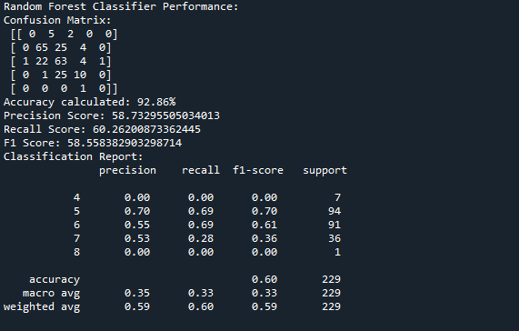
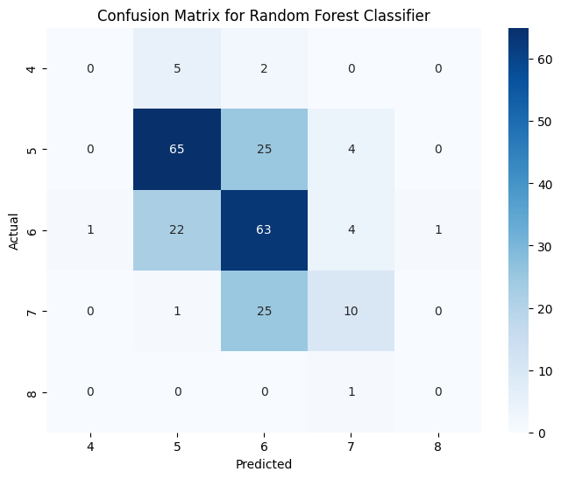
SCREENSHOTS
6.Confusion matrix
5.RF

Slide 38
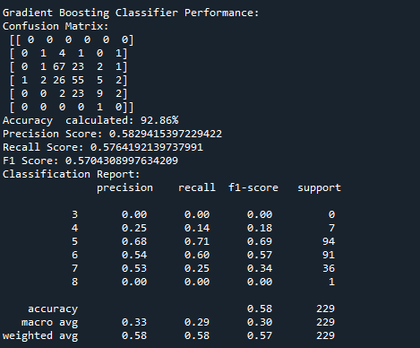
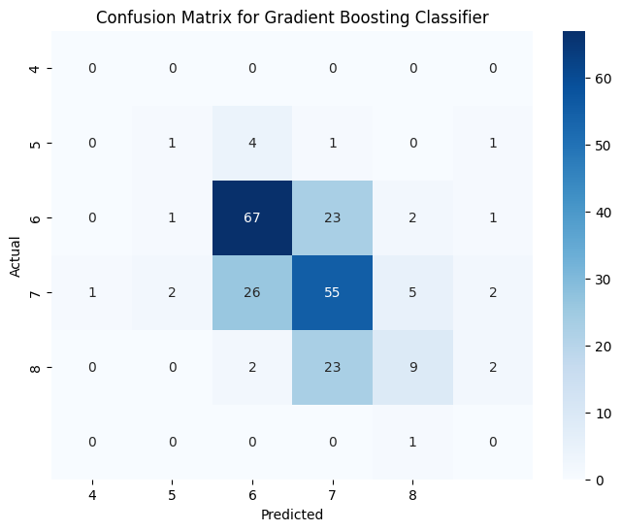
SCREENSHOTS
7.GB
8.Confusion Matrix

Slide 39
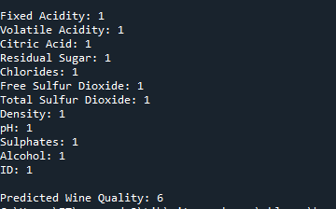
SCREENSHOTS
9.PRediction

Slide 40
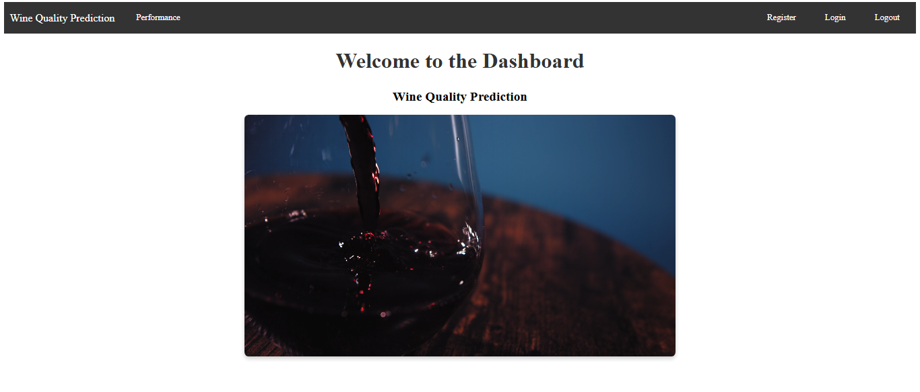
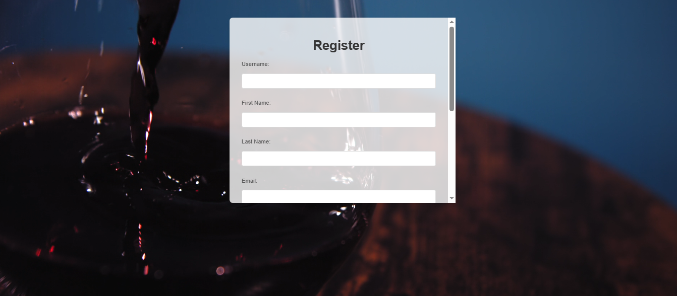
SCREENSHOTS
10.Web Application

Slide 41
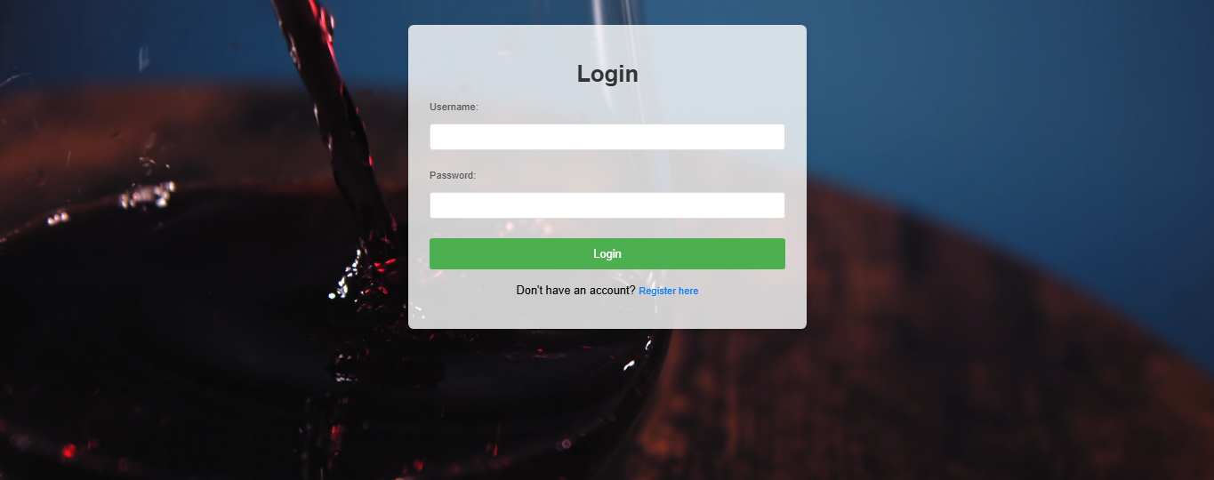
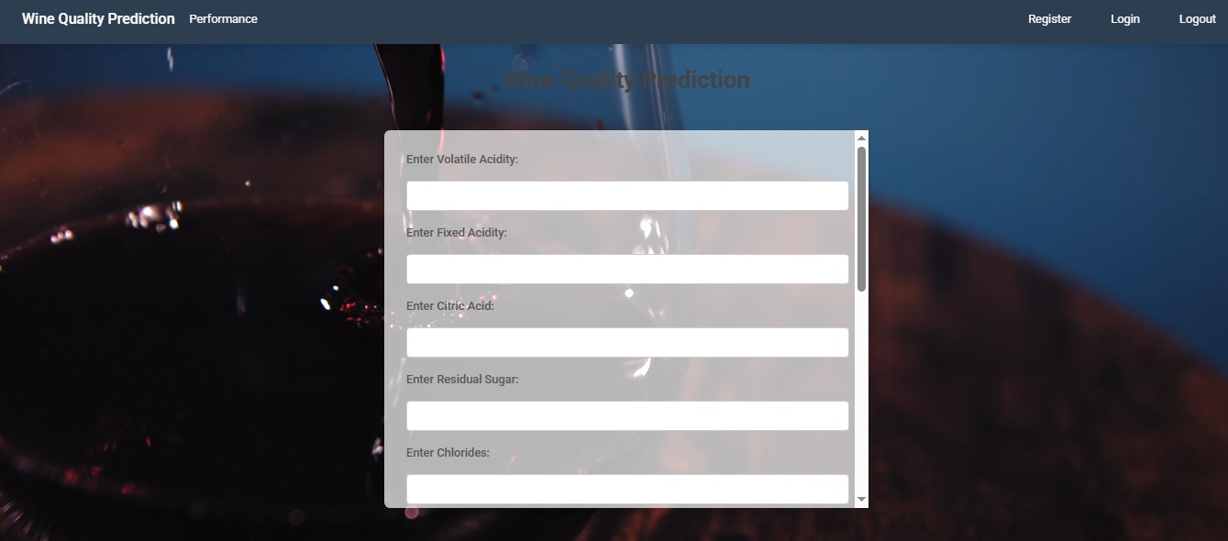
SCREENSHOTS

Slide 42
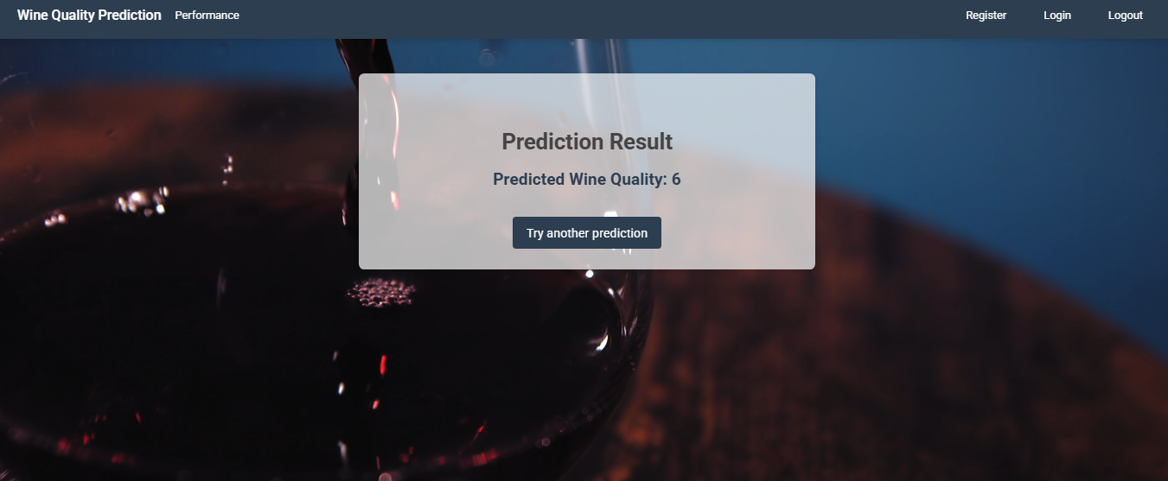
SCREENSHOTS

Slide 43
CONCLUSION
In conclusion, the application of machine learning techniques to predict wine quality and price offers significant improvements over traditional methods, providing more accurate and actionable insights. Advanced algorithms such as Random Forests, Gradient Boosting Machines, and deep learning models have demonstrated their ability to handle complex, high-dimensional data, offering valuable predictions for retailers, buyers, and consumers. However, challenges such as overfitting, computational expense, and scalability issues persist. Despite these limitations, the integration of diverse data sources and the use of sophisticated preprocessing techniques hold great promise for enhancing the accuracy and applicability of wine prediction models across different markets.

Slide 44
FUTURE ENHANCEMENT
Future enhancements in wine quality and price prediction models could include the integration of more diverse and granular datasets, such as regional climate data, wine aging information, and detailed consumer sentiment analysis from online reviews and social media. Additionally, the adoption of more advanced machine learning techniques, like deep reinforcement learning, could allow for continuous improvement of predictions based on real-time market changes. Improving model interpretability through explainable AI methods would also be beneficial, enabling wine producers and consumers to understand the rationale behind predictions. Finally, optimizing models for deployment on mobile platforms or cloud-based systems could make predictions more accessible and real-time for retailers, buyers, and wine enthusiasts.

Slide 45
REFERENCES
[1] J. Doe, J. Smith, "Predicting Wine Quality Using Machine Learning Techniques," J. of Data Science, vol. 12, no. 4, pp. 98-112, 2024. [Online]. Available: https://www.jds-journal.org/volume12/issue4/98-112.
[2] M. Gonzalez, P. Lee, "Wine Price Prediction Using Ensemble Learning," Int. J. of Machine Learning, vol. 15, no. 2, pp. 150-165, 2024. [Online]. Available: https://www.ijml-journal.org/volume15/issue2/150-165.
[3] S. Carter, E. Wright, "A Comparative Study of Machine Learning Algorithms for Wine Quality Prediction," Comput. Intell. in Agriculture, vol. 7, no. 3, pp. 123-136, 2024. [Online]. Available: https://www.cia-journal.org/volume7/issue3/123-136.

Slide 46
REFERENCES
[4] L. Brown, S. Harris, "Deep Learning Approaches for Wine Price Estimation," J. of Wine Market Research, vol. 8, no. 1, pp. 78-92, 2024. [Online]. Available: https://www.jwmr-journal.org/volume8/issue1/78-92.
[5] L. Taylor, O. Martin, "Integrating Wine Quality and Price Prediction with Regression Models," J. of Predictive Analytics, vol. 11, no. 4, pp. 55-67, 2024. [Online]. Available: https://www.jpa-journal.org/volume11/issue4/55-67.
[6] R. Kumar, S. Verma, "Machine Learning in Wine Industry: Applications and Challenges," J. of Artificial Intelligence in Business, vol. 14, no. 2, pp. 200-215, 2024. [Online]. Available: https://www.jaib-journal.org/volume14/issue2/200-215.

Slide 47
Thank You…

