Slide 1
CSE 5330
Project Presentation
Team <02>
Instructor: Abhishek Santra
Rahul Rajaraman
Harshada Padwal
Aniket Gadekar
Shruti Borge

Slide 2
Cricket League Management System
The cricket league management system makes it easier and effective tracking ticket sales per team and location provides insight into revenue generation and enables optimization of strategic pricing strategies and ticket sales.
By utilizing this system, the risk of errors and inconsistencies in handling player information, game schedules, and fan data is eliminated.

Slide 3
Cricket League Management System
Using Cricket League Management System the Franchise can start the fans loyalty programs like Identifying the fans who are attending all matches and rewarding the dedicated fans can enhance the overall fan experience and loyalty.
Analyzing fan demographics helps in targeting specific age groups for promotional activities and customizing offers based on fan preferences enhances overall fan experience.

Slide 4
Project Overview
Sr. No | Table Name | Attributes | #Rows
1 | Teams | (TeamID, TName, Captain) | 5
2 | Players | (Id, Runs, Wickets, PName,DOB,Role, TeamID) | 75
3 | Stadium | (StadiumId, Sname, Seatcapacity) | 5
4 | Fans | (Seatnum, Age, Fname) | 300
5 | Match | (MatchId, Date_time ,Team1, Team2, Winner, Tickets_sold, StadiumId, Mlocation) | 13
6 | Involves | (Id, MatchId) | 286
7 | Fans_entering | (Seatnum, MatchID) | 3550
8 | Fans_Ticketprice | (Seatnum, ticket_price) | 300
9 | Supports | (seatnum, teamid) | 431
10 | Fans_email | (Seatnum, email) | 467

Slide 5
Business Goals
1. At which stadium does the seating reach full capacity during games involving which teams?
2. Find which team has scored more than 2000 runs, in the league.
3. Retrieve the top 3 teams with the highest fanbase
4. Provide a summary of the total ticket sales per team, including subtotals.
5. Find out the fans who are attending all the matches
6. Find out the average number of wickets within each team
7. Identify the batsman or wicket-keeper with the highest run total in each team and
who has achieved a score exceeding 200.

Slide 6
Business Goals (Cont.)
8. Determine the age group of adults with over 100 attendance at matches.
9. Generate a report showing the total number of tickets sold, subtotals by match
location and stadium, and a grand total.
10. Which bowler has taken the maximum wickets in the league?
11. Which player who has scored the maximum runs in the league

Slide 7
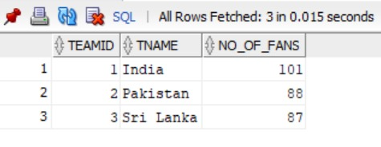
Business Goals (Cont.)
Retrieve the top 3 teams with the highest fanbase.
Query: SELECT T.TeamID, T.TName, Count(F.Seatnum) AS No_of_Fans
FROM F23_S003_T2_Teams T
JOIN F23_S003_T2_Supports S ON T.TeamID = S.TeamID
JOIN F23_S003_T2_Fans F ON S.Seatnum = F.Seatnum
GROUP BY T.TeamID, T.TName
ORDER BY No_of_Fans DESC
FETCH FIRST 3 ROWS ONLY;
Output:

Slide 8
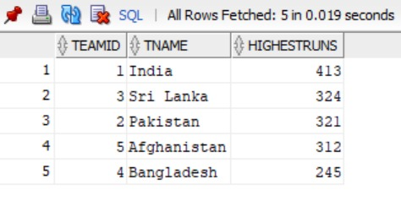
Business Goals (Cont.)
Identify the batsman or wicket-keeper with the highest run total in each team and who has achieved a score exceeding 200.
Query: SELECT T.TeamID, T.TName, MAX(P.Runs) AS HighestRuns
FROM F23_S003_T2_Teams T
JOIN F23_S003_T2_Players P ON T.TeamID = P.TeamID
WHERE P.Role LIKE '%Batsman%' or P.role like '%Wicket-Keeper%’
GROUP BY T.TeamID, T.TName
Having MAX(P.Runs)>200
order by highestruns desc;
Output:

Slide 9
Project Lookback
If done in a team, how did you break down the phases into sub-tasks and manage time?
Identified the tasks to be completed in the given phase.
Delegated the tasks among all the members.
Regular follow-ups to review the tasks completed and provide feedback if needed.
Which phase(s) of the project was (were) difficult and why?
If you are asked to redo this project, what will you change in the approach you followed?
Difficult phases – Phase 2, Phase 4.
Were not able to satisfy the constraints of queries in one go in phase 4,
Had to do multiple changes to the Phase 1 document,
Adding new business goals,
Introducing new constraints and updating already added one go,
Wrong cardinality assigned due to unidentified constraints in phase 2,
Changes to relations,
Added new Entity,
Will make note of each attribute why is it taken.

Slide 10
Project Takeaway
Are you happy with what you have developed?
Do you think this will add strength to your resume?
Yes. Got to learn from each phase –
Identifying Business Goals,
Identifying Constraints,
Drawing EER,
Functional dependencies,
Normalization,
Writing SQL queries.
What was your takeaway from the project that you think may help you in future?
Dividing the project into proper phases and working in teams,
Working towards the deadline
Applying theoretical concepts to real-world business problems

Slide 11

Discussion

