Slide 1


SIMPLYFLY
Air Ticket Booking System
By:RAHUL k
Mentor:Mr.Javeed
A Full-Stack Flight Reservation Platform | Final Project Presentation

Slide 2







ARCHITECTURE
System Architecture
React Frontend
Spring Boot API
JWT Auth Layer
MySQL Database
UI, booking flow, admin & owner panels
REST controllers & business logic
Token issuing & validation
Users, flights, bookings, payments
HTTPS REST calls, secured with a Bearer JWT on every request after login
User
Flight Owner
Admin
SimplyFly — Air Ticket Booking System
4

Slide 3




ROLE: ADMINISTRATOR
Admin Features
Manage Users
Manage Flight Owners
Manage Routes
Create, update, or deactivate user accounts.
Onboard and oversee flight owner accounts.
Define and maintain flight routes across the system.
Manage Bookings
Monitor System
Full visibility and control over all bookings.
Track system health and overall platform activity.
SimplyFly — Air Ticket Booking System
7

Slide 4




ROLE: FLIGHT OWNER
Owner Features
Add / Edit / Delete Flights
Manage Seat Availability
View Bookings
Full control over the flights an owner operates.
Keep seat maps accurate in real time.
See all reservations made across owned flights.
Approve Refunds
Update Fares
Review and act on passenger refund requests.
Adjust pricing in response to demand.
SimplyFly — Air Ticket Booking System
6

Slide 5





ROLE: PASSENGER
User Features
Register / Login
Search Flights
Book Multiple Seats
Create an account or sign in securely with JWT-based authentication.
Find flights by origin, destination, and travel date.
Select and reserve one or more seats in a single booking.
Online Payment
Booking History
Cancellation
Pay securely for bookings through an integrated payment step.
Review past and upcoming trips at a glance.
Cancel a booking and track refund status.
SimplyFly — Air Ticket Booking System
5

Slide 6

PROJECT FLOW
The Booking Journey
STEP 2
STEP 4
STEP 6
Search Flights
Book & Pay
Manage Booking
By origin, destination, and travel date
Confirm booking with online payment
View history, cancel, or request refund
STEP 1
STEP 3
STEP 5
Register / Login
Select Seats
E-Ticket
Secure sign-up with JWT authentication
Browse available flights and pick seats
Instant digital ticket generation
SimplyFly — Air Ticket Booking System
3

Slide 7
DATA LAYER
Database Design
FLIGHT
PAYMENT
id (PK)
id (PK)
USER
origin
BOOKING
booking_id (FK)
destination
amount
id (PK)
date
id (PK)
status
name
owner_id (FK)
user_id (FK)
email
flight_id (FK)
password
seats
role
status
OWNER
id (PK)
REFUND
name
id (PK)
email
booking_id (FK)
flights[]
amount
approved_by
SimplyFly — Air Ticket Booking System
8

Slide 8
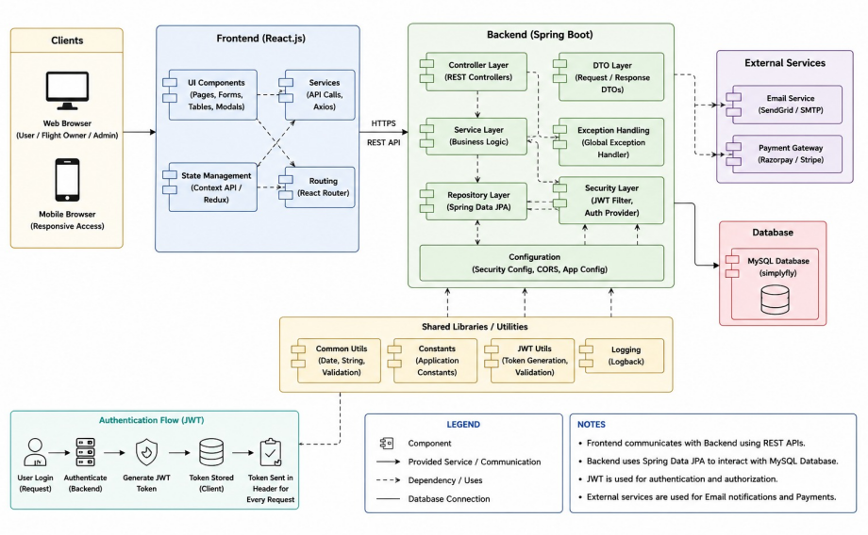
Component Diagram
SimplyFly — Air Ticket Booking System
7

Slide 9
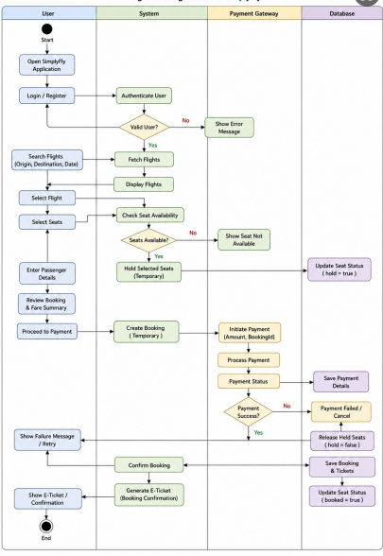
Activity Diagram
SimplyFly — Air Ticket Booking System
7

Slide 10
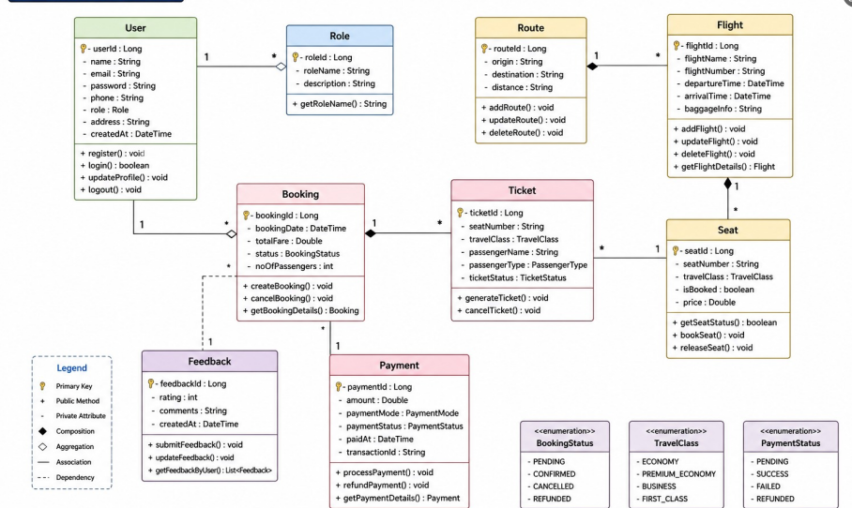
Class Diagram
SimplyFly — Air Ticket Booking System
7

Slide 11
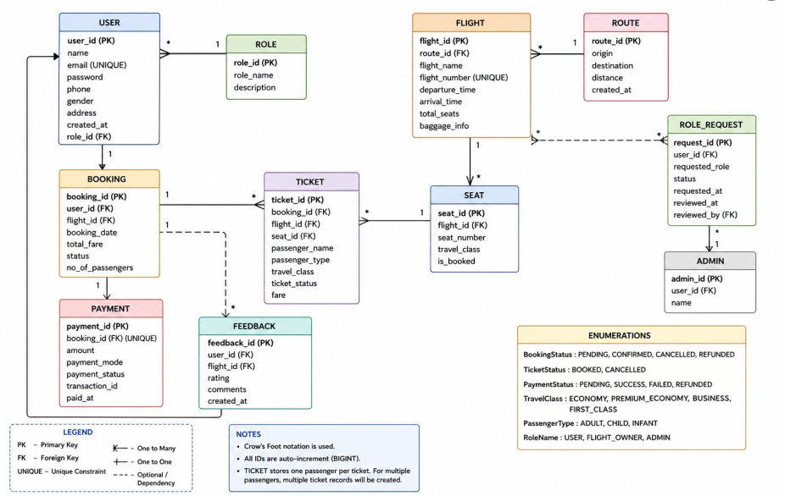
ER Diagram
SimplyFly — Air Ticket Booking System
7

Slide 12
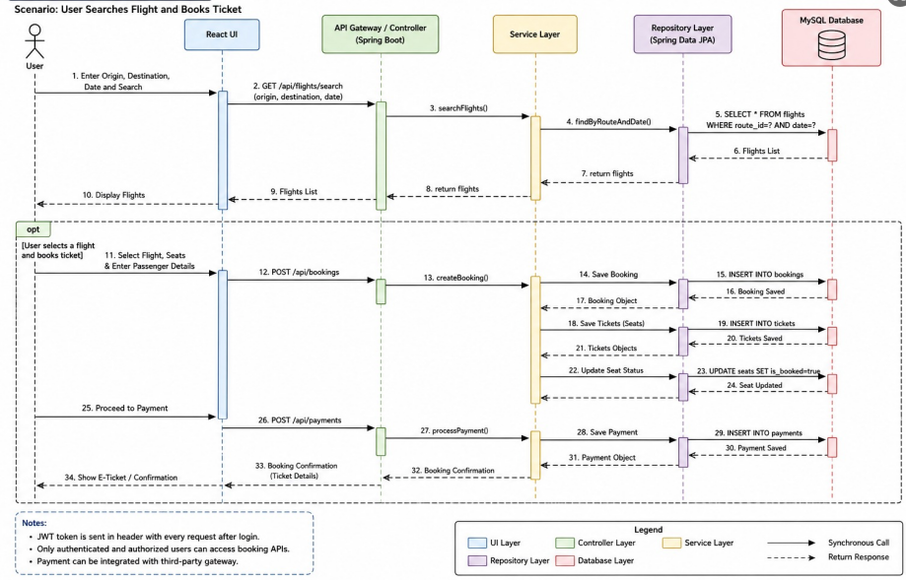
Sequence Diagram
SimplyFly — Air Ticket Booking System
7

Slide 13
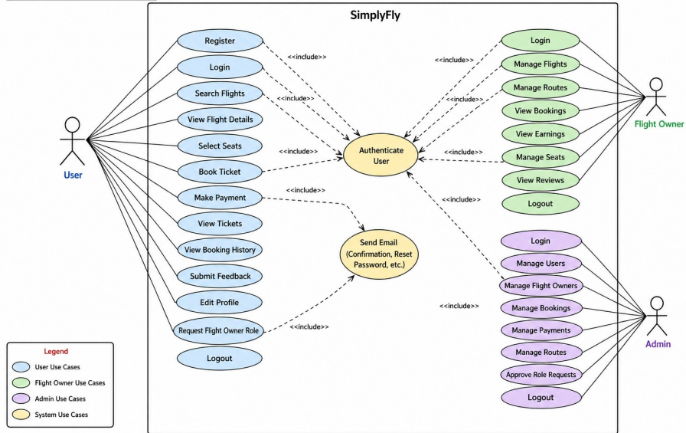
UseCase Diagram
SimplyFly — Air Ticket Booking System
7

Slide 14
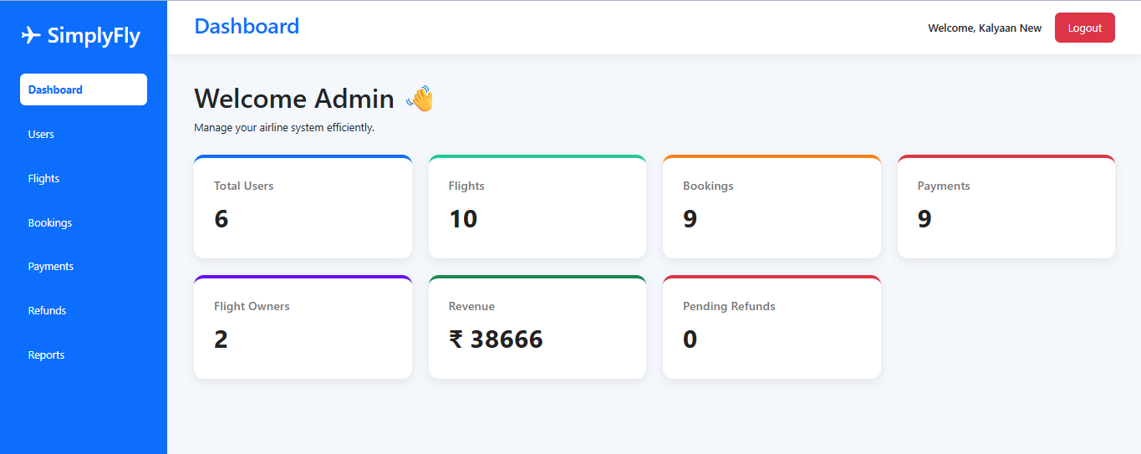
Admin Dashboard
SimplyFly — Air Ticket Booking System
10

Slide 15
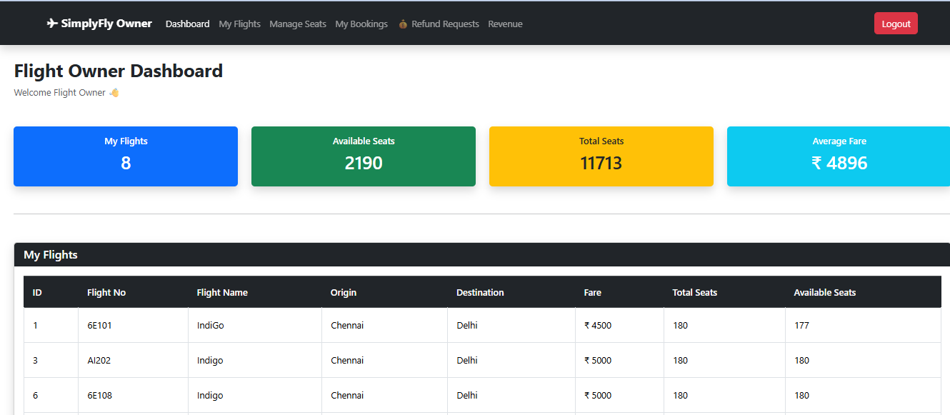
FlightOwner Dashboard
SimplyFly — Air Ticket Booking System
10

Slide 16
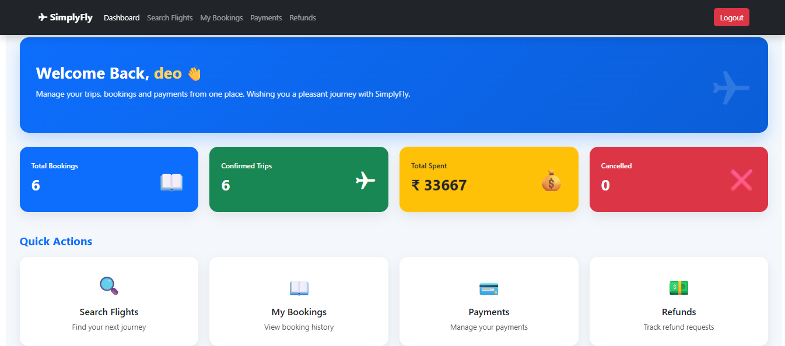
User Dashboard
SimplyFly — Air Ticket Booking System
10

Slide 17
Thank You
— SimplyFly Air Ticket Booking System
React
Spring Boot
MySQL
JWT

