Slide 1

22AIE452 Data Driven Material Modelling & Simulation
AURA: Autonomous Unified Research Assistant for
Battery Materials DiscoverY
Team 8 AIE C Batch
Sreeshanth K CB.SC.U4AIE24225
Kishore B CB.SC.U4AIE24227
Rahul L S CB.SC.U4AIE24248
Manas T CB.SC.U4AIE24257
Zahwa K CB.SC.U4AIE24261

Slide 2
Table of Contents
Introduction
Problem Statement
Literature Review/Survey
Research Gap
Motivation
Project Objectives
Methodology / Proposed Work Pipeline
Tech Stack
Preliminary Results and Discussion
Workflow
Work Completed & Work Remaining
References

Slide 3
1. Introduction
The rapid transition towards electric vehicles (EVs) and grid-scale renewable energy storage has created an unprecedented demand for next-generation batteries (e.g., solid-state, high-capacity, cobalt-free).
Historically, discovering novel battery materials (cathodes, anodes, electrolytes) is a painstakingly slow, manual trial-and-error process in physical laboratories (often taking 10+ years from discovery to commercialization).
Recent breakthroughs in Large Language Models (LLMs) and computational chemistry offer the potential to dramatically accelerate discovery by mining vast amounts of scientific literature and running predictive simulations.
AURA (Autonomous Unified Research Assistant) is a domain-specific multi agent system.
It introduces a completely novel architecture combining a Hybrid Graph RAG Engine (semantic Vector Search + strict Knowledge Graphs) to autonomously evolve, validate, and predict the properties of new battery materials entirely in silico.

Slide 4
2. Problem Statement
Battery research spans multiple disciplines (materials science, electrochemistry, physics). Crucial knowledge is scattered across thousands of disconnected academic papers and databases, making it impossible for a human researcher to synthesize all existing data.
Standard LLMs and naive RAG (Retrieval-Augmented Generation) systems often fail catastrophically when applied to chemistry. They hallucinate chemically impossible structures (e.g., swapping incompatible periodic groups or breaking valence rules) because they lack an understanding of rigid physical laws.
While there are AI "chatbots" that can retrieve material data, they are entirely passive. There is a critical lack of autonomous agentic systems that can actively design, mutate, and rigorously validate novel materials based on specific user-defined constraints

Slide 5
3. Literature Review
S.No | Paper Name | Methodology | Contributions | Year
1 | Chat-RFB: a flow battery chat system leveraging knowledge graphs and LLMs | Knowledge Graph (KG) Construction | Constructed 164k nodes & 853k relationships from 5,353 articles; up to 94.9% domain accuracy | 2026
2 | G-RAG: Knowledge Expansion in Material Science | Graph RAG | Extracted material entities (MatIDs); GraphRAG outperforms standard vector RAG | 2024
3 | Advancing battery failure diagnosis by knowledge-augmented LLMs | Knowledge Graph + LLM | Case-level battery failure KG; feature-aware retrieval enhances diagnostic reasoning | 2026
4 | LISA: A Lithium-Ion Solid-State Assistant using LLMs | Documet RAG + | Domain assistant for solid-state batteries; defragments knowledge, aids collaboration | 2025
5 | Intelligent, Personalized Scientific Assistant via LLMs for Solid-State Battery Research | RAG + Multi-agent Collaboration (ChatSSB) | ChatSSB with dynamic feedback & agent collaboration for data collection/visualization | 2025

Slide 6
3. Literature Review
S.No | Paper Name | Methodology | Contributions | Year
6 | Automating Knowledge Discovery in Material Science with RAG Framework | MatSciBERT Embeddings + RAG | Curated domain-specific dataset from PDFs; high accuracy parsing heterogeneous data | 2025
7 | Graph RAG in the Wild: Insights and Best Practices | Graph RAG application | Highlighted limitations of pure vector-RAG; formalized best practices for graph-structured querying | 2026
8 | RAG4GFM: Bridging Knowledge Gaps in Graph Foundation Models | Graph Retrieval Augmented Generation | Hierarchical graph indexing and task-aware retrieval fusing graph & query features | 2026
9 | Advancing battery research through large language models: A review | LLM + RAG | Detailed the paradigm shift of LLMs in battery knowledge iteration & materials development | 2025
10 | Materials science in the era of large language models: a perspective | Prompt Engineering | Studied how LLMs can be used in the future to make materials research faster, easier, and more automated | 2024

Slide 7
4. Research Gap
Researchers spend excessive time searching multiple platforms for relevant information.
Existing AI assistants mainly perform document retrieval or question answering.
They cannot automatically organize knowledge, identify research gaps, or prepare structured reports.
There is a need for an intelligent research assistant capable of automating the complete research workflow.
Papers such as Chat-RFB and ChatSSB successfully use LLMs for Question-Answering (acting as assistants), but stop at information retrieval. There is a lack of systems that use Graph RAG as a validation engine inside a generative evolutionary loop to actually invent new materials.

Slide 8
5. Motivation
AURA is an AI-powered research assistant that automates the initial stages of scientific research.
Instead of manually searching papers, datasets, and patents, users simply provide a research topic.
The system uses multiple AI agents to collect, organize, analyze, and summarize research information.
It builds a Knowledge Graph and Vector Database from collected documents.
GraphRAG enables relationship-aware reasoning across multiple research sources.
Finally, the system generates a structured research report with literature review, related work, research gaps, and references.

Slide 9
6. Project Objectives
To develop a Hybrid Knowledge System by building a pipeline that ingests raw PDFs into both a ChromaDB vector store (for semantic context) and a Neo4j Knowledge Graph (for hard chemistry rules).
To implement an Evolutionary Engine by creating a Genetic Algorithm (Mutator Node) to computationally breed and mutate battery materials based on stoichiometric rules.
To use the Neo4j/ChromaDB hybrid engine to mathematically block chemically impossible mutations (e.g., breaking valence rules) for validation of Graph RAG.
To use LangGraph to coordinate Planner, Mutator, Validator, and Predictor agents in a continuous loop until target properties are met.

Slide 10
7. Methodology / Proposed Work Pipeline
Data Ingestion: Parse unstructured battery literature (PDFs), chunk the text using a SemanticTextSplitter, and generate local embeddings using all-MiniLM-L6-v2.
Knowledge Graph Seeding & Extraction: Seed Neo4j with fundamental ground truths
(seed_graph. json ), then dynamically extract new Subject-Predicate-Object triplets from the literature using an LLM.
Agentic Planning: A Planner agent translates natural language user prompts (e.g., "Cobalt-free") into strict mathematical JSON constraints.
Genetic Evolution (The Loop): A population of baseline materials undergoes tournament selection, crossover, and elemental substitution.
Hybrid GraphRAG Prediction: Mutated materials are cross-referenced against Neo4j (for validity) and ChromaDB (for context). Valid materials are sent to an LLM Predictor to estimate Capacity, Cost, and Cycle Life.

Slide 11
8. Tech Stack
React · Vite · TailwindCSS · react-force-graph-2D (KG visualization)
Frontend
FastAPI (Python) · OpenRouter (LLM Gateway)
Backend API
Task Orchestration
LangGraph (multi-agent loop) · Celery (background worker) · Redis (message broker)
Supabase / PostgreSQL (auth & relational) · ChromaDB (vector) · Neo4j AuraDB (graph)
Databases
Hugging Face all-MiniLM-L6-v2 · Claude 3.5 Sonnet / GPT-4o
AI / ML Models

Slide 12
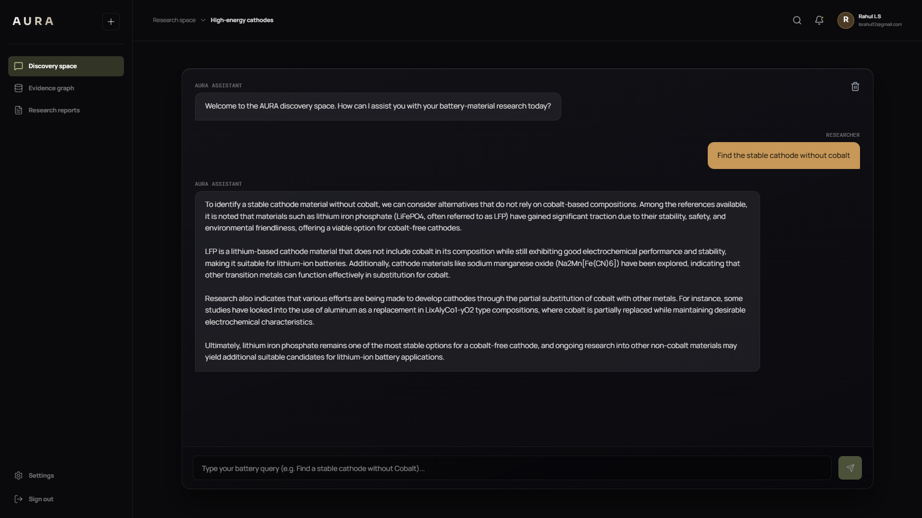
9. Preliminary Results and Discussion
Hallucination Prevention: The Hybrid GraphRAG effectively blocks the Predictor LLM from hallucinating by forcing it to read hard chemistry facts from Neo4j alongside its semantic context.
Asynchronous Stability: Long-running evolutionary loops (3-5 minutes) execute flawlessly in the background using Celery/Redis without timing out the client, proving the system architecture is highly scalable.

Slide 13
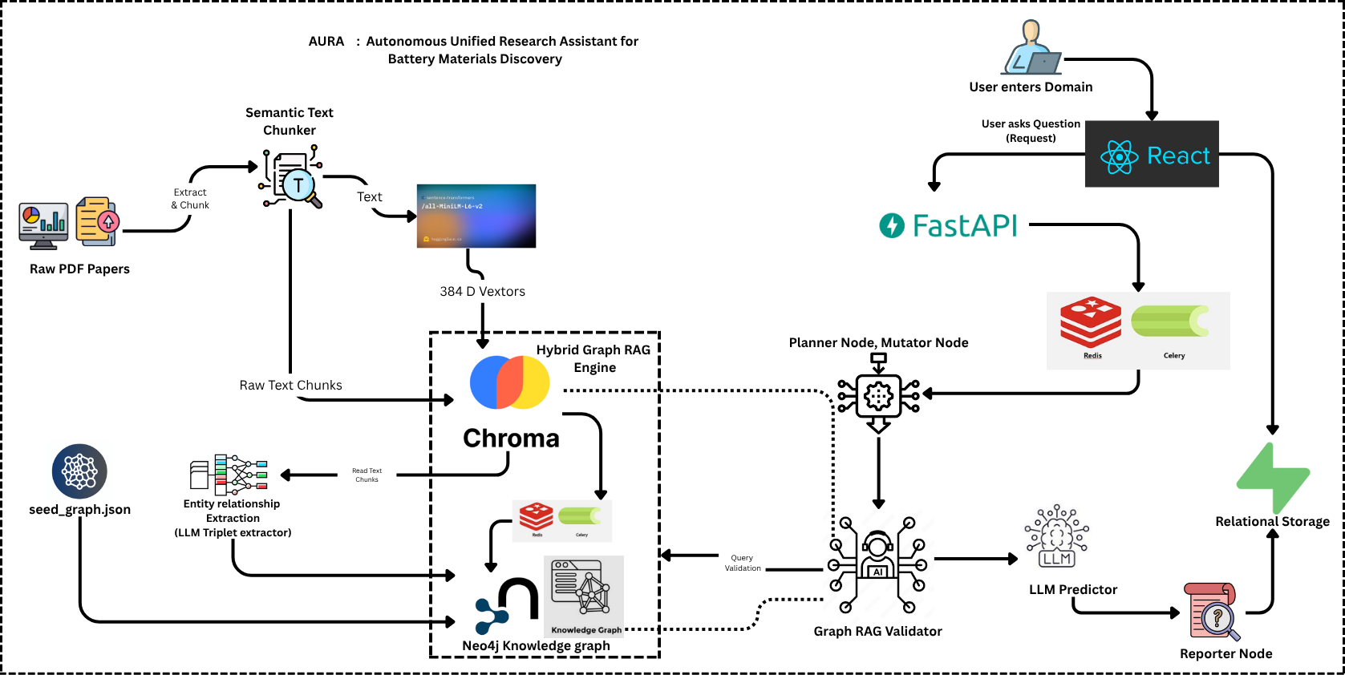
10. Proposed Workflow

Slide 14
Current Workflow
1. Building the Memory (ChromaDB + Knowledge Graph)
We built a dual-memory system, to make AI educated on Battery Materials
PDF research papers are dropped into the system. The backend python scripts chop those papers into paragraphs, run them through an embedding model ( all-MiniLM-L6-v2 ), and save them in ChromaDB. This gives the Al the ability to do semantic searches.
Simultaneously, we established a structured knowledge graph seeded with foundational, undeniable ground truths (e.g., "Lithium is an Alkali Metal") to act as the AI's absolute logic base.
We developed a dynamic extraction pipeline where the AI pulls unstructured text from the semantic memory, distills it into strict relationship rules (Subject-Predicate-Object), and pushes them directly into the knowledge graph (Background Worker)

Slide 15
Current Workflow
2. Background Worker (Redis + Celery)
Massive Batch Processing: When triggered, the Celery background worker fetches all the raw scientific text chunks currently stored in ChromaDB.
Concurrent LLM Extraction: Because reading thousands of paragraphs takes a long time, Celery processes the chunks in batches of 10 simultaneously. It uses a ThreadPoolExecutor to concurrently fire these chunks at the LLM, instructing it to extract strict scientific rules (Triplets).
Direct Graph Ingestion: As soon as the LLM returns valid triplets (e.g., Cobalt -> INCREASES -> Cost), Celery automatically pushes and saves them directly into your Neo4j Knowledge Graph.
Non-Blocking Progress: All of this runs completely in the background via Redis. The main web server never freezes, and Celery continuously emits its progress state (e.g., "Processed 50/1000 chunks") so the frontend can track its completion in real-time.

Slide 16
Current Workflow
3. Hybrid Extraction (The GraphRAG Engine)
Concurrent Database Querying: instead of searching ChromaDB first and Neo4j second, FastAPI starts both searches together and combines their results when they are ready.
Rigid Rules Extraction (Neo4j): NLP identifies important terms in the user’s question, such as “Cobalt” and “Thermal Stability,” and Neo4j retrieves the relevant trusted chemistry rules from the Knowledge Graph. These rules are then used by the Validator Agent to check whether the generated battery material is chemically valid.
Context Retrieval (ChromaDB): The system converts the user’s question into a mathematical representation (embedding) and compares it with the embeddings of paragraphs from battery research papers. It then finds the top 5 most similar paragraphs and uses them to provide relevant research context for answering the query

Slide 17
11. Work Completed & Work Remaining
Completed
ChromaDB (semantic) and Neo4j (structural) ingestion pipeline
Neo4j Knowledge Graph seeding + LLM extractor logic
FastAPI, Celery & Redis orchestration skeleton
Planner Node: translates prompts to JSON constraints & initializes base materials
Agent to fetch papers, patterns and data
Genetic Algorithm (Mutator): The core math engine that "breeds" new materials using elemental substitution
A final synthesis agent that compiles the winning material candidates into a readable PDF research report.
Dashboard allowing researchers to visually track the background evolutionary loops and view results.
Remaining

Slide 18
12. References
Wang, H.-T. et al. (2026). Chat-RFB: a flow battery chat system leveraging knowledge graphs and large language models.
Mostafa, R. et al. (2024). G-RAG: Knowledge Expansion in Material Science.
Zhang, X. et al. (2026). Advancing battery failure diagnosis by knowledge-augmented large language models.
Zhao, Y. et al. (2025). LISA: A Lithium-Ion Solid-State Assistant using large language models.
Leng, Y. et al. (2025). Intelligent, Personalized Scientific Assistant via Large Language Models for Solid-State Battery Research.

Slide 19
THANK YOU
Team 8
AIE C

