Slide 1
HRS Net: A Fusion model of HRNet and RESNet
Rahul Autade | Raj Surya Rajendran Kathirvel

Slide 2
Problem Statement
Objectives
Reimplement HRNet and create a fusion model between HRNet and Resnet.
HRNet, a multi modal network for visual recognition tasks.
Analyse performance on Image Classification for different parameters, and evaluate the model accuracy.

Slide 3
Dataset
In comparison to ImageNet dataset, CIFAR100 is more feasible w.r.t. Computing units and size and runtime.
CIFAR-100 dataset:
Number of Images: 60,000 images.100 Classes and each class contains 600 images.
Each image contains two labels - ‘fine’ (the class to which it belongs) and ‘coarse’ (the superclass to which it belongs).
Size of Image: 32x32 pixels (resized to 224x224)
Size of Dataset: Approximately 170 MB
Each class was split into 500 images for training, and 100 for testing.

Slide 4
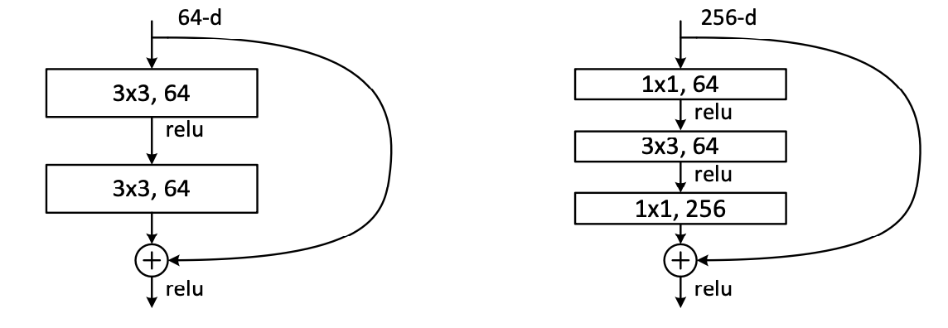
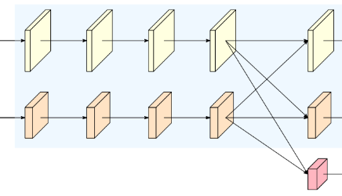
HRNet
INPUT
STEM
2 Conv
Reduce size by 1/4
Stage 1
4 Bottlenecks
1 Branch*
Stage 2
1 Modularized block
2 Branches
OUTPUT
Head
100 Classes
Stage 4
3 Modularized blocks
4 Branches
Stage 3
4 Modularized blocks
3 Branches
Each residual unit is implemented as a preactivated unit.
Branch k has (2^(k-1))*C feature maps
Residual Unit
Bottleneck
Modularized Block
1 Modularized Block = 4 Residual Units

Slide 5
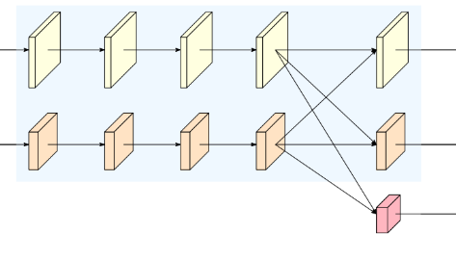
HRSNet
Stages 2,3,4 each have 4 modularized blocks.
Each stage is modelled as a residual unit with inputs combined with the outputs.

Slide 6
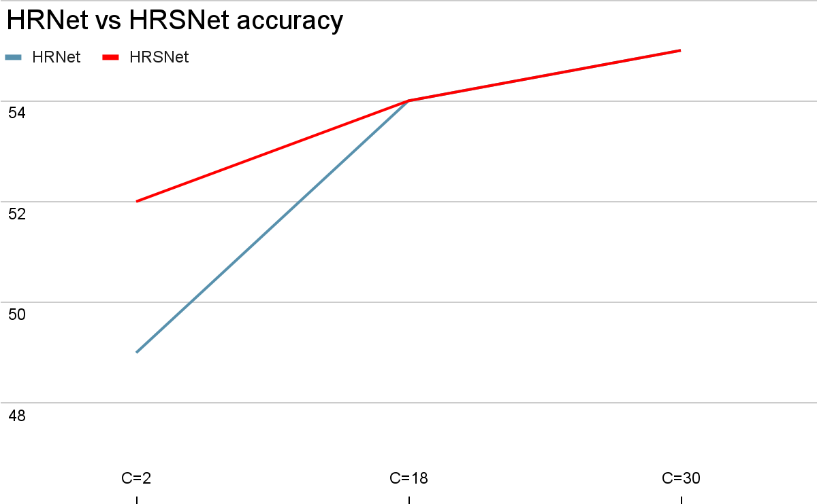
Effect of Parameter - C
Notes:
The graph illustrates how the accuracy of HRNet and HRSNet models is influenced by changes in the parameter C. At lower C level HRSNet model have higher accuracy but it converges with HRNet model for at higher c value.

Slide 7
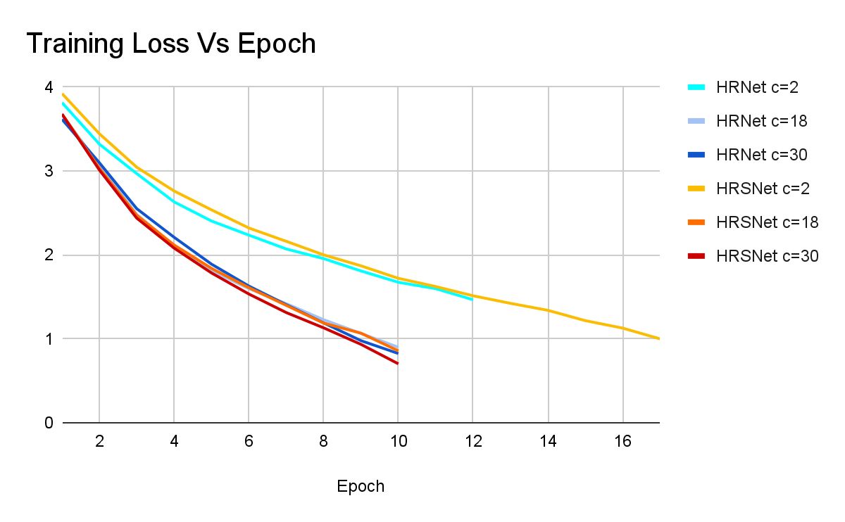
Quantitative Results
Configuration
Optimizer Adam (over SGD)
C=2,18, 30
Learning rate 0.005
Momentum = 0.9
Patience=2
Image size 224*224
Epochs ~10
Notes:
Here comparing the training loss for different configurations of a neural network model. Here is the configuration we used. The graph displays higher c value converges faster than lower c values. While there is significant difference in c=2 and c=18 but not a significant improvement form c =18 to c=30.

Slide 8
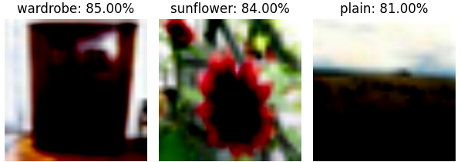
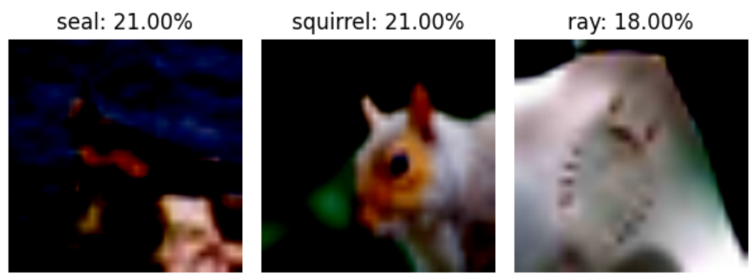
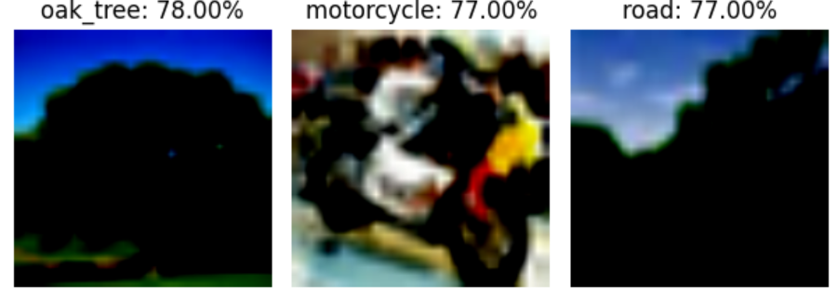
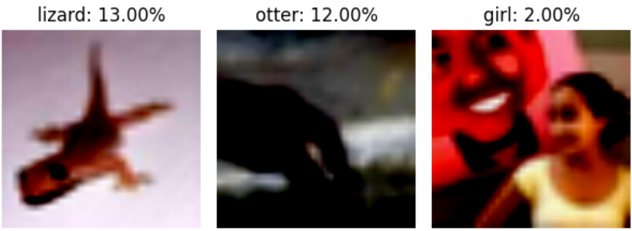
Qualitative Results
Classes with highest accuracy:
Classes with least accuracy:
Notes:
Here is the varying degrees of accuracy, our model has achieved across different classes. It's apparent that the model excels at recognizing simple objects like wardrobes and sunflowers but struggles with more complex classes such as ‘girl’ or ‘otter’. This insight pinpoints the improvements in our training approach to enhance model reliability across all classes. This can be achieved with increasing data sample for lower accuracy class.

Slide 9
Future Work
Experimenting with different parameters to get better results.
Benchmarking performance for different datasets.
Extend our method to other computer vision tasks.
Notes:
Designing a better architecture search space for enhanced upper bound performance.
Benchmarking various hyperparameters for performance optimization.
Applying the method to a broader range of computer vision tasks.

Slide 10
Questions?

