Slide 1

Chapter 1: Introduction
Purpose of Database Systems
View of Data
Data Models
Data Definition Language
Data Manipulation Language
Transaction Management
Storage Management
Database Administrator
Database Users
Overall System Structure

Slide 2
Database Management System (DBMS)
Collection of interrelated data
Set of programs to access the data
DBMS contains information about a particular enterprise
DBMS provides an environment that is both convenient and efficient to use.
Database Applications:
  Banking: all transactions
  Airlines: reservations, schedules
  Universities: registration, grades
  Sales: customers, products, purchases
  Manufacturing: production, inventory, orders, supply chain
  Human resources: employee records, salaries, tax deductions
Databases touch all aspects of our lives

Slide 3
Purpose of Database System
In the early days, database applications were built on top of file systems
Drawbacks of using file systems to store data:
  Data redundancy and inconsistency
    Multiple file formats, duplication of information in different files
  Difficulty in accessing data
    Need to write a new program to carry out each new task
  Data isolation — multiple files and formats
  Integrity problems
    Integrity constraints (e.g. account balance > 0) become part of program code
    Hard to add new constraints or change existing ones

Slide 4
Purpose of Database Systems (Cont.)
Drawbacks of using file systems (cont.)
  Atomicity of updates
    Failures may leave database in an inconsistent state with partial updates carried out
    E.g. transfer of funds from one account to another should either complete or not happen at all
  Concurrent access by multiple users
    Concurrent accessed needed for performance
    Uncontrolled concurrent accesses can lead to inconsistencies
      E.g. two people reading a balance and updating it at the same time
  Security problems
Database systems offer solutions to all the above problems

Slide 5
Previous Lecture
Models a real-world enterprise
A Database Management System (DBMS) is a software system designed to store, manage, and facilitate access to databases.
Advantages
Data redundancy and inconsistency
Difficulty in accessing data
Data isolation – multiple files and formats
Integrity problems
Atomicity of updates
Concurrent access by multiple users
Security problems

Slide 6
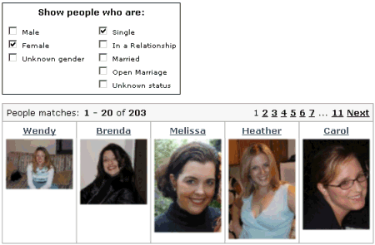
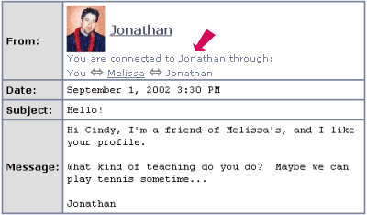
Example

Slide 7
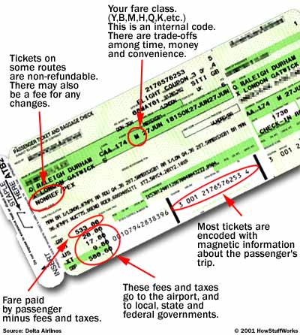
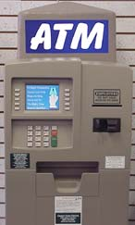

Slide 8
Is the WWW a DBMS?
Fairly sophisticated search available
  crawler indexes pages on the web
  Keyword-based search for pages
But, currently
  data is mostly unstructured and untyped
  search only:
    can’t modify the data
    can’t get summaries, complex combinations of data
  few guarantees provided for freshness of data, consistency across data items, fault tolerance, …
  Web sites typically have a DBMS in the background to provide these functions.
  XML, Semantic Web can help data modeling

Slide 9
Levels of Abstraction
Physical level describes how a record (e.g., customer) is stored.
Logical level: describes data stored in database, and the relationships among the data.
type customer = record
name : string;
street : string;
city : integer;
end;
View level: application programs hide details of data types. Views can also hide information (e.g., salary) for security purposes.

Slide 10

View of Data
An architecture for a database system

Slide 11
View 1
View 2
View 3
Conceptual Schema
Physical Schema
DB

Slide 12
Instances and Schemas
Similar to types and variables in programming languages
Schema – the logical structure of the database
  e.g., the database consists of information about a set of customers and accounts and the relationship between them)
  Analogous to type information of a variable in a program
  Physical schema: database design at the physical level
  Logical schema: database design at the logical level
Instance – the actual content of the database at a particular point in time
  Analogous to the value of a variable

Slide 13
Data Independence
Ability to modify a schema definition in one level without affecting a schema definition in the other levels.
The interfaces between the various levels and components should be well defined so that changes in some parts do not seriously influence others.
Two levels of data independence
  Physical data independence
  Logical data independence
Physical Data Independence – the ability to modify the physical schema without changing the logical schema
  Applications depend on the logical schema
  In general, the interfaces between the various levels and components should be well defined so that changes in some parts do not seriously influence others.

Slide 14
Data Models
A data model is a collection of concepts and constructs for describing data.
A collection of tools for describing
  data
  data relationships
  data semantics
  data constraints
Object-based logical models
  Entity-relationship model
  Object-oriented model
  Semantic model
  Functional model
Record-based logical models
  Relational model (e.g., SQL/DS, DB2)
  Network model
  Hierarchical model (e.g., IMS)
Other models:
  semi-structured data models

Slide 15
Basic DBMS types
Linear files
  Sequence of records with a fixed format usually stored on a single file
  Limitation: single file
  Example query: Salesperson='Mary' AND Price>100
Hierarchical structure
  Trees of records: one-to-many relationships
  Limitations:
    Requires duplicating records (e.g. many-to-many relationship)
    Problems when updated
    Retrieval requires knowing the structure (limited data independence):
    Traversing the tree from top to bottom using a procedural language
Network structure: similar to the hierarchical database with the implementation of many-to-many
relationships
Relational structure
Object-Oriented structure
  Objects (collection of data items and procedures) and interactions between them.
  Separate implementation vs. implementation on top of a RDBMS

Slide 16

Entity-Relationship Model
Example of schema in the entity-relationship model

Slide 17
Entity Relationship Model (Cont.)
E-R model of real world
  Entities (objects)
    E.g. customers, accounts, bank branch
  Relationships between entities
    E.g. Account A-101 is held by customer Johnson
    Relationship set depositor associates customers with accounts
Widely used for database design
  Database design in E-R model usually converted to design in the relational model (coming up next) which is used for storage and processing

Slide 18
Relational Model
Attributes
Example of tabular data in the relational model
Customer-id
customer-
name
customer-
street
customer-
city
account-
number
192-83-7465
019-28-3746
192-83-7465
321-12-3123
019-28-3746
Johnson
Smith
Johnson
Jones
Smith
Alma
North
Alma
Main
North
Palo Alto
Rye
Palo Alto
Harrison
Rye
A-101
A-215
A-201
A-217
A-201

Slide 19

A Sample Relational Database

Slide 20
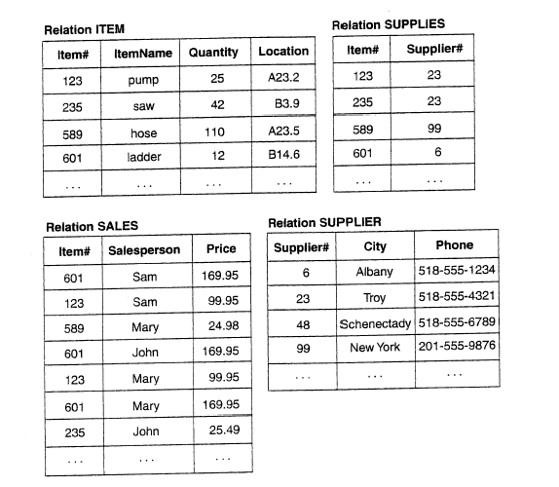
Inventory Relational Database

Slide 21
Data Definition Language (DDL)
Specification notation for defining the database schema
  E.g.
  create table account (
  account-number char(10),
  balance integer)
DDL compiler generates a set of tables stored in a data dictionary
Data dictionary contains metadata (i.e., data about data)
  database schema
  Data storage and definition language
    language in which the storage structure and access methods used by the database system are specified
    Usually an extension of the data definition language

Slide 22
Data Manipulation Language (DML)
Language for accessing and manipulating the data organized by the appropriate data model
  DML also known as query language
Two classes of languages
  Procedural – user specifies what data is required and how to get those data
  Nonprocedural – user specifies what data is required without specifying how to get those data
SQL is the most widely used query language

Slide 23
SQL
SQL: widely used non-procedural language
  E.g. find the name of the customer with customer-id 192-83-7465
  select customer.customer-name
  from customer
  where customer.customer-id = ‘192-83-7465’
  E.g. find the balances of all accounts held by the customer with customer-id 192-83-7465
  select account.balance
  from depositor, account
  where depositor.customer-id = ‘192-83-7465’ and
  depositor.account-number = account.account-number
Application programs generally access databases through one of
  Language extensions to allow embedded SQL
  Application program interface (e.g. ODBC/JDBC) which allow SQL queries to be sent to a database

Slide 24
Database Users
Users are differentiated by the way they expect to interact with the system
Application programmers – interact with system through DML calls
Sophisticated users – form requests in a database query language
Specialized users – write specialized database applications that do not fit into the traditional data processing framework
Naïve users – invoke one of the permanent application programs that have been written previously
  E.g. people accessing database over the web, bank tellers, clerical staff

Slide 25
Database Administrator
Coordinates all the activities of the database system; the database administrator has a good understanding of the enterprise’s information resources and needs.
Database administrator's duties include:
  Schema definition
  Storage structure and access method definition
  Schema and physical organization modification
  Granting user authority to access the database
  Specifying integrity constraints
  Acting as liaison with users
  Monitoring performance and responding to changes in requirements

Slide 26
Transaction Management
A transaction is a collection of operations that performs a single logical function in a database application
Transaction-management component ensures that the database remains in a consistent (correct) state despite system failures (e.g., power failures and operating system crashes) and transaction failures.
Concurrency-control manager controls the interaction among the concurrent transactions, to ensure the consistency of the database.

Slide 27
ACID Properties
Key concept is a transaction: a sequence of database actions (reads/writes).
DBMS ensures atomicity (all-or-nothing property) even if system crashes in the middle of a Xact.
Each transaction, executed completely, must take the DB between consistent states or must not run at all.
DBMS ensures that concurrent transactions appear to run in isolation.
DBMS ensures durability of committed Xacts even if system crashes.
Note: can specify simple integrity constraints on the data. The DBMS enforces these.
  Beyond this, the DBMS does not understand the semantics of the data.
  Ensuring that a single transaction (run alone) preserves consistency is largely the user’s responsibility

Slide 28
Storage Management
Storage manager is a program module that provides the interface between the low-level data stored in the database and the application programs and queries submitted to the system.
The storage manager is responsible to the following tasks:
  interaction with the file manager
  efficient storing, retrieving and updating of data

Slide 29

Overall System Structure
DBMS

Slide 30

Application Architectures
Two-tier architecture: E.g. client programs using ODBC/JDBC to
communicate with a database
Three-tier architecture: E.g. web-based applications, and
applications built using “middleware”

