Slide 1


20 CST302 MINI PROJECT
FIRST INTERNAL REVIEW
VOICE BIOMETRICS
GUIDED BY:
Er Gayathri J. L
TEAM NO: 16
TEAM MEMBERS:
Krishna Sagar
Rahul Biju
Swathy Mahesh
LEARN . GROW . EXCEL

Slide 2
CONTENTS
I. Introduction
II. Project Plan
III. Scope of the Mini Project
IV. Requirements Analysis
V. Design Diagrams
1. Use case diagram
2. Class diagram
VI. System Architecture
VII. Wireframes/Mockups
VIII. Flow Diagram
IX. Technology Stack
X. Future Scope
XI. Demo Video
XII. Conclusion
XIII. References
LEARN . GROW . EXCEL

Slide 3
1. Introduction
In today's rapidly evolving technological landscape, safeguarding our devices and personal information has become paramount. However, the traditional methods of authentication such as passwords or PINs can often be cumbersome and prone to security risks.
Voice biometrics offers a seamless and intuitive alternative to traditional authentication methods. By simply using unique voice patterns, users can reliably authenticate their identities to access secure systems and sensitive information.
This innovative technology not only eliminates the need for remembering complex passwords but also provides a convenient option for individuals with busy lifestyles.
Beyond its convenience, voice biometrics offers unparalleled security. With sophisticated algorithms analyzing various vocal characteristics, including pitch, tone, and cadence, it creates a highly secure authentication process that is exceptionally difficult to replicate or spoof.
LEARN . GROW . EXCEL

Slide 4
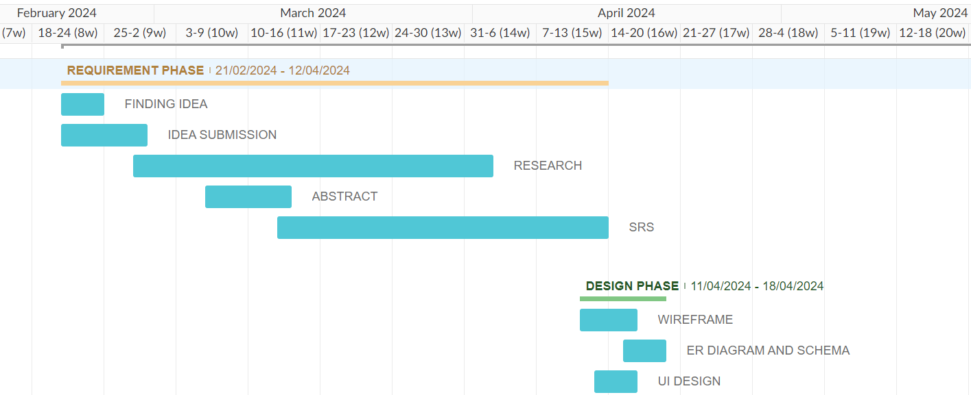
2. PROJECT PLAN
LEARN . GROW . EXCEL

Slide 5
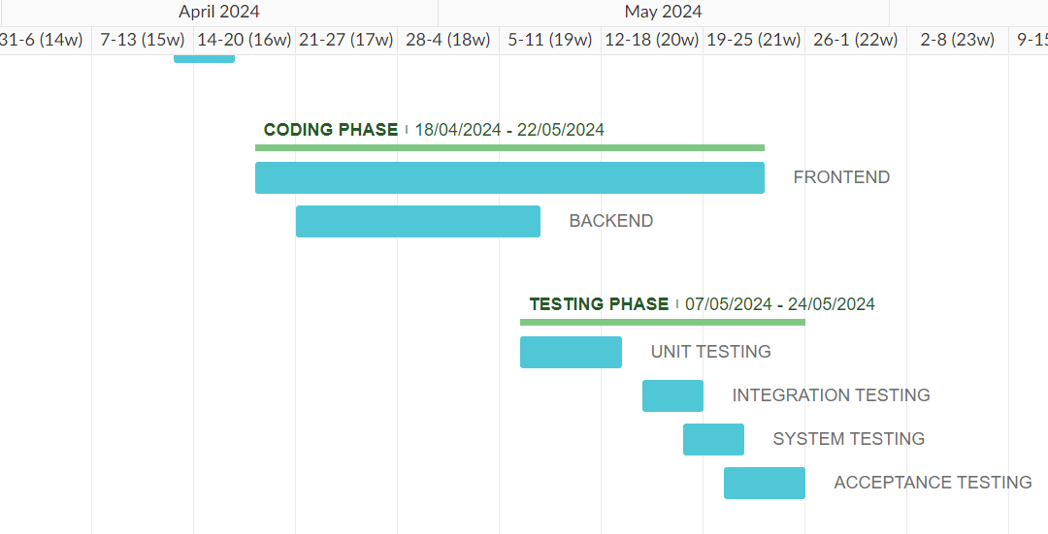
2. PROJECT PLAN
LEARN . GROW . EXCEL

Slide 6
3. Scope of the Mini Project
Seamless Authentication: In today's fast-paced tech world, protecting our devices and data is crucial. Yet, traditional methods like passwords are often cumbersome and risky. Voice biometrics offers a seamless alternative. With unique voice patterns, users can securely authenticate their identities, accessing sensitive information effortlessly.
Accessibility: Voice biometrics provides an accessible authentication method for individuals with disabilities or those who may have difficulty typing or using traditional authentication methods.
Real-Time Processing: involves capturing and analyzing voice samples instantaneously during both enrollment and authentication phases, ensuring immediate and adaptive user verification. Continuous model updates and low-latency algorithms enable the system to provide accurate and efficient authentication on-the-fly.
LEARN . GROW . EXCEL

Slide 7
4. Requirements Analysis
Functional Requirements:
User Authentication
User Sign-Up: A new user must sign up and provide a voice sample during the sign-up phase.
Voice Login: After signing up, the user can log in using their voice to access voice biometric features.
Input Processing:
Voice Sample Acceptance: The system must accept voice samples for analysis.
Voice Analysis and Identification
Accurate Processing: The system must accurately process voice samples and match them to registered users.
LEARN . GROW . EXCEL

Slide 8
User Interface
Intuitive Design: The website must feature a user-friendly interface for uploading voice samples and viewing authentication results.
LEARN . GROW . EXCEL

Slide 9
Non-Functional Requirements:
Performance: The system should process voice authentication requests efficiently, with minimal latency and response times, even under peak loads.
Scalability: The application should be scalable to handle an increasing number of users and voice authentication requests without compromising performance.
Accuracy: The voice biometrics system should have high accuracy in recognizing and authenticating users' voices to minimize false positives and negatives.
Security: Ensure the confidentiality, integrity, and availability of biometric data through encryption, access controls, and secure storage mechanisms to prevent unauthorized access or data breaches.
LEARN . GROW . EXCEL

Slide 10
User Requirements:
Easy Voice Sample Upload
Seamless Upload Process: Users should be able to easily upload their voice samples through a straightforward and intuitive process on the website.
Quick User Authentication
Fast Authentication: The application should authenticate users quickly, minimizing wait times and providing immediate access to voice biometric features.
Low Latency: The system should have low latency to ensure a smooth and efficient user experience.
LEARN . GROW . EXCEL

Slide 11
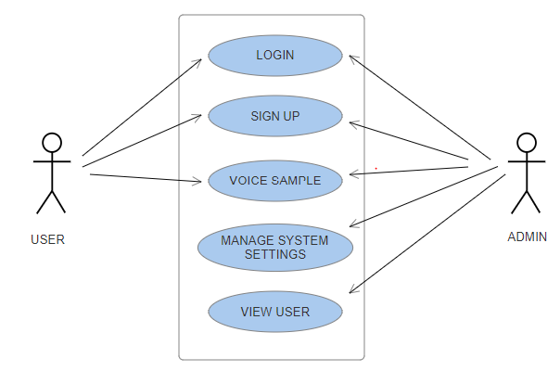
5. Design Diagrams
1.Use Case Diagram
LEARN . GROW . EXCEL

Slide 12
1.Use Case Diagram
Actors:
Admin: An administrator who has additional privileges compared to regular users, such as managing user accounts, system configurations, and accessing administrative features.
User: Represents the typical end-user of the system, who interacts with the various functionalities provided by the system.
Use case:
Signup (User): This use case involves the user signing up for a new account in the system. It's specifically related to regular users creating their accounts.
Login (User and Admin): Both users and admins need to log in to access their respective accounts or dashboards. While regular users log in to access their accounts, admins also log in to access the admin dashboard for managing the system.
LEARN . GROW . EXCEL

Slide 13
1.Use Case Diagram
Voice Sample (User): This use case involves the user providing a voice sample for authentication purposes. It's specific to regular users providing their voice samples for authentication.
Manage System Settings (Admin): This use case is specific to admins and involves managing various system-wide settings, configurations, or parameters. It includes tasks such as configuring security settings, access control rules, and other system settings.
View Users (Admin): This use case allows admins to view a list of users registered in the system. It's related to user management and provides admins with insights into the user base.
LEARN . GROW . EXCEL

Slide 14
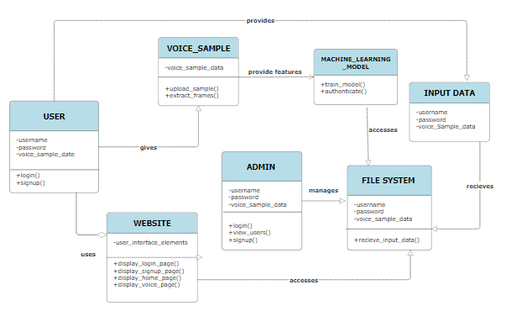
2. Class Diagram
LEARN . GROW . EXCEL

Slide 15
2. Class Diagram
User class: represents users with username, password, and voice samples; provides methods for sign-up, login, password reset, and modifying voice samples.
Machine Learning Model class: trains, authenticates, and detects spoofing in voice samples.
File system class: manages user data, settings, and input data;
Admin class :represents administrators with username and password;
InputData class: represents input data with username, password, and voice samples.
Voice Sample class: represents voice samples with sample data; provides methods for uploading and extracting features; connects to Machine Learning Model for feature extraction.
LEARN . GROW . EXCEL

Slide 16
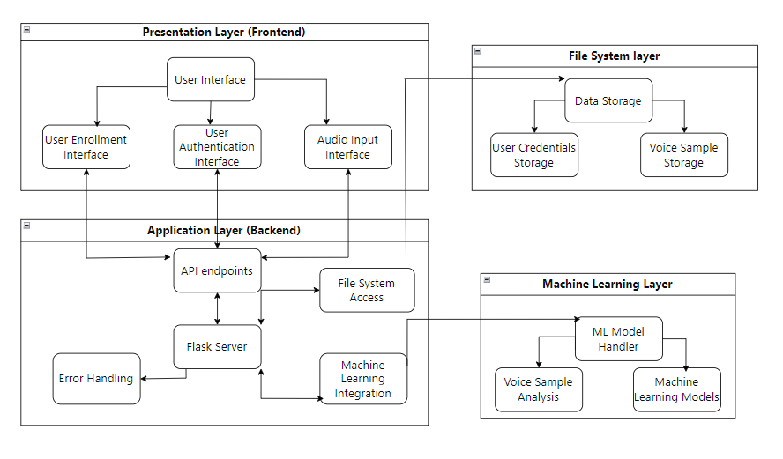
6. System Architecture
LEARN . GROW . EXCEL

Slide 17
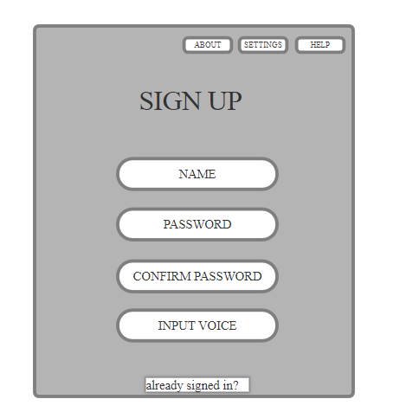
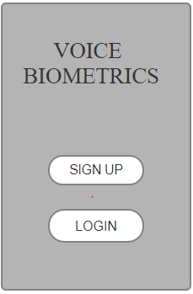
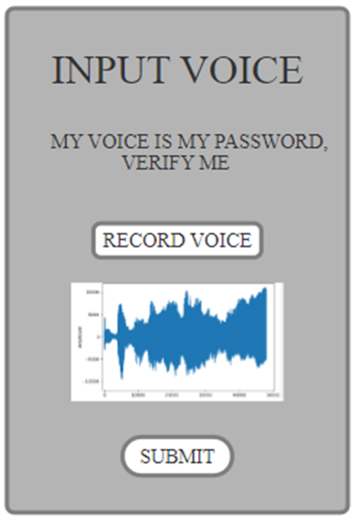
7. Wireframes/Mockups
LEARN . GROW . EXCEL

Slide 18
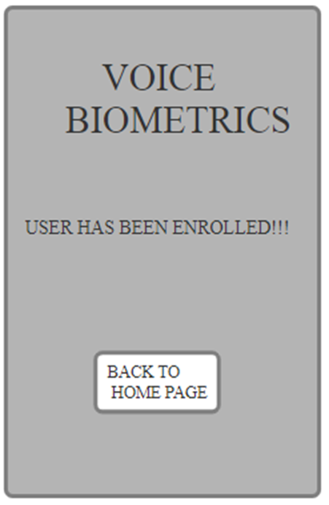
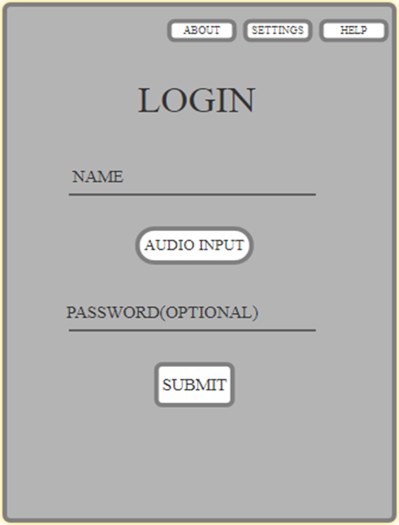
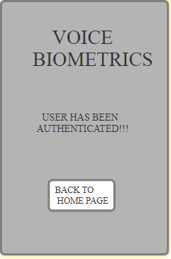
7. Wireframes/Mockups
LEARN . GROW . EXCEL

Slide 19
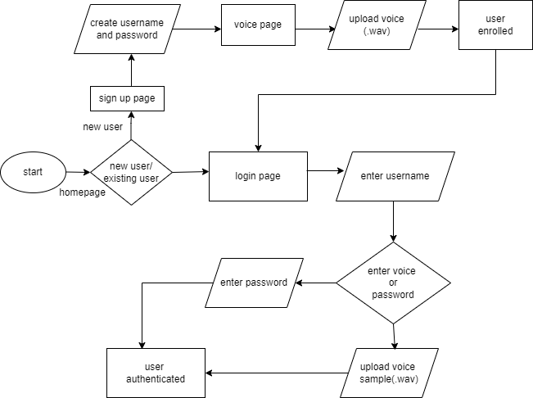
8. Flow diagram
LEARN . GROW . EXCEL

Slide 20
9. Technology Stack
Machine Learning:
Scikit-learn : to train and utilize Gaussian Mixture Models (GMM) for modeling and distinguishing the unique voice characteristics from MFCC features in voice biometrics.
Scipy : read WAV audio files.
Google's Web Speech API : Transcribe the uploaded audio file into text for further processing and validation.
Frontend:
HTML,CSS and JavaScript
Backend:
Flask
LEARN . GROW . EXCEL

Slide 21
10. Future Scope
Multi-Factor Authentication (MFA)
Enhanced Security: Integrating voice biometrics with other authentication factors, such as passwords, OTPs (one-time passwords), or biometric methods (fingerprint or facial recognition), to provide a multi-layered security approach.
Anti-Spoofing Mechanisms
Liveness Detection: Implementing techniques to detect and prevent spoofing attempts, such as replay attacks, by verifying that the voice sample is from a live person rather than a recording.
Behavioral Analysis: Utilizing behavioral patterns and other physiological traits (e.g., voice modulation, breathing patterns) to enhance the system's ability to distinguish between genuine users and potential attackers.
LEARN . GROW . EXCEL

Slide 22
Text-Independent Biometrics
Flexible Voice Commands: Developing the system to authenticate users based on their natural speech, regardless of the specific phrases or words used, enabling more flexible and user-friendly interactions.
Continuous Authentication: Implementing continuous voice authentication that verifies the user's identity throughout a session, rather than just at login, enhancing security for sensitive transactions or prolonged access periods.
LEARN . GROW . EXCEL

Slide 23
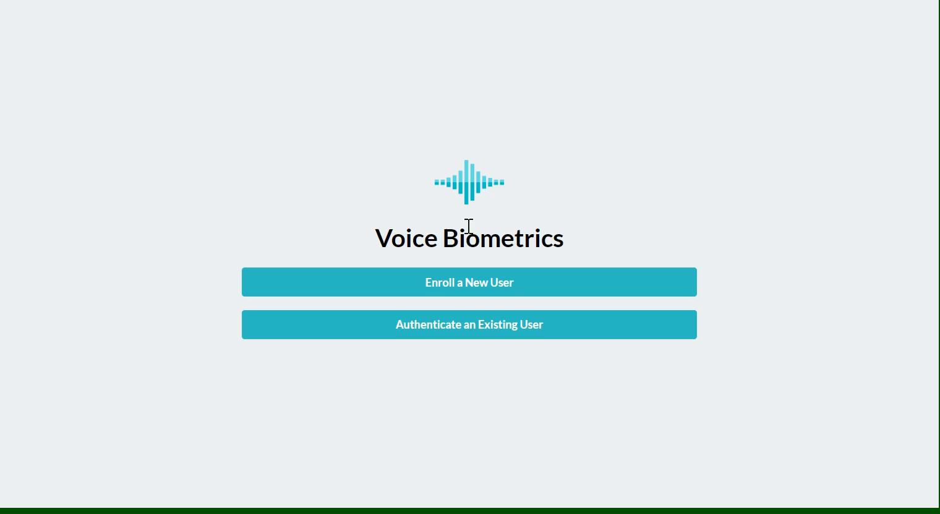
11.Demo Video
LEARN . GROW . EXCEL

Slide 24
12. Conclusion
The voice biometrics system offers top-notch security by providing a unique authentication method that relies on the user's voice, making it extremely difficult for unauthorized access.
Leveraging machine learning algorithms, it analyzes voice patterns with precision, enhancing its authentication accuracy and resilience against fraudulent attempts.
Its user-friendly interface simplifies the authentication process, ensuring a seamless experience for all users, including those with disabilities.
Moreover, it is highly reliable and efficient, performing authentication tasks swiftly and accurately.
Its robust security measures and accessibility features make it a trustworthy and indispensable tool for protecting digital assets while accommodating users of all abilities.
LEARN . GROW . EXCEL

Slide 25
13. References
Markowitz, J.A., 2000. Voice biometrics. Communications of the ACM, 43(9), pp.66-73.
González-Rodríguez, J., Toledano, D.T. and Ortega-García, J., 2008. Voice biometrics. In Handbook of biometrics (pp. 151-170). Boston, MA: Springer US.
Scheffer, N., Ferrer, L., Lawson, A., Lei, Y. and McLaren, M., 2013, November. Recent developments in voice biometrics: Robustness and high accuracy. In 2013 IEEE international conference on technologies for homeland security (HST) (pp. 447-452). IEEE.
Aronowitz, H., Hoory, R., Pelecanos, J. and Nahamoo, D., 2011. New developments in voice biometrics for user authentication. In Twelfth Annual Conference of the International Speech Communication Association.
LEARN . GROW . EXCEL

Slide 26
13. References
Aronowitz, H., 2012, June. Voice biometrics for user authentication. In Afeka-AVIOS Speech Processing Conference 2012 (Vol. 29).
Gupta, P., Singh, S., Prajapati, G.P. and Patil, H.A., 2022. Voice privacy in biometrics. In Biomedical Signal and Image Processing with Artificial Intelligence (pp. 1-29). Cham: Springer International Publishing.
Shah, H.N.M., Ab Rashid, M.Z., Abdollah, M.F., Kamarudin, M.N., Chow, K.L. and Kamis, Z., 2014. Biometric voice recognition in security system. Indian journal of Science and Technology, pp.104-112.
Sadkhan, S.B., Al-Shukur, B.K. and Mattar, A.K., 2017, March. Biometric voice authentication auto-evaluation system. In 2017 Annual Conference on New Trends in Information & Communications Technology Applications (NTICT) (pp. 174-179). IEEE.
LEARN . GROW . EXCEL

Slide 27
13. References
AL-Shakarchy, N.D., Obayes, H.K. and Abdullah, Z.N., 2023. Person identification based on voice biometric using deep neural network. International Journal of Information Technology, 15(2), pp.789-795.
Ibrahim, W., Candra, H. and Isyanto, H., 2022. Voice recognition security reliability analysis using deep learning convolutional neural network algorithm. Journal of Electrical Technology UMY, 6(1), pp.1-11.
Dhillon, I., Rupp, J., Vankina, A. and Slater, R., 2021. Real-Time Voice Biometric Speaker Verification. SMU Data Science Review, 5(2), p.11..
Kuznetsov, A., Oleshko, I., Chernov, K., Bagmut, M. and Smirnova, T., 2019, April. Biometric authentication using convolutional neural networks. In Conference on Mathematical Control Theory (pp. 85-98). Cham: Springer International Publishing.
LEARN . GROW . EXCEL

Slide 28
THANK YOU!
LEARN . GROW . EXCEL

