Slide 1
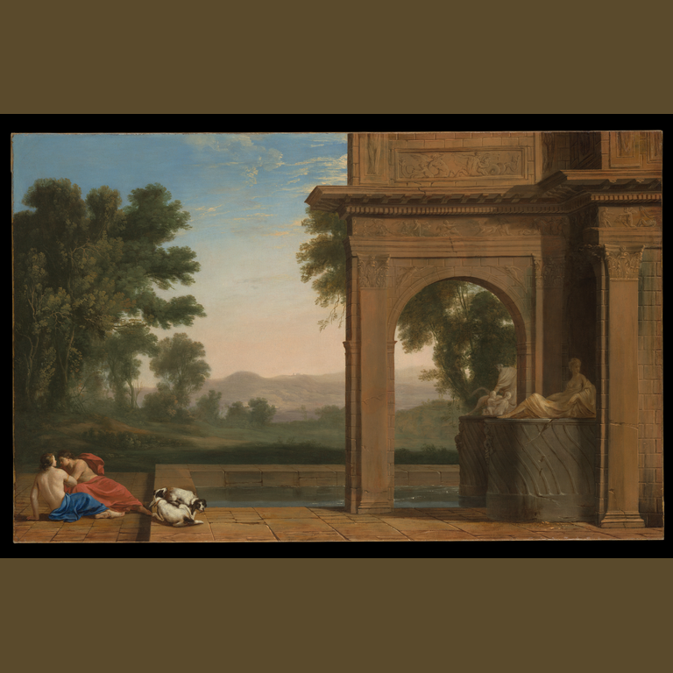
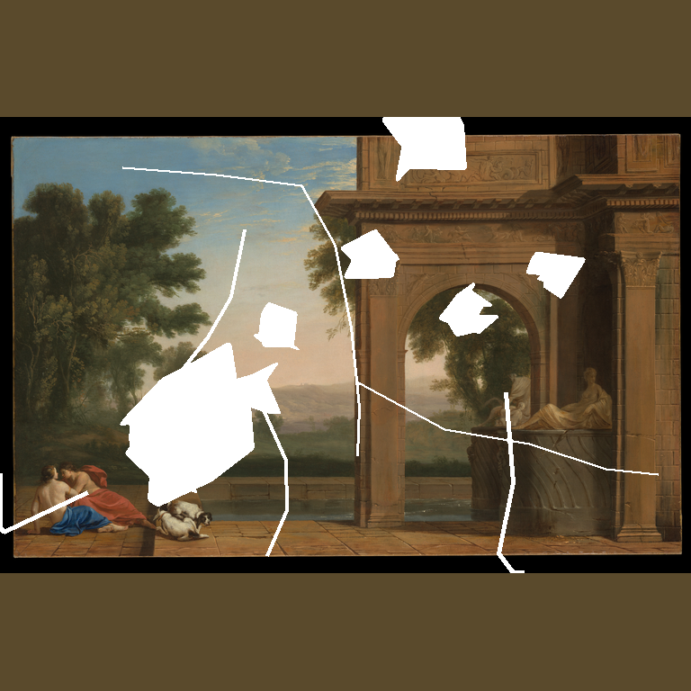

01 / PROPOSAL
Motivation
A plausible image can still be a poor restoration.
Restoration quality is local, multi-dimensional and easy to misread.
Traditional whole-image similarity can reward a visually smooth result while hiding errors inside the repaired area or along its boundary.
Where did the image change?
damaged region, boundary and unchanged context
What kind of evidence changed?
pixels, perception, features, texture, colour and seams
Can the result be trusted?
REFERENCE
CONTROLLED DAMAGE
RESTORATION CANDIDATE
inspect stability and failure signals before acceptance
Clean digital reference
Mixed missing-region damage
LaMa candidate for inspection
CORE POSITION
The framework supports transparent inspection of digital candidates. It does not approve physical conservation treatment.
TRUSTWORTHY EVALUATION FRAMEWORKS FOR AI-ASSISTED PAINTING RESTORATION
RAHUL MADDINENI • 1/5
Notes:
Presenter cue: Start with the three-image sequence. A restoration can look convincing at presentation size and still alter structure, colour, texture or the repair boundary. The thesis therefore treats metrics as complementary diagnostic evidence.
Sources: docs/proposal/Rahul_Thesis_Proposal.docx; outputs/02_image_preprocessing/images/clean/p018.png; outputs/04_canonical_damaged_image_generation/images/damaged/p018/mixed_damage.png; outputs/10_lama_restoration/images/restored/canonical_missing_region/canonical__p018__mixed_damage.png

Slide 2
02 / PROPOSAL
Research Questions
Three questions connect measurement, comparison and stability.
RQ1
Evidence beyond similarity
REGIONS +
METRICS
What additional evidence does a region-aware, multi-metric evaluation framework provide beyond traditional image-similarity metrics when evaluating AI-assisted painting restoration?
RQ2
Method differences
PAIRED
COMPARISON
How do selected inpainting methods differ in restoration quality across controlled artificial damage conditions, and how consistent are these differences across the evaluated paintings?
RQ3
Stochastic stability
SEEDS +
DIAGNOSTICS
How can repeated-candidate disagreement be used to characterize the stability of stochastic painting restorations, and how does it relate to other restoration-quality diagnostics?
The questions deliberately separate candidate quality from candidate consistency.
TRUSTWORTHY EVALUATION FRAMEWORKS FOR AI-ASSISTED PAINTING RESTORATION
RAHUL MADDINENI • 2/5
Notes:
Presenter cue: Read the short labels first, then state the full questions. RQ1 asks what is gained beyond classic similarity. RQ2 asks how the methods differ under controlled conditions. RQ3 asks what repeated stochastic candidates reveal about stability, without equating agreement with correctness.
Source: docs/proposal/Rahul_Thesis_Proposal.docx, Research Questions and Hypotheses.

Slide 3
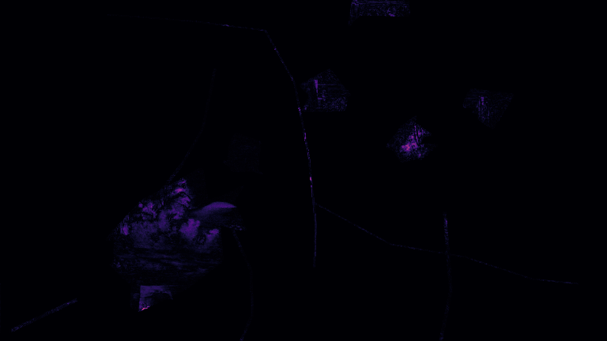
03 / PROPOSAL
Methods
Controlled inputs, complementary evidence, traceable decisions.
1
PREPARE
2
DAMAGE
3
RESTORE
4
DIAGNOSE
Normalize to 768 × 768 RGB
Preserve aspect ratio and content bounds
Canonical masks
Size and geometry variants
Procedural degradations
Telea · LaMa · HINT
Stable Diffusion 1.5
Bounded SDXL branch
Absolute error vs original
Bright pixels = mismatch
Dark pixels = closer match
EVIDENCE REMAINS SEPARATE
REFERENCE
PERCEPTUAL
LOCAL
SPATIAL
pixel error · PSNR · SSIM
LPIPS · CLIP · DINOv2
texture · direction · colour · seam
error · improvement · uncertainty maps
ANALYSIS DISCIPLINE
Paintings are the independent unit. Shared cases use paired comparisons; seeds, masks and cases are treated as repeated or nested evidence. No universal quality, uncertainty or trustworthiness score is constructed.
TRUSTWORTHY EVALUATION FRAMEWORKS FOR AI-ASSISTED PAINTING RESTORATION
RAHUL MADDINENI • 3/5
Notes:
Presenter cue: Walk from left to right. The normalized reference receives controlled damage, the selected method produces a restoration candidate, and spatial diagnostics show where the repair and its boundary require closer inspection. The lower half summarizes the complementary evidence families. Stable Diffusion varies seeds 2026 to 2029 within fixed groups. Telea, LaMa and HINT are deterministic, so they are examined through sensitivity and robustness rather than repeated-seed uncertainty.
Sources: docs/proposal/Rahul_Thesis_Proposal.docx; outputs/02_image_preprocessing/images/clean/p018.png; outputs/04_canonical_damaged_image_generation/images/damaged/p018/mixed_damage.png; outputs/10_lama_restoration/images/restored/canonical_missing_region/canonical__p018__mixed_damage.png; outputs/16_difference_maps_and_spatial_diagnostics/images/maps/lama/spm_e5f9511cc6c7d95a/spatial_overlay.png

Slide 4
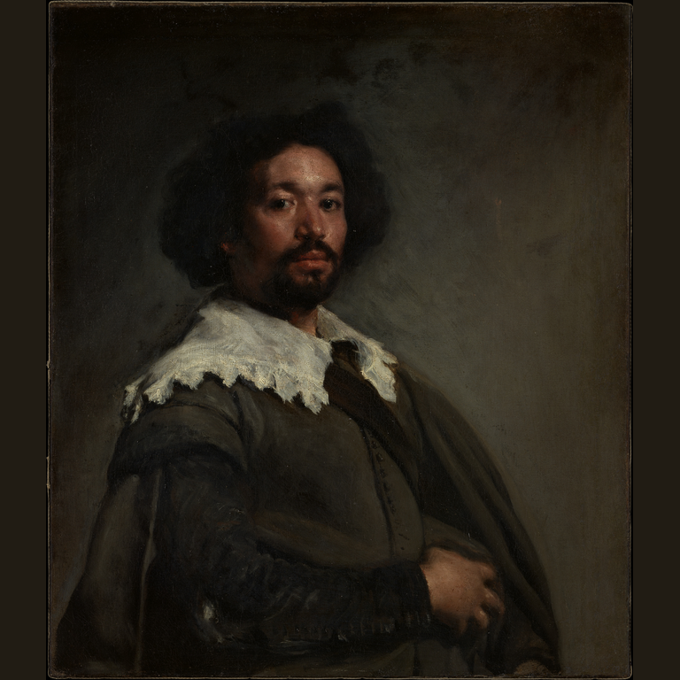
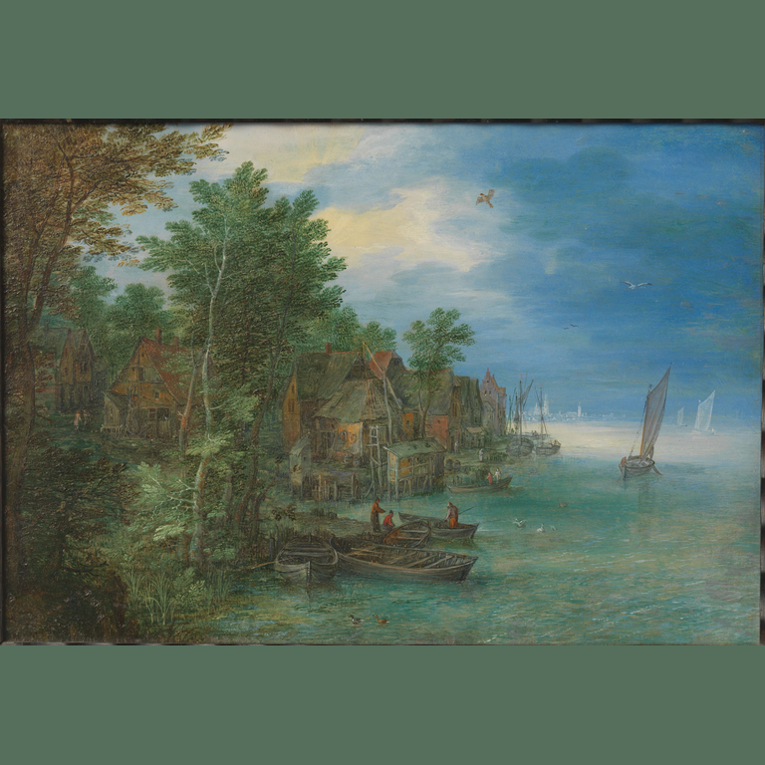
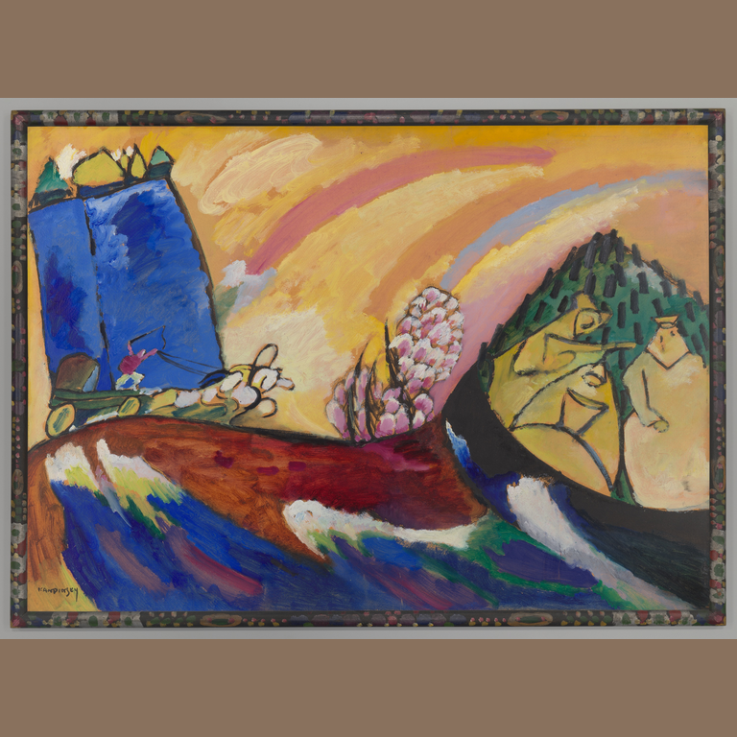
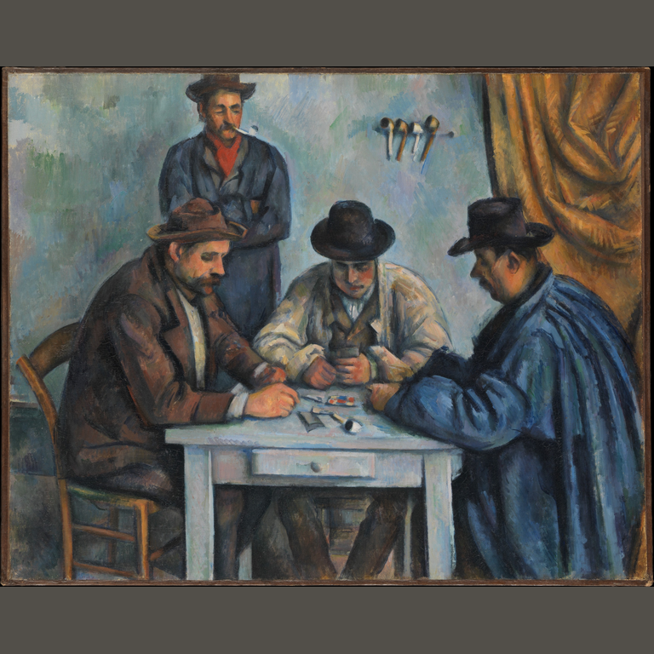
04 / PROPOSAL
Data
A balanced controlled collection, designed to scale.
300
60
768 × 768
GROUPING BOUNDARY
Five broad visual categories support balanced comparison. They are not treated as validated art-historical styles.
target paintings
per visual category
RGB analysis canvas
PORTRAIT / FIGURE
LANDSCAPE / NATURAL
ARCHITECTURE / STRUCTURED
ABSTRACTION / SURREALISM
HIGH-TEXTURE / BRUSHWORK
p001 Juan de Pareja
p018 Classical Landscape with Figures
p026 View of a Village along a River
p039 Painting with Troika
p043 The Card Players
EXPERIMENT DESIGN
CANONICAL
DAMAGE SIZE
MASK ROBUSTNESS
DEGRADATION
Four damage families plus zero-damage control across the collection
Seven nested target levels on a focused, balanced subset
Matched placement and geometry changes on focused cases
Individual and combined procedural effects with task eligibility rules
TRUSTWORTHY EVALUATION FRAMEWORKS FOR AI-ASSISTED PAINTING RESTORATION
RAHUL MADDINENI • 4/5
Notes:
Presenter cue: The current plan expands the validated controlled design to 300 paintings, balanced as 60 per broad visual category. Images are normalized to a 768 by 768 RGB canvas with aspect ratio, padding and content bounds recorded. Canonical damage covers the full collection; size and mask robustness experiments use smaller balanced cohorts. Procedural effects are separated from restoration eligibility so global degradations are not falsely presented as masked inpainting tasks.
Sources: docs/proposal/Rahul_Thesis_Proposal.docx; representative normalized images from outputs/02_image_preprocessing/images/clean/.

Slide 5
05 / PROPOSAL
Project Plan
June 2026 to June 2027, with review gates built in.
WORKSTREAM
2026
2027
JUN
JUL
AUG
SEP
OCT
NOV
DEC
JAN
FEB
MAR
APR
MAY
JUN
Proposal and scope
M1–M2
Literature and dataset
M3–M4
Masks and method setup
M5–M6
Evaluation and experiments
M7 · M9 · M10
Supervisor reviews
M8 · M12
Writing and submission
M11 · M13 · M14
MILESTONE GATES
M2 Proposal approved · 10 Sep 2026
M6 Models selected and tested · 30 Nov 2026
M8 Intermediate supervisor review · 15 Jan 2027
M10 Uncertainty analysis and reporting · 28 Feb 2027
M11 First thesis version · 31 Mar 2027
M12 Final supervisor review · 15 Apr 2027
M13 Final thesis handed in · 31 May 2027
M14 Paper or extended abstract · 15 Jun 2027
TRUSTWORTHY EVALUATION FRAMEWORKS FOR AI-ASSISTED PAINTING RESTORATION
RAHUL MADDINENI • 5/5
Notes:
Presenter cue: Emphasize the review gates and the dependency between dataset preparation, method setup, evaluation and writing. The schedule remains proposal-facing and conservative. Exact milestones in the proposal run from the thesis start on 10 June 2026 to the paper or extended abstract on 15 June 2027.
Source: docs/proposal/Rahul_Thesis_Proposal.docx, Timetable and Project Bar Chart.

