Slide 1
Definition of website
_______________________________________________________________________________________
a place connected to the Internet, where a company, organization, etc. puts information that can be found on the World Wide Web.
a collection of files accessed through a web address, covering a particular theme or subject, and managed by a particular person or organization.
________________________________________________________
Website example
The website can be published on at least one web server and can be identified by a common domain name, for example - javatpoint.com, google.com, youtube.com.

Slide 2
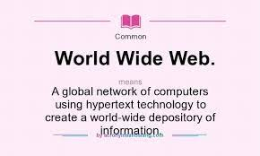
www
Full from of www :- “ world wide web _________________________________________ _____________ Definition of www_____________
all the public websites or pages
that users can access on their
local computers and other
devices through the internet.
______________________________________________________________________________example_______________________
www.learncomputerscienceonline.com
www.youvaworld.com

Slide 3
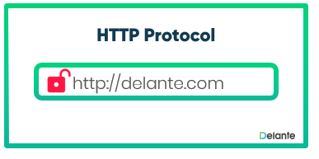

Meaning of http & https
http :-
“ Hypertext Transfer Protoco ”
https
“ Hypertext Transfer Protocol Secure ”
___________________________________________________________________
*definition of http & https*
http :- “ The communications protocol used to connect to Web servers on the Internet or to servers on a local network if an intranet is used. The primary function of HTTP is to establish a connection with the server and send HTML pages back to the user's browser. It is also used to download data from the server either to the browser or to any requesting application that uses HTTP.
__________*___________*__________*__________*____________*__________*__________*___________
https :- “HTTP Secure (HTTPS) is a secure HTTP encrypted using the Secure Sockets Layer or Transport Layer Security (SSL/TLS) convention. HyperText Transfer Protocol Secure, enables protected communication over the computer network.”
_________*___________*__________*_____________*_____________*_____________*____________*______________

Slide 4
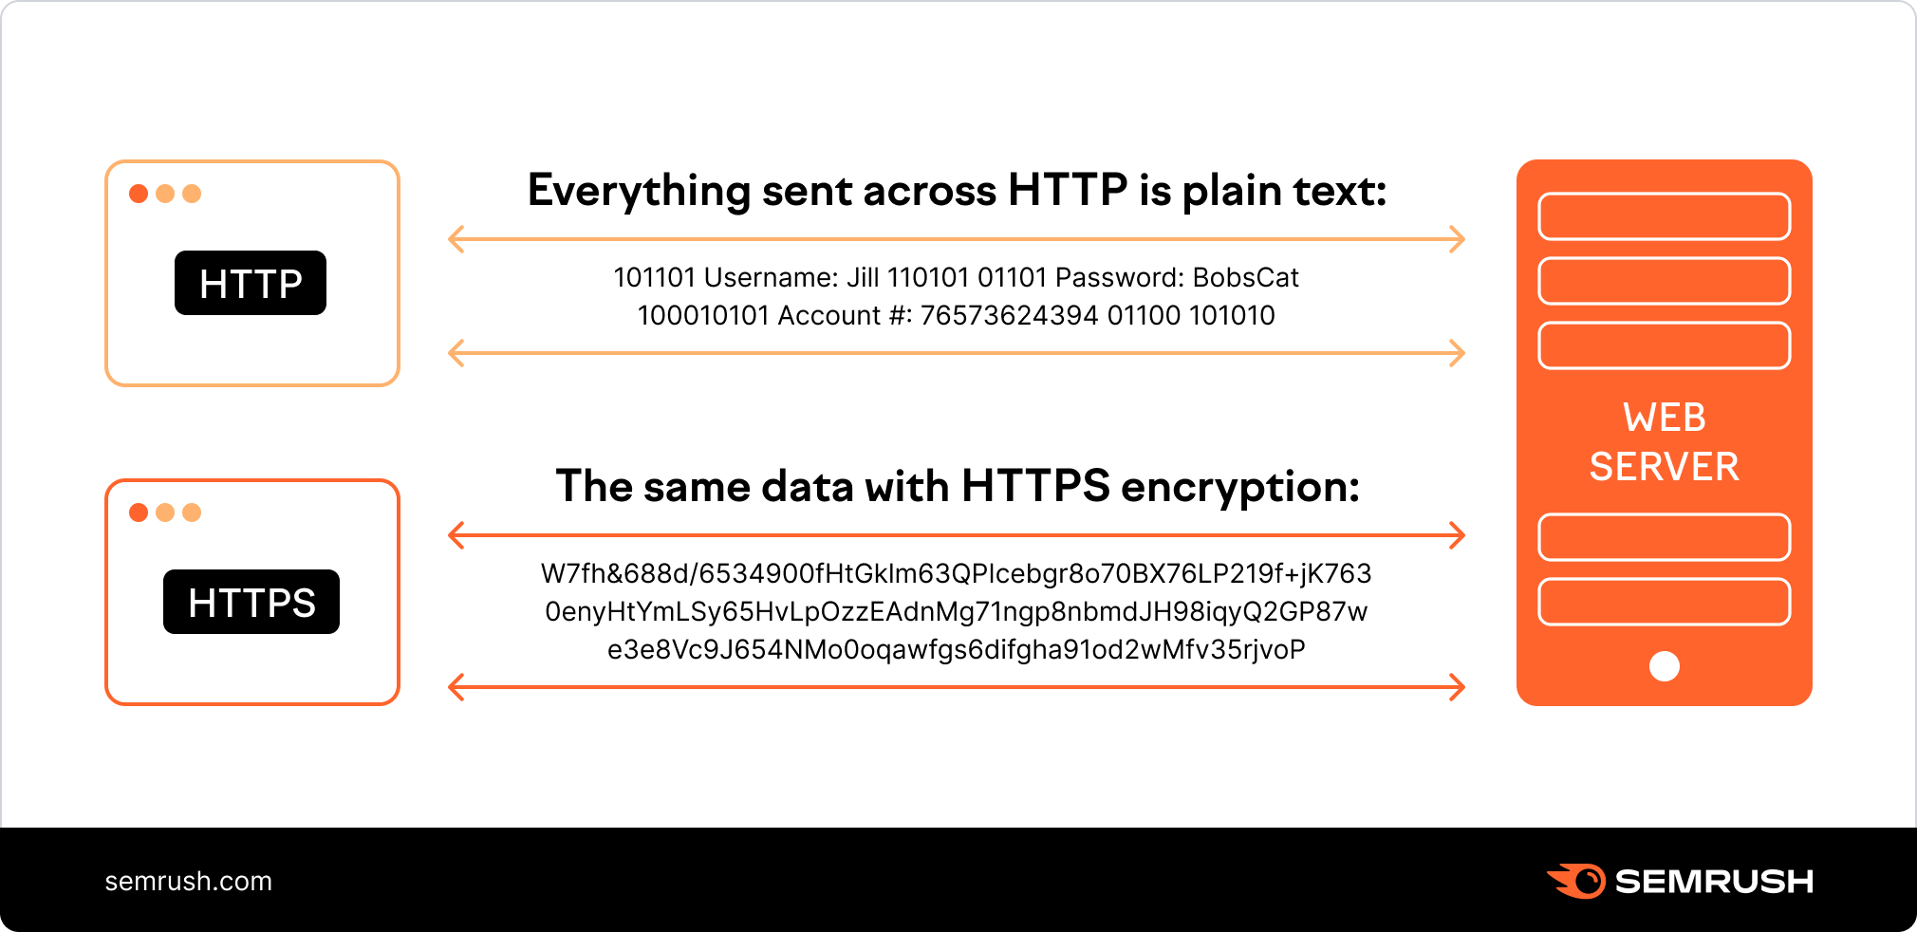
Example of http & https
http :- “The request is sent to the server, which then sends another request back with the query results. These results are displayed on the SERP (search engine results page) that you see when you complete the search.”
https :- “Unlike HTTP, HTTPS uses a secure certificate from a third-party vendor to secure a connection and verify that the site is legitimate. This secure certificate is known as an SSL Certificate (or "cert").

Slide 5
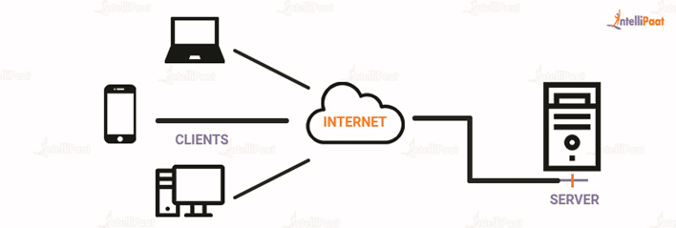
* Client server *
denoting a computer system in which a central server provides data to a number of networked workstations.
__________________________________________________________
a computing model in which the server hosts, delivers, and manages most of the resources and services requested by the client .
* Exa. =

Slide 6
*DOMAIN*
an area of interest or an area over which a person has control.

