Slide 1
Project Title: Car Black Box using PIC Microcontroller
Name : Rahul H Hanumagatti .
ID : 24024_016 .
Batch ID : 24024B .
Mentor:
Sabarinathan

Slide 2
Overview:
Introduction
Project Overview
System Design & Components
Implementation & Working
Results & Testing
Future Scope & Applications
Conclusion

Slide 3
Introduction:
Problem Statement :
Title: Need for a Car Black Box System
In the event of a car accident, determining the exact sequence of events leading up to the crash is challenging. Drivers may not recall critical details, and traditional investigation methods lack real-time vehicle event data.
Proposed Solution:
A Car Black Box system that logs vehicle data in real time, including: ✔ Speed changes using a potentiometer. ✔ Gear shifts & crash events with timestamps . ✔ Real-time display of events on an LCD screen . ✔ Secure event storage in EEPROM for post-accident analysis . ✔ Easy data retrieval via UART for investigation .

Slide 4
Project Overview:
Objective:
Develop an advanced Car Black Box system for real-time event monitoring,
ensuring accurate crash analysis and vehicle data logging.
Store critical events and speed data for post-crash analysis .
Key Features:
Real-time Event Logging: Logs critical vehicle events (gear shifts, speed changes,
crash detection).
Accurate Time Tracking: Uses RTC to timestamp each event.
User-Friendly Display: LCD shows real-time speed, event logs, and alerts.
Secure Data Storage: Stores event logs in external EEPROM for post-analysis.
Seamless Data Transfer: UART allows downloading stored logs to an external system.

Slide 5
System Design & Components:
Microcontroller: PIC18F4580
Peripherals:
Potentiometer: Simulates vehicle speed .
RTC: Provides real-time data .
LCD: Displays real-time clock, current event, and speed .
Matrix Keypad : To communicate with controller.

Slide 6
Communication Protocols:
I2C: Interfaces RTC and EEPROM .
UART: Displays downloaded logs .
Event Logging:
Gear Shifts: GN, GR, G1, G2, G3, G4, G4 C .
Speed changing via Potentiometer.

Slide 7
Implementation & Working:
Dashboard:
Displays real-time clock .
Shows current event and vehicle speed .
For each MKP2 press to increment event. → "Press MKP2 to increment the event.".
itch press the current data will be stored to external eeprom.
MKP2 press to decrement event.
MKP1 press to get event as C (Crash).
MKP4 press to go to Menu Option.

Slide 8
Menu :
View Log: Displays last 10 logged events and timestamps.
Download Log: Retrieves last 10 stored data via UART.
Clear Log: Erases stored event data from EEPROM.
Set Time: Allows setting and adjusting the RTC time.
MKP3 press to increment the indicator to point to next menu options.
MKP2 press to decrement the indicator to point to previous menu options.
MKP4 to enter into particular Log.
MKP5 press to go back to Dashboard.

Slide 9
View Log:
Displays last 10 logged events and timestamps.
MKP3 press to go to next event.
MKP2 press to go back to previous event.
Download Log:
Retrieves last 10 stored data via UART.
Indicates by displaying “DOWNLOAD SUCCESSFULLY” in CLCD.

Slide 10
Clear Log:
Clears the entire Data from eeprom.
Set Time Log:
MKP3 press to change the field i.e. hour, minute, second.
MKP2 press to increment the value of the particular field.
MKP4 press to go back to Dashboard by saving what has been edited .
MKP5 press to go back to Dashboard without saving what has been edited.

Slide 11
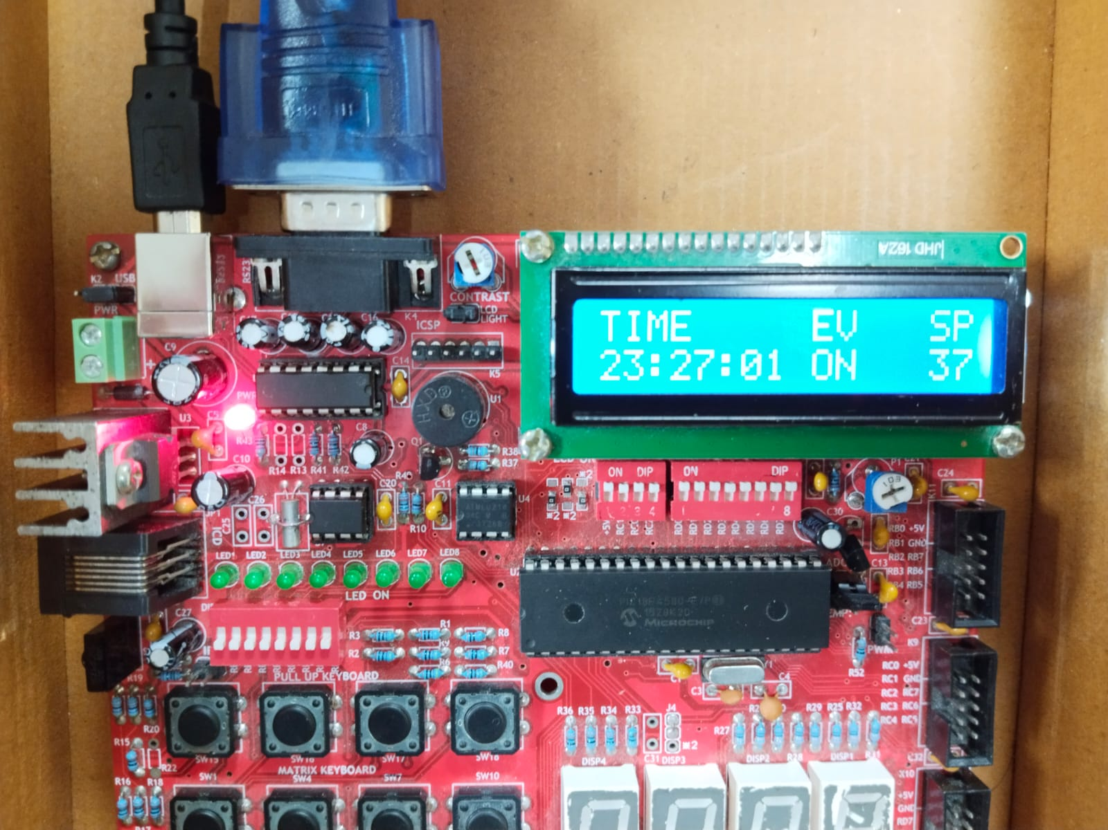
Results & Testing:
Dashboard:

Slide 12
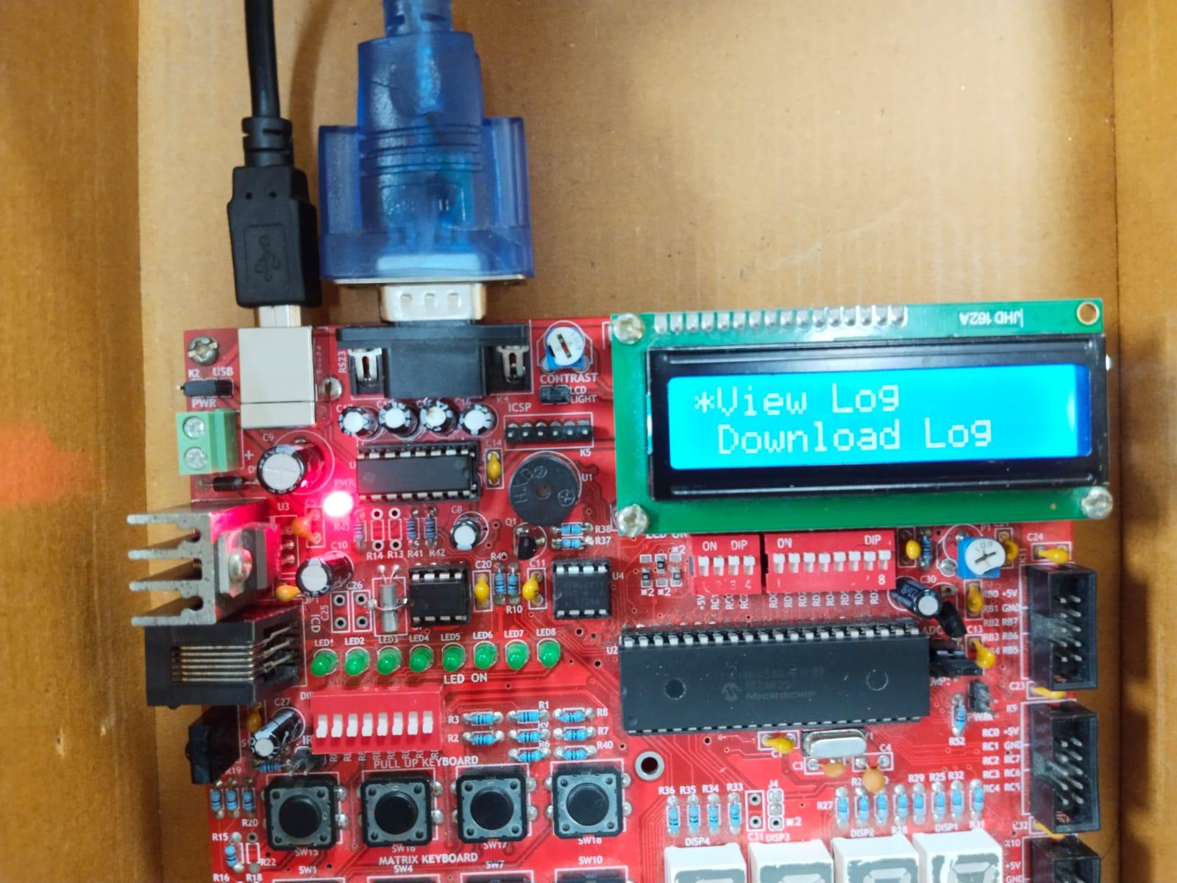
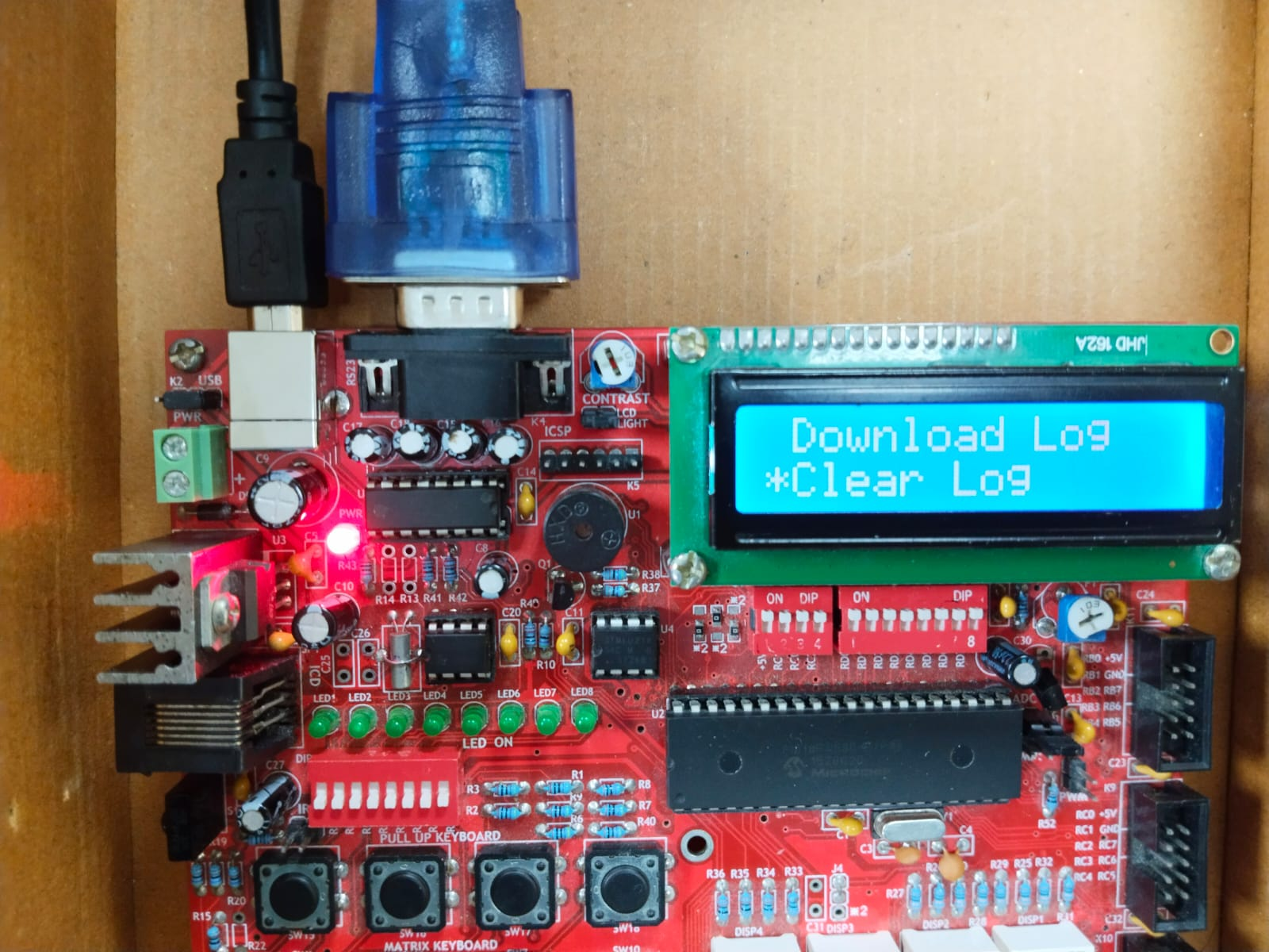
Menu:

Slide 13
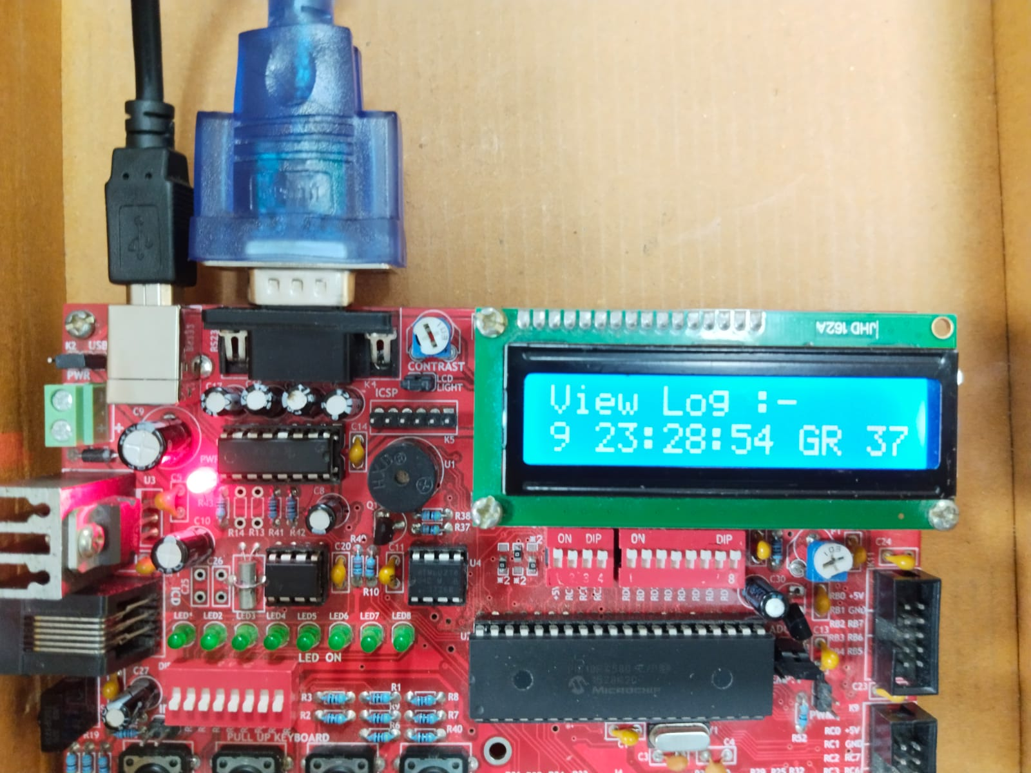
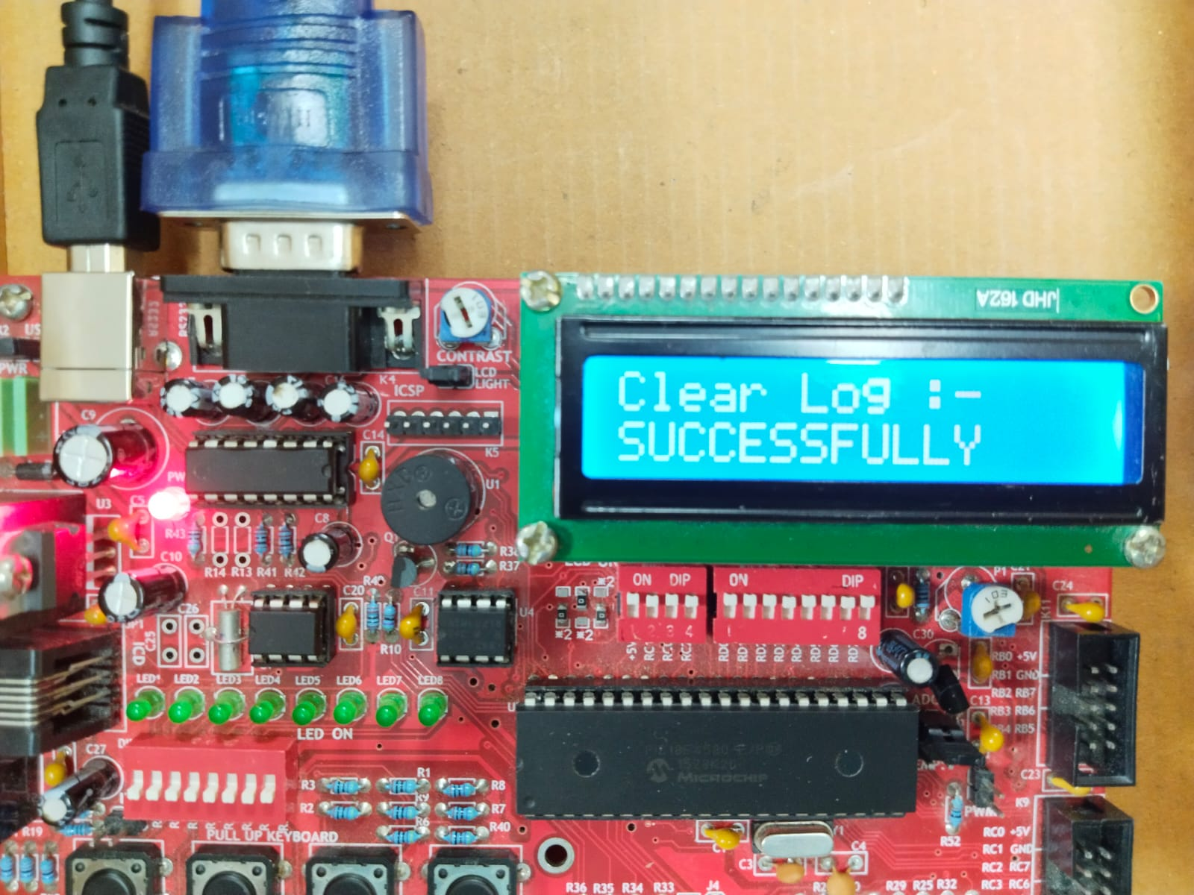
View Log:
Clear Log:

Slide 14
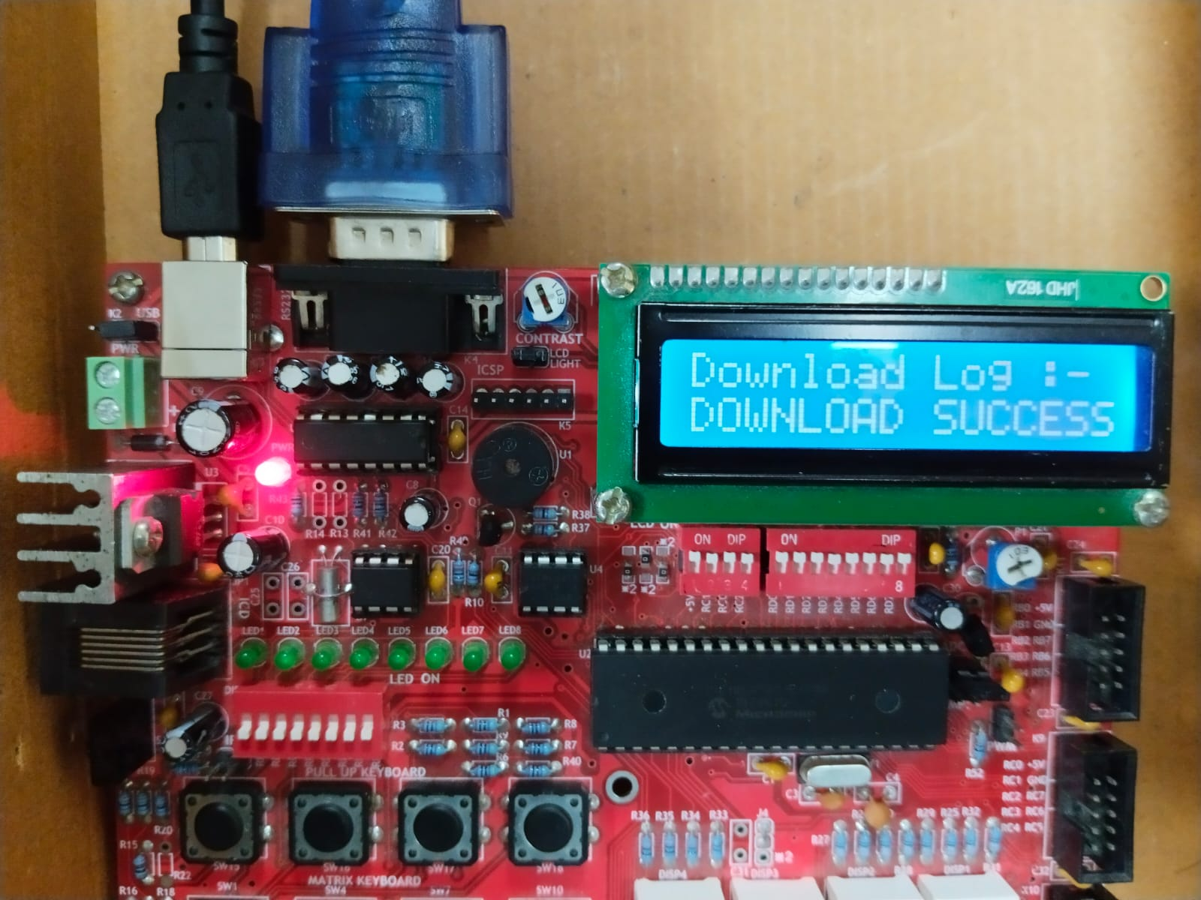
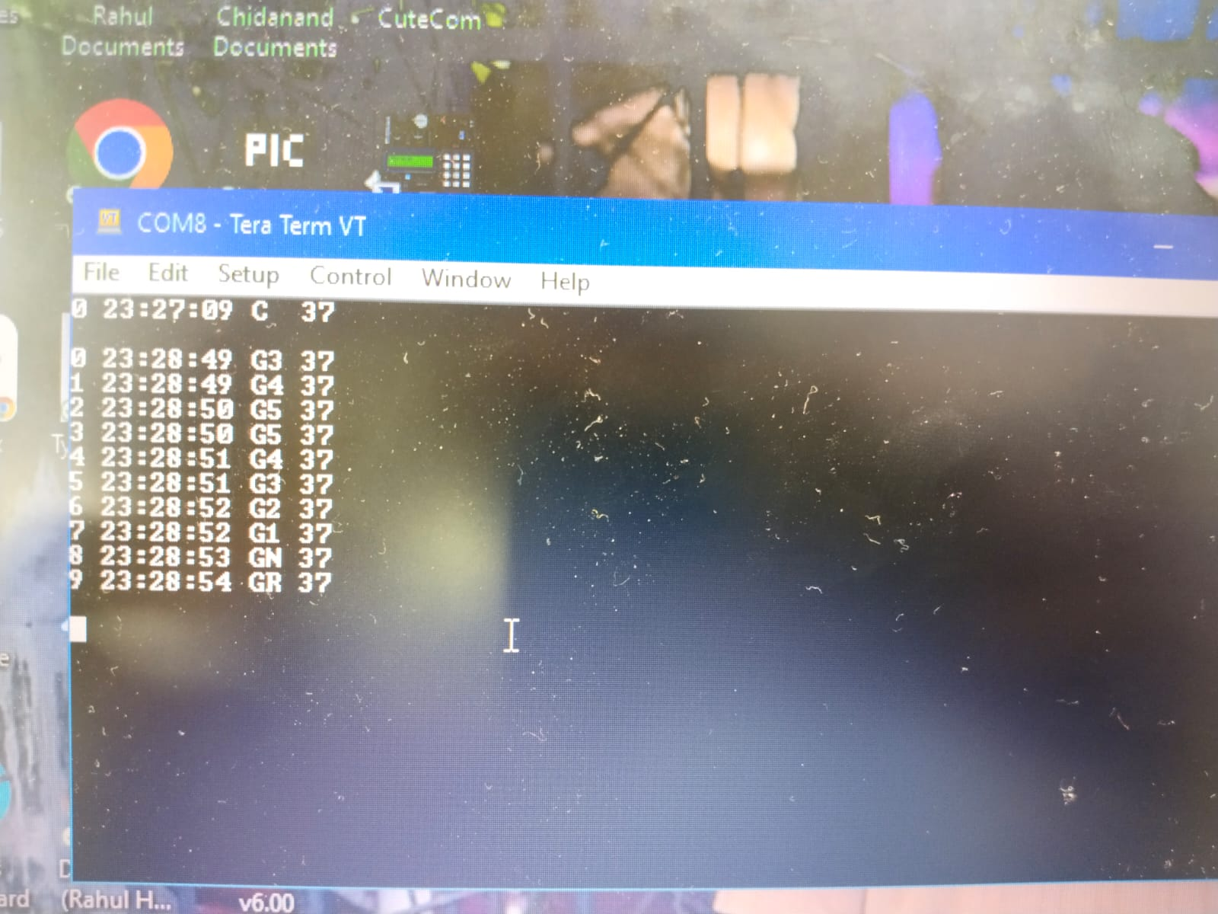
Download Log:

Slide 15
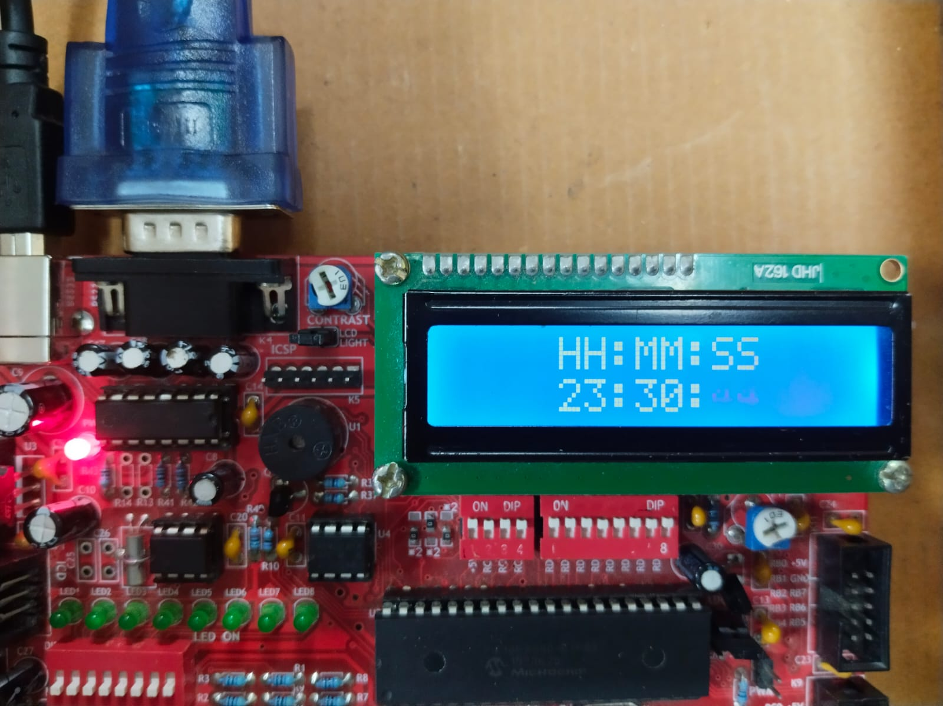
Set Time:

Slide 16
Future Scope & Applications:
Enhancements:
Add impact sensors for crash detection.
Integrate GPS for location tracking .
Wireless data transfer for remote monitoring .
Applications:
Accident investigation and root cause analysis .
Real-time vehicle health and behavior monitoring .
Fleet management for logistics and safety .

Slide 17
Conclusion:
The Car Black Box System successfully logs and monitors critical vehicle events such as speed changes, gear shifts, and crash detection in real time. By storing event data in External EEPROM and allowing easy retrieval via UART, this system provides reliable accident analysis and driver behavior insights.
With future enhancements like GPS tracking, AI-based crash prediction, and cloud integration, this project has the potential to significantly improve road safety, fleet management, and insurance claims processing.
This project demonstrates the effectiveness of real-time vehicle data logging in enhancing accident investigation and driving safety.

Slide 18
THANK YOU

