Slide 1
JAVA COUSRSE INTRO
Soni Ishwarya v
Assistant professor
soniishwarya.v@vit.ac.in

Slide 2
Course
Course Name: Computer Programming : Java
Course Code: BCSE103E
Class ID : CH2024250502984 / CH2024250502953
Slot : TD1 / L29+L30+L37+L38
Credit: 2 + 1

Slide 3
What is needed from you?
Attendance – 75% (Theory and LAB)
Time is limited.
Bring Notebook

Slide 4
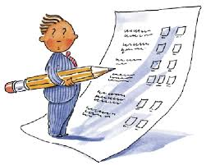
ASSESSMENT
Activities (MCQ and Coding)
PAT - Periodic Assessment Test
6 PAT (10 marks) :- 6x10 = 60 -----> 60%
30mins
FAT-Final Assessment Test
2 FAT (50 marks) :- 2x20 = 40 -----> 40%
100 mins

Slide 5
PRINT STATEMENTS

Slide 6
PRINT STATEMENTS
print()
println()
printf()
format()

Slide 7
Basic Printing
System.out.println()
println appends a newline after printing the message.
System.out.println() prints the text and moves to the next line.
System.out.print()
System.out.print() prints the text on the same line.
print does not add a newline; subsequent text will continue on the same line.

Slide 8
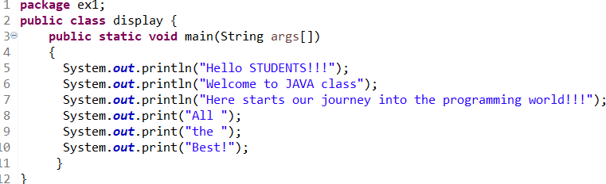

Example 1
Hello World Program
Output

Slide 9
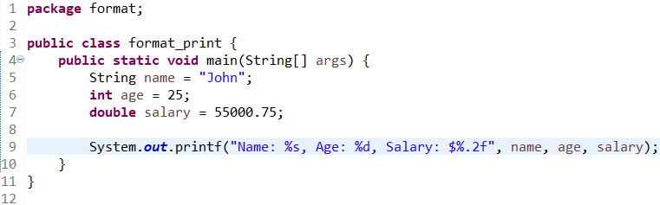
Formatting with print
System.out.printf()
printf allows formatted strings like in C programming.
Place holders
%s: string
%d: integer
%f : float
Output:

Slide 10
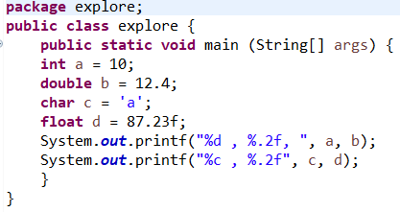
Output:

Slide 11
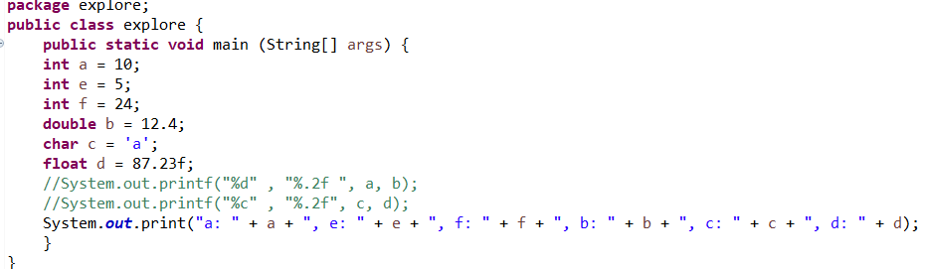
Output:

Slide 12
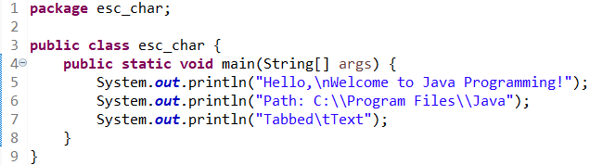

Printing with Escape Characters
Escape sequences like \n (new line), \t (tab), and \\ (backslash).
Output:

Slide 13
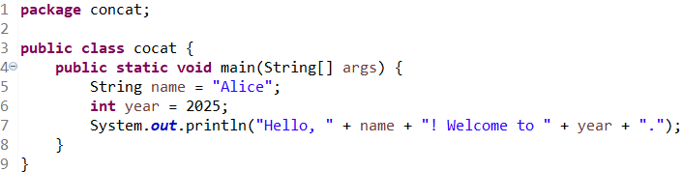
String Concatenation with Print
You can concatenate strings and variables in print/ println by using +.
Output:

Slide 14
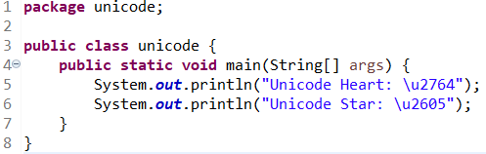

Printing Special Unicode Characters
Use \uXXXX for Unicode.
Output:

Slide 15
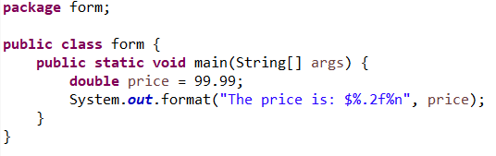
Printing using format
format() is similar to printf.
Output:

Slide 16
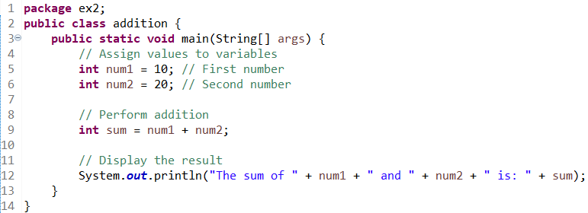
Example 2
Addition of 2 numbers
Output:

Slide 17
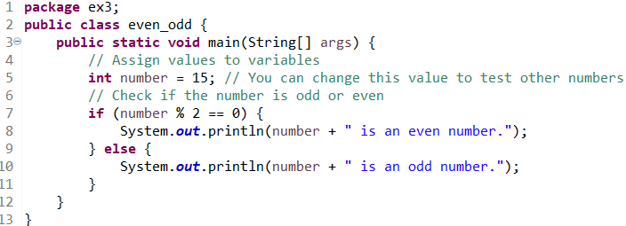
Example 3
Find if the number is even or odd
Output:

Slide 18
User-Defined Input
User defined Input can be used by importing the SCANNER (allows you to read input from any input sources like keyboard, files etc)
import java.util.Scanner;
Scanner scanner = new Scanner(System.in);
Standard input stream
CLASS
OBJECT
KEYWORD
CONSTRUCTOR
used to parse (read) primitive types (int, double, float, string
Used to allocate memory and create a new object.
initializes the Scanner object.

Slide 19
User-Defined Input
System.out.print("Enter first number: ");
int num1 = scanner.nextInt();
Wait for the user to enter a value.
Parse the input and return it as an integer.
Name of the Scanner (Class) object

Slide 20
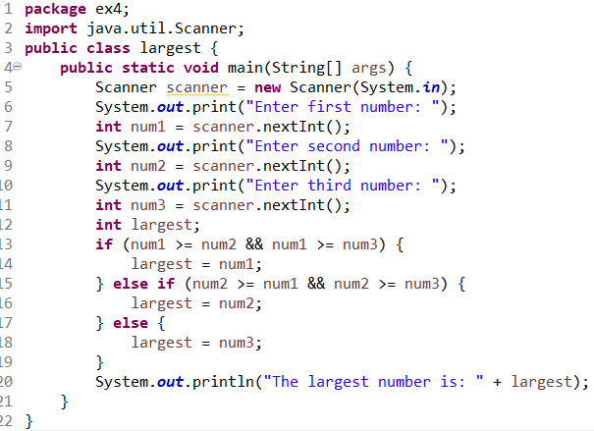
Example 4
Find Largest of Three Numbers

Slide 21

Output:

Slide 22
TASK
Compute the average of three numbers and print the average. Get the input from the user and have statement that says “the average is “ and then print the answer.
Compute the area of a circle and print the value. Get the radius from the user and print a statement that says “the area of the circle is “ and then print the answer.

