Slide 1
DREAM JOB
Submitted By:
Rahul Ratusaria
and Pankaj Bisht

Slide 2
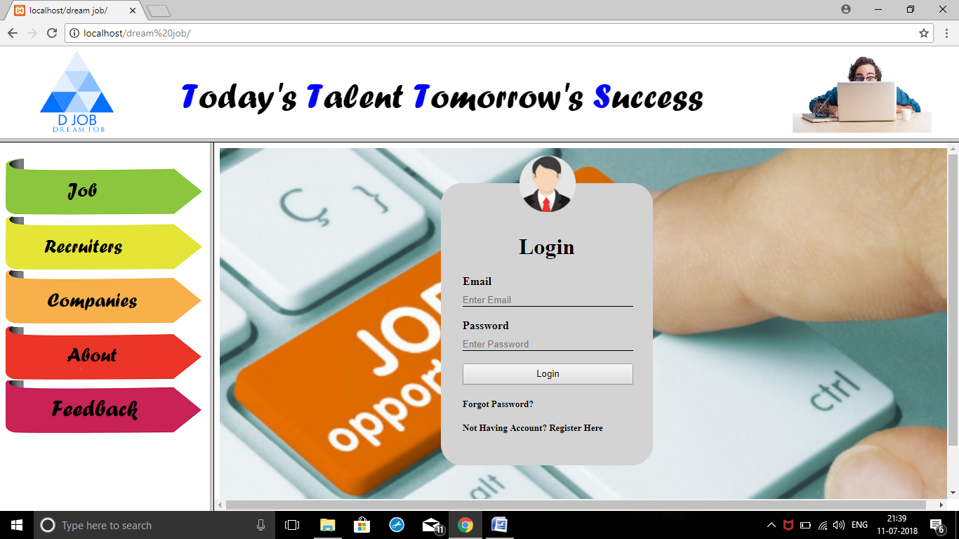

Slide 3
INTRODUCTION
Dream Job is a site which provides the jobs for job seekers online.
It includes an recruiters section where job providers add data about the job and company that which type of workers they needed.
It provides complete packages regarding job related concepts .

Slide 4
ABOUT PROJECT
Get detailed information about the Dream Job:-
●Firstly when open the website there is job section which displays the types of jobs that our site provides you
●After that there is recruiter button where recruiters add the type of workers they need for their works
●Then there is companies section where all the companies who are linked to us are displayed.
● About us section of our site tells our users about our motive, intention and our contact information.
●Users can login and register to our site through login button.

Slide 5
PURPOSE
The main objective of the project provides the information about the record of jobs with every detail about the particular speciality.
●When user enters the user id and password then that password match with database values if value match then login success the open the next page.
●Jobs can be added by the Recruiter.
●Job Seekers can contact the Recruiter through their given details.

Slide 6
Modular description
Requirement Analysis
Software Requirement Specification
Performance Requirements

Slide 7
FRONT END
PHP is a server-side, cross-platform, HTML-embedded scripting language. Currently there are over half a million domains running PHP and it is freely available for download online from www.php.net. Much of PHP’s syntax is borrowed from C, Java and Perl with a couple of unique PHP-specific features thrown in. The goal of the language is to allow web developers to write dynamically generated pages quickly. PHP eliminates the need for numerous small cgi programs by allowing you to place simple scripts directly in your HTML files. It also makes it easier to manage large web sites by placing all components of a web page in a single html file.

Slide 8
PROJECT UNDERTAKEN
Team structure.
Technologies used.
Good environment.

Slide 9
TECHNOLOGIES USED
Dreamweaver.
PHP.
MYSQL.
XAMPP Server.

Slide 10
BACK END
MY SQL
XAMPP SERVER

Slide 11
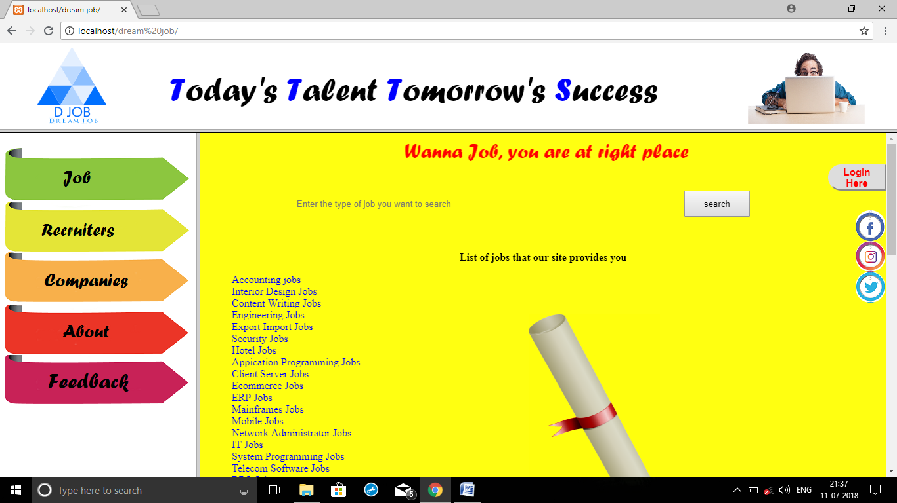
SNAPSHOTS

Slide 12
LOGIN PAGE

Slide 13
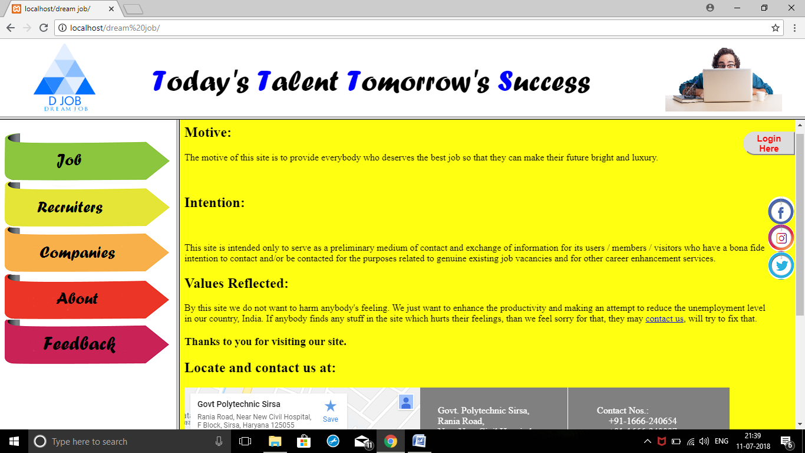
ABOUT US PAGE

Slide 14
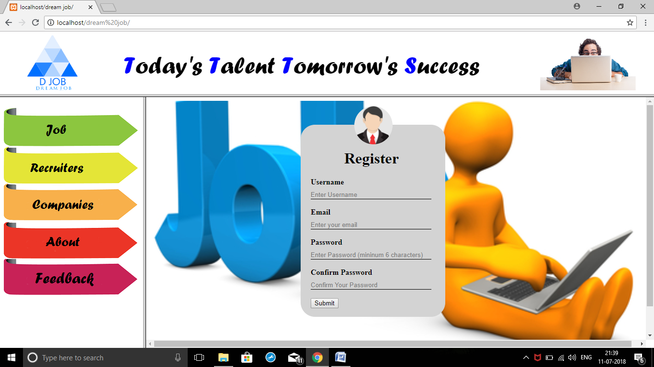
REGISTER PAGE

Slide 15
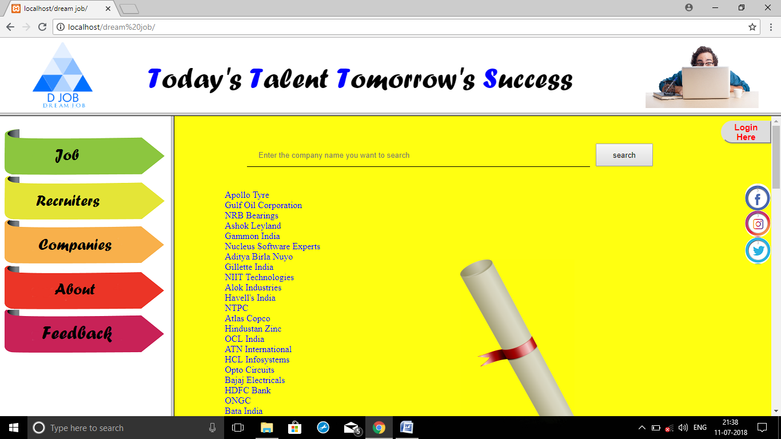
COMPANIES PAGE

Slide 16
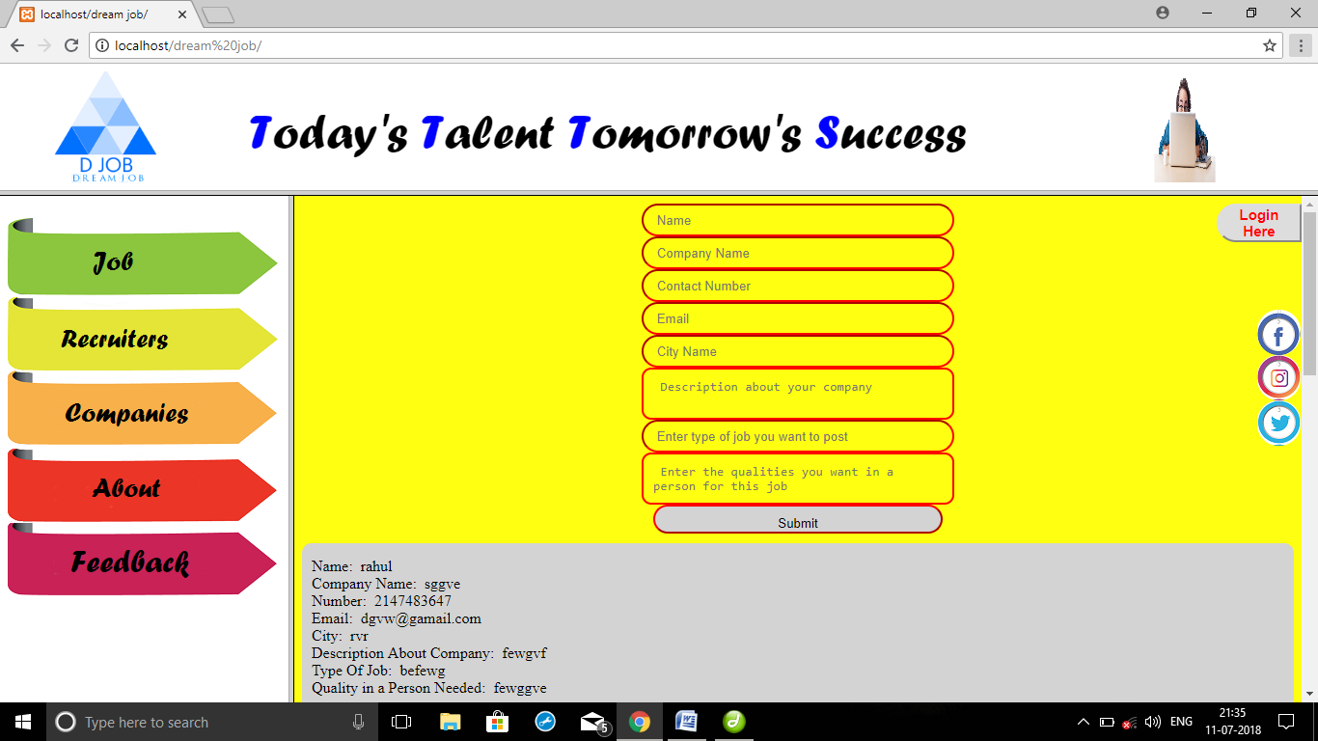
RECRUITERS PAGE

Slide 17
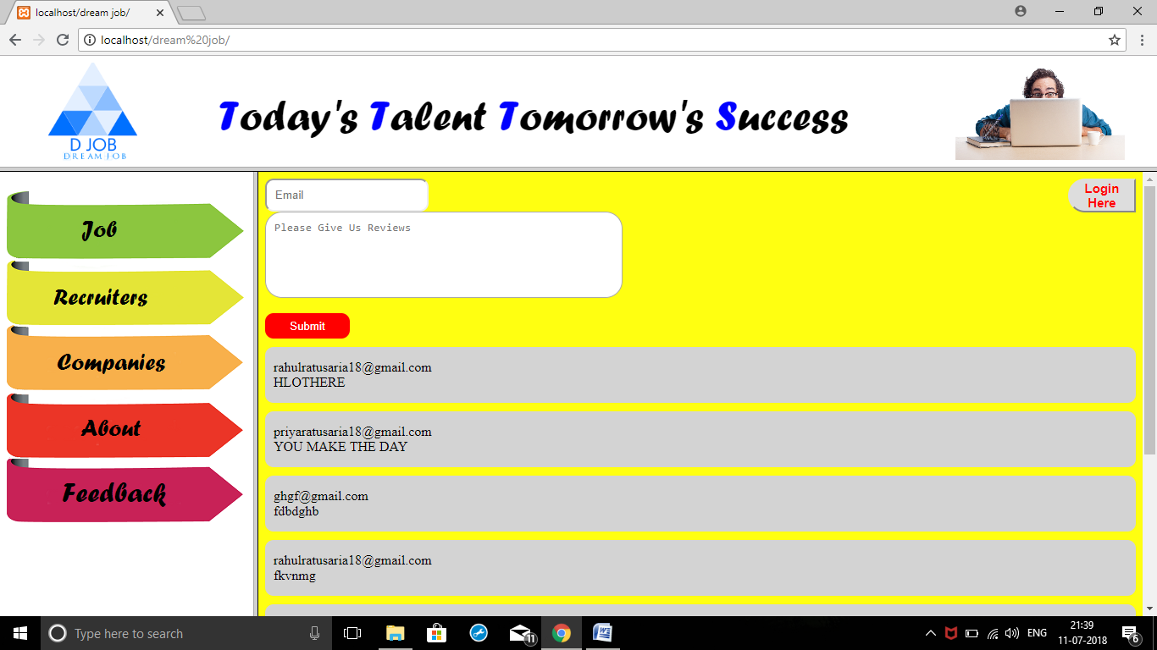
FEEDBACK page

Slide 18
THANK YOU

