Slide 1
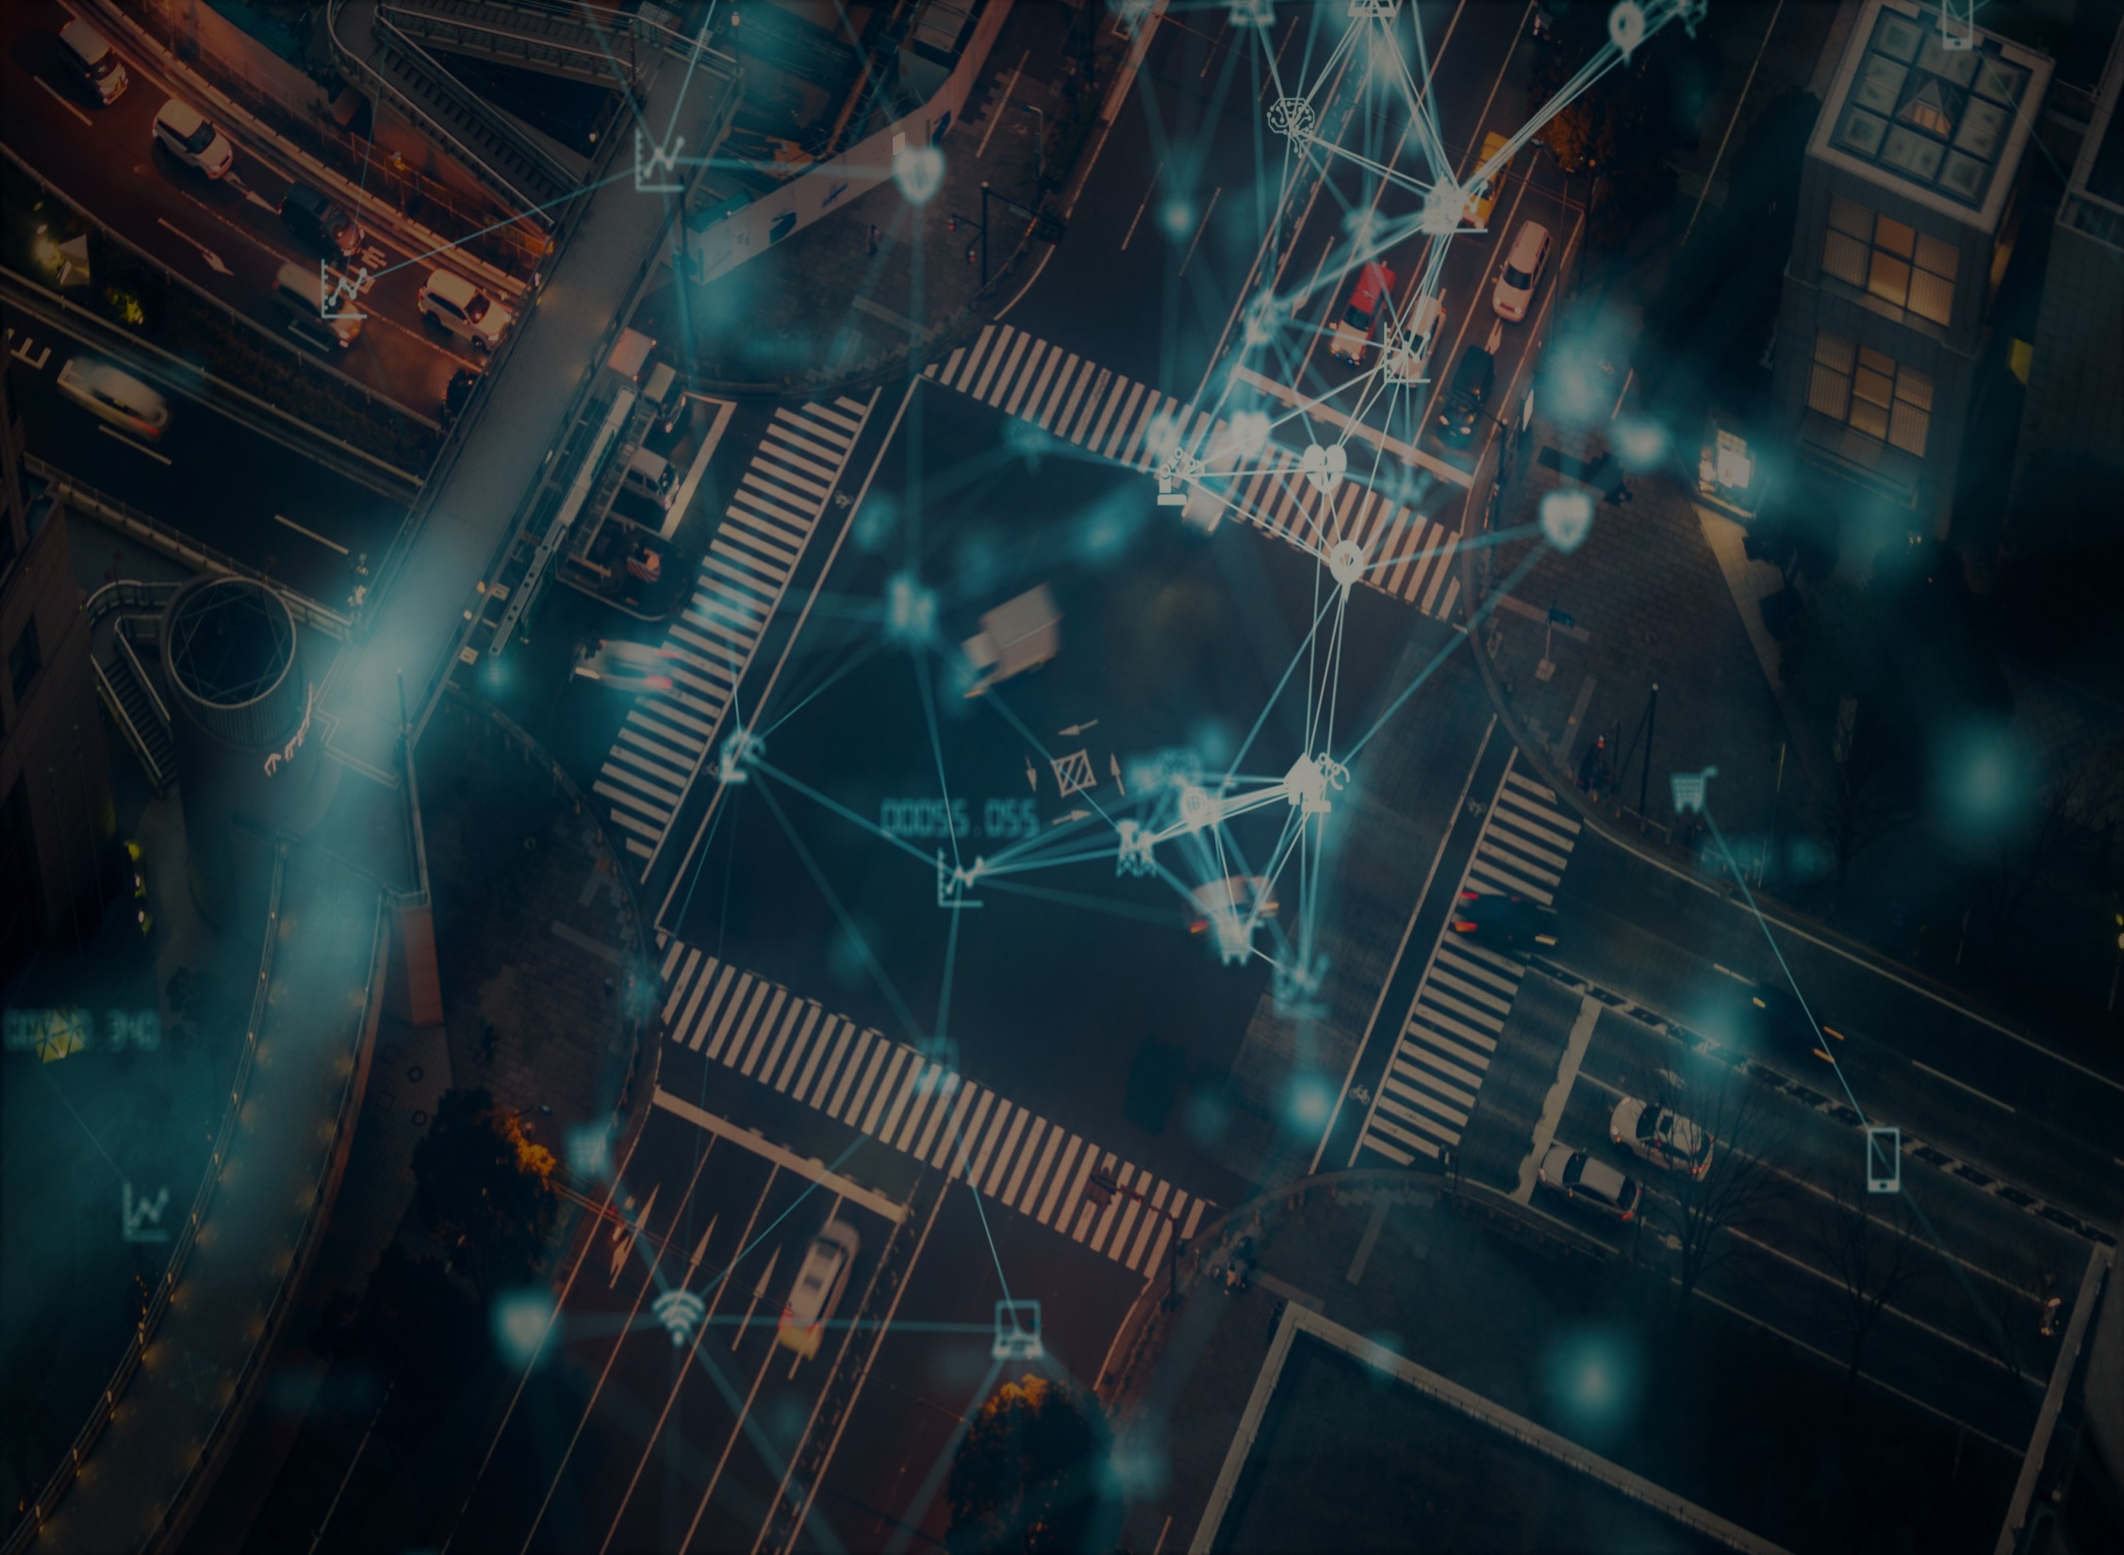

SMART TRAFFIC
MANAGEMENT SYSTEMS

Slide 2
ABSRACT:
Millions of vehicles pass via roads and cities every day. The effect of traffic congestion has major impacts on accidents, loss of time, cost, delay of emergency, etc.. For this problem , the proposed system serves as an alternative to the existing traffic management system with an intersection control station that communicates with vehicles approaching the control centre. The traffic signals are equipped with camera and IoT sensors that communicate with the infrastructure. The algorithm checks the status of conflicting lanes to ensure that vehicle pass the intersection safely. This project will be more efficient because it reduces manual power.
Keywords: Smart Traffic ,IoT, Traffic management ,Road congestion

Slide 3
Introduction:
Due to traffic congestions there is a loss in productivity from workers, people lose time, trade opportunities are lost, delivery gets delayed leading to increasing cost. In providing solutions to these congestion problems, a new robust and smart solution which is capable of controlling pollution and violation of traffic rules .To optimise the flow of traffic on roadways, a hybrid model is applied, and a system is developed to handle varied traffic scenarios successfully.
The sensors used are FACE DETECTION , MOTION and SMOKE DETECTION sensors.
Face detection sensor is used to identify those who don’t wear an helmet.
Motion sensor is used to identify the signal jumps.
Smoke detection sensor is used to identify highly polluted vehicles.
These sensors along with camera are placed with the traffic signals.

Slide 4
Implementation:
This can be implemented by using the above sensors.
All the components are interconnected with each other.
This will be developed by using phyton.
Sensor
Camera
Control centre
Verification
Challan

Slide 5
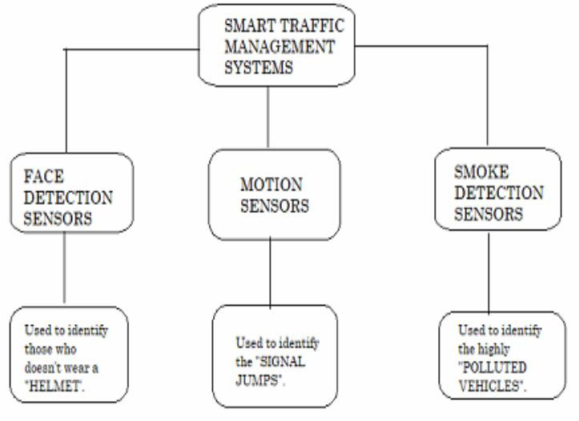

Slide 6
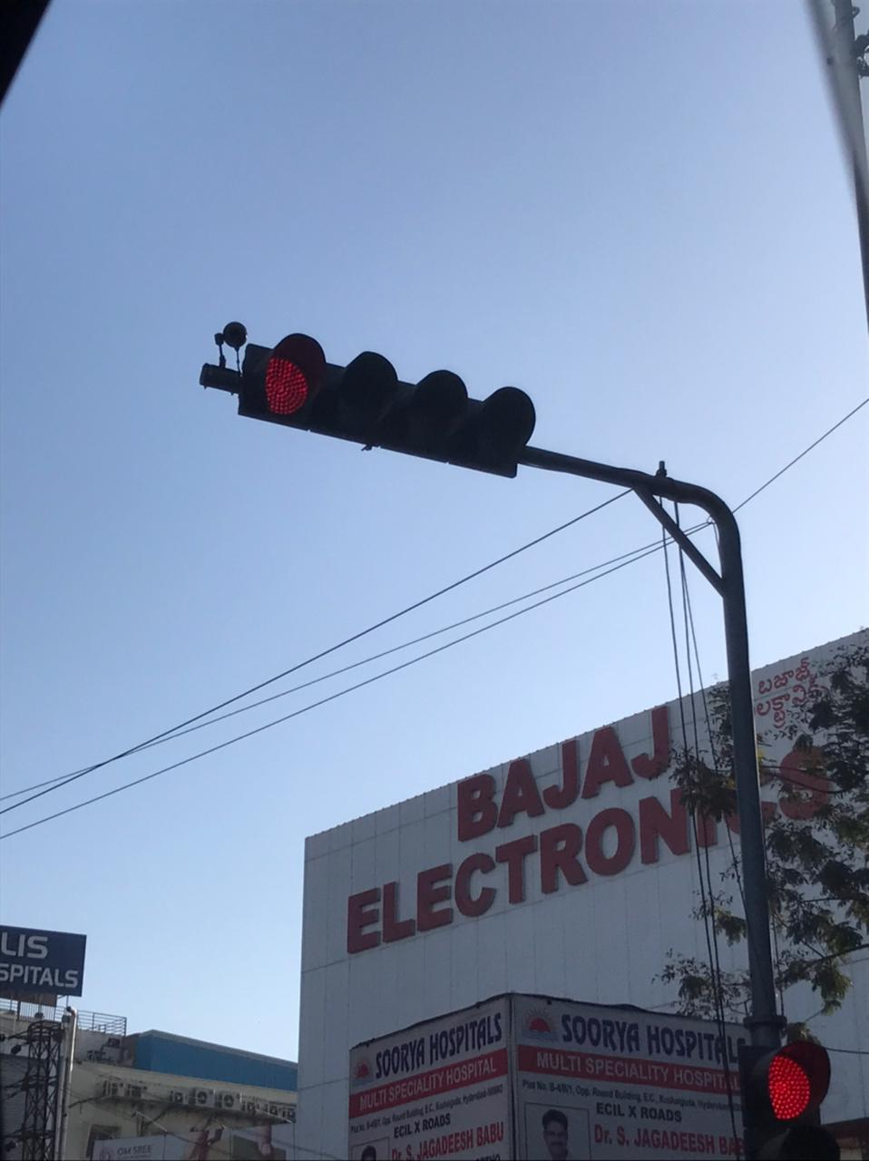
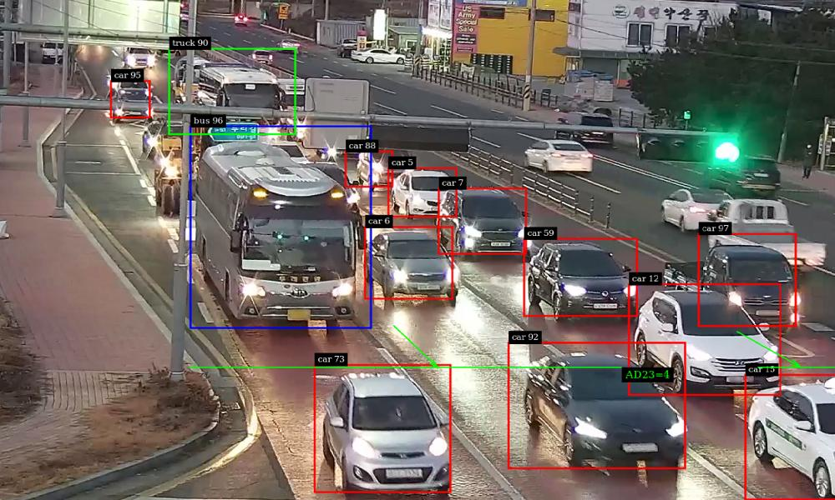
Working..

Slide 7
Advantages:
This reduces manpower.
It decreases traffic congestion.
It increases the security of traffic rules.
Helps in decreasing pollution .
Detecting faces with criminal records.

Slide 8
Conclusion:
As a conclusion, the controller can control the traffic movement and detect people without helmets, vehciles with more pollution and signal jumps. The implementation of this is not costly .Therefore for achieving pollution free and good security traffic management ,we can use this smart traffic management idea.
REFERENCES:
IEEE magazine on smart traffic management.
Author
Abubakar M. Miyim
Department of Information Technology, Federal University Dutse. P.M.B.7156, Dutse, Jigawa State, Nigeria.
Internet of things ecosystem
Author:
Maggie lin and Qiang lin

Slide 9
Vaniquishers
Rahul Reddy
Aishwarya
Sathwika Reddy
Mentor: Deepthi Sree

