Slide 1
IBM University Engagement Project Submission
“Exploring the Power of Agentic AI with IBM Granite and LangFlow”

Slide 2

Project Tile – Agentic AI Powered Mock Interview & Career Preparation Platform
Domain of Project – Education & Career Development
Student Name | Recent Passport Photo | Email ID | Mobile number [WhatsApp]
Geggalapally Rahul Reddy |  | grahulreddy38@gmail.com | 9346846643

Slide 3
Problem Statement - Interview Trainer Agent
Problem Statement : Interview Trainer Agent
The Challenge
Many students struggle to prepare effectively for technical and HR interviews due to lack of structured guidance, personalized learning paths, and real-time feedback. Interview preparation content is scattered across multiple sources such as websites, books, and mock tests, making it difficult to practice in a focused and efficient way. Without personalized, adaptive, and AI-driven training, learners often fail to identify their weak areas, improve their responses, and gain real interview confidence.
The Objective
The main objective of this project is to design and develop an Intelligent AI-powered Interview Trainer Agent that helps students and job seekers improve their interview preparation through personalized learning, real-time practice, and AI-driven feedback. The system aims to make interview preparation more structured, adaptive, and effective using Agentic AI and modern IBM technologies.
Build an AI-powered Interview Trainer Agent that helps students prepare for technical and HR interviews in a personalized way.
Analyze resumes to extract skills, experience, and domain knowledge to generate relevant interview questions.
Conduct mock interviews and simulate real interview environments for better practice and confidence building.
Evaluate user responses using AI and provide instant feedback, scoring, and improvement suggestions.
Use RAG and Agentic AI to deliver accurate, company-specific preparation and personalized learning guidance.

Slide 4
Technology Used
Tech Stack (Mandatory)
The project is developed using a modern IBM AI ecosystem for building an intelligent Interview Trainer Agent.
LangFlow is used for designing and visualizing the complete multi-agent workflow in a structured manner.
IBM watsonx.ai is used for deploying, managing, and running AI models in a scalable cloud environment.
IBM Granite Models are used for natural language understanding, reasoning, and generating interview questions and feedback.
The combination of LangFlow + watsonx.ai + Granite Models enables Agentic AI workflows, RAG-based retrieval, and personalized interview preparation.

Slide 5
Proposed Solution -
Proposed Solution: Interview Trainer Agent
The proposed system is an Agentic AI-powered Interview Trainer built using LangFlow, IBM watsonx.ai, and IBM Granite Models.
The system performs:
Resume analysis
Technical interview simulation
HR interview simulation
AI-based evaluation
Skill gap analysis
Learning recommendations
The platform provides a complete interview preparation ecosystem for students and job seekers.

Slide 6
Langflow component Used -
Chat Input – Interface where users enter their resume, queries, or interview-related responses (text input for mock interview interaction).
IBM watsonx AI Agent – Processes user input using IBM Granite models to generate interview questions, evaluate answers, and provide personalized feedback.
IBM Granite Model – Granite-4.0-8B-Instruct → Used for real-time reasoning, generating technical/HR questions, and scoring candidate responses efficiently.
Chat Output – Displays AI-generated results such as interview questions, evaluation scores, feedback, and learning recommendations.
File Component – Stores and retrieves user resumes, interview history, skill data, and performance tracking information for analysis.
Vector Database (FAISS / Chroma) – Used for RAG-based retrieval of interview questions, DSA notes, HR datasets, and company-specific preparation data for accurate responses.

Slide 7
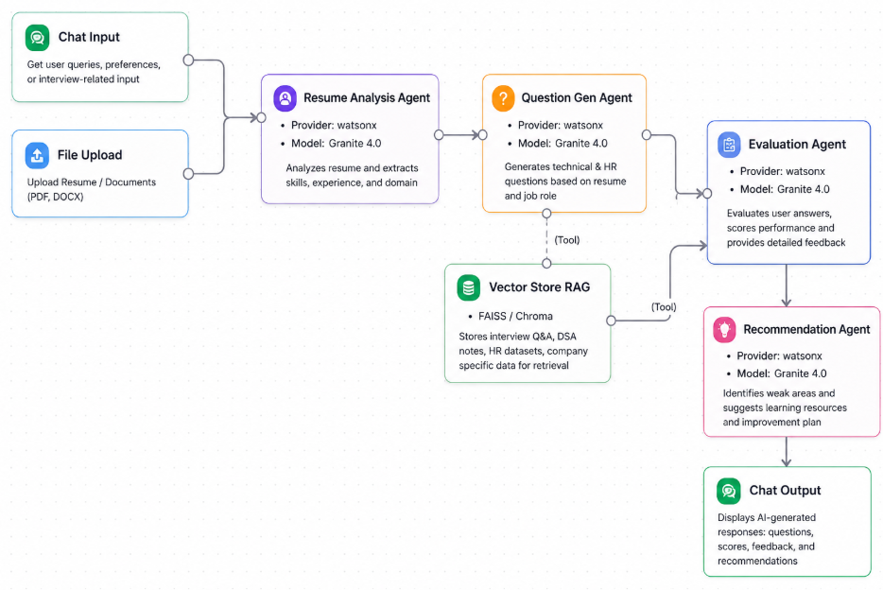
Langflow workflow -

Slide 8
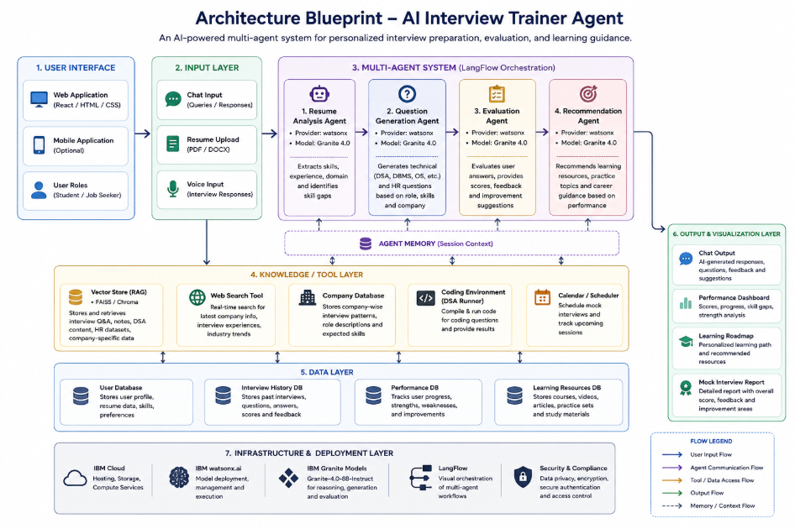
Architecture blueprint

Slide 9

Role of Agentic AI in the solution
Agentic AI enables the Interview Trainer Agent to work as an intelligent, autonomous system rather than a simple chatbot. Using IBM watsonx.ai and IBM Granite models, it coordinates multiple agents for resume analysis, interview question generation, answer evaluation, and learning recommendations.
Each agent handles a specific task and collaborates to deliver accurate and structured interview preparation. The system understands user context such as skills, experience, and goals to generate personalized guidance.
It also adapts in real time based on user performance, improving feedback and recommendations continuously. Overall, Agentic AI makes the system proactive, personalized, and goal-driven, acting like a smart AI interview coach.

Slide 10
Technology Used
LangFlow platform – Used to visually design and manage multi-agent workflows for interview preparation tasks.
IBM Granite model – Provides natural language understanding, reasoning, and personalized interview question generation and feedback.
IBM Cloud – Offers a secure and scalable environment to deploy and run the Interview Trainer Agent.
RAG (Retrieval-Augmented Generation) – Retrieves relevant interview and technical data first, then generates accurate, context-aware responses.
IBM watsonx.ai – Used for model deployment, embeddings, and AI governance.
Vector Database (FAISS/Chroma) – Stores and retrieves interview-related data efficiently using semantic search.

Slide 11
Novelty and Uniqueness
The Interview Trainer Agent combines Agentic AI, RAG, and personalization to create an intelligentinterview preparation system.
It uses multiple agents for resume analysis, question generation, evaluation, and learning recommendations instead of a single chatbot.
RAG improves accuracy by using real interview and technical data, reducing incorrect responses. The system provides personalized interview questions and learning paths based on user skills and performance.
It also adapts in real time by adjusting difficulty levels and feedback according to user progress.
Overall, it acts as a smart, adaptive, and goal-driven AI interview coach.

Slide 12
Git Hub Link -
Please test and Paste the working Github URL – https://github.com/Rahul-Reddy9/Interview-Trainer-AI-Agent

Slide 13
Future Scope
1. Voice-Based Interview System & Multilingual Support –
The system can be enhanced with a voice-enabled AI interviewer that conducts real-time spoken interviews. Adding multilingual support will allow users to practice interviews in different languages, making the platform more accessible and inclusive.
2. Video Interview Analysis & Placement Prediction –
The platform can be extended with video-based analysis to evaluate body language, confidence, and communication skills. It can also include an AI-driven placement prediction system to estimate a candidate’s readiness based on performance and skill levels.
·
·
·

Slide 14


