Slide 1
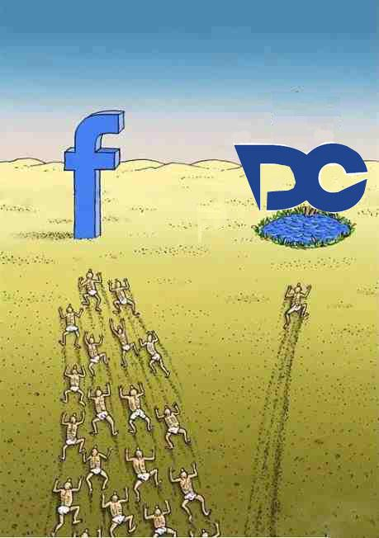
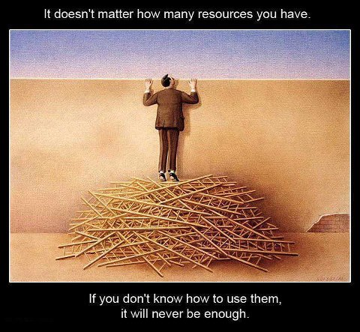
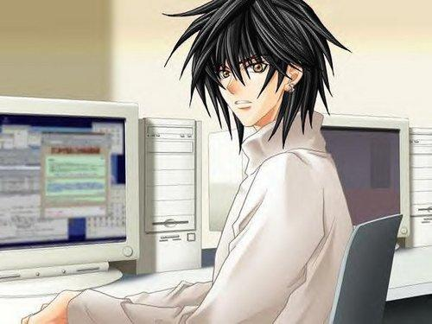
See the Lifecycle below to find out more.
Big
Buddy

Slide 2
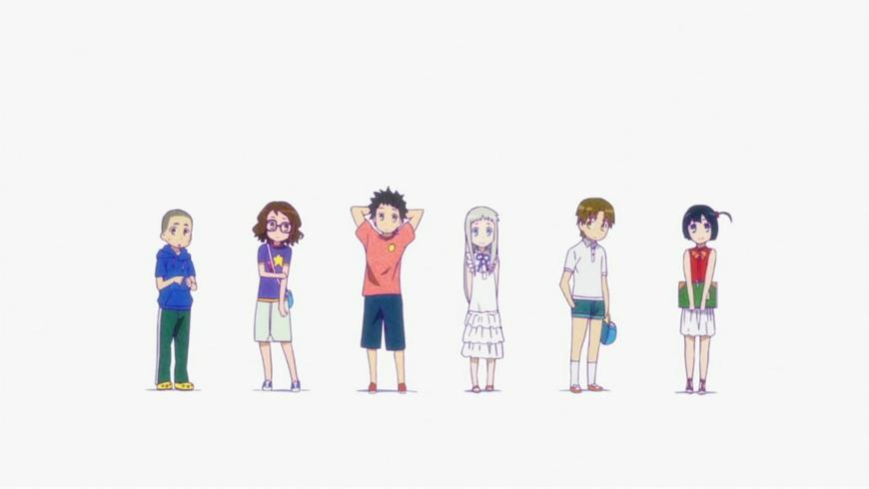
I heard those aliens develop softwares enjoying their working days and night. I too want to learn this .
Hey... they asked us for certain prerequisites ?
Yes , everything is listed on their website.
Lets try aleast and submit our forms
DC? What the heck is that?

Slide 3
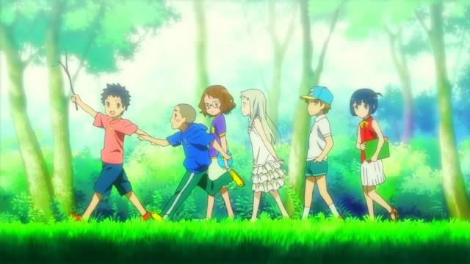
Hurry Up ! We have to join DC
Well I did it!
Me too ! Also completed prerequisites
Will they give us response?
Yeah But I have not filled the form?
Let’s find out!

Slide 4

Where to get help?
Whom to talk?
? Confused ?
? Confused ?

Slide 5
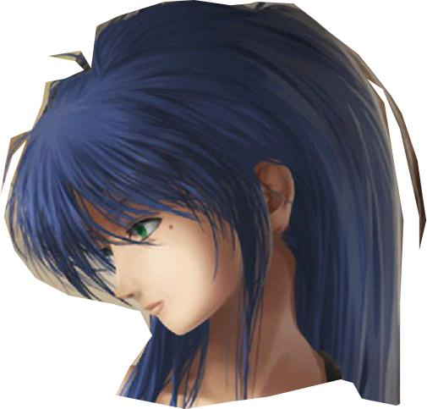


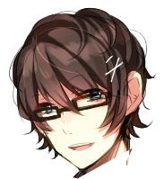
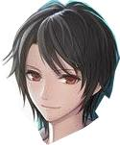

We are here to help you ! ☺
Don’t be confused☺
Big Buddies
Newbies learn from their peers and buddies

Slide 6
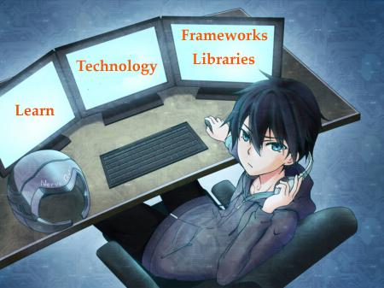
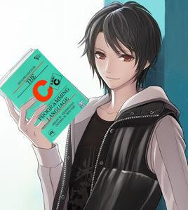
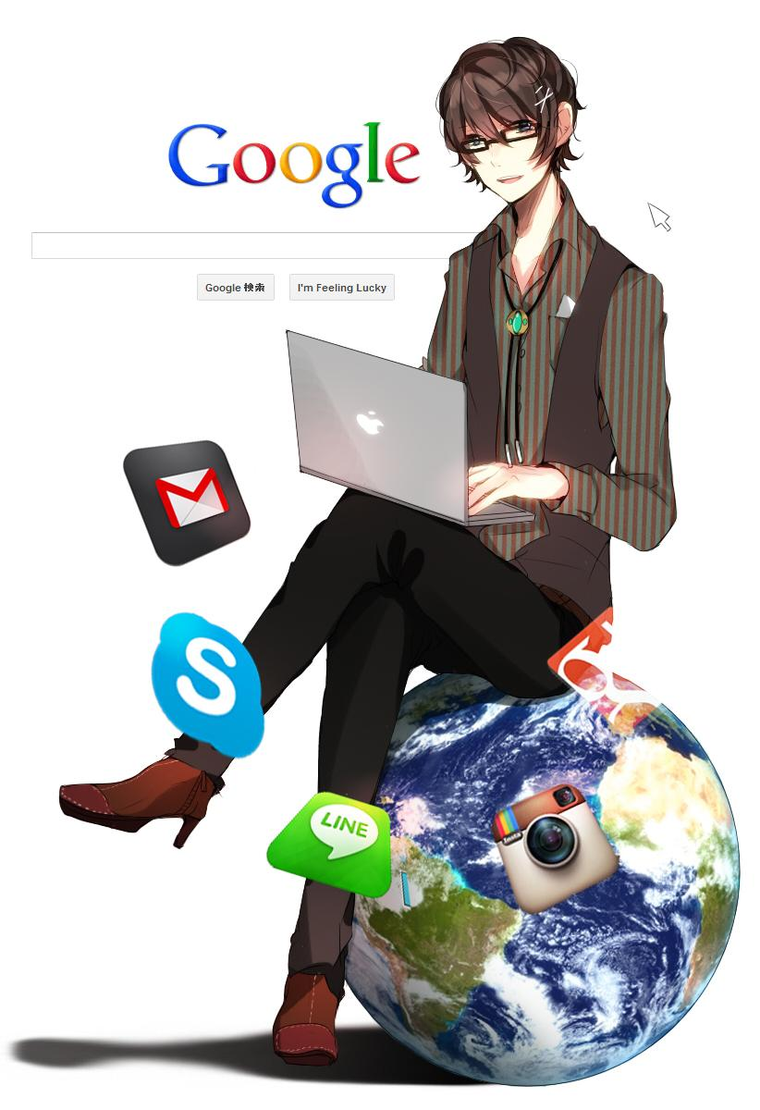
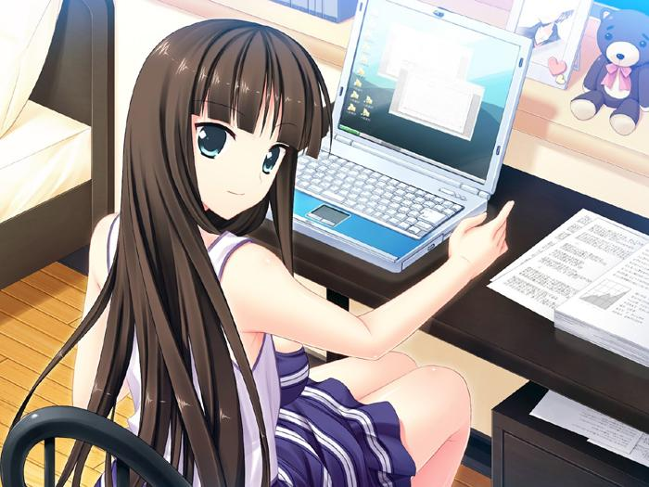
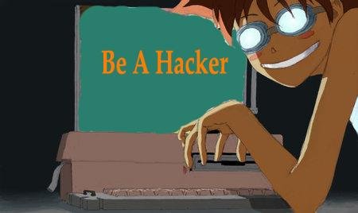
Explore the world of open source.

Slide 7
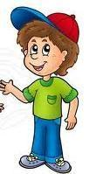



A few weeks
with
Hey do you know Python’s new version released?
Yeh! Its old news...Now!!.. I really love Python
Me too!!
Learn the process of s/w development
Its time to learn coding standards and guidelines
Learn best practices in s/w development
Develop small project
If have any problem feel free to ask
Bug Buddies

Slide 8



path to be an entrepreneur
Wow!! Now I can develop and maintain live projects
Hey learned much of the things...now you are ready to get your hand dirty with s/w development
And I would like to involve in research work
Yes now you can grow yourself in whichever field you interest
Hey common, lets attend a few workshops, conferences, events

Slide 9

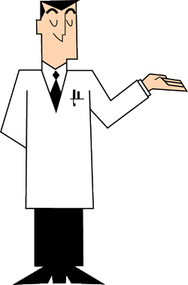

path to be an entrepreneur
You can meet entrepreneurs to share experiences
Grow yourself and benefit society by your work!!
Build leadership skills, public speaking, delivering fantastic presentations!!
Mentor

Slide 10
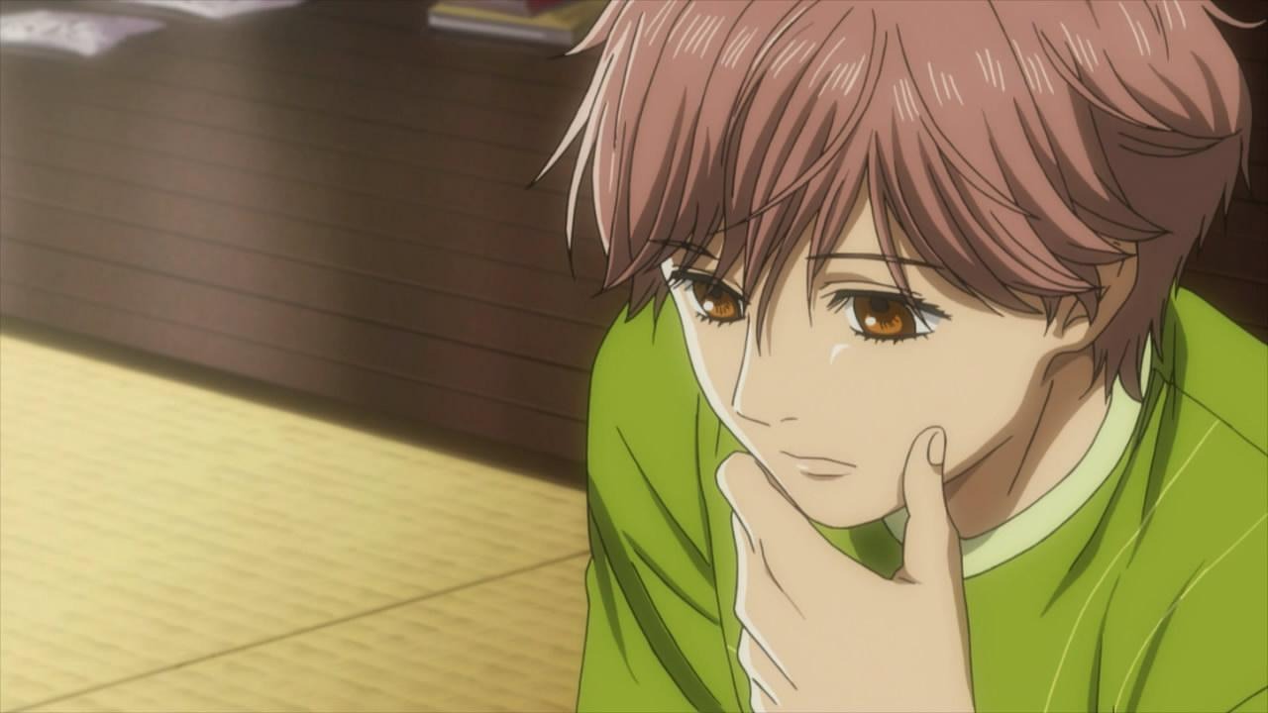
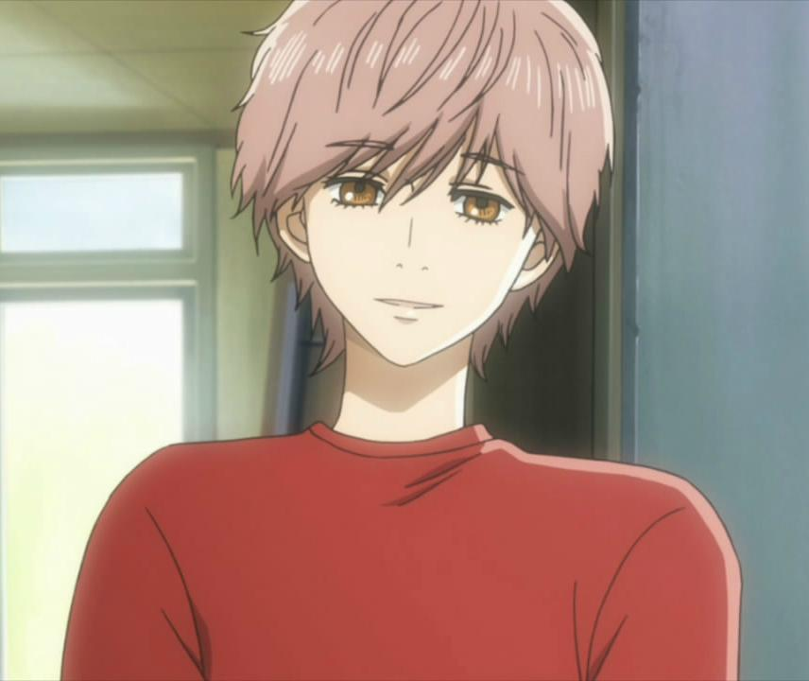
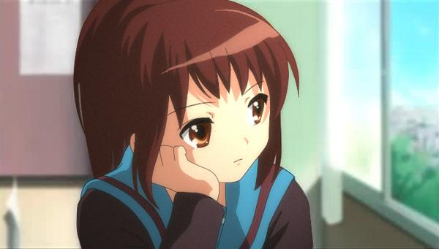

After few day..
I am just about to win this Google Competition !
I won the competition
!! That was easy !
I have final exam of Stanford’s online course !
In the evening
Wow! I just got 98%, with Certificate!!!

Slide 11
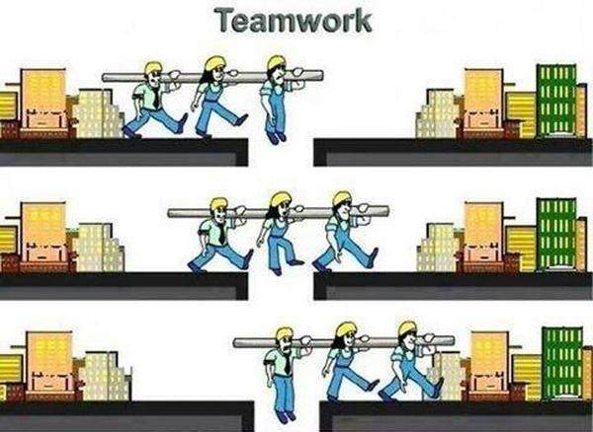
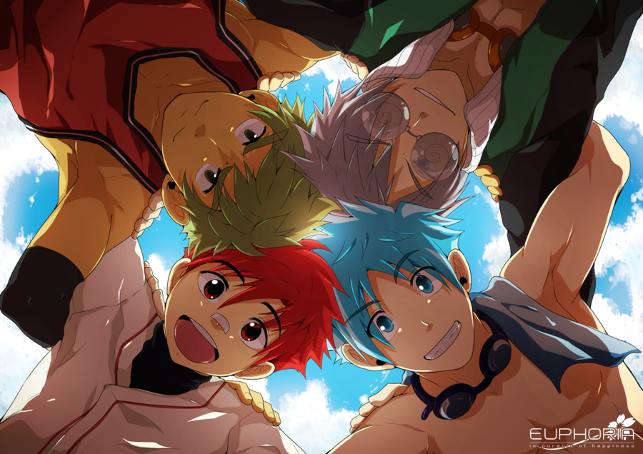
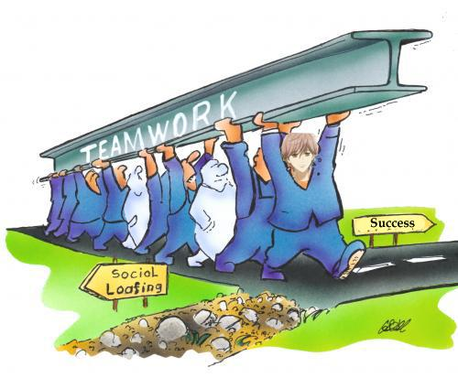
WooHoo!! We have successfully Completed a project! Best Buddies

Slide 12
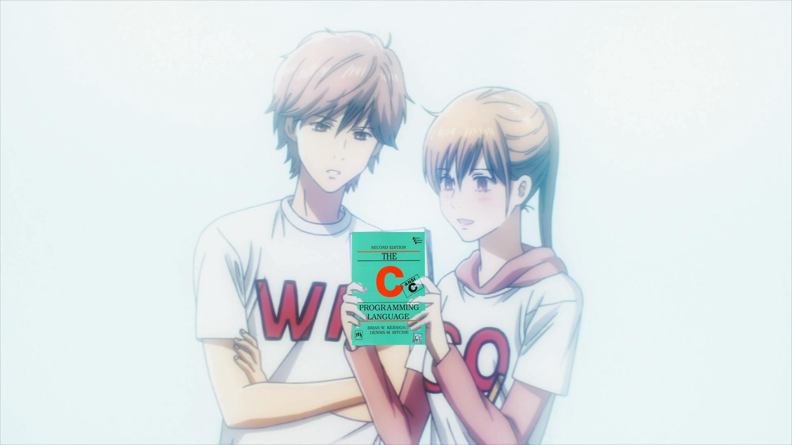

Haha… okay!
We all are here to help you…
Amm….Hello..am we are new in DC… amm we want to do a Project, tell us what to do?… am… actually we..
Don’t worry, very first read this ….
Confused

Slide 13
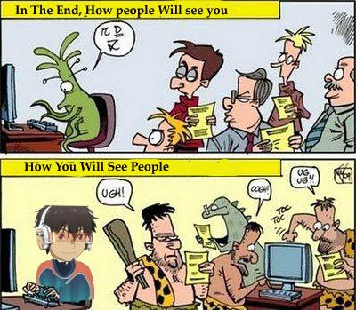
So this is how your life will be in DC… Still if you have any problem or doubts we are here to help you out.
☺
The only thing we need is your
time and dedication

Slide 14
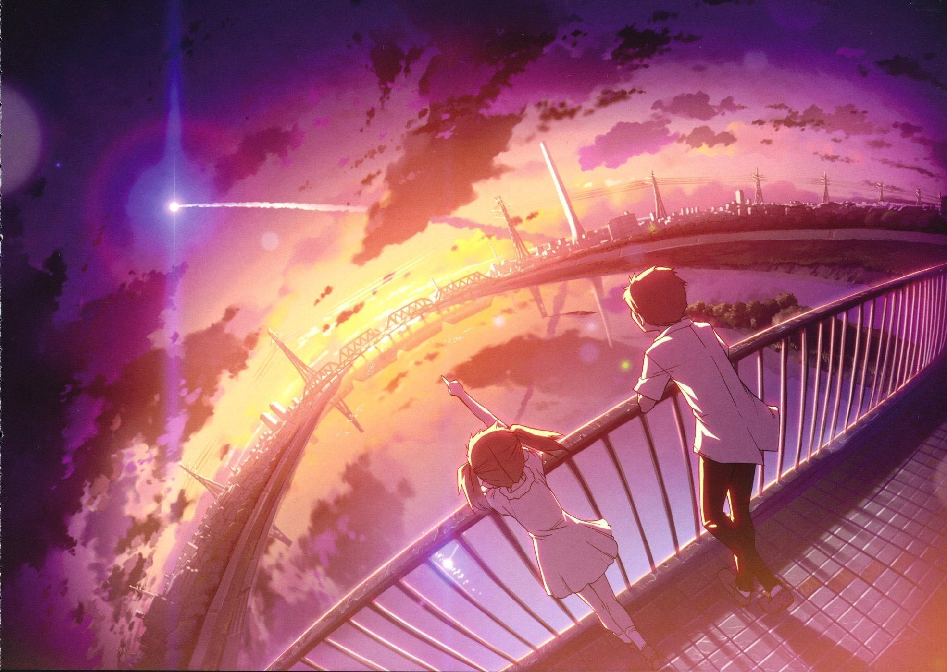
DC Mentor
Yes kid, I am proud of being part of this, they are lightening the world.
Is that DC? which is shining like a Star ?

