Slide 1
AI Usage Data Presentation
Rahul Sehraya
25/SCA/MCAN/081

Slide 2
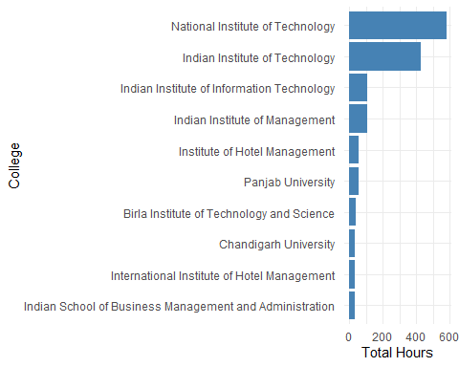
Top 10 Colleges by Total AI Usage Hours

Slide 3
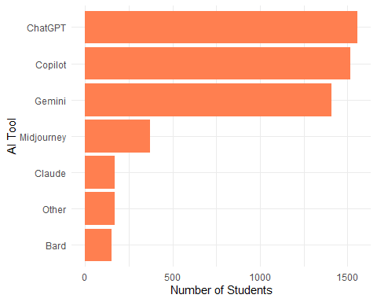
Most Popular AI Tools

Slide 4
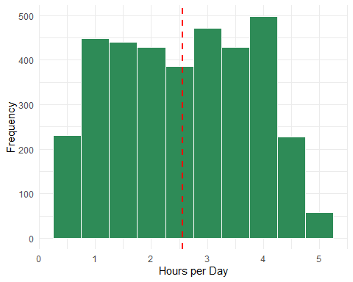
Distribution of Daily AI Usage Hours

Slide 5
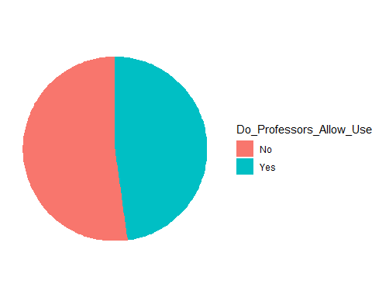
Professor AI Approval Rate

Slide 6
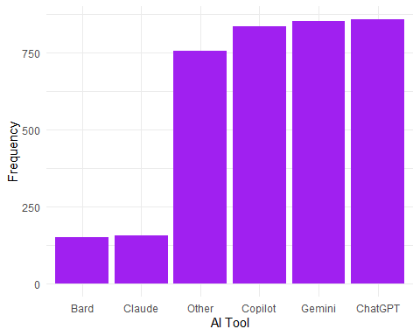
Preferred AI Tools

Slide 7
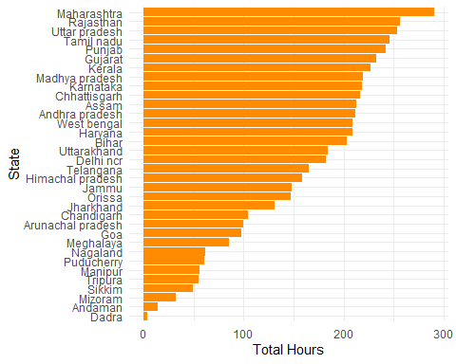
AI Usage by State

Slide 8
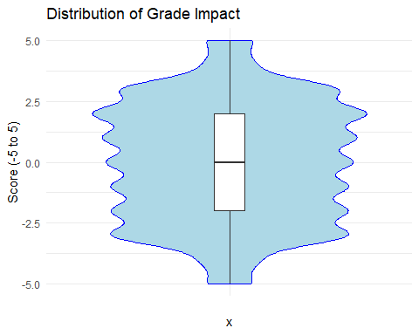
Impact of AI on Student Grades

Slide 9
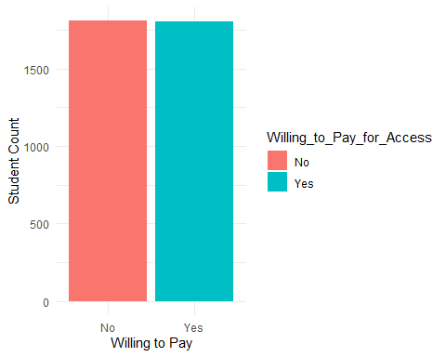
Willingness to Pay for Premium AI

Slide 10
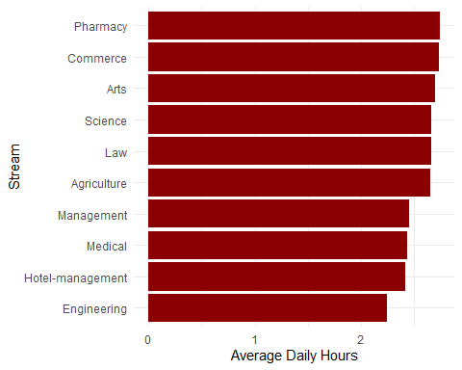
Average AI Usage by Academic Stream

Slide 11
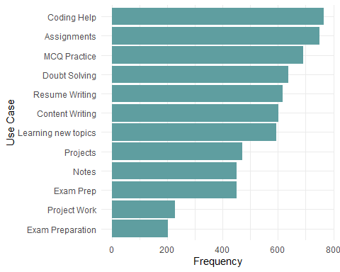
Common AI Use Cases among Students

