Slide 1
Analyzing the Impact of
AI
Data
Analysis
AI Tools on College
Students' Academic Experience
Rahul Sehraya
Roll No: 25/SCA/MCAN/081
Dataset: AI Tool Usage by Indian College Students 2025
Source: Kaggle

Slide 2
Problem Statement & Objectives
🔍 Problem Statement
🎯 Objectives
AI tools are rapidly adopted by Indian college students, yet the academic impact remains unclear. Key Questions: • How many hours do students spend using AI daily? • Does AI usage help or hurt academic grades? • Which tools are most popular? • Do professors approve of AI usage? • Are students willing to pay for premium AI?
1
Analyze distribution patterns of AI awareness & daily usage
2
Identify the most popular AI tools among Indian students
3
Examine the correlation between AI usage and academic grades
4
Explore professor approval and institutional attitudes
5
Understand usage patterns across states & academic streams
6
Investigate student willingness to invest in premium AI tools

Slide 3
Introduction
🤖
AI in Education
📊
Dataset Overview
Generative AI tools like ChatGPT, Gemini, and Copilot have transformed how students learn, write, and solve problems across Indian universities.
This analysis uses a 2025 Kaggle dataset capturing AI tool usage patterns from Indian college students — covering 5,000+ respondents across multiple states and streams.
📈
Key Variables
🇮🇳
Indian Context
The dataset includes Awareness Level, Daily Usage Hours, Impact on Grades, Trust in AI Tools, academic stream, college type, and willingness to pay for premium access.
India has one of the world's largest student populations. Understanding how AI tools are being adopted in higher education has major policy and pedagogical implications.
Dataset: 5,000+ Indian College Students | Year: 2025 | Source: Kaggle | Fields: 15+ variables

Slide 4
Tools, Libraries & Visualizations Used
ggplot2
dplyr
tidyr
Grammar of Graphics visualization engine for R. Used for all statistical charts including bar plots, histograms, scatter plots, box plots, and bell curves.
Data manipulation library providing verbs like filter(), group_by(), summarize(), and arrange() for transforming and aggregating the dataset.
Data tidying toolkit for reshaping wide/long data, handling missing values, and preparing clean data frames for analysis and visualization.
Key functions: Bar, Histogram, Scatter, Box, Bell Curve
Key functions: filter, group_by, summarize, mutate
Key functions: pivot_longer, pivot_wider, drop_na
📊 Plots Used: Bar Chart • Histogram • Pie Chart • Box Plot • Bell Curve • Correlation Heatmap • Regression Plot • Grouped Bar

Slide 5
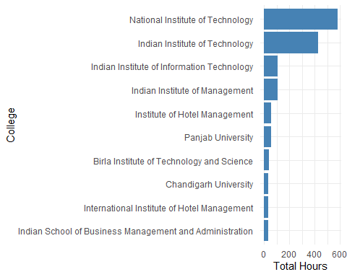
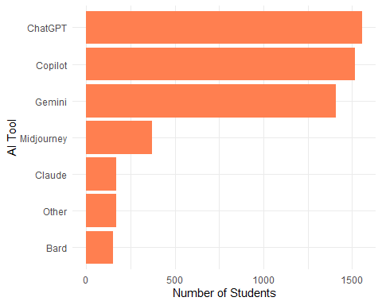
AI Usage Patterns — Institutions & Tools
Top 10 Colleges by Total AI Usage Hours
Most Popular AI Tools Among Students

Slide 6
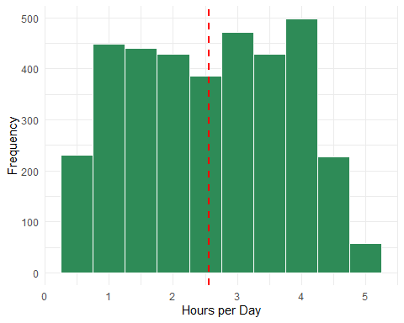
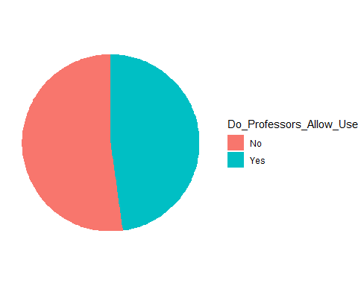
Usage Distribution & Institutional Attitude
Distribution of Daily AI Usage Hours
Professor AI Approval Rate

Slide 7
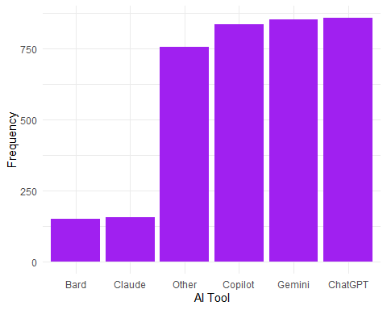
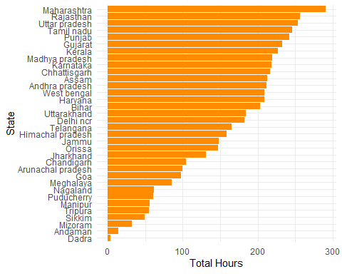
Tool Preferences & Geographic Distribution
Preferred AI Tools
AI Usage by State

Slide 8
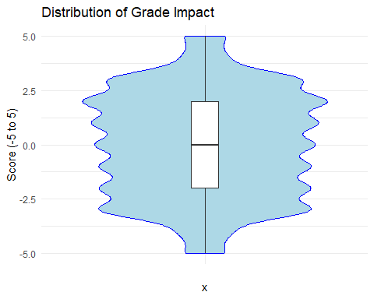
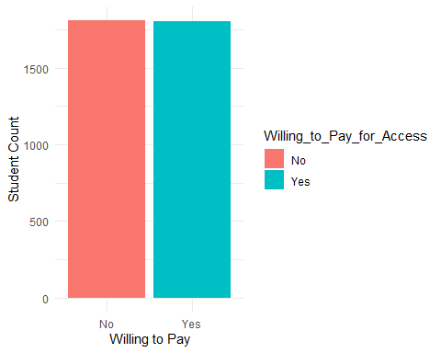
Academic Impact & Monetization Insights
Impact of AI on Student Grades
Willingness to Pay for Premium AI

Slide 9
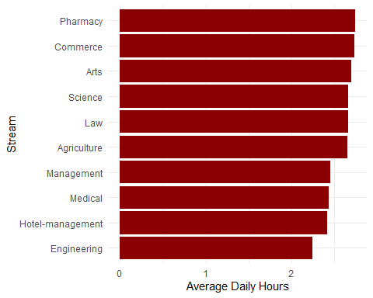
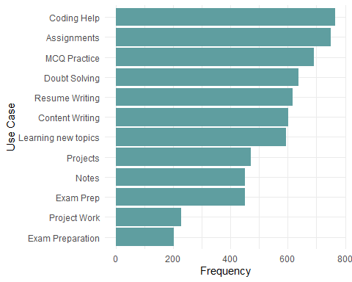
Stream-Wise Usage & Student Use Cases
Average AI Usage by Academic Stream
Common AI Use Cases Among Students

Slide 10
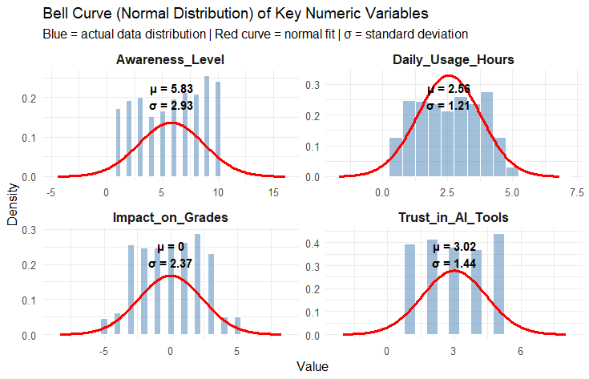
Statistical Distributions of Key Variables
Bell Curve — Normal Distribution Fit
Awareness Level (μ=5.83, σ=2.93) • Daily Usage Hours (μ=2.56, σ=1.21) • Impact on Grades (μ=0, σ=2.37) • Trust in AI Tools (μ=3.02, σ=1.44)

Slide 11
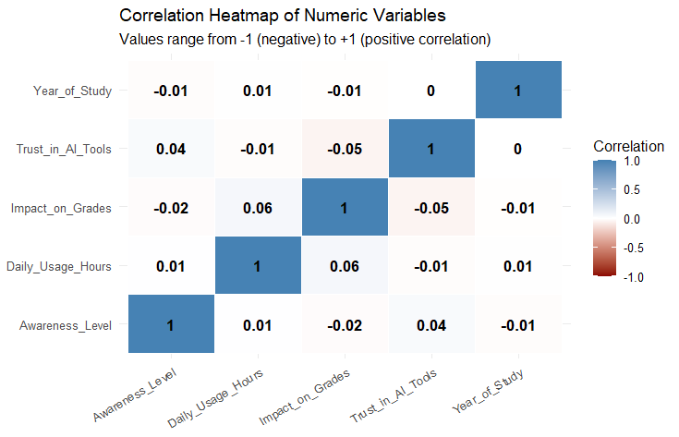
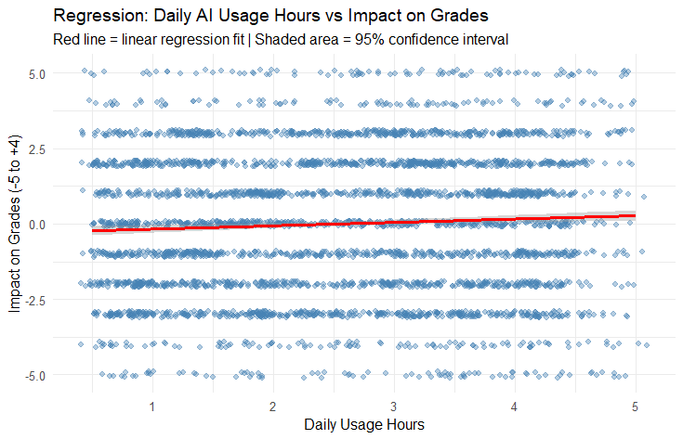
Correlation & Regression Analysis
Correlation Heatmap
Regression: Daily AI Usage vs Grade Impact

Slide 12
Conclusion
📡
ChatGPT, Gemini & Copilot dominate AI tool adoption among Indian college students
⏱️
Average daily AI usage is 2.56 hrs (σ=1.21), indicating moderate but consistent engagement
📚
Impact on grades is near-neutral (μ≈0), suggesting AI aids productivity without a strong grade uplift
🗺️
Maharashtra leads in total AI usage; Engineering students are the heaviest users
👨‍🏫
~60% of professors do NOT currently use AI — indicating a gap between student and faculty adoption
💳
Significant proportion of students are willing to invest in premium AI tools
🔗
Correlations between variables are weak — AI usage decisions are driven by diverse, independent factors
Analysis conducted using R (ggplot2, dplyr, tidyr)

Slide 13
References
[1] Dataset
Kapilavai, R. (2025). AI Tool Usage by Indian College Students 2025.
Kaggle Datasets. Retrieved from:
https://www.kaggle.com/datasets/rakeshkapilavai/ai-tool-usage-by-indian-college-students-2025
[2]
Wickham, H. (2016). ggplot2: Elegant Graphics for Data Analysis. Springer-Verlag New York.
[3]
Wickham, H., François, R., Henry, L., Müller, K. (2023). dplyr: A Grammar of Data Manipulation. R package version 1.1.2.
[4]
Wickham, H., Vaughan, D., Girlich, M. (2023). tidyr: Tidy Messy Data. R package version 1.3.0.
[5]
R Core Team (2024). R: A Language and Environment for Statistical Computing. R Foundation for Statistical Computing, Vienna, Austria.

