Slide 1
Demo App
Rahul Sharma
87.Sharma.Rahul@gmail.com
Developer, Bangalore, India

Slide 2
Highlights
Angular 2.0
Strongly typed objects (TypeScript)
Client Side MVVM
Extensible Design
Data in JSON
Easy Navigation
Render to Any device browser

Slide 3
Context
Demo application is about recording of data at clinical trails with the use of Angular using TypeScripts.

Slide 4
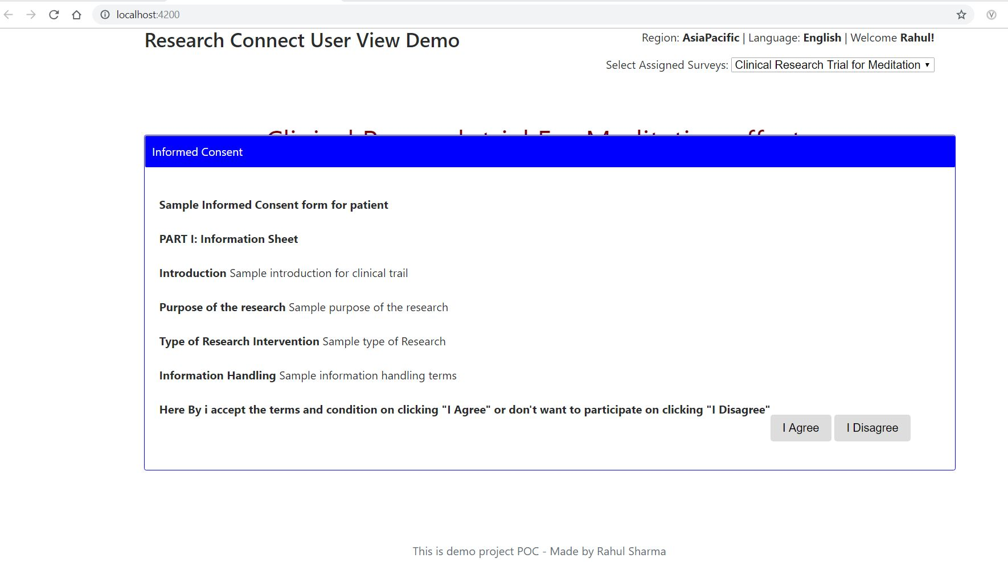
User Consent Page

Slide 5
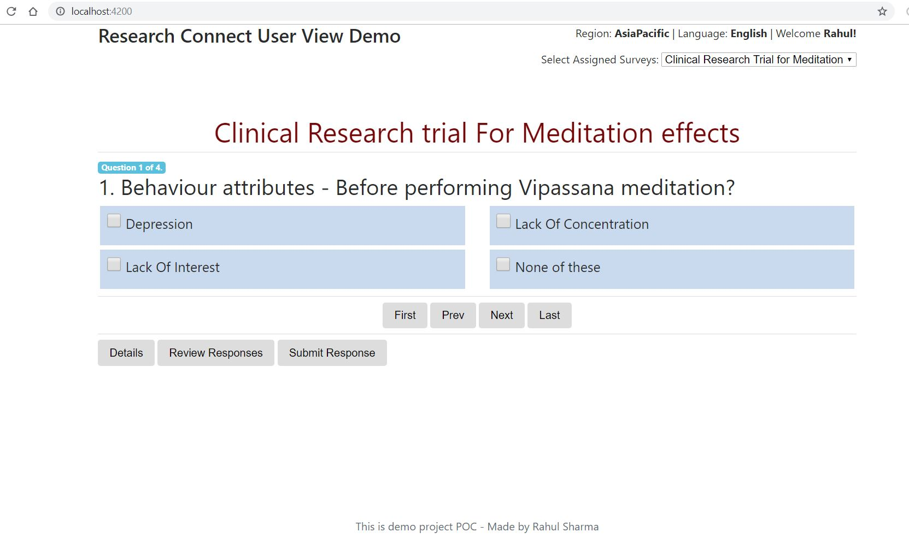
Survey Page display

Slide 6
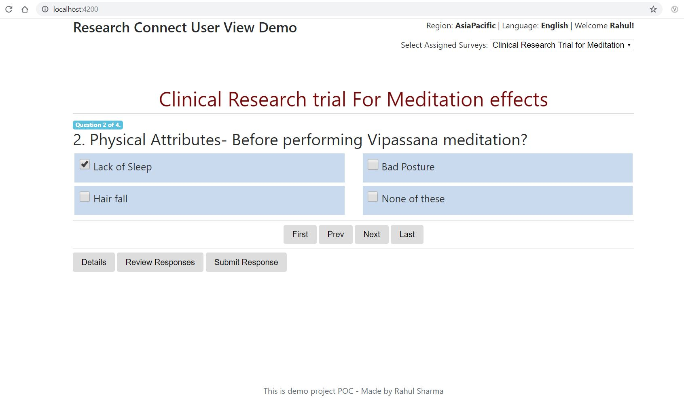
Survey Page display- Navigation

Slide 7
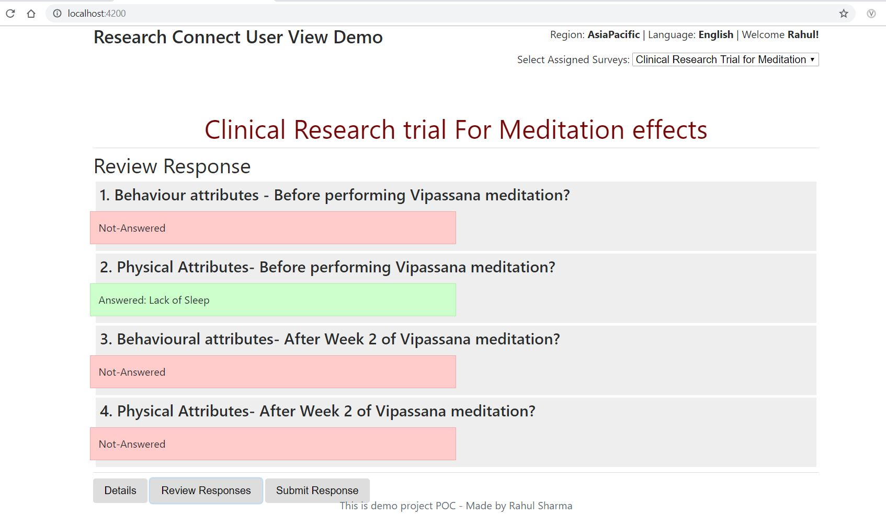
Review Survey Responses

Slide 8
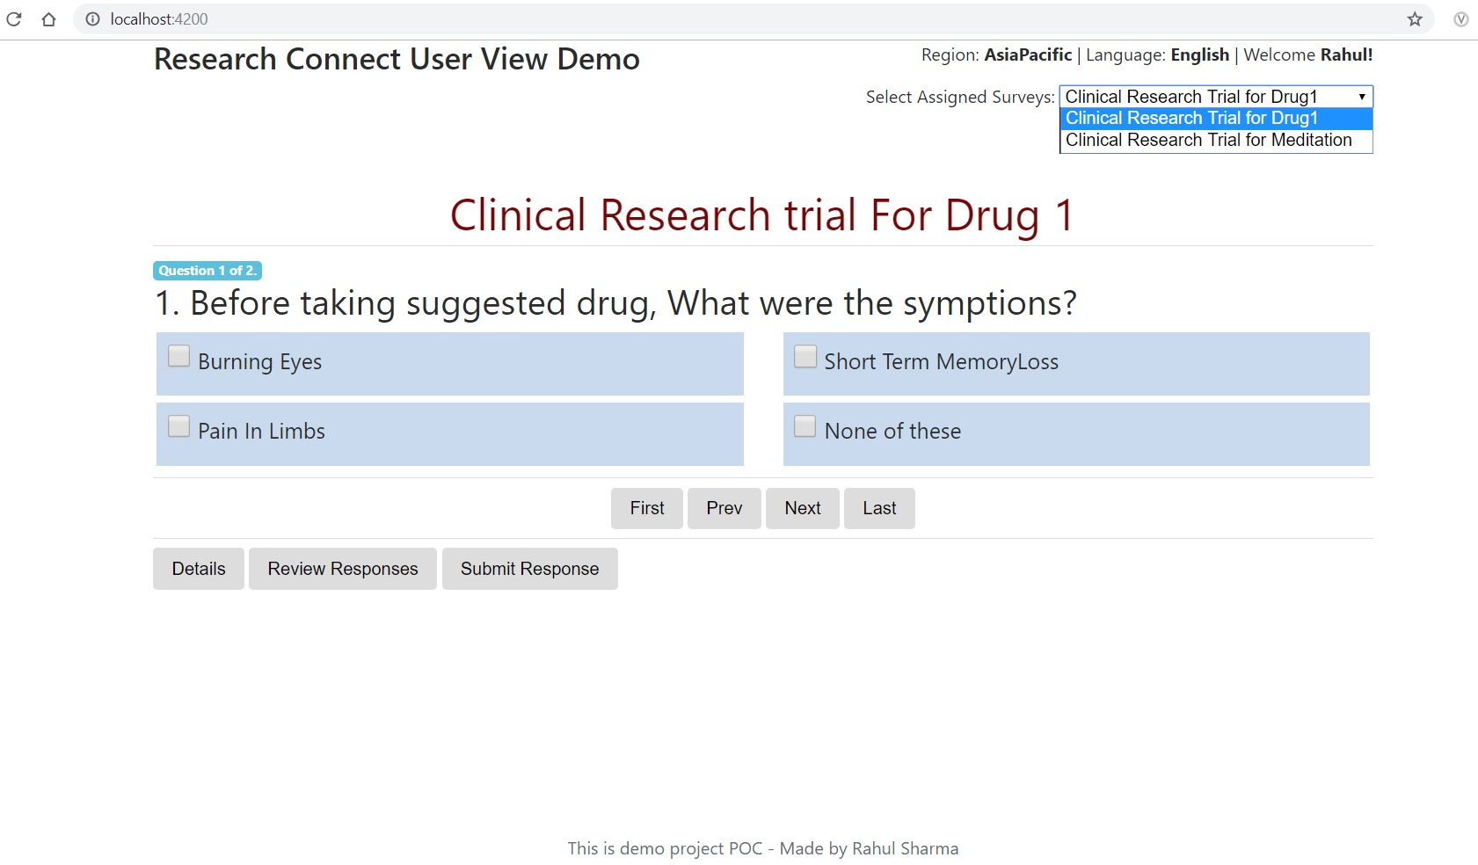
Selection and load assigned Survey

Slide 9
Code available at:
https://github.com/Rahul-Sharma-87/Angular_ClinicalSurveyApp
Drop email for access to : 87.Sharma.Rahul@gmail.com
Completed in Duration: 8 hours

