Slide 1

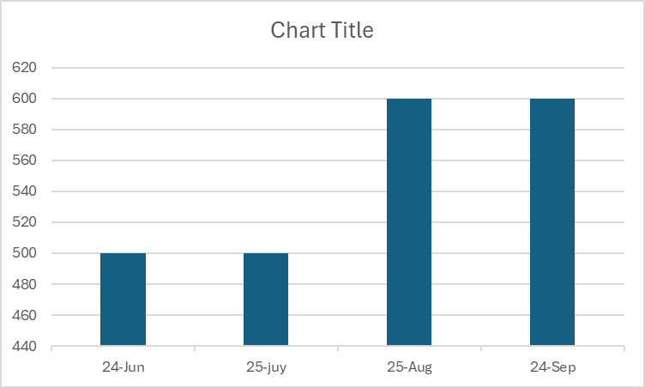
{client}
VIRP Violations
{location}
Summary
VIRP Violations
 |  | Rahul
Case Details
sssd
 | Rahul | Rahul | Rahul
Rahul | Rahul | Rahul
NCA Case
 | Rahul
 |  |  |  |  | Rahul

Slide 2
{client}
VIRP Violations
{location}
Summary
VIRP Violations
 |  | Rahul
Case Details
sssd
 | Rahul | Rahul | Rahul
Rahul | Rahul | Rahul
NCA Case
 | Rahul
 |  |  |  |  | Rahul

Slide 3
{client}
VIRP Violations
{location}
Summary
VIRP Violations
 |  | Rahul
Case Details
sssd
 | Rahul | Rahul | Rahul
Rahul | Rahul | Rahul
NCA Case
 | Rahul
 |  |  |  |  | Rahul

