Slide 1
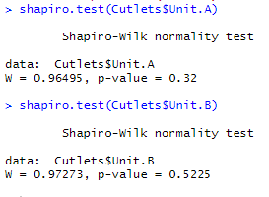
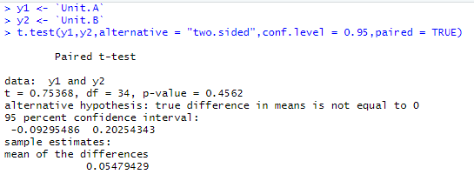
Hypothesis Testing Exercise
A F&B manager wants to determine whether there is any significant difference in the diameter of the cutlet between two units. A randomly selected sample of cutlets was collected from both units and measured? Analyze the data and draw inferences at 5% significance level. Please state the assumptions and tests that you carried out to check validity of the assumptions.
Since we have continuous data and comparing 2 population
Step 1: Normality Test
H0: Normal Dist.
H1: Not Normal
p- value > 0.05 H0 accepted
Step 2 : Since its normal then
check External Condition
Step 3: Since the External Condition
are same go for Paired T test

Slide 2
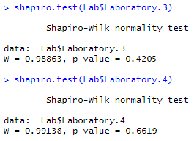
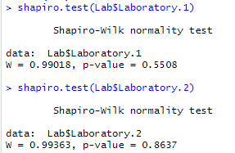
Hypothesis Testing Exercise
A hospital wants to determine whether there is any difference in the average Turn Around Time (TAT) of reports of the laboratories on their preferred list. They collected a random sample and recorded TAT for reports of 4 laboratories. TAT is defined as sample collected to report dispatch.
Analyze the data and determine whether there is any difference in average TAT among the different laboratories at 5% significance level.
Data is Continuous
Comparing between more than 2 population
Step 1: Normality Test H0: Normally Dist. ; H1: Not Normally Dist.
Here p value > 0.05,
So h0 is accepted
continued……..

Slide 3
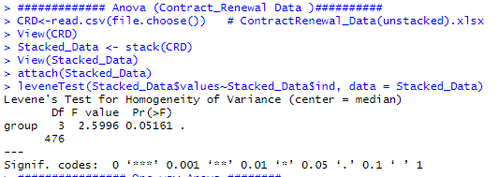
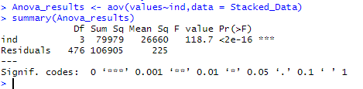
Continued……
Step 2: Check variance are equal or not
Since p > 0.05 H0: is accepted means variance are equal
Step 3 : When Variance are equal go for ANOVA Test

Slide 4
Hypothesis Testing Exercise
Sales of products in four different regions is tabulated for males and females. Find if male-female buyer rations are similar across regions.
 | East | West | North | South
Males | 50 | 142 | 131 | 70
Females | 550 | 351 | 480 | 350
Check p-value
If p-Value < alpha, we reject Null Hypothesis
H0
All proportions are equal
Ha
Not all Proportions are equal
Buyer Ratio.mtw

Slide 5
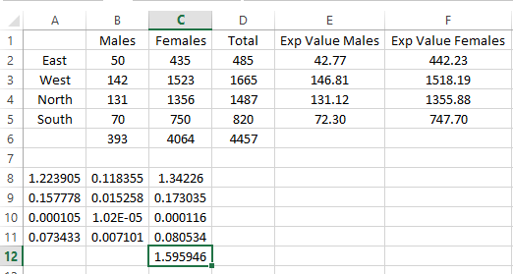
Buyer Ratio
Degrees of Freedom= 3
Obtain value from Chi Square Test = 1.59
From the Chi- Squared table we get 7.81
Since 1.59 < 7.81 means the data is significant
pchisq(7.81, df=3, lower.tail=FALSE) [1] 0.05010606

Slide 6
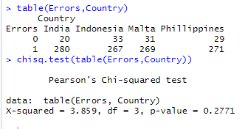
Hypothesis Testing Exercise
TeleCall uses 4 centers around the globe to process customer order forms. They audit a certain % of the customer order forms. Any error in order form renders it defective and has to be reworked before processing. The manager wants to check whether the defective % varies by centre. Please analyze the data at 5% significance level and help the manager draw appropriate inferences
HO : Defective % varies
H1 : Defective % do not varies
Since the p value > 0.05
So ‘H0’ is accepted

Slide 7
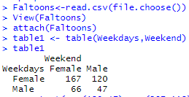
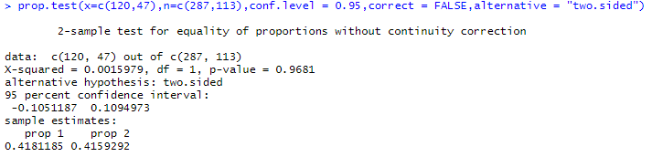
Fantaloons Sales managers commented that % of males versus females walking in to the store differ based on day of the week. Analyze the data and determine whether there is evidence at 5 % significance level to support this hypothesis.
H0: % of males versus females walking in to the store differ based on day of the week.
H1: % of males versus females walking in to the store do not differ based on day of the week.
Since p value> 0.05 so H0 is accepted

