Slide 1
ARP
Address Resolution Protocol

Slide 2
What is ARP ?
Address Resolution Protocol (ARP) is a communication protocol used to find the MAC (Media Access Control) address of a device from its IP address.
This protocol is used when a device wants to communicate with another device on a Local Area Network.

Slide 3
How does ARP Work ?
ARP broadcasts a request packet to all the machines on the LAN
and asks if any of the machines are using that particular IP address.
When a machine recognizes the IP address as its own, it sends a reply so ARP can update the cache for future reference and proceed with the communication.

Slide 5
The Address Resolution Protocol itself is a two-step process – a request and a response.
1) ARP Request:
The Ethernet header will include Four major fields: Source MAC address, Source IP address, Destination IP Address, Destination MAC Address, Opcode as Request and an EtherType.
This request is sent over the Network as a Broadcast.
ARP Request is a Broadcast frame to the entire network.

Slide 6
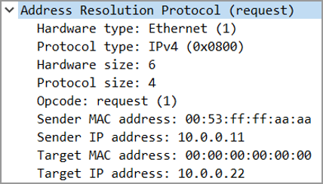
ARP Request Frame

Slide 7
2) ARP Response:
When the destination IP matches with the ARP Request came from the sender or When a machine recognizes the IP address as its own, it sends a reply so ARP can update the cache for future reference and proceed with the communication.
The Ethernet header will include Four major fields: Destination IP Address, Destination MAC Address, Source MAC address, Source IP address, Opcode as Response and an EtherType.
ARP Response is a Unicast reply to the sender.

Slide 8
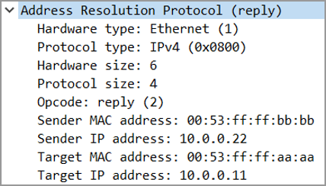
ARP Response Frame

Slide 9
ARP Table/ARP Cache
ARP Table is used to keep the record of the IP address and MAC address of the devices.
C:\Users\vaddimukkalr>arp -a
Internet Address Physical Address Type
192.168.1.1 a4-2a-95-3c-f6-c0 dynamic
192.168.1.255 ff-ff-ff-ff-ff-ff static
Dynamic Type: The device creates dynamic addresses from the ARP Process.
Static Type: Static addresses are manually configured. Network admins can do this to reduce unnecessary ARP broadcast traffic for devices constantly going to communicate each other.

Slide 10
Configuring Static ARP as Admin
C:\Users\Admin>arp -s 10.0.0.3 90-02-7b-c2-c0-67
C:\Users\vaddimukkalr>arp -a
Internet Address Physical Address Type
192.168.1.1 a4-2a-95-3c-f6-c0 dynamic
192.168.1.255 ff-ff-ff-ff-ff-ff static
10.0.0.3 90-02-7b-c2-c0-67 static

Slide 11
ARP Timing
When the ARP process completes, the information learned is stored in an ARP Table, or ARP Cache. Every device that has an IP address maintains such a table. Entries in this table expire after a certain duration.
Typically, for clients and end hosts, the ARP timeout will be pretty short – typically 60 seconds or less.
The reason for this is at the client level, lots of mobility and movement happens, and you don’t want to cache an ARP entry for a very long time.
Whereas for network infrastructure devices (routers, firewalls, etc), the ARP timeout is very long – typically 2-4 hours.
The reason for this is at the infrastructure level, the nodes joining and leaving the network should remain pretty consistent.

Slide 12



Thank You

