Slide 1
BGP
Border Gateway Protocol

Slide 2
What is BGP?
Border Gateway Protocol (BGP) refers to a gateway protocol that enables the internet to exchange routing information between autonomous systems (AS).
As networks interact with each other, they need a way to communicate. This is accomplished through peering.
BGP makes peering possible. Without it, networks would not be able to send and receive information with each other.

Slide 3

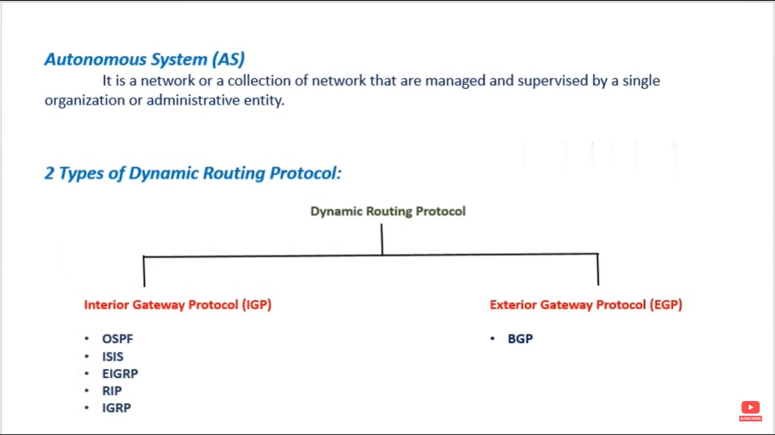

Slide 4
Types of Dynamic Routing Protocol
IGP(Interior Gateway Protocol)
Protocols used to share the routing information within the Autonomous system
OSFP
ISIS
EIGRP
RIP
IGRP
EGP(Exterior Gateway Protocol)
Protocols used to share the routing information between the two Autonomous systems
BGP

Slide 5
Advantages of BGP
It’s a Path Vector Protocol
It’s a Loop free Protocol
Internet Operation: BGP is the protocol that makes the internet work by connecting different networks worldwide. It is fundamental to the operation of the internet, ensuring that data can be sent and received across global networks.
Network Stability: BGP contributes to network stability by continuously monitoring paths and making dynamic adjustments. It can reroute traffic in the event of a path failure, ensuring uninterrupted network services.

Slide 6
Advantages of BGP
Policy Implementation: BGP helps network administrators in implementing routing policies.
Knowledge of BGP is essential for setting up policies that can control the network traffic flow, ensuring
adherence to organizational requirements and standards.
Troubleshooting: Knowledge of BGP routing is vital for troubleshooting network issues related to routing. It enables the identification and resolution of routing problems, ensuring the smooth operation of network services.
Network Design: For designing robust and efficient network architectures, understanding BGP routing is essential. It helps in making informed decisions for network design, ensuring scalability, reliability, and efficiency.
Security: Understanding BGP is crucial for network security. BGP knowledge helps in identifying and mitigating BGP-related security issues such as route hijacking and leaks, protecting the network from potential vulnerabilities.

Slide 7
Features of BGP
Open Standard Protocol.
Protocol used to share the routing information between the two Autonomous systems.
Designed for huge inter-network like Internet.
Basically, internet is formed by interconnecting all the service providers.
Slowest Routing Protocol in the world.
It uses TCP Port Number 179 for Communication.
It sends the update to the manually defined neighbor as unicast.
Unlike other routing protocols like OSPF and EIGRP it will not discover the neighbor using Hello
Packet.
Manually we need to define the neighbor and updates will be sent as unicast message
Attributes – BGP has huge set of attributes.

Slide 8
Path Vector Protocol
A path vector protocol is a computer network routing protocol which maintains the path information that gets updated dynamically. Updates which have looped through the network and returned to the same node are easily detected and discarded.
Each entry in the routing table contains the destination network, the next router and the path to reach the destination.

Slide 9
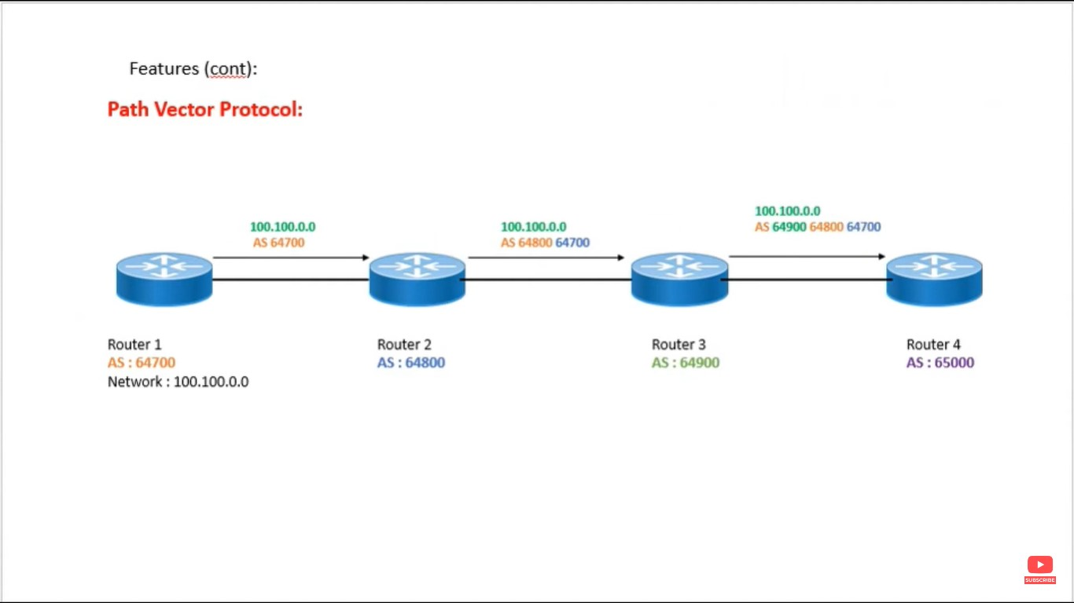


Slide 10
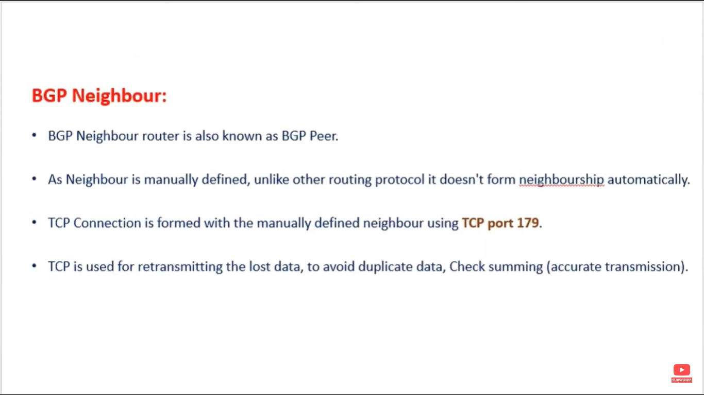


Slide 11
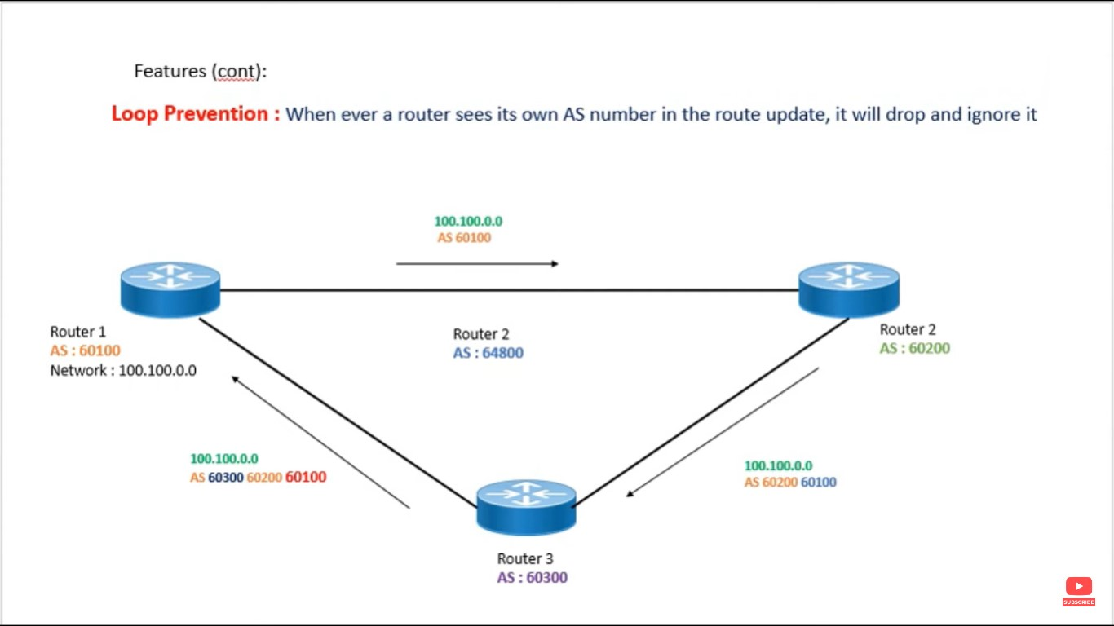

Slide 12
BGP Tables
Neighbor Table:
Displays information about the list of manually defined neighbors will be managed in the neighbor table.
BGP Database Table:
The list of all possible network learnt by BGP will be managed along with their attributes and path.
Routing Table:
The list of only the best path will be available in the IP routing table

Slide 13
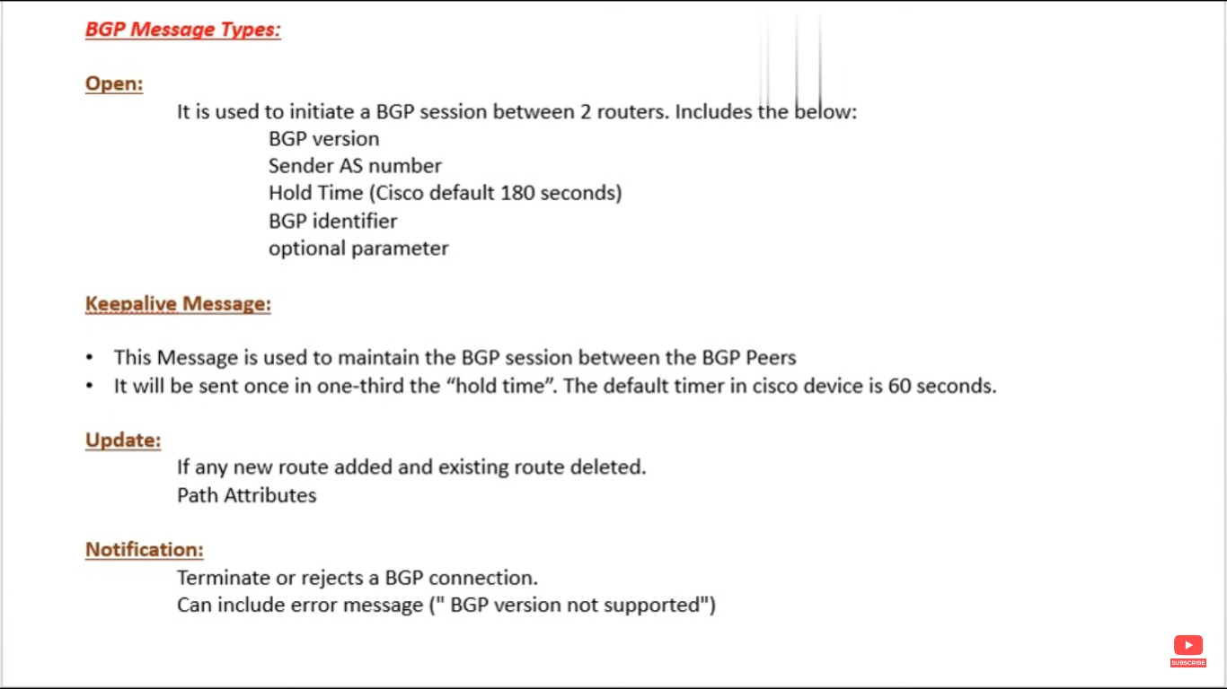

Slide 14
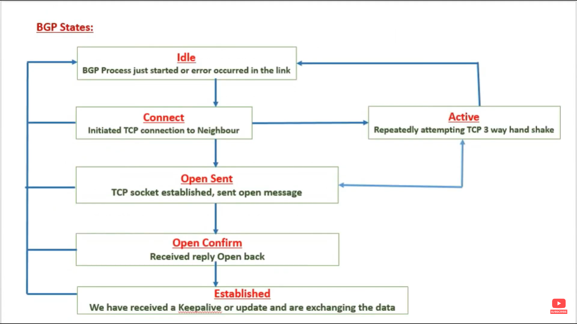

Slide 15
How BGP Works ?

Slide 18
Thank You

