Slide 1
LLDP
Link Layer Discovery Protocol

Slide 2
Why LLDP ?
Link Layer Discovery Protocol (LLDP) is a vendor independent link layer protocol used by network devices for advertising their identity, capabilities to its neighbors on a LAN segment.

Slide 3
How LLDP Works ?
LLDP works by sending out periodic messages, called LLDP frames, which contain information about the device that is sending them. The protocol uses a management information base (MIB) to define the information exchanged between devices, which is typically accessed using the Simple Network Management Protocol (SNMP).
When a device sends out an LLDP frame, it includes information from its MIB, such as the device's type, manufacturer, and capabilities. Other devices on the network can receive and process these frames to gather information about their neighbors. This information is stored in a database on each device, which can then be accessed using SNMP to view and manage the network.
In short, LLDP protocol and SNMP work together to provide a simple and effective way for network devices to advertise their identity and capabilities and for other devices on the network to discover and manage this information. This allows for efficient and automated management of large networks.

Slide 4
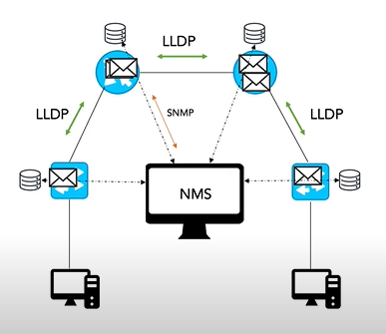
LLDP Workflow

Slide 5

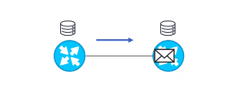
LLDP Operating Modes
LLDP support three different operating modes:
Transmit only :
Transmits LLDP packets, do not
process received packets and discards
them.

Slide 6
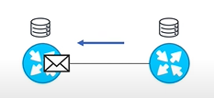
LLDP Operating Modes
Receive only :
Processes received LLDP packets but do
not sends LLDP packets.

Slide 7
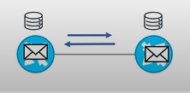
LLDP Operating Modes
Both transmit and receive:
Perform both transmit and receive
LLDP packet processing.

Slide 8
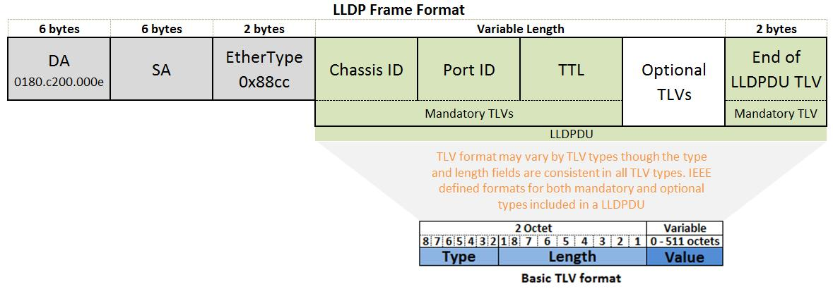
LLDP Frame Format

Slide 9
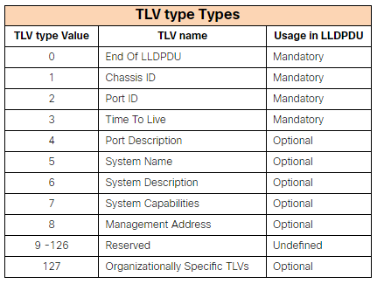
Type-Length-Value

Slide 10
LLDP Frame Format
In LLDP information’s are sent by devices from each of their interfaces at a fixed interval, in the form of an Ethernet frame. Each frame contains one LLDP Data Unit (LLDPDU). Each LLDPDU is a sequence of type-length-value (TLV) structures.
EtherType field is set to 0x88cc.
Each LLDP frame starts with the following mandatory TLVs and must intact in LLDP implementations.
Chassis ID
Port ID
Time-to-Live (TTL).
Any numbers of optional TLVs are followed by mandatory TLVs.
The frame ends with a special TLV named end of LLDPDU in which both the type and length fields are O.
The LLDP specification allows for various organizations to define and encode their own TLVs. These are called Organizationally Specific TLVs. All Organizationally Specific TLVs start with an LLDP TLV Type value of 127.

Slide 11
LLDP Timers:
Hold time: - Is the duration that a receiving device should maintain LLDP neighbor information before aging it. If this timer expires and no LLDP packet being received the neighbor information is wiped. Default is 120 seconds.
LLDP Packet Frequency timer: - An interval at which the device sends LLDP updates to neighbor. Default is 30 seconds.
Reinit time: - The delay time in seconds for LLDP to initialize on any interface. Default is 2 seconds.

Slide 12
Configuration
R0: lagaM-pvl-p1c3-02
set protocols lldp interface mge-0/0/7
R1: lagaM-pvl-p1c3-04
set protocols lldp interface mge-0/0/7
regress@lagaM-pvl-p1c3-02> show lldp neighbors
Local Interface Parent Interface Chassis Id Port info System Name
mge-0/0/7 - c0:bf:a7:01:d8:a0 mge-0/0/7 lagaM-pvl-p1c3-04.englab.juniper.net
regress@lagaM-pvl-p1c3-02> show lldp statistics
Interface Parent Interface Received UnknownTLVs WithErrors DiscardedTLVs Transmitted Untransmitted
mge-0/0/7 - 44 0 0 0 44 0

Slide 13
LLDP-MED: An Enchanted Version of LLDP
LLDP-MED (Media Endpoint Discovery) is an extension to the LLDP (Link Layer Discovery Protocol) that is specifically designed for use in voice-over IP (VoIP) networks. LLDP-MED provides a way for network devices to advertise their identity and capabilities and information specific to VoIP, such as the device's power source, Quality of Service (QoS) settings, and VLAN assignment.
LLDP-MED is based on the same principles as LLDP and uses the same MIB and SNMP standards for exchanging information. However, LLDP-MED defines a specific set of MIB objects that are relevant to VoIP networks, such as the device's power source, VLAN assignment, and QoS settings.
By using LLDP-MED, network administrators can easily see what devices are connected to the network, what their capabilities are, and how they are connected. This can help in verifying network performance and ensure that VoIP calls are delivered reliably and with high quality.

Slide 14
Thank You

