Slide 1
Q #1) What is a Network?
Answer: Network is defined as a set of devices connected to each other using a physical transmission medium.
For Example, A computer network is a group of computers connected with each other to communicate and share information and resources like hardware, data, and software. In a network, nodes are used to connect two or more networks.
Q #2) What is a Node?
Answer: Two or more computers are connected directly by an optical fiber or any other cable. A node is a point where a connection is established. It is a network component that is used to send, receive and forward the electronic information.
A device connected to a network is also termed as Node. Let’s consider that in a network there are 2 computers, 2 printers, and a server are connected, then we can say that there are five nodes on the network.
Q #3) What is Network Topology?
Answer: Network topology is a physical layout of the computer network and it defines how the computers, devices, cables, etc are connected to each other.
Q #4) What are Routers?
Answer: The router is a network device that connects two or more network segments. It is used to transfer information from the source to the destination.
Routers send the information in terms of data packets and when these data packets are forwarded from one router to another router then the router reads the network address in the packets and identifies the destination network.
Q #5) What is the OSI reference model?
Answer: Open System Interconnection, the name itself suggests that it is a reference model that defines how applications can communicate with each other over a networking system.
It also helps to understand the relationship between networks and defines the process of communication in a network.
Q #6) What are the layers in OSI Reference Models? Describe each layer briefly. Answer: Given below are the seven layers of OSI Reference Models:
a) Physical Layer (Layer 1): It converts data bits into electrical impulses or radio signals. Example: Ethernet.
b) Data Link Layer (Layer 2): At the Data Link layer, data packets are encoded and decoded into bits and it provides a node to node data transfer. This layer also detects the errors that occurred at Layer 1.
c) Network Layer (Layer 3): This layer transfers variable length data sequence from one node to another node in the same network. This variable-length data sequence is also known as “Datagrams”.
Juniper Business Use Only

Slide 2
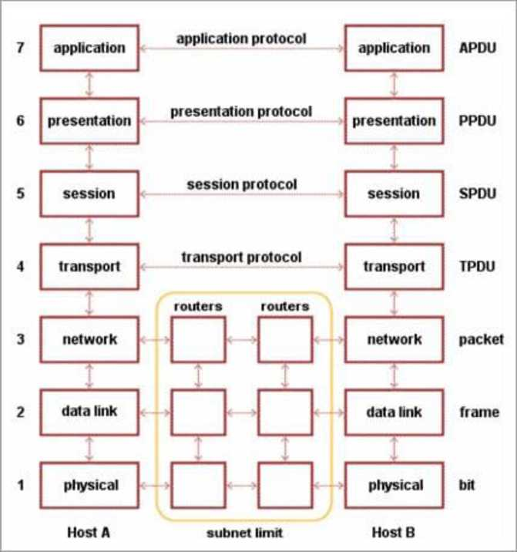
d) Transport Layer (Layer 4): It transfers data between nodes and also provides acknowledgment of successful data transmission. It keeps track of transmission and sends the segments again if the transmission fails.
e) Session Layer (Layer 5): This layer manages and controls the connections between computers. It establishes, coordinates, exchange and terminates the connections between local and remote applications.
f) Presentation Layer (Layer 6): It is also called as “Syntax Layer”. Layer 6 transforms the data into the form in which the application layer accepts.
g) Application Layer (Layer 7): This is the last layer of the OSI Reference Model and is the one that is close to the end-user. Both end-user and application layer interacts with the software application. This layer provides services for email, file transfer, etc.
Q #7) What is the difference between Hub, Switch, and Router?
Q #8) Explain TCP/IP Model
Answer: The most widely used and available protocol is TCP/IP i.e. Transmission Control Protocol and Internet Protocol. TCP/IP specifies how data should be packaged, transmitted and routed in their end to end data communication.
There are four layers as shown in the below diagram:
Juniper Business Use Only

Slide 3
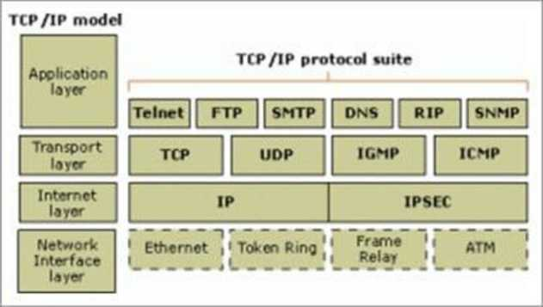
Given below is a brief explanation of each layer:
• Application Layer: This is the top layer in the TCP/IP model. It includes processes that use the Transport Layer Protocol to transmit the data to their destination. There are different Application Layer Protocols such as HTTP, FTP, SMTP, SNMP protocols, etc.
• Transport Layer: It receives the data from the Application Layer which is above the Transport Layer. It acts as a backbone between the host’s system connected with each other and it mainly concerns about the transmission of data. TCP and UDP are mainly used as Transport Layer protocols.
• Network or Internet Layer: This layer sends the packets across the network. Packets mainly contain source & destination IP addresses and actual data to be transmitted.
• Network Interface Layer: It is the lowest layer of the TCP/IP model. It transfers the packets between different hosts. It includes encapsulation of IP packets into frames, mapping IP addresses to physical hardware devices, etc.
Q #9) What is HTTP and what port does it use?
Answer: HTTP is HyperText Transfer Protocol and it is responsible for web content.
Many web pages are using HTTP to transmit the web content and allow the display
and navigation of HyperText. It is the primary protocol and port used here is TCP port
80.
Q #10) What is HTTPs and what port does it use?
Answer: HTTPs is a Secure HTTP. HTTPs is used for secure communication over a computer network. HTTPs provides authentication of websites that prevents unwanted attacks.
In bi-directional communication, the HTTPs protocol encrypts the communication so that the tampering of the data gets avoided. With the help of an SSL certificate, it verifies if the requested server connection is a valid connection or not. HTTPs use TCP with port 443.
Juniper Business Use Only

Slide 4
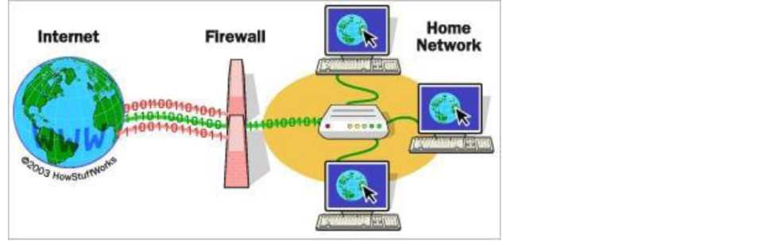
Q #11) What are TCP and UDP?
Answer: Common factors in TCP and UDP are:
• TCP and UDP are the most widely used protocols that are built on the top of the IP protocol.
• Both protocols TCP and UDP are used to send bits of data over the Internet, which is also known as ‘packets’.
• When packets are transferred using either TCP or UDP, it is sent to an IP address. These packets are traversed through routers to the destination.
The difference between TCP and UDP are enlisted in the below table:
TCP
TCP stands for Transmission Control Protocol
Once the connection is setup, data can be sent bidirectional i.e. TCP is a connection oriented protocol The speed of TCP is slower than UDP TCP is used for the application where time is not critical part of data transmission TCP transmission occurs in a sequential manner
It is heavy weight connection
TCP tracks the data sent to ensure no data loss during data transmission
UDP
UDP is stands for User Datagram Protocol or Universa Protocol
UDP is connectionless, simple protocol. Using UDP, m as packets
UDP is faster compared to TCP
UDP is suitable for the applications which require fast
data and time is crucial in this case.
UDP transmission also occurs in a sequential manner b maintain the same sequence when it reaches the destina It is lightweight transport layer UDP does not ensure whether receiver receives packets packets are misses then they are just lost
Q #12) What is a Firewall?
Answer: Firewall is a network security system that is used to protect computer networks from unauthorized access. It prevents malicious access from outside to the computer network. A firewall can also be built to grant limited access to outside users. The firewall consists of a hardware device, software program or a combined configuration of both. All the messages that route through the firewall are examined by specific security criteria and the messages which meet the criteria are successfully traversed through the network or else those messages are blocked.
[image source]
Juniper Business Use Only

Slide 5

Firewalls can be installed just like any other computer software and later can be customized as per the need and have some control over the access and security features. “
Windows Firewall” is an inbuilt Microsoft Windows application that comes along with the operating system. This “Windows Firewall” also helps to prevent viruses, worms, etc.
Q #13) What is DNS?
Answer: Domain Name Server (DNS), in a non-professional language and we can call it an Internet’s phone book. All the public IP addresses and their hostnames are stored in the DNS and later it translates into a corresponding IP address.
For a human being, it is easy to remember and recognize the domain name, however, the computer is a machine that does not understand the human language and they only understand the language of IP addresses for data transfer.
There is a “Central Registry” where all the domain names are stored and it gets updated on a periodic basis. All Internet service providers and different host companies usually interact with this central registry to get the updated DNS details.
For Example, When you type a website www.softwaretestinghelp.com, then your Internet service provider looks for the DNS associated with this domain name and translates this website command into a machine language - IP address -151.144.210.59 (note that, this is the imaginary IP address and not the actual IP for the given website) so that you will get redirected to the appropriate destination.
This process is explained in the below diagram:
DNS Server
[image source ]
Q #14) What is the difference between a Domain and a Workgroup? Answer: In a computer network, different computers are organized in different methods and these methods are - Domains and Workgroups. Usually, computers which run on the home network belong to a Workgroup.
Juniper Business Use Only

Slide 6
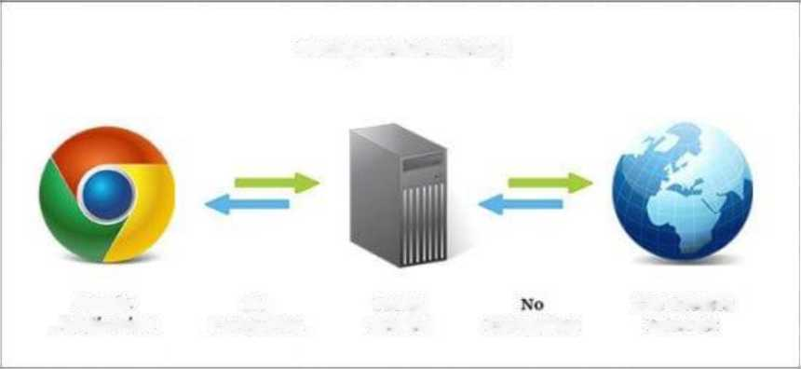
However, computers that are running on an office network or any workplace network belong to the Domain.
Their differences are as follows:
Workgroup
All computers are peers and no computer has control over another computer
In a Workgroup, each computer maintains their own database
Each computer has their own authentication rule for every user account
Each computer has set of user account. If user has account
Domain
Network admin uses one or more computer as a ser all accesses, security permission to all other comput The domain is a form of a computer network in whi printers, and user accounts are registered in a centra It has centralized authentication servers which set th authentication
If user has an account in a domain then user can log
on that computer then only user able to access the computer computer in a domain
Workgroup does not bind to any security permission or does Domain user has to provide security credentials whe not require any password accessing the domain network
Computer settings need to change manually for each In a domain, changes made in one computer automa
computer in a Workgroup same changes to all other computers in a network
All computers must be on same local area network In a domain, computers can be on a different local n
In a Workgroup, there can be only 20 computers connected In a domain, thousands of computers can be connec
Q #15) What is a Proxy Server and how do they protect the computer network?
Answer: For data transmission, IP addresses are required and even DNS uses IP addresses to route to the correct website. It means without the knowledge of correct and actual IP addresses it is not possible to identify the physical location of the network.
Proxy servers prevent external users who are unauthorized to access such IP addresses of the internal network. It makes the computer network virtually invisible to external users.
Proxy Server Setup
Single
No
Proxy
The Creator
Application
Encryption
Server
Encryp tion
Internet
Proxy Server also maintains the list of blacklisted websites so that the internal user is automatically prevented from getting easily infected by viruses, worms, etc.
Juniper Business Use Only

Slide 7
Q #16) What are IP classes and how can you identify the IP class of given an IP address?
Answer: An IP address has 4 sets (octets) of numbers each with a value up to 255.
For Example, the range of the home or commercial connection started primarily between 190 x or 10 x. IP classes are differentiated based on the number of hosts it supports on a single network. If IP classes support more networks then very few IP addresses are available for each network.
There are three types of IP classes and are based on the first octet of IP addresses which are classified as Class A, B or C. If the first octet begins with 0 bit then it is of type Class A.
Class A type has a range up to 127.x.x.x (except 127.0.0.1). If it starts with bits 10 then it belongs to Class B. Class B having a range from 128.x to 191.x. IP class belongs to Class C if the octet starts with bits 110. Class C has a range from 192.x to 223.x.
Q #17) What is meant by 127.0.0.1 and localhost?
Answer: IP address 127.0.0.1, is reserved for loopback or localhost connections.
These networks are usually reserved for the biggest customers or some of the original members of the Internet. To identify any connection issue, the initial step is to ping the server and check if it is responding.
If there is no response from the server then there are various causes like the network is down or the cable needs to be replaced or the network card is not in good condition.
127.0. 0.1 is a loopback connection on the Network Interface Card (NIC) and if you are able to ping this server successfully, then it means that the hardware is in a good shape and condition.
127.0. 0.1 and localhost are the same things in most of the computer network functioning.
Q #18) What is NIC?
Answer: NIC stands for Network Interface Card. It is also known as Network Adapter or Ethernet Card. It is in the form of an add-in card and is installed on a computer so that the computer can be connected to a network.
Each NIC has a MAC address which helps in identifying the computer on a network.
Q #19) What is Data Encapsulation?
Answer: In a computer network, to enable data transmission from one computer to another, the network devices send messages in the form of packets. These packets are then added with the IP header by the OSI reference model layer.
Juniper Business Use Only

Slide 8
The Data Link Layer encapsulates each packet in a frame that contains the hardware address of the source and the destination computer. If a destination computer is on the remote network then the frames are routed through a gateway or router to the destination computer.
Q #20) What is the difference between the Internet, Intranet, and Extranet? Answer: The terminologies Internet, Intranet, and Extranet are used to define how the applications in the network can be accessed. They use similar TCP/IP technology but differ in terms of access levels for each user inside the network and outside the network.
• Internet: Applications are accessed by anyone from any location using the web.
• Intranet: It allows limited access to users in the same organization.
• Extranet: External users are allowed or provided with access to use the network application of the organization.
Q #21) What is a VPN?
Answer: VPN is the Virtual Private Network and is built on the Internet as a private wide area network. Internet-based VPNs are less expensive and can be connected from anywhere in the world.
VPNs are used to connect offices remotely and are less expensive when compared to WAN connections. VPNs are used for secure transactions and confidential data can be transferred between multiple offices. VPN keeps company information secure against any potential intrusion.
Juniper Business Use Only

Slide 9



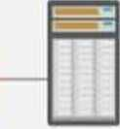



Internet
VPN Gateway Router
VPN Router
Server 1
Server 2
Notebook PC Desktop PC
Server 3
VPN Concentrator Router Access Server
[image source]
Given below are the 3 types of VPN’s:
1. Access VPN: Access VPN’s provide connectivity to mobile users and telecommuters. It is an alternative option for dial-up connections or ISDN connections. It provides low-cost solutions and a wide range of connectivity.
2. Intranet VPN: They are useful for connecting remote offices using shared infrastructure with the same policy as a private network.
3. Extranet VPN: Using shared infrastructure over an intranet, suppliers, customers, and partners are connected using dedicated connections.
Q #22) What are Ipconfig and Ifconfig?
Answer: Ipconfig stands for Internet Protocol Configuration and this command is used on Microsoft Windows to view and configure the network interface.
The command Ipconfig is useful for displaying all TCP/IP network summary information currently available on a network. It also helps to modify the DHCP protocol and DNS setting.
Ifconfig (Interface Configuration) is a command that is used on Linux, Mac, and UNIX operating systems. It is used to configure, control the TCP/IP network interface parameters from CLI i.e. Command Line Interface. It allows you to see the IP addresses of these network interfaces.
Juniper Business Use Only

Slide 10
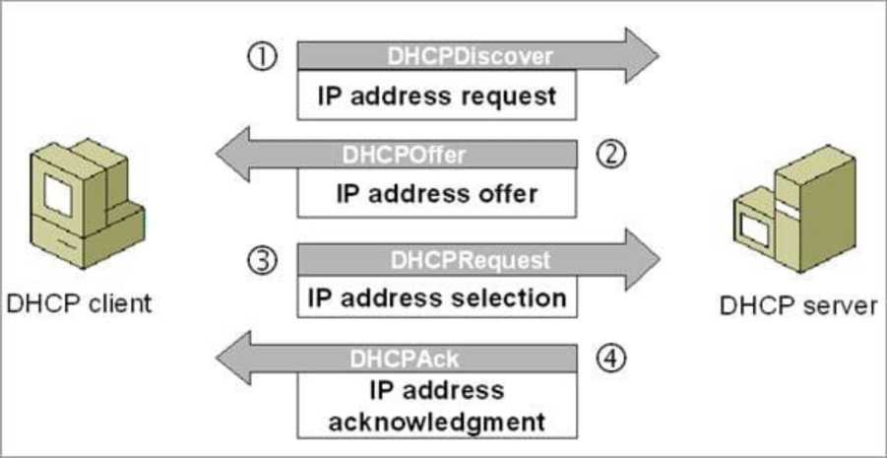
Q #23) Explain DHCP briefly?
Answer: DHCP stands for Dynamic Host Configuration Protocol and it automatically assigns IP addresses to the network devices. It completely removes the process of manual allocation of IP addresses and reduces the errors caused due to this.
This entire process is centralized so that the TCP/IP configuration can also be completed from a central location. DHCP has a “pool of IP addresses” from which it allocates the IP address to the network devices. DHCP cannot recognize if any device is configured manually and assigned with the same IP address from the DHCP pool.
In this situation, it throws the “IP address conflict” error.
[image source ]
DHCP environment requires DHCP servers to set-up the TCP/IP configuration. These servers then assign, release and renew the IP addresses as there might be a chance that network devices can leave the network and some of them can join back to the network.
Q #24) What is SNMP?
Answer: SNMP stands for Simple Network Management Protocol. It is a network protocol used for collecting organizing and exchanging information between network devices. SNMP is widely used in network management for configuring network devices like switches, hubs, routers, printers, servers.
SNMP consists of the below components:
• SNMP Manager
• Managed device
• SNMP Agent
Juniper Business Use Only

Slide 11
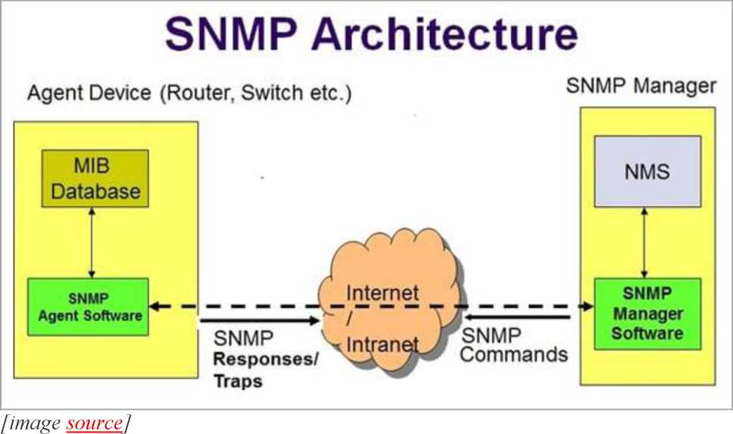
• Management Information Base (MIB)
The below diagram shows how these components are connected with each other in the SNMP architecture:
SNMP is a part of the TCP/IP suite. There are 3 main versions of SNMP which include SNMPv1, SNMPv2, and SNMPv3.
Q #25) What are the different types of a network? Explain each briefly.
Answer: There are 4 major types of networks.
Let’s take a look at each of them in detail.
1. Personal Area Network (PAN): It is the smallest and basic network type that is often used at home. It is a connection between the computer and another device such as phone, printer, modem tablets, etc
2. Local Area Network (LAN): LAN is used in small offices and Internet cafes to connect a small group of computers to each other. Usually, they are used to transfer a file or for playing the game in a network.
3. Metropolitan Area Network (MAN): It is a powerful network type than LAN. The area covered by MAN is a small town, city, etc. A huge server is used to cover such a large span of area for connection.
4. Wide Area Network (WAN): It is more complex than LAN and covers a large span of the area typically a large physical distance. The Internet is the largest WAN which is spread across the world. WAN is not owned by any single organization but it has distributed ownership.
There are some other types of the network as well:
Juniper Business Use Only

Slide 12
• Storage Area Network (SAN)
• System Area Network (SAN)
• Enterprise Private Network (EPN)
• Passive Optical Local Area Network (POLAN)
Part 2: Networking Questions Series Q #26) Differentiate Communication and Transmission?
Answer: Through Transmission the data gets transferred from source to destination (only one way). It is treated as the physical movement of data.
Communication means the process of sending and receiving data between two media (data is transferred between source and destination in both ways).
Q #27) Describe the layers of the OSI model?
Answer: OSI model stands for Open System Interconnection It is a framework that guides the applications on how they can communicate in a network.
OSI model has seven layers. They are listed below,
1. Physical Layer: Deals with transmission and reception of unstructured data through a physical medium.
2. Data Link Layer: Helps in transferring error-free data frames between nodes.
3. Network Layer: Decides the physical path that should be taken by the data as per the network conditions.
4. Transport Layer: Ensures that the messages are delivered in sequence and without any loss or duplication.
5. Session Layer: Helps in establishing a session between processes of different stations.
6. Presentation Layer: Formats the data as per the need and presents the same to the Application layer.
7. Application Layer: Serves as the mediator between Users and processes of applications.
Q #28) Explain various types of networks based on their sizes?
Answer: The size of the network is defined as the geographic area and the number of computers covered in it. Based on the size of the network they are classified as below:
1. Local Area Network (LAN): A network with a minimum of two computers to a maximum of thousands of computers within an office or
Juniper Business Use Only

Slide 13
a building is termed as LAN. Generally, it works for a single site where people can share resources like printers, data storage, etc.
2. Metropolitan Area Network (MAN): It is larger than LAN and used to connect various LANs across small regions, a city, campus of colleges or universities, etc which in turn forms a bigger network.
3. Wide Area Network (WAN): Multiple LANs and MAN’s connected together form a WAN. It covers a wider area like a whole country or world.
Q #29) Define various types of Internet connections?
Answer: There are three types of Internet connections. They are listed below:
1. Broadband Connection: This type of connection gives continuous high-speed Internet. In this type, if we log off from the Internet for any reason then there is no need to log in again. For Example, Modems of cables, Fibres, wireless connection, satellite connection, etc.
2. Wi-Fi: It is a wireless Internet connection between the devices. It uses radio waves to connect to the devices or gadgets.
3. WiMAX: It is the most advanced type of Internet connection which is more featured than Wi-Fi. It is nothing but a high-speed and advanced type of broadband connection.
Q #30) A few important terminologies we come across networking concepts?
Answer: Below are a few important terms we need to know in networking:
• Network: A set of computers or devices connected together with a communication path to share data.
• Networking: The design and construction of a network are termed as networking.
• Link: The physical medium or the communication path through which the devices are connected in a network is called a Link.
• Node: The devices or the computers connected to the links are named as nodes.
• Router/Gateway: A device/computer/node that is connected to different networks is termed as a Gateway or Router. The basic difference between these two is that Gateway is used to control the traffic of two contradictory networks whereas the router controls the traffic of similar networks.
• The router is a switch that processes the signal/traffic using routing protocols.
• Protocol: A set of instructions or rules or guidelines that are used in establishing communications between computers of a network is called Protocol.
• Unicasting: When a piece of information or a packet is sent from a particular source to a specified destination then it is called Unicasting.
Juniper Business Use Only

Slide 14
• Anycasting: Sending the datagrams from a source to the nearest device among the group of servers that provide the same service as the source is termed as Anycasting.
• Multicasting: Sending one copy of data from a single sender to multiple clients or receivers (selected clients) of the networks which are in need of such data.
• Broadcasting: Sending a packet to each device of the network is termed as broadcasting.
Q #31) Explain the characteristics of networking?
Answer: The main characteristics of networking are mentioned below:
• Topology: This deals with how the computers or nodes are arranged in the network. The computers are arranged physically or logically.
• Protocols: Deals with the process of how computers communicate with one another.
• Medium: This is nothing but the medium used by computers for communication.
Q #32) How many types of modes are used in data transferring through networks?
Answer: Data transferring modes in computer networks are of three types. They are listed below,
1. Simplex: Data transferring which takes place only in one direction is called Simplex. In Simplex mode, the data gets transferred either from sender to receiver or from receiver to sender. For Example, Radio signal, the print signal given from computer to printer, etc.
2. Half Duplex: Data transferring can happen in both directions but not at the same time. Alternatively, the data is sent and received. For Example, Browsing through the internet, a user sends the request to the server and later the server processes the request and sends back the web page.
3. Full Duplex: Data transferring happens in both directions that too simultaneously. For Example, Two-lane roads where traffic flows in both directions, communication through telephone, etc.
Q #33) Name the different types of network topologies and brief their advantages?
Answer: Network Topology is nothing but the physical or logical way in which the devices (like nodes, links, and computers) of a network are arranged. Physical Topology means the actual place where the elements of a network are located.
Logical Topology deals with the flow of data over the networks. A link is used to connect more than two devices of a network. And more than two links located nearby form a topology.
Juniper Business Use Only

Slide 15
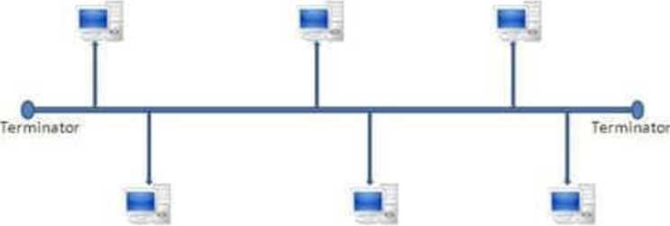
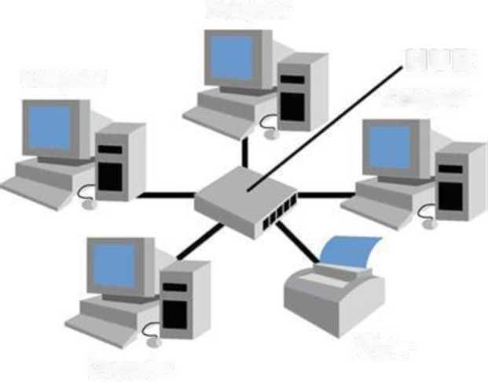
Network topologies are classified as below:
a) Bus Topology: In Bus Topology, all the devices of the network are connected to a common cable (also called as the backbone). As the devices are connected to a single cable, it is also termed as Linear Bus Topology.
Nod*
The advantage of bus topology is that it can be installed easily. And the disadvantage is that if the backbone cable breaks then the whole network will be down.
b) Star Topology: In Star Topology, there is a central controller or hub to which every node or device is connected through a cable. In this topology, the devices are not linked to each other. If a device needs to communicate with the other, then it has to send the signal or data to the central hub. And then the hub sends the same data to
the destination device.
Computer
Computer
HUB
Computer
Computer
Printer
The advantage of the star topology is that if a link breaks then only that particular link
is affected. The whole network remains undisturbed. The main disadvantage of the star topology is that all the devices of the network are dependent on a single point (hub). If the central hub gets failed, then the whole network gets down.
Juniper Business Use Only

Slide 16
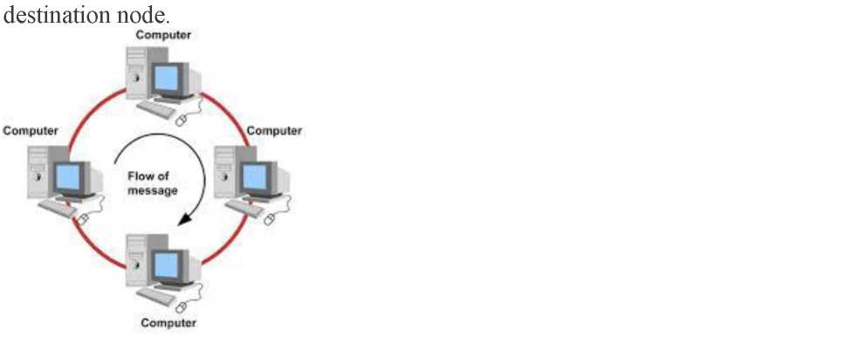
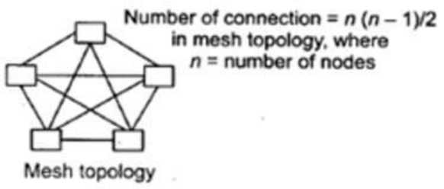
c) Ring Topology: In Ring Topology, each device of the network is connected to two other devices on either side which in turn forms a loop. Data or Signal in ring topology flow only in a single direction from one device to another and reaches the
The advantage of ring topology is that it can be installed easily. Adding or deleting devices to the network is also easy. The main disadvantage of ring topology is the data flows only in one direction. And a break at a node in the network can affect the whole network.
d) Mesh Topology: In a Mesh Topology, each device of the network is connected to all other devices of the network. Mesh Topology uses Routing and Flooding techniques for data transmission.
The advantage of mesh topology is if one link breaks then it does not affect the whole network. And the disadvantage is, huge cabling is required and it is expensive.
Q #34) What is the full form of IDEA?
Answer: IDEA stands for International Data Encryption Algorithm.
Q #35) Define Piggybacking?
Answer: In data transmission, if the sender sends any data frame to the receiver then the receiver should send the acknowledgment to the sender. The receiver will temporarily delay (waits for the network layer to send the next data packet) the
Juniper Business Use Only

Slide 17
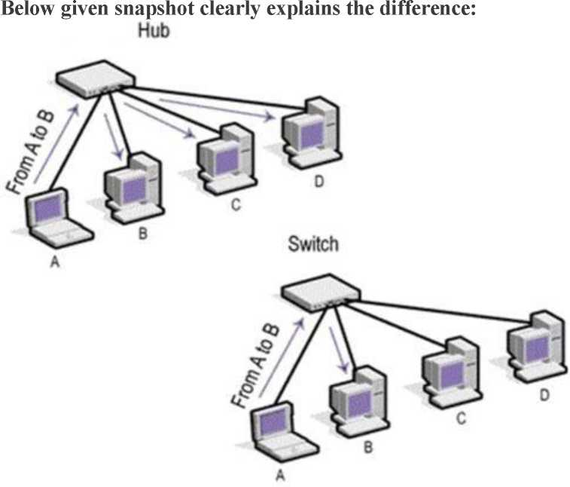
acknowledgment and hooks it to the next outgoing data frame, this process is called Piggybacking.
Q #36) In how many ways the data is represented and what are they?
Answer: Data transmitted through the networks’ comes in different ways like text, audio, video, images, numbers, etc.
• Audio: It is nothing but the continuous sound which is different from text and numbers.
• Video: Continuous visual images or a combination of images.
• Images: Every image is divided into pixels. And the pixels are represented using bits. Pixels may vary in size based on image resolution.
• Numbers: These are converted into binary numbers and are represented using bits.
• Text: Text is also represented as bits.
Q #37) What is the full form of ASCII?
Answer: ASCII stands for American Standard Code for Information Interchange.
Q #38) How a Switch is different from a Hub?
Answer: Below are the differences between a Switch and a Hub,
Q #39) Define Round Trip Time?
Juniper Business Use Only

Slide 18
Answer: The time taken for a signal to reach the destination and travel back to the sender with the acknowledgment is termed as Round Trip Time (RTT). It is also called Round Trip Delay (RTD).
Q #40) Define Brouter?
Answer: Brouter or Bridge Router is a device that acts as both a bridge and a router. As a bridge, it forwards data between the networks. And as a router, it routes the data to specified systems within a network.
Q #41) Define Static IP and Dynamic IP?
Answer: When a device or computer is assigned a specified IP address then it is named as Static IP. It is assigned by the Internet Service Provider as a permanent address.
Dynamic IP is the temporary IP address assigned by the network to a computing device. Dynamic IP is automatically assigned by the server to the network device.
Q #42) How VPN is used in the corporate world?
Answer: VPN stands for Virtual Private Network. With the help of a VPN, remote users can securely connect to the organization’s network. Corporate companies, educational institutions, government offices, etc use this VPN.
Q #43) What is the difference between Firewall and Antivirus?
Answer: Firewall and Antivirus are two different security applications used in networking. A firewall acts as a gatekeeper which prevents unauthorized users to access the private networks as intranets. A firewall examines each message and blocks the same which are unsecured.
Antivirus is a software program that protects a computer from any malicious software, any virus, spyware, adware, etc.
Note: A Firewall cannot protect the system from viruses, spyware, adware, etc.
Q #44) Explain Beaconing?
Answer: If a network self-repair its problem then it is termed as Beaconing. Mainly, it is used in the token ring and FDDI (Fiber Distributed Data Interface) networks. If a device in the network is facing any problem, then it notifies the other devices that they are not receiving any signal. Likewise, the problem gets repaired within the network.
Q #45) Why the standard of an OSI model is termed as 802.xx?
Answer: The OSI model was started in the month of February in 1980. So it is standardized as 802.XX. This ‘80’ stands for the year 1980 and ‘2’ represents the month of February.
Q #46) Expand DHCP and describe how it works?
Answer: DHCP stands for Dynamic Host Configuration Protocol.
DHCP is used to assign IP addresses automatically to the devices over the network. When a new device is added to the network, it broadcasts a message stating that it is new to the network. Then the message is transmitted to all the devices of the network.
Juniper Business Use Only

Slide 19
Only the DHCP server will react to the message and assigns a new IP address to the newly added device of the network. With the help of DHCP, IP management became very easy.
Q #47) How can a network be certified as an effective network? What are the factors affecting them?
Answer: A network can be certified as an effective network based on below-mentioned factors:
• Performance: A network’s performance is based on its transmitted time and response time. The factors affecting the performance of a network are hardware, software, transmission medium types and the number of users using the network.
• Reliability: Reliability is nothing but measuring the probability of failures occurred in a network and the time taken by it to recover from it. The factors affecting the same are the frequency of failure and recovery time from failure.
• Security: Protecting the data from viruses and unauthorized users. The factors affecting the security are viruses and users who do not have permission to access the network.
Q #48) Explain DNS?
Answer: DNS stands for Domain Naming Server. DNS acts as a translator between domain names and IP addresses. As humans remember names, the computer understands only numbers. Generally, we assign names to websites and computers like Gmail.com, Hotmail, etc. When we type such names the DNS translates it into numbers and executes our requests.
Translating the names into numbers or IP address is named as a Forward lookup. Translating the IP address to names is named as a Reverse lookup.
Q #49) Define IEEE in the networking world?
Answer: IEEE stands for the Institute of Electrical and Electronic Engineer. This is used to design or develop standards that are used for networking.
Q #50) What is the use of encryption and decryption?
Answer: Encryption is the process of converting the transmission data into another form that is not read by any other device other than the intended receiver.
Decryption is the process of converting back the encrypted data to its normal form.
An algorithm called cipher is used in this conversion process.
Q #51) Brief Ethernet?
Juniper Business Use Only

Slide 20
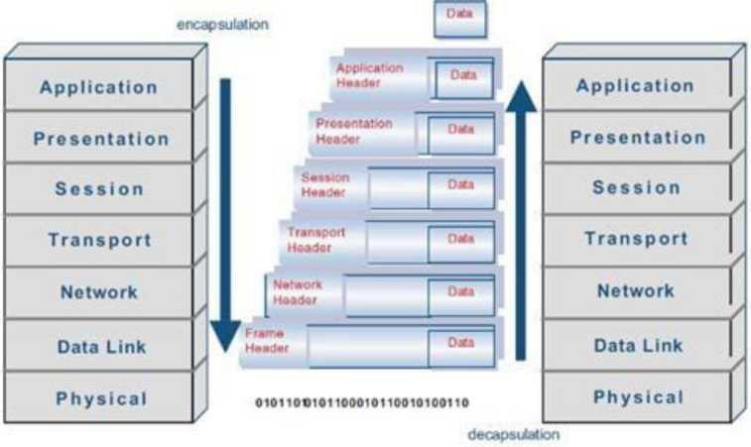
Answer: Ethernet is a technology that is used to connect computers all over the network to transmit the data between each other.
For Example, if we connect a computer and laptop to a printer, then we can call it as an Ethernet network. Ethernet acts as the carrier for the Internet within short distance networks like a network in a building.
The main difference between the Internet and Ethernet is security. Ethernet is safer than the Internet as Ethernet is a closed-loop and has only limited access.
Q #52) Explain Data Encapsulation?
Answer: Encapsulation means adding one thing on top of the other thing. When a message or a packet is passed through the communication network (OSI layers), every layer adds its header information to the actual packet. This process is termed as Data Encapsulation.
Note: Decapsulation is exactly the opposite of encapsulation. The process of removing the headers added by the OSI layers from the actual packet is termed as Decapsulation.
Q #53) How are networks classified based on their connections?
Answer: Networks are classified into two categories based on their connection types. They are mentioned below:
• Peer-to-peer networks (P2P): When two or more computers are connected together to share resources without the use of a central server is termed as a peer-to-peer network. Computers in this type of network act as both server and client. It is generally used in small companies as they are not expensive.
• Server-based networks: In this type of network, a central server is located to store the data, applications, etc of the clients. The server
Juniper Business Use Only

Slide 21
computer provides the security and network administration to the network.
Q #54) Define Pipelining?
Answer: In Networking, when a task is in progress another task gets started before the previous task is finished. This is termed as Pipelining.
Q #55) What is an Encoder?
Answer: Encoder is a circuit that uses an algorithm to convert any data or compress audio data or video data for transmission purposes. An encoder converts the analog signal into the digital signal.
Q #56) What is a Decoder?
Answer: Decoder is a circuit that converts the encoded data to its actual format. It converts the digital signal into an analog signal.
Q #57) How can you recover the data from a system which is infected with a Virus?
Answer: In another system (not infected with a virus) install an OS and antivirus with the latest updates. Then connect the HDD of the infected system as a secondary drive. Now scan the secondary HDD and clean it. Then copy the data into the system.
Q #58) Describe the key elements of the protocol?
Answer: Below are the 3 key elements of the protocol:
• Syntax: It is the format of the data. That means in which order the data is displayed.
• Semantics: Describes the meaning of the bits in each section.
• Timing: At what time the data is to be sent and how fast it is to be sent. Q #59) Explain the difference between baseband and broadband transmission? Answer:
• Baseband Transmission: A single signal consumes the whole bandwidth of the cable.
• Broadband Transmission: Multiple signals of multiple frequencies are sent simultaneously.
Q #60) Expand SLIP?
Answer: SLIP stands for Serial Line Interface Protocol. SLIP is a protocol used for transmitting IP datagrams over a serial line
Basic Networking Interview Questions and
Answers for Freshers
1) What is a Link?
Juniper Business Use Only

Slide 22

A link refers to the connectivity between two devices. It includes the type of cables and protocols used for one device to be able to communicate with the other.
2) What are the layers of the OSI reference model?
There are 7 OSI layers: 1) Physical Layer, 2) Data Link Layer, 3) Network Layer, 4) Transport Layer, 5) Session Layer, 6) Presentation Layer, and 7) Application Layer.
3) What is the backbone network?
A backbone network is a centralized infrastructure that is designed to distribute different routes and data to various networks. It also handles the management of bandwidth and multiple channels.
4) What is a LAN?
Juniper Business Use Only

Slide 23
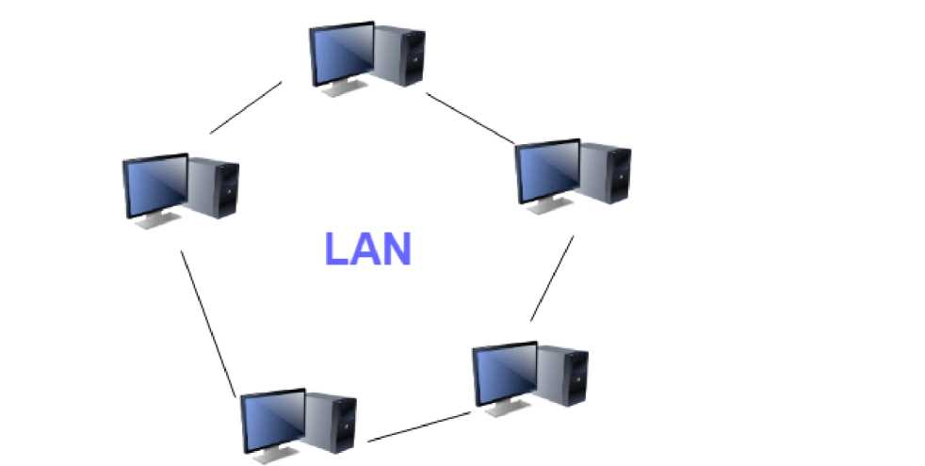
LAN network
LAN stands for Local Area Network. It refers to the connection between computers and other network devices that are located within a small physical location.
5) What is a node?
A node refers to a point or joint where a connection takes place. It can be a computer or device that is part of a network. Two or more nodes are needed to form a network connection.
6) What are routers?
Juniper Business Use Only

Slide 24
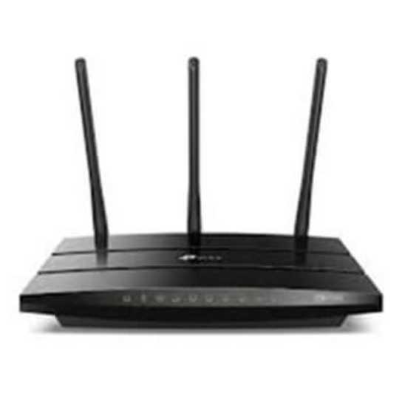
Router
Routers can connect two or more network segments. These are intelligent network devices that store information in its routing tables, such as paths, hops, and bottlenecks. With this info, they can determine the best path for data transfer. Routers operate at the OSI Network Layer.
7) What is a point to point link?
It refers to a direct connection between two computers on a network.
A point to point connection does not need any other network devices other than connecting a cable to the NIC cards of both computers.
8) What is anonymous FTP?
Anonymous FTP is a way of granting user access to files in public servers. Users that are allowed access to data in these servers do not need to identify themselves, but instead, log in as an anonymous guest.
9) What is a subnet mask?
Juniper Business Use Only

Slide 25
A subnet mask is combined with an IP address to identify two parts: the extended network address and the host address. Like an IP address, a subnet mask is made up of 32 bits.
10) What is the maximum length allowed for a UTP cable?
A single segment of UTP cable has an allowable length of 90 to 100 meters. This limitation can be overcome by using repeaters and switches.
11) What is data encapsulation?
Data encapsulation is the process of breaking down information into smaller, manageable chunks before it is transmitted across the network. In this process that the source and destination addresses are attached to the headers, along with parity checks.
12) Describe Network Topology
Network Topology refers to the layout of a computer network. It shows how devices and cables are physically laid out, as well as how they connect.
13) What is a VPN?
VPN means Virtual Private Network, a technology that allows a secure tunnel to be created across a network such as the Internet. For example, VPNs allow you to establish a secure dial-up connection to a remote server.
14) Briefly describe NAT
NAT is Network Address Translation. This is a protocol that provides a way for multiple computers on a common network to share a single connection to the Internet.
Juniper Business Use Only

Slide 26
15) What is the job of the Network Layer under the OSI reference model?
The Network layer is responsible for data routing, packet switching, and control of network congestion. Routers operate under this layer.
16) How does a network topology affect your decision to set a network?
Network topology dictates what media you must use to interconnect devices. It also serves as a basis on what materials, connectors, and terminations that is applicable for the setup.
17) What is RIP?
RIP, short for Routing Information Protocol is used by routers to send data from one network to another. It efficiently manages routing data by broadcasting its routing table to all other routers within the network. It determines the network distance in units of hops.
18) What are the different ways of securing a computer network?
There are several ways to do this. Install a reliable and updated antivirus program on all computers. Make sure firewalls are setup and configured correctly. User authentication will also help a lot. All these combined would make a highly secured network.
19) What is NIC?
NIC is short for Network Interface Card. This is a peripheral card that is attached to a PC in order to connect to a network. Every NIC has its own MAC address that identifies the PC on the network.
20) What is WAN?
Juniper Business Use Only

Slide 27
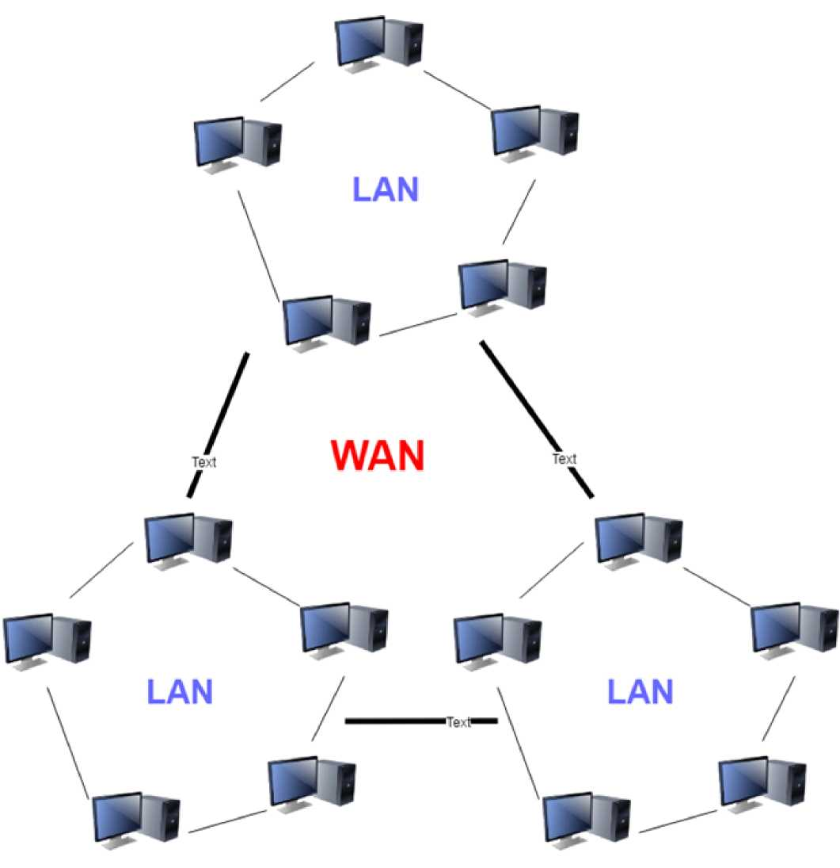
WAN network
WAN stands for Wide Area Network. It is an interconnection of computers and devices that are geographically dispersed. It connects networks that are located in different regions and countries.
Juniper Business Use Only

Slide 28
Computer Network Engineer Interview Questions and Answers for Experienced
21) What is the importance of the OSI Physical Layer?
The physical layer does the conversion from data bits to the electrical signal, and vice versa. This is where network devices and cable types are considered and setup.
22) How many layers are there under TCP/IP?
There are four layers: 1) The Network Layer, 2) Internet Layer, 3) Transport Layer, and 4) Application Layer.
Application
Transport
Internet
Network
Interface
Juniper Business Use Only

Slide 29
TCP/IP Layers
23) What are proxy servers, and how do they protect computer networks?
Proxy servers primarily prevent external users who are identifying the IP addresses of an internal network. Without knowledge of the correct IP address, even the physical location of the network cannot be identified. Proxy servers can make a network virtually invisible to external users.
24) What is the function of the OSI Session Layer?
This layer provides the protocols and means for two devices on the network to communicate with each other by holding a session. This includes setting up the session, managing information exchange during the session, and tear-down process upon termination of the session.
25) What is the importance of implementing a Fault Tolerance System?
A fault tolerance system ensures continuous data availability. This is done by eliminating a single point of failure.
26) What does 10Base-T mean?
The 10 refers to the data transfer rate. In this case, it is 10Mbps. The word Base refers to baseband, as opposed to broadband.
27) What is a private IP address?
Private IP addresses are assigned for use on intranets. These addresses are used for internal networks and are not routable on external public networks. These ensure that no conflicts are present among internal networks. At the same time, the same range of private IP addresses is reusable for multiple intranets since they do not “see” each other.
Juniper Business Use Only

Slide 30
28) What is NOS?
NOS, or Network Operating System, is specialized software. The main task of this software is to provide network connectivity to a computer in order to communicate with other computers and connected devices.
29) What is DoS?
DoS, or Denial-of-Service attack, is an attempt to prevent users from being able to access the Internet or any other network services. Such attacks may come in different forms and are done by a group of perpetrators. One common method of doing this is to overload the system server so it cannot anymore process legitimate traffic and will be forced to reset.
30) What is OSI, and what role does it play in computer networks?
OSI (Open Systems Interconnect) serves as a reference model for data communication. It is made up of 7 layers, with each layer defining a particular aspect of how network devices connect and communicate with one another. One layer may deal with the physical media used, while another layer dictates how data is transmitted across the network.
31) What is the purpose of cables being shielded and having twisted pairs?
The primary purpose of this is to prevent crosstalk. Crosstalk’s are electromagnetic interferences or noise that can affect data being transmitted across cables.
32) What is the advantage of address sharing?
By using address translation instead of routing, address sharing provides an inherent security benefit. That’s because host PCs on the Internet can only see the public IP address of the external interface on the computer. Instead, it provides address translation and not the private IP addresses on the internal network.
Juniper Business Use Only

Slide 31
33) What are MAC addresses?
MAC, or Media Access Control, uniquely identifies a device on the network. It is also known as a physical address or an Ethernet address. A MAC address is made up of 6-byte parts.
34) What is the equivalent layer or layers of the TCP/IP Application layer in terms of the OSI reference model?
The TCP/IP Application layer has three counterparts on the OSI model: 1) Session Layer, 2) Presentation Layer, and 3) Application Layer.
35) How can you identify the IP class of a given IP address?
By looking at the first octet of any given IP address, you can identify whether it’s Class A, B, or C. If the first octet begins with a 0 bit, that address is Class A. If it begins with bits 10 then that address is a Class B address. If it begins with 110, then it’s a Class C network.
36) What is the main purpose of OSPF?
OSPF, or Open Shortest Path First, is a link-state routing protocol that uses routing tables to determine the best possible path for data exchange.
37) What are firewalls?
Firewalls serve to protect an internal network from external attacks. These external threats can be hackers who want to steal data or computer viruses that can wipe out data in an instant. It also prevents other users from external networks from gaining access to the private network.
38) Describe star topology
Juniper Business Use Only

Slide 32
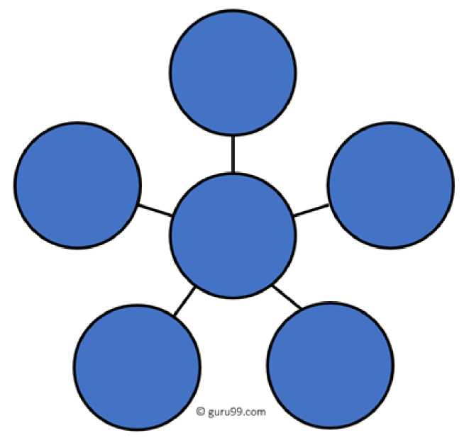
Star topology consists of a central hub that connects to nodes. This is one of the easiest to set up and maintain.
Star Topology
Advantages:
Here are pros/benefits of start topology:
. Easy to troubleshoot, set up, and modify.
. Only those nodes are affected, that has failed. Other nodes still work.
• Fast performance with few nodes and very low network traffic.
. In Star topology, addition, deletion, and moving of the devices are easy.
Disadvantages:
Here are cons/drawbacks of using Star:
• If the Hub or concentrator fails, attached nodes are disabled.
• The cost of installation of star topology is costly.
Juniper Business Use Only

Slide 33
. Heavy network traffic can sometimes slow the bus considerably.
. Performance depends on the Hub’s capacity
. A damaged cable or lack of proper termination may bring the network down.
39) What are gateways?
Gateways provide connectivity between two or more network segments. It is usually a computer that runs the gateway software and provides translation services. This translation is key in allowing different systems to communicate on the network.
40) What is the disadvantage of a star topology?
One major disadvantage of star topology is that once the central Hub or switch gets damaged, the entire network becomes unusable.
41) What is SLIP?
SLIP, or Serial Line Interface Protocol, is an old protocol developed during the early UNIX days. This is one of the protocols that are used for remote access.
42) Give some examples of private network addresses.
10.0.0.0 with a subnet mask of 255.0.0.0172.16.0.0 with subnet mask of 255.240.0.0192.168.0.0 with subnet mask of 255.255.0.0
43) What is tracert?
Tracert is a Windows utility program that can use to trace the route taken by data from the router to the destination network. It also shows the number of hops taken during the entire transmission route.
44) What are the functions of a network administrator?
Juniper Business Use Only

Slide 34
A network administrator has many responsibilities that can be summarized into 3 key functions: installation of a network, a configuration of network settings, and maintenance/troubleshooting of networks.
45) What is the main disadvantage of a peer to peer network?
Accessing the resources that are shared by one of the workstations on the network takes a performance hit.
46) What is a Hybrid Network?
A hybrid network is a network setup that makes use of both client-server and peer-to-peer architecture.
47) What is DHCP?
DHCP is short for Dynamic Host Configuration Protocol. Its main task is to assign an IP address to devices across the network automatically. It first checks for the next available address not yet taken by any device, then assigns this to a network device.
48) What is the main job of the ARP?
The main task of the ARP or Address Resolution Protocol is to map a known IP address to a MAC layer address.
49) What is TCP/IP?
TCP/IP is short for Transmission Control Protocol / Internet Protocol. This is a set of protocol layers that is designed to make data exchange possible on different types of computer networks, also known as a heterogeneous network.
50) How can you manage a network using a router?
Routers have a built-in console that lets you configure different settings, like security and data logging. You can assign restrictions to
Juniper Business Use Only

Slide 35
computers, such as what resources it is allowed access or what particular time of the day, they can browse the Internet. You can even put restrictions on what websites are not viewable across the entire network.
51) What protocol can be applied when you want to transfer files between different platforms, such as UNIX systems and Windows servers?
Use FTP (File Transfer Protocol) for file transfers between such different servers. This is possible because FTP is platform-independent.
52) What is the use of a default gateway?
Default gateways provide means for the local networks to connect to the external network. The default gateway for connecting to the external network is usually the address of the external router port.
53) What can be considered as good passwords?
Good passwords are made up of not just letters, but by combining letters and numbers. A password that combines uppercase and lowercase letters is favorable than one that uses all upper case or all lower-case letters. Passwords must be not words that can easily be guessed by hackers, such as dates, names, favorites, etc. Longer passwords are also better than short ones.
54) What is the proper termination rate for UTP cables?
The proper termination for unshielded twisted pair network cable is 100 ohms.
55) What is netstat?
Netstat is a command-line utility program. It provides useful information about the current TCP/IP settings of a connection.
Juniper Business Use Only

Slide 36
56) What is the number of network IDs in a Class C network?
For a Class C network, the number of usable Network ID bits is 21. The number of possible network IDs is 2 raised to 21 or 2,097,152. The number of host IDs per network ID is 2 raised to 8 minus 2, or 254.
57) What happens when you use cables longer than the prescribed length?
Cables that are too long would result in signal loss. It means that data transmission and reception would be affected because the signal degrades over length.
58) What common software problems can lead to network defects?
Software related problems can be any or a combination of the following:
• Client-server problems . Application conflicts
• Error in configuration
• Protocol mismatch
• Security issues
• User policy and rights issues
59) What is ICMP?
ICMP is an Internet Control Message Protocol. It provides messaging and communication for protocols within the TCP/IP stack. This is also the protocol that manages error messages that are used by network tools such as PING.
Juniper Business Use Only

Slide 37
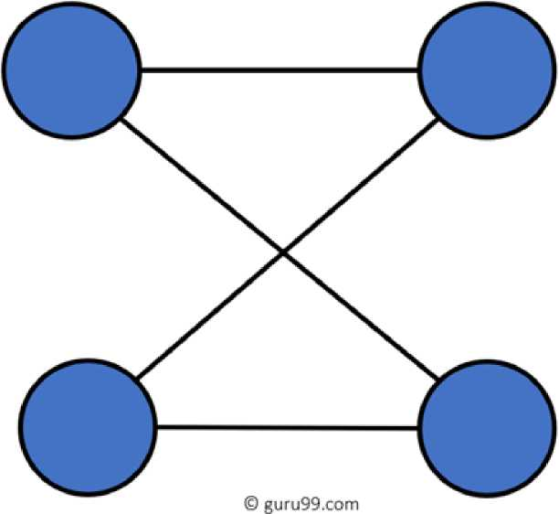
60) What is Ping?
Ping is a utility program that allows you to check connectivity between network devices on the network. You can ping a device by using its IP address or device name, such as a computer name.
61) What is peer to peer?
P2P Network
Peer to peer (P2P) are networks that do not rely on a server. All PCs on this network act as individual workstations.
62) What is DNS?
DNS is the Domain Name System. The main function of this network service is to provide host names to TCP/IP address resolution.
63) What advantages does fiber optics have over other media?
One major advantage of fiber optics is that it is less susceptible to electrical interference. It also supports higher bandwidth, meaning
Juniper Business Use Only

Slide 38
more data can be transmitted and received. Signal degrading is also very minimal over long distances.
64) What is the difference between a hub and a switch?
Here is the major difference between Hub and switch: Hub Switch
A hub operates on the physical layer. Hubs perform frame flooding that can be unicast, multicast, or broadcast. Just a singular domain of collision is present in a hub.
The transmission mode is Half-duplex Hubs operate as a Layer 1 device per the OSI model.
To connect a network of personal computers should be joined through a central hub.
A switch operates on the data link layer.
It performs broadcast, then the unicast ar as needed.
Varied ports have separate collision dom«
The transmission mode is Full duplex Network switches help you to operate at l the OSI model.
Allow connecting multiple devices and po
Uses electrical signal orbits Does not offer Spanning-Tree Collisions occur mostly in setups using hubs.
Uses frame & packet
Multiple Spanning-Tree is possible
No collisions occur in a full-duplex switch
Hub is a passive device
A network hub can’t store MAC addresses.
Not an intelligent device Its speed is up to 10 Mbps Does not use software
A switch is an active device Switches use CAM (Content Accessible M can be accessed by ASIC (Application Sp Integrated Chips).
Intelligent device
10/100 Mbps, 1 Gbps, 10 Gbps
Has software for administration
65) What are the different network protocols that are supported by Windows RRAS services?
Juniper Business Use Only

Slide 39
There are three main network protocols supported: NetBEUI, TCP/IP, and IPX.
66) What are the maximum networks and hosts in class A, B, and C network?
For Class A, there are 126 possible networks and 16,777,214 hosts. For Class B, there are 16,384 possible networks and 65,534 hosts.
For Class C, there are 2,097,152 possible networks and 254 hosts
67) What is the standard color sequence of a straight-through cable?
Orange/white, orange, green/white, blue, blue/white, green, brown/white, brown.
68) What protocols fall under the Application layer of the TCP/iP stack?
The following are the protocols under the TCP/IP Application layer: FTP, TFTP, Telnet, and SMTP.
69) You need to connect two computers for file sharing. Is it possible to do this without using a hub or a router?
Yes, you can connect two computers, using only one cable. A crossover type cable can be used in this scenario. In this setup, the data transmit pin of one cable is connected to the data receive pin of the other cable, and vice versa.
70) What is ipconfig?
Ipconfig is a utility program that is commonly used to identify the addresses information of a computer on a network. It can show the physical address as well as the IP address.
Juniper Business Use Only

Slide 40
71) What is the difference between a straight-through and crossover cable?
A straight-through cable is used to connect computers to a switch, hub, or router. A crossover cable is used to connect two similar devices, such as a PC to PC or Hub, to the Hub.
72) What is the client/server?
Client/server is a type of network wherein one or more computers act as servers. Servers provide a centralized repository of resources such as printers and files. Clients refer to a workstation that accesses the server.
73) Describe networking.
Networking refers to the interconnection between computers and peripherals for data communication. Networking can be done using wired cabling or through a wireless link.
74) When you move the NIC cards from one PC to another PC, does the MAC address gets transferred as well?
Yes, that’s because MAC addresses are hard-wired into the NIC circuitry, not the PC. This also means that a PC can have a different MAC address when another one replaced the NIC card.
75) Explain clustering support
Clustering support refers to the ability of a network operating system to connect multiple servers in a fault-tolerant group. The main purpose of this is the if one server fails, all processing will continue with the next server in the cluster.
76) Where is the best place to install an Anti-virus program?
Juniper Business Use Only

Slide 41
An anti-virus program must be installed on all servers and workstations to ensure protection. That’s because individual users can access any workstation and introduce a computer virus. You can plug in their removable hard drives or flash drives.
77) Describe Ethernet
Ethernet is one of the popular networking technologies used these days. It was developed during the early 1970s and is based on specifications, as stated in the IEEE. Ethernet is used in local area networks.
78) What are some drawbacks of implementing a ring topology?
In case one workstation on the network suffers a malfunction, it can bring down the entire network. Another drawback is that when there are adjustments and reconfigurations needed to be performed on a particular network, the entire network must be temporarily brought down.
79) What is the difference between CSMA/CD and CSMA/CA?
CSMA/CD, or Collision Detect, retransmits data frames whenever a collision occurred. CSMA/CA, or Collision Avoidance, will first broadcast intent to send prior to data transmission.
80) What is SMTP?
SMTP is short for Simple Mail Transfer Protocol. This protocol deals with all internal mail and provides the necessary mail delivery services on the TCP/IP protocol stack.
81) What is multicast routing?
Juniper Business Use Only

Slide 42
Multicast routing is a targeted form of broadcasting that sends a message to a selected group of the user instead of sending it to all users on a subnet.
82) What is the importance of Encryption on a network?
Encryption is the process of translating information into a code that is unreadable by the user. It is then translated back or decrypted back to its normal readable format using a secret key or password. Encryption ensures that information that is intercepted halfway would remain unreadable because the user must have the correct password or key for it.
83) How are IP addresses arranged and displayed?
IP addresses are displayed as a series of four decimal numbers that are separated by period or dots. Another term for this arrangement is the dotted-decimal format. An example is 192.168.101.2
84) Explain the importance of authentication.
Authentication is the process of verifying a user’s credentials before he can log into the network. It is normally performed using a username and password. This provides a secure means of limiting access from unwanted intruders on the network.
85) What is meaning by tunnel mode?
This is a mode of data exchange wherein two communicating computers do not use IPsec themselves. Instead, the gateway that is connecting their LANs to the transit network creates a virtual tunnel. So, it uses the IPsec protocol to secure all communication that passes through it.
86) What are the different technologies involved in establishing WAN links?
Juniper Business Use Only

Slide 43
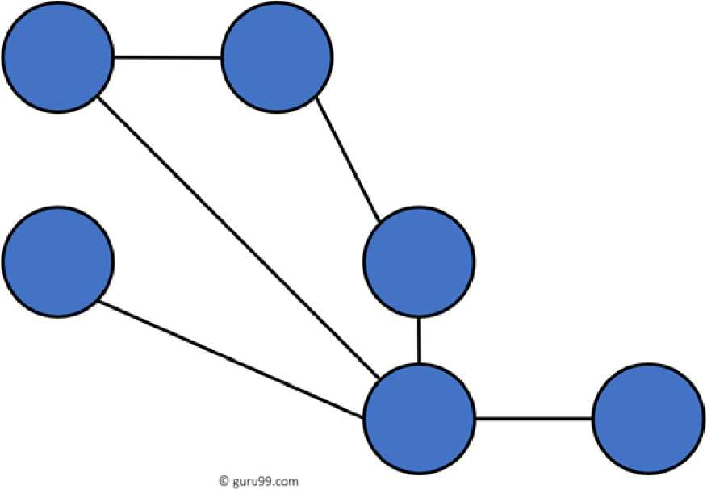
. Analog connections - using conventional telephone lines
• Digital connections - using digital-grade telephone lines
. Switched connections - using multiple sets of links between the sender and receiver to move data.
87) Explain Mesh Topology
The mesh topology has a unique network design in which each computer on the network connects to every other. It is developing a P2P (point-to-point) connection between all the devices of the network. It offers a high level of redundancy, so even if one network cable fails, data still has an alternative path to reach its destination.
Types of Mesh Topology:
Partial Mesh Topology: In this type of topology, most of the devices are connected almost similarly as full topology. The only difference is that few devices are connected with just two or three devices.
Partially Connected Mesh Topology
Juniper Business Use Only

Slide 44
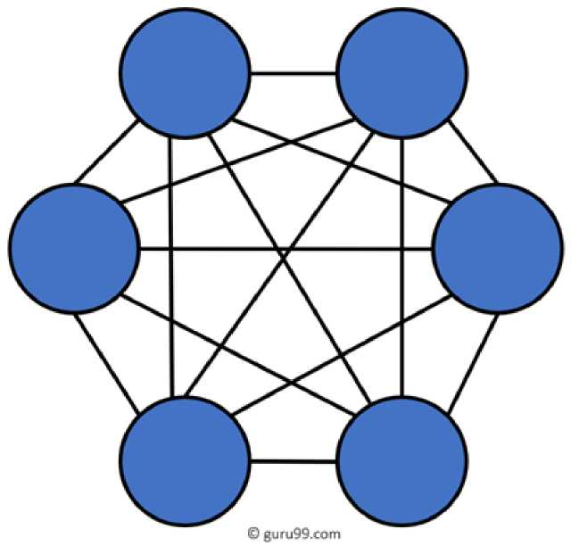
Full Mesh Topology: In this topology, every node or device are directly connected with each other.
Fully Connected Mesh Topology
88) When troubleshooting computer network problems, what common hardware-related problems can occur?
A large percentage of a network is made up of hardware. Problems in these areas can range from malfunctioning hard drives, broken NICs, and even hardware startups. Incorrect hardware configuration is also one of those culprits to look into.
89) How can you fix signal attenuation problems?
A common way of dealing with such a problem is to use repeaters and hubs because it will help regenerate the signal and therefore prevent signal loss. Checking if cables are properly terminated is also a must.
Juniper Business Use Only

Slide 45
90) How does dynamic host configuration protocol aid in network administration?
Instead of having to visit each client computer to configure a static IP address, the network administrator can apply dynamic host configuration protocol to create a pool of IP addresses known as scopes that can be dynamically assigned to clients.
91) Explain profile in terms of networking concepts
Profiles are the configuration settings made for each user. A profile may be created that puts a user in a group, for example.
92) What is sneakernet?
Sneakernet is believed to be the earliest form of networking wherein data is physically transported using removable media, such as disk, tapes.
93) What is the role of the IEEE in computer networking?
IEEE, or the Institute of Electrical and Electronics Engineers, is an organization composed of engineers that issues and manages standards for electrical and electronic devices. This includes networking devices, network interfaces, cablings, and connectors.
94) What protocols fall under the TCP/IP Internet Layer?
There are 4 protocols that are being managed by this layer. These are ICMP, IGMP, IP, and ARP.
95) When it comes to networking, what are rights?
Rights refer to the authorized permission to perform specific actions on the network. Each user on the network can be assigned individual rights, depending on what must be allowed for that user.
Juniper Business Use Only

Slide 46
96) What is one basic requirement for establishing VLANs?
A VLAN is required because at the switch level. There is only one broadcast domain. It means whenever a new user is connected to switch. This information is spread throughout the network. VLAN on switch helps to create a separate broadcast domain at the switch level. It is used for security purposes.
97) What is IPv6?
IPv6, or Internet Protocol version 6, was developed to replace IPv4. At present, IPv4 is being used to control internet traffic but is expected to get saturated in the near future. IPv6 was designed to overcome this limitation.
98) What is the RSA algorithm?
RSA is short for the Rivest-Shamir-Adleman algorithm. It is the most commonly used public-key encryption algorithm in use today.
99) What is mesh topology?
Mesh topology is a setup wherein each device is connected directly to every other device on the network. Consequently, it requires that each device has at least two network connections.
100) what is the maximum segment length of a 100Base-FX network?
The maximum allowable length for a network segment using 100BaseFX is 412 meters. The maximum length for the entire network is 5 kilometers.
101) What is the 5-4-3 rule, and in which architecture is it used?
The 5-4-3 rule is used in 10Base2 and 10Base5 Ethernet architectures. In this rule, there can be a maximum of five segments in
Juniper Business Use Only

Slide 47
a network connected with four repeaters. Out of these five segments, only three segments can be populated with nodes.
102) What is the difference between TCP and UDP?
Here are some major differences between TCP and UDP protocols: TCP UDP
It is a connection-oriented protocol.
TCP reads data as streams of bytes, and the message is transmitted to segment boundaries
It is a connectionless protocol. UDP messages contain packets ■ sent one by one. It also checks f< the arrival time.
TCP messages make their way across the Internet from one computer to another.
TCP rearranges data packets in the specific order.
The speed for TCP is slower.
Header size is 20 bytes
TCP is heavy-weight. TCP needs three packets to set up a socket connection before any user data can be sent.
It is not connection-based, so one can send lots of packets to anoth UDP protocol has no fixed order packets are independent of each UDP is faster as error recovery is attempted.
The header size is 8 bytes.
UDP is lightweight. There are no connections, ordering of message
TCP does error checking and also makes error recovery.
Acknowledgment segments
Using handshake protocol like SYN, SYN-ACK,
ACK
UDP performs error checking, bu erroneous packets.
No Acknowledgment segments
No handshake (so connectionles
TCP is reliable as it guarantees delivery of data The delivery of data to the destin to the destination router. be guaranteed in UDP.
TCP offers extensive error checking mechanisms because it provides flow control and acknowledgment of data.
UDP has just a single error checl mechanism that is used for ched
103) What are the important elements of the protocol?
Here, are three most important elements of the protocol:
Juniper Business Use Only

Slide 48
. Syntax: It is the format of the data. It is an order the data is displayed.
• Semantics: It describes the meaning of the bits in each section.
. Timing: What time the data is to be sent and how fast it is to be sent.
104) What is the maximum segment length of a 100Base-FX network?
The maximum length for a network segment using 100Base-FX is 412 meters.
105) What is a Decoder?
The decoder is a type of circuit that converts the encoded data to its original format. It also converts the digital signal into an analog signal.
106) What is Brouter?
Brouter is also known as Bridge Router. It is a device that acts as both a bridge and a router. As a bridge can forwards data between the networks. It also routes the data to specified systems within a network.
107) How to use VPN?
By using a Virtual Private Network (VPN), users can connect to the organization’s network. Corporate companies, educational institutions, government offices.
108) Why the standard OSI model is known as 802.xx?
The OSI model was started in February 1980. In 802.XX, ’80’ stands for the year 1980, and ‘2’ represents the month of February.
109) What is NVT (Network Virtual Terminal)?
NVT is a set of pre-defined rules to very simple virtual terminal interaction. This terminal helps you to start a Telnet session.
Juniper Business Use Only

Slide 49
110) What is the source route?
The source route is a sequence of IP addresses that helps you to identify the route a datagram. You can include the source route in the IP datagram header.
111) Explain the term Pipelining
Pipelining describes the sequencing of processes. When any new task begins before an ongoing task is finished, it is called sequencing.
112) Which measurement unit is used to measure the transmission speed of Ethernet?
The transmission speed of Ethernet is mostly measured in Mbps.
113) What is the maximum length of Thinnet cable?
The length of the Thinnet cable is 185 meters.
114) Which cable is also called as the RG8 cable?
Thicknet cable is also called as the RG8 cable.
115) Is coaxial cable still used in the computer network?
No, Nowadays, coaxial cable no longer used in a computer network.
116) Which cable uses the RJ11 connector?
Most of the telephone cable uses the RJ11 connector.
117) Explain Multi-homed Host
It is a host that has multiple network interfaces that multiple IP addresses is called a Multi-homed Host.
118) Explain EGP
Juniper Business Use Only

Slide 50
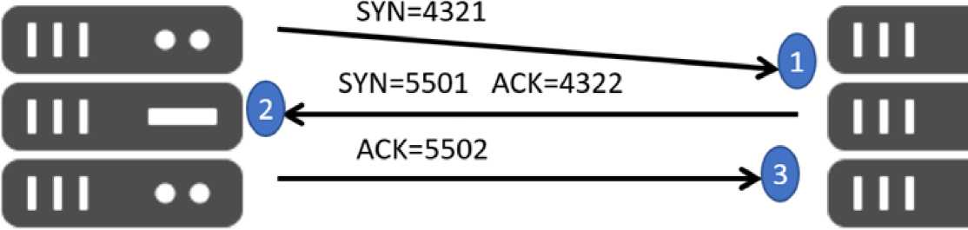
The full form of EGP is Exterior Gateway Protocol. It is the protocol of the routers. It is the neighboring autonomous systems that help you to identify the set of networks that you will able to reach within or via each independent system.
119) Explain the term Passive Topology
When a computer in the network listen and receive the signal, they are called passive topology.
120) What is the use of a Pseudo TTY?
It is a false terminal which allows you external machines to connect through Telnet or log in. Without this, no connection can take place.
121) Explain Redirector
Redirector is a kind of software which intercepts file or prints I/O requests and translates them into network requests. This component comes under the presentation layer.
122) What Is TCP Three-Way Handshake?
© guru99.com
Host X Servi
TCP Three-Way Handshake
THREE-WAY handshake or a TCP 3-way handshake is a process that is used in a TCP/IP network to make a connection between the server and client. It is a three-step process that requires both the client and
Juniper Business Use Only

Slide 51
server to exchange synchronization and acknowledgment packets before the real data communication process starts.
123) What is a Hamming code?
Hamming code is a liner code that is useful for error detection up to two immediate bit errors. It is capable of single-bit errors.
In Hamming code, the source encodes the message by adding redundant bits in the message. These redundant bits are mostly inserted and generated at certain positions in the message to accomplish the error detection and correction process.
124) What is the Application of Hamming code?
Here are some common applications of using Hemming code:
. Satellites
• Computer Memory . Modems
• PlasmaCAM
• Open connectors
• Shielding wire
• Embedded Processor
125) What are the benefits of the Hamming code?
Here, are important benefits of Hamming code
• The Hamming code method is effective on networks where the data streams are given for the single-bit errors.
• Hamming code not only provides the detection of a bit error but also helps you to indent bit containing error so that it can be corrected.
Juniper Business Use Only

Slide 52
• The ease of use of hamming codes makes it suitable for use in computer memory and single-error correction.
126) What is a MAC Address?
MAC address is a unique identifier that is assigned to a NIC (Network Interface Controller/ Card). It consists of a 48 bit or 64-bit address, which is associated with the network adapter. MAC address can be in hexadecimal format. The full form of MAC address is Media Access Control address.
127) Why Use MAC Address?
Here are the important reasons for using MAC address:
• It provides a secure way to find senders or receivers in the network.
• MAC address helps you to prevent unwanted network access.
• MAC address is a unique number. Hence it can be used to track the device.
• Wi-Fi networks at the airport use the MAC address of a specific device in order to identify it.
128) What are the types of MAC Addresses?
Here are the important types of MAC addresses:
• Universally Administered AddressUAA(Universally Administered Address) is the most used type of MAC address. It is given to the network adapter at the time of manufacturing.
• Locally Administered AddressLAA (Locally Administered Address) is an address that changes the MAC address of the adapter. You may assign this address to a device used by network administrator.
Juniper Business Use Only

Slide 53
129) What are the important differences between MAC address and IP address
Here, are some difference between MAC and IP address:
MAC IP address
The MAC address stands for Media Access IP address stands for Internet Pr Control Address. Address.
It consists of a 48-bit address. It consists of a 32-bit address.
MAC address works at the link layer of the OSI IP address works at the network model. model.
It is referred to as a physical address. It is referred to as a logical addre
You can retrieve the MAC address of any device You can retrieve the MAC addrei using ARP protocol. device RARP protocol.
Classes are not used in MAC address. In IP, IPv4 uses A, B, C, D, and I
130) What is an Analog Signal?
Juniper Business Use Only

Slide 54
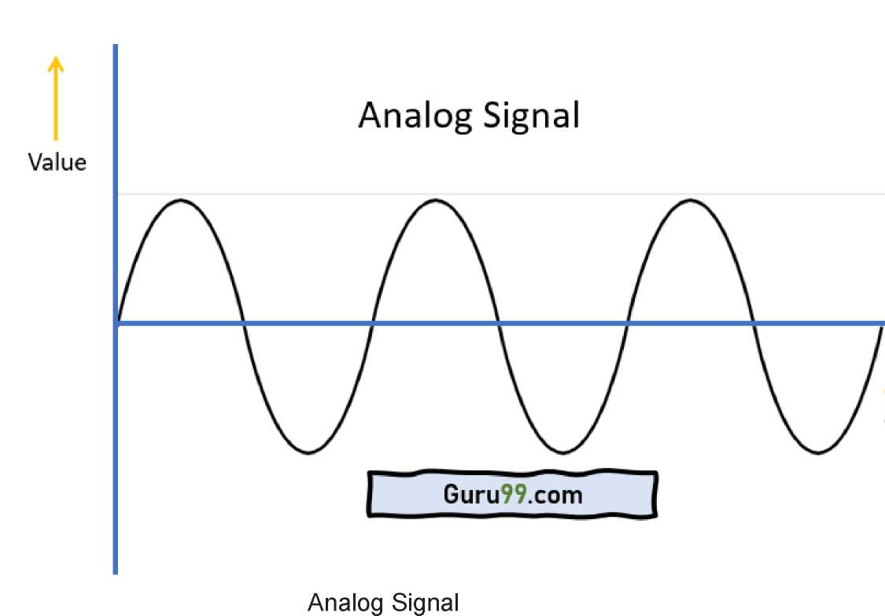
Analog signal is a continuous signal in which one time-varying quantity represents another time-based variable. These kind of signals works with physical values and natural phenomena such as earthquake, frequency, volcano, speed of wind, weight, lighting, etc.
131) What is a Digital Signal?
Juniper Business Use Only

Slide 55
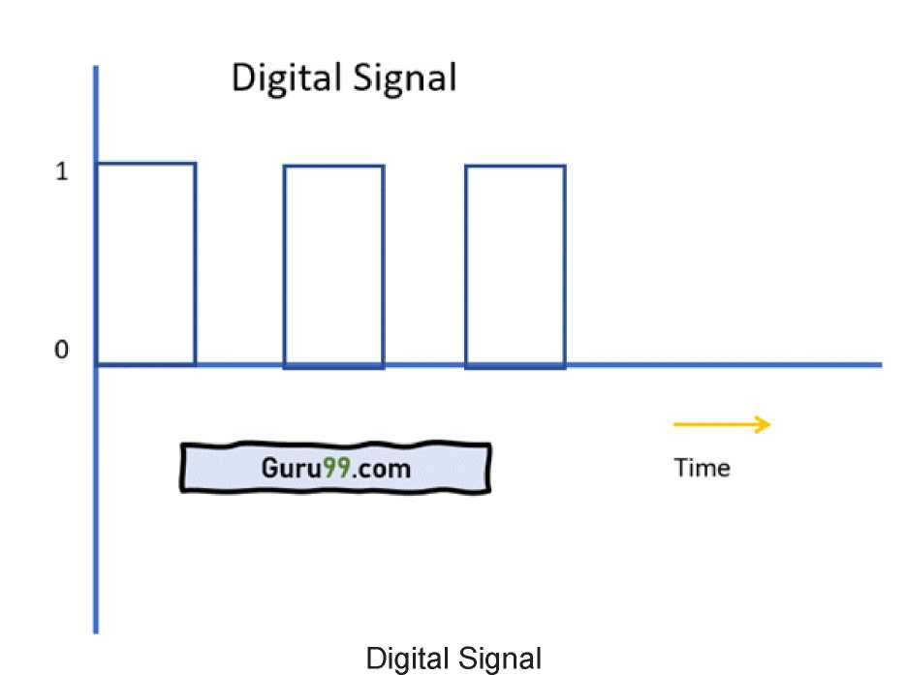
A digital signal is a signal that is used to represent data as a sequence of separate values at any point in time. It can only take on one of a fixed number of values. This type of signal represents a real number within a constant range of values.
132) What are the differences between analog and digital signal?
Here are the main differences between Analog and Digital Signal:
Analog Digital
An analog signal is a continuous signal that Digital signals are time separated si represents physical measurements. are generated using digital modulati
It is denoted by sine waves It is denoted by square waves.
It uses a continuous range of values that The Digital signal uses discrete 0 ar
help you to represent information. represent information.
The analog signal bandwidth is low The digital signal bandwidth is high.
Analog hardware never offers flexible Digital hardware offers flexibility in
Juniper Business Use Only

Slide 56
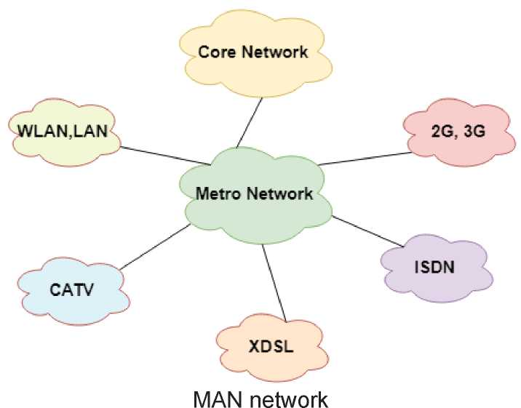
implementation.
It is suited for audio and video transmission. The Analog signal doesn’t offer any fixed range.
implementation.
It is suited for Computing and digital Digital signal has a finite number, i.e
133) What is MAN?
A Metropolitan Area Network or MAN is consisting of a computer network across an entire city, college campus, or a small region. This type of network is large than a LAN, which is mostly limited to a single building or site. Depending upon the type of configuration, this type of network allows you to cover an area from several miles to tens of miles.
134) What is Modem?
A modem (modulator-demodulator) is a device that modulates an analog signal to digital information. It also decodes carrier signals to demodulates the transmitted information.
The main aim of the Modem is to produce a signal that can be transmitted easily and decoded to reproduce the digital data in its
Juniper Business Use Only

Slide 57
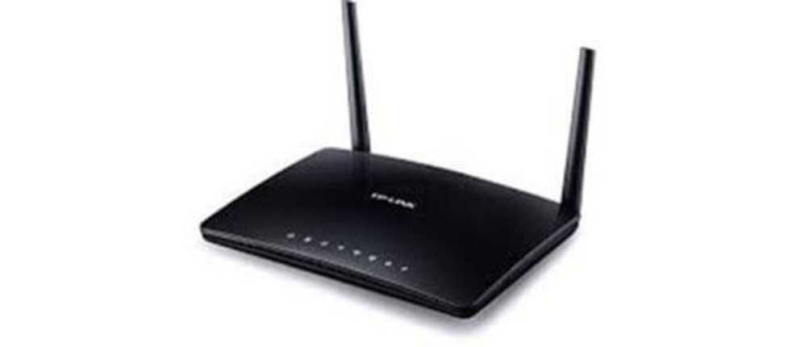
original form. Modems are also used for transmitting analog signals, from Light Emitting Diodes (LED) to radio.
Modem
135) What are the advantages of a Modem?
Here, are pros/advantage of Modem:
. More useful in connecting LAN with the Internet . Speed depends on the cost
. The Modem is the most widely used data communication roadway.
These interview questions will also help in your viva(orals)
Juniper Business Use Only

Slide 58
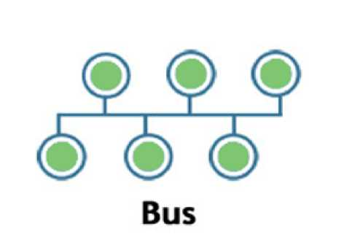
Networking Interview Questions
A list of top frequently asked networking interview questions and answers are given below
1) What is the network?
o A network is a set of devices that are connected with a physical media link. In a network, two or more nodes are connected by a physical link or two or more networks are connected by one or more nodes.
o A network is a collection of devices connected to each other to allow the sharing of data.
o Example of a network is an internet. An internet connects the millions of people across the world.
2) What do you mean by network topology?
Network topology specifies the layout of a computer network. It shows how devices and cables are connected to each other. The types of topologies are:
Bus:
o Bus topology is a network topology in which all the nodes are connected to a single cable known as a central cable or bus.
o It acts as a shared communication medium, i.e., if any device wants to send the data to other devices, then it will send the data over the bus which in turn sends the data to all the attached devices.
Juniper Business Use Only

Slide 59
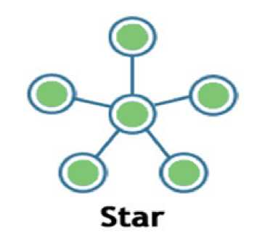
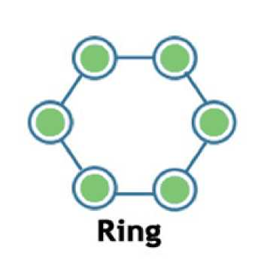
o
Bus topology is useful for a small number of devices. As if the bus is damaged then the whole network fails.
Star:
Backward Skip 10sPlay VideoForward Skip 10s
o Star topology is a network topology in which all the nodes are connected to a single device known as a central device.
o Star topology requires more cable compared to other topologies. Therefore, it is more robust as a failure in one cable will only disconnect a specific computer connected to this cable.
o If the central device is damaged, then the whole network fails. o Star topology is very easy to install, manage and troubleshoot. o Star topology is commonly used in office and home networks.
Ring
Juniper Business Use Only

Slide 60
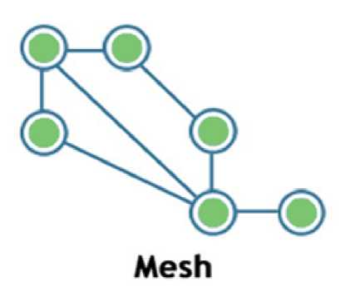
o
Ring topology is a network topology in which nodes are exactly connected to two or more nodes and thus, forming a single continuous path for the transmission.
o It does not need any central server to control the connectivity among the nodes.
o If the single node is damaged, then the whole network fails.
o Ring topology is very rarely used as it is expensive, difficult to install and manage.
o Examples of Ring topology are SONET network, SDH network, etc.
Mesh
o Mesh topology is a network topology in which all the nodes are individually connected to other nodes.
o It does not need any central switch or hub to control the connectivity among the nodes.
o Mesh topology is categorized into two parts:
o Fully connected mesh topology: In this topology, all the nodes are connected to each other.
o Partially connected mesh topology: In this topology, all the nodes are not connected to each other.
o It is a robust as a failure in one cable will only disconnect the specified computer connected to this cable.
o Mesh topology is rarely used as installation and configuration are difficult when connectivity gets more.
Juniper Business Use Only

Slide 61
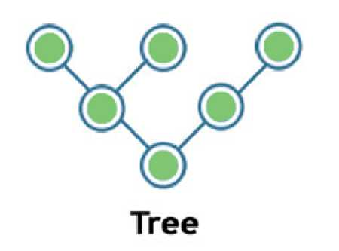
o
Cabling cost is high as it requires bulk wiring.
Tree
o Tree topology is a combination of star and bus topology. It is also known as the expanded star topology.
o In tree topology, all the star networks are connected to a single bus.
o Ethernet protocol is used in this topology.
o In this, the whole network is divided into segments known as star networks which can be easily maintained. If one segment is damaged, but there is no effect on other segments.
o Tree topology depends on the "main bus," and if it breaks, then the whole network gets damaged.
Hybrid
o A hybrid topology is a combination of different topologies to form a resulting topology.
o If star topology is connected with another star topology, then it remains star topology. If star topology is connected with different topology, then it becomes a Hybrid topology.
o It provides flexibility as it can be implemented in a different network environment.
o The weakness of a topology is ignored, and only strength will be taken into consideration.
3) What are the advantages of Distributed Processing?
A list of advantages of distributed processing:
Juniper Business Use Only

Slide 62
o
Secure
o Support Encapsulation o Distributed database o Faster Problem solving o Security through redundancy o Collaborative Processing
4) What is the criteria to check the network reliability?
Network reliability: Network reliability means the ability of the network to carry out the desired operation through a network such as communication through a network.
Network reliability plays a significant role in the network functionality. The network monitoring systems and devices are the essential requirements for making the network reliable.The network monitoring system identifies the problems that are occurred in the network while the network devices ensure that data should reach the appropriate destination.
The reliability of a network can be measured by the following factors:
o Downtime: The downtime is defined as the required time to recover.
o Failure Frequency: It is the frequency when it fails to work the way it is intended.
o Catastrophe: It indicates that the network has been attacked by some unexpected event such as fire, earthquake.
5) Which are the different factors that affect the security of a network?
There are mainly two security affecting factors: o Unauthorized Access o Viruses
Juniper Business Use Only

Slide 63
6) Which are the different factors that affect the reliability of a network?
The following factors affect the reliability of a network: o Frequency of failure o Recovery time of a network after a failure
7) Which are the different factors that affect the performance of a network?
The following factors affect the performance of a network: o Large number of users o Transmission medium types o Hardware o Software
8) What makes a network effective and efficient?
There are mainly two criteria which make a network effective and efficient:
o Performance: : performance can be measured in many ways like transmit time and response time.
o Reliability: reliability is measured by frequency of failure.
o Robustness: robustness specifies the quality or condition of being strong and in good condition.
o Security: It specifies how to protect data from unauthorized access and viruses.
9) What is bandwidth?
Every signal has a limit of upper range frequency and lower range frequency. The range of limit of network between its upper and lower frequency is called bandwidth.
Juniper Business Use Only

Slide 64
10) What is a node and link?
A network is a connection setup of two or more computers directly connected by some physical mediums like optical fiber or coaxial cable. This physical medium of connection is known as a link, and the computers that it is connected are known as nodes.
11) What is a gateway? Is there any difference between a gateway and router?
A node that is connected to two or more networks is commonly known as a gateway. It is also known as a router. It is used to forward messages from one network to another. Both the gateway and router regulate the traffic in the network.
Differences between gateway and router:
A router sends the data between two similar networks while gateway sends the data between two dissimilar networks.
12) What is DNS?
DNS is an acronym stands for Domain Name System.
o DNS was introduced by Paul Mockapetris and Jon Postel in 1983.
o It is a naming system for all the resources over the internet which includes physical nodes and applications. It is used to locate to resource easily over a network.
o DNS is an internet which maps the domain names to their associated IP addresses.
o Without DNS, users must know the IP address of the web page that you wanted to access.
Working of DNS:
If you want to visit the website of "javaTpoint", then the user will type "https://www.javatpoint.com" into the address bar of the web browser. Once the domain name is entered, then the domain name system will translate the domain name into the IP address which can be easily interpreted by the computer. Using the IP address, the computer can locate the web page requested by the user.
Juniper Business Use Only

Slide 65
13) What is DNS forwarder?
o A forwarder is used with DNS server when it receives DNS queries that cannot be resolved quickly. So it forwards those requests to external DNS servers for resolution.
o A DNS server which is configured as a forwarder will behave differently than the DNS server which is not configured as a forwarder.
o Following are the ways that the DNS server behaves when it is configured as a forwarder:
o When the DNS server receives the query, then it resolves the query by using a cache.
o If the DNS server is not able to resolve the query, then it forwards the query to another DNS server.
o If the forwarder is not available, then it will try to resolve the query by using root hint.
14) What is NIC?
o NIC stands for Network Interface Card. It is a peripheral card attached to the PC to connect to a network. Every NIC has its own MAC address that identifies the PC on the network.
o It provides a wireless connection to a local area network.
o NICs were mainly used in desktop computers.
15) What is the meaning of 10Base-T?
It is used to specify data transfer rate. In 10Base-T, 10 specify the data transfer rate, i.e., 10Mbps. The word Base specifies the baseband as opposed to broadband. T specifies the type of the cable which is a twisted pair.
16) What is NOS in computer networking?
Juniper Business Use Only

Slide 66
o NOS stands for Network Operating System. It is specialized software which is used to provide network connectivity to a computer to make communication possible with other computers and connected devices.
o NOS is the software which allows the device to communicate, share files with other devices.
o The first network operating system was Novel NetWare released in 1983. Some other examples of NOS are Windows 2000, Windows XP, Linux, etc.
17) What are the different types of networks?
Networks can be divided on the basis of area of distribution. For example:
o PAN (Personal Area Network): Its range limit is up to 10 meters. It is created for personal use. Generally, personal devices are connected to this network. For example computers, telephones, fax, printers, etc.
o LAN (Local Area Network): It is used for a small geographical location like office, hospital, school, etc.
o HAN (House Area Network): It is actually a LAN that is used within a house and used to connect homely devices like personal computers, phones, printers, etc.
o CAN (Campus Area Network): It is a connection of devices within a campus area which links to other departments of the organization within the same campus.
o MAN (Metropolitan Area Network): It is used to connect the devices which span to large cities like metropolitan cities over a wide geographical area.
o WAN (Wide Area Network): It is used over a wide geographical location that may range to connect cities and countries.
o GAN (Global Area Network): It uses satellites to connect devices over global are.
18) What is POP3?
POP3 stands for Post Office Protocol version3. POP is responsible for accessing the mail service on a client machine. POP3 works on two models such as Delete mode and Keep mode.
Juniper Business Use Only

Slide 67
19) What do you understand by MAC address?
MAC stands for Media Access Control. It is the address of the device at the Media Access Control Layer of Network Architecture. It is a unique address means no two devices can have same MAC addresses.
20) What is IP address?
IP address is a unique 32 bit software address of a computer in a network system.
21) What is private IP address?
There are three ranges of IP addresses that have been reserved for IP addresses. They are not valid for use on the internet. If you want to access internet on these private IPs, you must have to use proxy server or NAT server.
22) What is public IP address?
A public IP address is an address taken by the Internet Service Provider which facilitates you to communication on the internet.
23) What is APIPA?
APIPA is an acronym stands for Automatic Private IP Addressing. This feature is generally found in Microsoft operating system.
24) What is the full form of ADS?
o ADS stands for Active Directory Structure.
o ADS is a microsoft technology used to manage the computers and other devices.
o ADS allows the network administrators to manage the domains, users and objects within the network.
o ADS consists of three main tiers:
Juniper Business Use Only

Slide 68
o
Domain: Users that use the same database will be grouped into a single domain.
o Tree: Multiple domains can be grouped into a single tree. o Forest: Multiple trees can be grouped into a single forest.
25) What is RAID?
RAID is a method to provide Fault Tolerance by using multiple Hard Disc Drives.
26) What is anonymous FTP?
Anonymous FTP is used to grant users access to files in public servers. Users which are allowed access to data in these servers do not need to identify themselves, but instead log in as an anonymous guest.
27) What is protocol?
A protocol is a set of rules which is used to govern all the aspects of information communication.
28) What are the main elements of a protocol?
The main elements of a protocol are:
o Syntax: It specifies the structure or format of the data. It also specifies the order in which they are presented.
o Semantics: It specifies the meaning of each section of bits.
o Timing: Timing specifies two characteristics: When data should be sent and how fast it can be sent.
29 What is the Domain Name System?
There are two types of client/server programs. First is directly used by the users and the second supports application programs.
Juniper Business Use Only

Slide 69
The Domain Name System is the second type supporting program that is used by other programs such as to find the IP address of an e-mail recipient.
30) What is link?
A link is connectivity between two devices which includes the cables and protocols used in order to make communication between devices.
31) How many layers are in OSI reference model?
OSI reference model: OSI reference model is an ISO standard which defines a networking framework for implementing the protocols in seven layers. These seven layers can be grouped into three categories:
o Network layer: Layer 1, Layer 2 and layer 3 are the network layers.
o Transport layer: Layer 4 is a transport layer.
o Application layer. Layer 5, Layer 6 and Layer 7 are the application layers.
There are 7 layers in the OSI reference model.
1. Physical Layer
o It is the lowest layer of the OSI reference model.
o It is used for the transmission of an unstructured raw bit stream over a physical medium.
o Physical layer transmits the data either in the form of electrical/optical or mechanical form.
o The physical layer is mainly used for the physical connection between the devices, and such physical connection can be made by using twisted-pair cable, fibre-optic or wireless transmission media.
2. DataLink Layer
o It is used for transferring the data from one node to another node.
o It receives the data from the network layer and converts the data into data frames and then attach the physical address to these frames which are sent to the physical layer.
Juniper Business Use Only

Slide 70
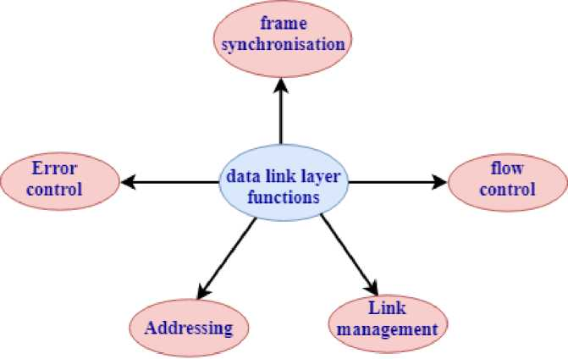
o It enables the error-free transfer of data from one node to another node. Functions of Data-link layer:
o Frame synchronization: Data-link layer converts the data into frames, and it ensures that the destination must recognize the starting and ending of each frame.
o Flow control: Data-link layer controls the data flow within the network.
o Error control: It detects and corrects the error occurred during the transmission from source to destination.
o Addressing: Data-link layer attach the physical address with the data frames so that the individual machines can be easily identified.
o Link management: Data-link layer manages the initiation, maintenance and, termination of the link between the source and destination for the effective exchange of data.
3. Network Layer
o Network layer converts the logical address into the physical address.
o It provides the routing concept means it determines the best route for the packet to travel from source to the destination.
Functions of network layer:
Juniper Business Use Only

Slide 71
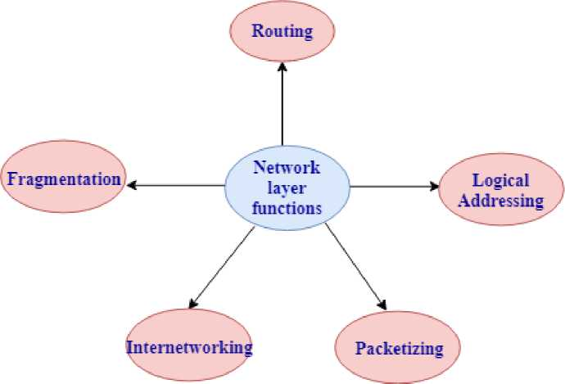
o Routing: The network layer determines the best route from source to destination. This function is known as routing.
o Logical addressing: The network layer defines the addressing scheme to identify each device uniquely.
o Packetizing: The network layer receives the data from the upper layer and converts the data into packets. This process is known as packetizing.
o Internetworking: The network layer provides the logical connection between the different types of networks for forming a bigger network.
o Fragmentation: It is a process of dividing the packets into the fragments.
4. Transport Layer
o It delivers the message through the network and provides error checking so that no error occurs during the transfer of data.
o It provides two kinds of services:
o Connection-oriented transmission: In this transmission, the receiver sends the acknowledgement to the sender after the packet has been received.
o Connectionless transmission: In this transmission, the receiver does not send the acknowledgement to the sender.
5. Session Layer
Juniper Business Use Only

Slide 72
o The main responsibility of the session layer is beginning, maintaining and ending the communication between the devices.
o Session layer also reports the error coming from the upper layers.
o Session layer establishes and maintains the session between the two users.
6. Presentation Layer
o The presentation layer is also known as a Translation layer as it translates the data from one format to another format.
o At the sender side, this layer translates the data format used by the application layer to the common format and at the receiver side, this layer translates the common format into a format used by the application layer. Functions of presentation layer:
o Character code translation
o Data conversion
o Data compression
o Data encryption
7. Application Layer
o Application layer enables the user to access the network.
o It is the topmost layer of the OSI reference model.
o Application layer protocols are file transfer protocol, simple mail transfer protocol, domain name system, etc.
o The most widely used application protocol is HTTP(Hypertext transfer protocol ). A user sends the request for the web page using HTTP.
32) What is the usage of OSI physical layer?
The OSI physical layer is used to convert data bits into electrical signals and vice versa.
On this layer, network devices and cable types are considered and setup.
Juniper Business Use Only

Slide 73
33) Explain the functionality of OSI session layer?
OSI session layer provides the protocols and means for two devices on the network to communicate with each other by holding a session. This layer is responsible for setting up the session, managing information exchange during the session, and tear-down process upon termination of the session.
34) What is the maximum length allowed for a UTP cable?
The maximum length of UTP cable is 90 to 100 meters.
35) What is RIP?
o RIP stands for Routing Information Protocol. It is accessed by the routers to send data from one network to another.
o RIP is a dynamic protocol which is used to find the best route from source to the destination over a network by using the hop count algorithm.
o Routers use this protocol to exchange the network topology information.
o This protocol can be used by small or medium-sized networks.
36) What do you understand by TCP/IP?
TCP/IP is short for Transmission Control Protocol /Internet protocol. It is a set of protocol layers that is designed for exchanging data on different types of networks.
37) What is netstat?
The "netstat" is a command line utility program. It gives useful information about the current TCP/IP setting of a connection.
38) What do you understand by ping command?
The "ping" is a utility program that allows you to check the connectivity between the network devices. You can ping devices using its IP address or name.
Juniper Business Use Only

Slide 74
39) What is Sneakernet?
Sneakernet is the earliest form of networking where the data is physically transported using removable media.
40) Explain the peer-peer process.
The processes on each machine that communicate at a given layer are called peer-peer process.
41) What is a congested switch?
A switch receives packets faster than the shared link. It can accommodate and stores in its memory, for an extended period of time, then the switch will eventually run out of buffer space, and some packets will have to be dropped. This state is called a congested state.
42) What is multiplexing in networking?
In Networking, multiplexing is the set of techniques that is used to allow the simultaneous transmission of multiple signals across a single data link.
43) What are the advantages of address sharing?
Address sharing provides security benefit instead of routing. That's because host PCs on the Internet can only see the public IP address of the external interface on the computer that provides address translation and not the private IP addresses on the internal network.
44) What is RSA Algorithm?
RSA is short for Rivest-Shamir-Adleman algorithm. It is mostly used for public key encryption.
45) How many layers are in TCP/IP?
Juniper Business Use Only

Slide 75
There are basic 4 layers in TCP/IP:
1. Application Layer
2. Transport Layer
3. Internet Layer
4. Network Layer
46) What is the difference between TCP/IP model and the OSI model?
Following are the differences between the TCP/IP model and OSI model:
TCP/IP model | OSI model
Full form of TCP is transmission control protocol. | Full form of OSI is Open System Interconnection.
TCP/IP has 4 layers. | OSI has 7 layers.
TCP/IP is more reliable than the OSI model. | OSI model is less reliable as compared to the TCP/IP model.
TCP/IP model uses horizontal approach. | OSI model uses vertical approach.
TCP/IP model uses both session and presentation layer in the application layer. | OSI Reference model uses separate session and presentation layers.
TCP/IP model developed the protocols first and then model. | OSI model developed the model first and then protocols.
In Network layer, TCP/IP model supports only connectionless communication. | In the Network layer, the OSI model supports both connection-oriented and connectionless communication.
TCP/IP model is a protocol dependent. | OSI model is a protocol independent.
Juniper Business Use Only

Slide 76
47) What is the difference between domain and workgroup?
Workgroup Domain
A workgroup is a peer-to-peer computer network. | A domain is a Client/Server network.
A Workgroup can consist of maximum 10 computers. | A domain can consist up to 2000 computers.
Every user can manage the resources individually on their PCs. | There is one administrator to administer the domain and its resources.
All the computers must be on the same local area network. | The computer can be on any network or anywhere in the world.
Each computer must be changed manually. | Any change made to the computer will reflect the changes to all the computers.
Networking Interview Questions
Juniper Business Use Only

Slide 77
These questions will assess your technical skills, experience, and system preferences. Interviewers want to see whether you can easily communicate technical requirements. They will test the technical knowledge necessary to get the job done. This article lists 100+ networking interview questions that are categorized into two main segments -
• Networking Interview Questions For Freshers
• Networking Interview Questions For Experienced
Networking Interview Questions For Freshers
Let's start with the basic networking interview questions. This section covers networking interview questions for freshers.
Q1. What is a network?
Ans. A network consists of two or more separate devices linked together such that they can communicate. Networks can be classified according to different criteria such as scope, type of connection, functional relationship, topology, or function, among others.
Explore popular courses on Shiksha Online related to networking:
Popular Technology Course Top Networking and Hardware Courses
Top Cisco Certifications Courses Popular Networking Certifications Courses
Q2. What are the different types of networks?
Ans. Considering the size or span of a network, we can classify them as follows:
• PAN (Personal Area Network) - PAN is made up of devices used by a single person. It
has a range of a few meters.
• WPAN (Wireless Personal Area Network) - It is a PAN network that uses wireless
technologies as a medium.
• LAN (Local Area Network) - LAN is a network whose range is limited to a relatively
small area, such as a room, a building, an aeroplane, etc.
Juniper Business Use Only

Slide 78
• WLAN (Wireless Local Area Network) - WLAN is a LAN network that uses wireless
means of communication. It is a widely used configuration due to its scalability and because it does not require the installation of cables.
• CAN (Campus Area Network) - A network of high-speed devices that connects LANs in
a limited geographical area, such as a university campus, a military base, etc.
• MAN (Metropolitan Area Network) - MAN is a high-speed (broadband) network
providing coverage in a larger geographic area than a campus, but still limited.
• WAN (Wide Area Network) - WAN extends over a large geographical area using
unusual means of communication, such as satellites, interoceanic cables, fibre optics, etc. Use public media.
• VLAN - It is a type of logical or virtual LAN, mounted on a physical network, in order to
increase security and performance. In special cases, thanks to the 802.11Q protocol (also called QinQ), it is possible to mount virtual networks on WAN networks. It is important not to confuse this implementation with VPN technology.
What is the Difference Between LAN and WAN?
In this blog, we will learn what are LAN and WAN Networks, advantages and disadvantages as well as the difference...read more
Types Of Computer Networks
Juniper Business Use Only

Slide 79
If I ask you, which types of computer networks do you have at your organization? The majority of us will be...read
more
Read more - What is Networking?
Q3. What is Network Cabling?
Ans. Network cables can connect two computers or computer systems directly. A cable is a cord that is made up of different conductors, which are insulated from each other. This cord is usually protected by a wrap for better strength and flexibility.
To choose a network cable, several aspects must be taken into account such as -
• The distance that must be covered with that cable
• The maximum data transmission speed
• The coating of the cable
• The type of network to be created
• The type of braiding, shielding, and/or sheath
Q4. What are the different types of network cables used in networking?
Ans. The different types of cables used in networks are -
• Unshielded Twisted Pair (UTP) Cable
• Shielded Twisted Pair (STP) Cable
• Cable Installation Guides
• Coaxial Cable
• Fibre Optic Cable
• Wireless LANs
Juniper Business Use Only

Slide 80
Q5. What is a 'subnet'?
Ans. A 'subnet' is a generic term for a section of an extensive network, usually separated by a bridge or a router. It also works for the network's broadcast domains, manages traffic flow, and helps increasing network performance. Uses of the subnet in networking include:
• Relieving network congestion
• Reallocating IP addresses
• Improving network security
Q6. What is DNS?
Ans. The Domain Name System (DNS) is a central part of the internet, providing a way to match names (a website you're seeking) to numbers (the address for the website). Anything connected to the internet - laptops, tablets, mobile phones, and websites - has an Internet Protocol (IP) address made up of numbers.
You can also explore: What Is An IP Address?
Explore - What is network security?
Q7. Differentiate between 'forward lookup' and 'reverse lookup' in DNS?
Ans. Following are the major differences between a forward lookup and reverse lookup in DNS: Forward DNS lookup Reverse DNS lookup
Converts a human input or a domain name to an IP address
Converts an IP address into a domain name
Has a mapping between hostnames and IP addresses Has a mapping that relates IP addresses to hostnames
Used for a website or other server access Used for network troubleshooting
Juniper Business Use Only

Slide 81
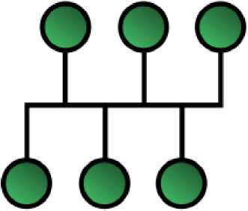
Utilizes different servers with different IP addresses
Resolves reverse lookup queries where a client request by providing an IP address
Uses DNS pointer record to identify a hostname for a g address
Uses A Records (basic) to identify any IP address for a particular hostname
Q8. What is Network Topology?
Ans. This is among the important networking interview questions. Network topology is the physical or logical arrangement in which the devices or nodes of a network (e.g. computers, printers, servers, hubs, switches, routers, etc.) are interconnected over a communication medium. It consists of two parts - the physical topology, which is the actual arrangement of the cables (the media), and the logical topology, which defines how the hosts access the media.
You must explore: What are the Different Types of Network Topology?
Types of network topologies -
Bus - In the bus network topology, each workstation is connected to a main cable called a bus. Therefore, each workstation is directly connected to every other workstation on the network.
Bus network topology
Star - In the star network topology, there is a central computer or server to which all workstations are directly connected. Each workstation is indirectly connected to the other through the central computer.
Juniper Business Use Only

Slide 82

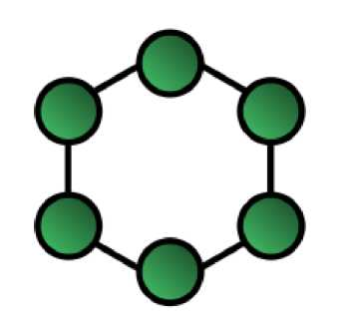
Star network topology
Ring - The workstations are connected in a closed-loop configuration in the ring network topology. Adjacent workstation pairs are directly connected. Other pairs of workstations are indirectly connected, passing data through one or more intermediate nodes.
Mesh - Mesh network topology has two forms - full and partial mesh. In the full mesh topology, each workstation is directly connected. In the partial mesh topology, some workstations are connected to all the others, and some are connected only to the other nodes with which they exchange more data.
Juniper Business Use Only

Slide 83
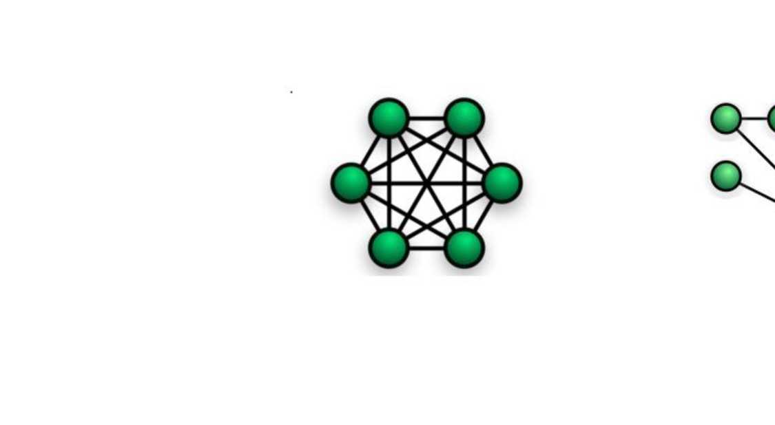
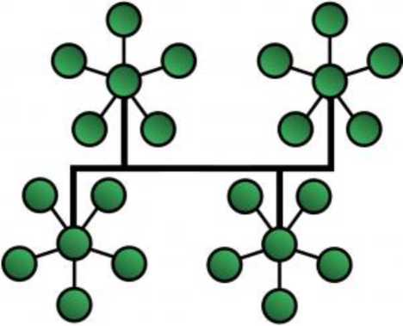
Fully Connected Mesh (Left) and Partial Mesh Network Topology (Right)
Tree - The tree network topology uses two or more star networks connected to each other. The central computers in star networks are connected to the main bus. Thus, a tree network is
a bus network of star networks.
Tree Network Topology
Juniper Business Use Only

Slide 84
Q9. What are 'client' and 'server' in a network?
Ans. Clients and servers are separate logical entities that work together over a network to accomplish a task.
A client application is the element of communication that requests or requests a network service, for example, accessing a web page, or downloading a file, or sending an email.
A server application is the element of communication that responds to customer requests, providing the required service, that is, sending the web page or the requested file or email.
The client-server model is used by computer applications such as email, the world wide web, and network printing.
Q10. What is a 'frame relay', and which layer does it operate?
Ans. Frame Relay is a data link layer digital packet-switched network protocol technology designed to connect local area networks (LANs) and transfer data over wide area networks (WANs). Frame Relay shares some of the same underlying technology as X.25.
It is based on the older X.25 packet-switching technology designed to transmit analogue data as voice conversations. Unlike X.25, designed for analogue signals, Frame Relay is a fast packet technology, meaning the protocol does not attempt to correct errors. It is often used to connect LANs with main backbones, as well as in public-wide area networks and in private network environments with leased T-1 lines. It requires a dedicated connection during the transmission period and is not ideal for voice or video, which require a constant stream of transmissions.
You can also read: Top Network Security Interview Questions
Q11. What are the different features of Frame Relay?
Ans. The different features of Frame Relay are:
• Frame Relay is a connectionless service, which means that every data packet that passes
over the network contains address information
• Frame Relay is a service that is provided with a variety of speeds from 56 Kbs to 25
Mbs. Although the speeds most used for the service are currently 56 Kbs and 1,544 Mbs
• The frames are of variable length and go up to 4,096 bytes
Juniper Business Use Only

Slide 85
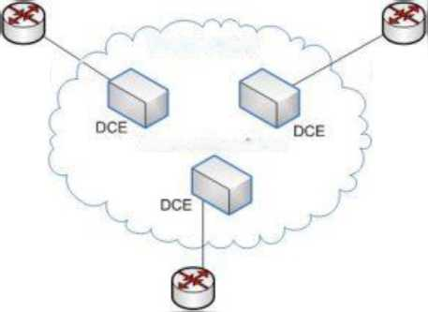
Frame Relay is considered a broadband ISDN service
• It operates at high speed (1,544 Mbps to 44,376 Mbps).
• It operates only on the physical and data link layers. Therefore, it can be easily used on
the Internet.
• It has a large frame size of 9000 bytes. Therefore, it can accommodate all local area
network frame sizes.
• Frame Relay can only detect errors (at the data link layer). But there is no flow control
or error control. It operates in the data link layer.
Q12. How does a Frame Relay Work?
Ans. Frame Relay supports the multiplexing of traffic from multiple connections over a shared physical link. It uses hardware components that include router frames, bridges, and switches to pack data into individual frame relay messages. Each connection uses a 10-bit Data Link Connection Identifier (DLCI) for unique channel addressing. There are two types of connections:
• Permanent Virtual Circuits (PVCs) for persistent connections are intended to be
maintained for long periods even if data is not actively transferred.
• Switched Virtual Circuits (SVCs) for temporary connections that last only one session.
Frame Relay then places the data in a variable-size unit called a frame. It leaves any necessary error correction (data retransmission) until the endpoints, speeding up the overall data transmission.
DTE .
Frame relay
□rre
Router 1
Router 2
Frame relay switches
DTE
Frame
Relay
-- xnr i
Juniper Business Use Only

Slide 86
Q13. What is a MAC address?
Ans. A MAC (Media Access Control) address is the unique 48-bit hardware address of a LAN card, usually stored in the ROM of the network adapter card.
The MAC address is a unique identifier that manufacturers assign to a network card or device. It is also known as a physical address represented by hexadecimal digits. Each MAC address is unique worldwide and, in theory, they are fixed for each device.
Each MAC address includes six pairs of numbers. The first three pairs help to identify the manufacturer, and the next three to the specific model. It is important to remember that a computer may have a variety of hardware to connect to networks; thus, it is common to have a MAC address for Ethernet, one for Wi-Fi, and another for Bluetooth.
Q14. What is 'beaconing'?
Ans. Beaconing is the process that allows a network to self-repair network problems. This is among the important networking interview questions; you must also prepare for the related terminologies.
Q15. Differentiate between 'attenuation', 'distortion', and 'noise'.
Ans. When a signal travels through a medium, it loses some of its energy due to the medium's resistance. This loss of energy is called attenuation.
When a signal travels through a medium from one point to another, it may change the form or shape of the signal. This is known as distortion.
Noise is unwanted electrical or electromagnetic energy that degrades the quality of signals and data.
Q16. What is an IP address?
Ans. An Internet Protocol address (IP address) is a numerical unique address of a device in a network. IP is a datagram-oriented connectionless protocol, therefore, each packet must contain a header with the source IP address, the destination IP address, and other data to be delivered successfully.
There are two types of IPs -
Juniper Business Use Only

Slide 87
• Private IP Address - A private IP address is a set of numbers assigned to each
computer or system connected to a private network. An example of a private IP address is your mobile phone or your home router, which has a default local address.
• Public IP Address - Public IP addresses are global addresses visible to anyone browsing
the Internet. A user needs an internet connection to connect to such devices.
Q17. How to find the IP address of a website?
Ans. Finding the IP address of a website or a domain is not a tricky task and involves the below steps -
• Press the “Start” button on your computer
• Type in the program and file browser “cdm”
• Hit “Enter”
• The MS-DOS console will open, where you must type “nslookup google.com”. Instead of
“google.com”, you must write the domain name of the page you want to consult
• Next, you will be able to see the IP address
Q18. What is 'bandwidth'?
Ans. The limited range of frequencies of signals that a line can carry is called the bandwidth. Bandwidth is often confused with Internet speed when it is the volume of information that can be sent over a connection in a measured amount of time, calculated in megabits per second (Mbps).
Logically the bandwidth of our network will be decisive for its quality and speed. The more bandwidth we have, the better, since we can transfer data faster.
Q19. What are 'firewalls'?
Ans. A firewall is a network security system, responsible for managing network traffic. It uses a set of security rules to prevent remote access and content filtering. Firewalls protect the systems or networks from viruses, worms, malware, etc. Firewalls are usually of two types -
Juniper Business Use Only

Slide 88
Physical - A physical firewall or hardware firewall is a physical device that sits between the external network and the server. They analyze incoming traffic and filter out any threats to the device. Widely used in institutions and large companies.
Logical - A logical or software firewall can exist anywhere on the subnet and protects hosts anywhere without rewiring. They only protect the computer on which they are installed, and in many cases, they are integrated into the operating system.
You can also explore: What are the Different Types of Firewalls?
Q20. How does a firewall work?
Ans. This is among the popularly asked networking interview questions. The firewall 'listens' for what information packets are trying to leave or enter the computer system. Blocking can be done based on various criteria, such as the IP to which they are destined, the type of port used to send them, or the application of origin.
One of the most complex aspects of using firewalls lies in their configuration, in deciding what types of connections are blocked and which ones are not.
Juniper Business Use Only

Slide 89
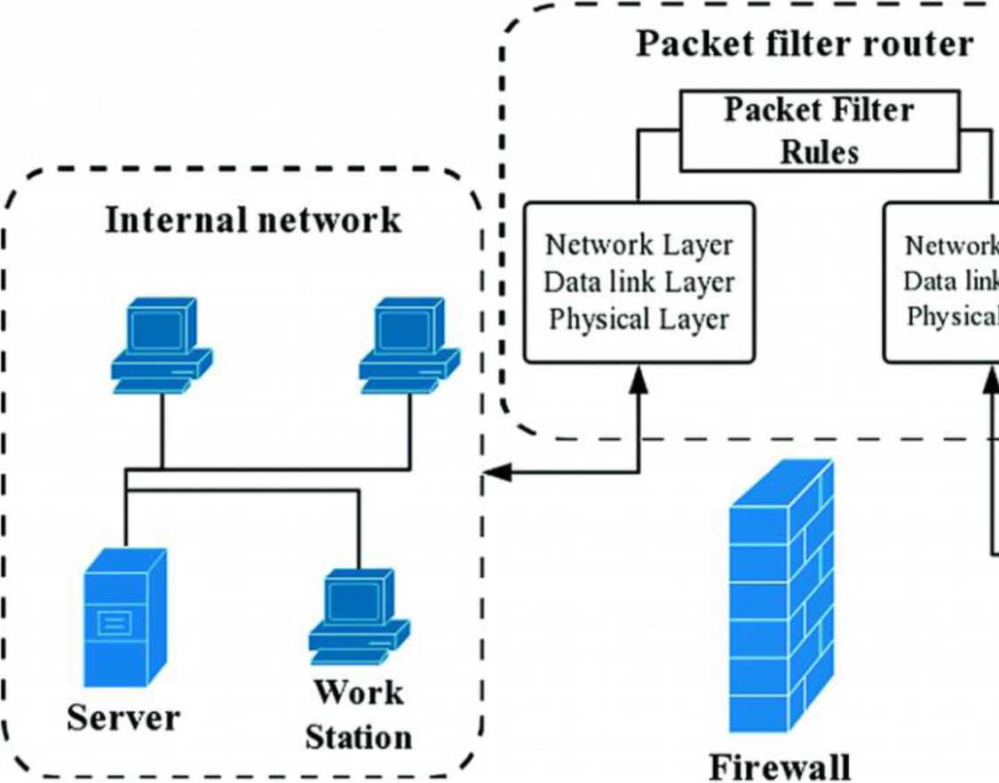
Q21. What are the major types of networks?
Ans. There are two major type of networks: Server-based network and Peer-to-peer network.
Q22. What are the important topologies for networks?
Ans. There are three essential topologies: Star, Bus, and Ring.
Q23. Differentiate between static IP addressing and dynamic IP addressing.
Ans. In a static IP address, a computer (or another device) is always configured to use the same IP address. In a dynamic IP address, the IP address can change periodically and is managed by a centralized network service.
Juniper Business Use Only

Slide 90
Q24. What are the different ways to exchange data?
Ans. Following are the different ways to exchange data:
• Simplex
• Half-duplex
• Full-duplex
Q25. What are routers?
Ans. Routers connect two or more network segments. These intelligent network devices store information in their routing tables such as paths, hops, and bottlenecks. They determine the most accurate data transfer paths and operate in Open Systems Interconnection (OSI) Network Layer.
The roles of a router include:
• Inter-network communication
• Best path selection
• Packet forwarding
• Packet filtering
For more information, you can also explore: What is Router in Computer Networks?
You can also explore: Network Devices in Computer Networks and Its Types
Q26. What are the criteria for the best path selection of a router?
Ans. The following parameters define the path selection:
• Longest prefix match
• Minimum AD (administrative distance)
• Lowest metric value
Q27. Explain what is a source route?
Juniper Business Use Only

Slide 91
Ans. The source route is defined as a sequence of IP addresses used to identify a datagram's route. You can also involve the source route in the IP datagram header.
Q28. What is the difference between 'standard' and 'extended' ACL (access control list)?
Ans. Standard ACLs are source-based, whereas extended ACLs are source- and destination-based.
Q29. What is data encapsulation?
Ans. Data encapsulation is breaking down information into smaller, manageable chunks before their transmission across the network.
Q30. What is RAS?
Ans. RAS (Remote Access Services) refers to any combination of hardware and software to enable remote access to tools or information that typically reside on a network of IT devices.
Q31. Mention the different network protocols that are supported by Windows RRAS services.
Ans. Following are the three main network protocols supported by Windows RRAS services:
. NetBEUI
. TCP/IP
. IPX
Q32. What are the perquisites to configure a server?
Ans. The perquisites to configure a server are:
• LAN card should be connected
• Root (partition on which window is installed) should be in NTFS format.
• A server should be configured with a static IP address.
Q33. How can you secure a computer network?
Ans. You can achieve a secure computer network in the following ways:
Juniper Business Use Only

Slide 92
Install a reliable and updated antivirus program across the network
• Ensure firewalls are setup and configured properly
• Monitor firewall performance
• Ensure User authentication
• Update passwords regularly every quarter
• Create a virtual private network (VPN)
You can also explore: What is a Virtual Private Network (VPN)?
Q34. Mention the uses of the Hamming code.
Ans. Following are some of the common applications of using Hemming code:
• Modems
• Satellites
• PlasmaCAM
• Shielding wire
• Embedded Processor
• Computer Memory
• Open connectors
Q35. What are proxy servers, and how do they protect computer networks?
Ans. Proxy servers prevent external users from identifying the IP addresses of an internal network. They make a network virtually invisible to external users, who cannot identify the physical location of a network without knowledge of the correct IP address.
Q36. What are Nodes and Links?
Ans. Nodes - Devices or data points on a more extensive network are known as nodes. They are individual parts of a larger data structure and contain data. They also link other nodes.
Juniper Business Use Only

Slide 93
Links- A link is the physical and logical network component for interconnecting hosts or nodes in a network. It is a physical communication medium such as a coaxial cable or optical fibre.
Q37. What is SLIP?
Ans. SLIP or Serial Line Interface Protocol was developed during the early UNIX days and is used for remote access.
SLIP does not provide error detection as it relies on higher-layer protocols. Therefore, SLIP alone is not successful on an error-prone dial-up connection. However, it is still useful to test the operating system's response capabilities under load (looking at ping flood statistics).
Interviewers often ask such networking interview questions, and you must prepare for such abbreviations.
Q38. What is TCP/IP?
Ans. TCP/IP is the short form of the Transmission Control Protocol / Internet Protocol. It is a set of protocol layers designed to facilitate data exchange on heterogeneous networks.
Learn all about Cisco Certifications, their Scope, and Benefits, read our blog - what are Cisco Certifications?
Q39. How many layers does TCP/IP Model have?
Ans. TCP/IP Model has four layers:
Layer
Description
Network Interface
Network Interface is also called a network access layer. It defines how data should be sent physically using the network.
Internet
It enables hosts to insert packets into the network and deliver them to the destination on the same or another remote network.
Transport
This layer permits devices on the source and destination hosts to converse. It ensures reliability, flow control, and data correction sent over the network.
Application
It is the topmost layer of the TCP/IP model. It defines TCP/IP application
Juniper Business Use Only

Slide 94
protocols and how host programs interface with transport layer services to use the network.
Q40. Explain the different layers in the OSI model?
Ans. It is one of the most commonly asked networking interview questions. The OSI (Open Systems Interconnection) Model consists of seven layers:
Layer | Description
Physical | It is the lowest layer of the OSI Model. It transmits raw unstructured data bits over a communication channel. The Physical layer is responsible for the actual physical connection between the devices. While receiving data, the Physical layer gets the signal received, converts it into 0s and 1s, and sends them to the Data Link layer.
Data Link | The directly connected nodes perform node-to-node data transfer at this layer, where data is packaged into frames. This layer also corrects errors that occur at the Physical layer. The data Link Layer is divided into two sub-layers : • Logical Link Control (LLC)Media Access Control (MAC)
Network | The Network layer transmits data from one host to another in different networks. It receives frames from the data link layer and delivers them to their intended destinations based on the addresses inside the frame. It also takes care of packet routing.
Transport | The transport layer manages the delivery and error-checking of data packets. It ensures the end-to-end delivery of the complete message.
Session | This layer creates communication channels, called sessions, between devices. It opens sessions, ensures they remain open while data is being transferred, and closes them when communication ends. It is also responsible for authentication and reconnections.
Presentation | This layer extracts data from the application layer and manipulates it per the required format to transmit over the network.
Application | At the Application layer, both the end-user and the application layer interact directly with the software application. This layer acts as a window for the application
Juniper Business Use Only

Slide 95
services to access the network and display the received information to the user.
Q41. A gateway works in which layer of the OSI model?
Ans. Transport layer.
Q42. Explain why the standard OSI model is known as 802.xx?
Ans. The OSI model was introduced in February 1980. In 802.XX, '80' is named for the year 1980, and '2' is named for the month of February.
Q43. What common software problems lead to network defects?
Ans. It can be any or a combination of:
• Application conflicts
• Client-server problems
• Configuration error
• Protocol mismatch
• Security issues
• User policy & rights issues
This question is among the basic networking interview questions and you must prepare for such questions.
Q44. Why is encryption on a network necessary?
Ans. Encryption is changing data from its original readable to unreadable format, thus ensuring network security. The user must use a secret key or password to decrypt the data.
Encryption is useful for communications and in any case where you want to protect sensitive information. Thus, it is possible to encrypt the information in disks, folders or even individual files to prevent unauthorized access. Then, in addition to protecting users' privacy, data encryption prevents other types of attacks, such as identity theft or bank fraud, and provides a protection mechanism against the theft or loss of devices with sensitive information.
Juniper Business Use Only

Slide 96
Q45. What are the types of errors?
Ans. There are two categories of errors -
• Single-bit error - one-bit error per data unit
• Burst error - Two or more bits of errors per data unit
Q46. What is a client-server model?
Ans. The client-server model or architecture is a communication framework for network processes. This framework is distributed among service requestors, clients, and service providers. It offers them transparent access to applications, data, computing services or any other resource of the workgroup and/or across the organization on multiple platforms.
Client-Server Functions
• User interface management
• Management of shared peripherals
• Capture and validation of input data
• Generation of queries and reports on databases
• Control of concurrent access to shared databases
• Create communications links with other local or wide area networks
Q47. What is TELNET?
Ans. TELNET is a client-service protocol on the internet or local area network, allowing a user to log on to a remote device and have access to it. This is among the most commonly asked networking interview questions. Technically, it is a bidirectional interactive text-oriented communication facility, which uses a virtual terminal connection.
Q48. What is RIP?
Ans. In networking, RIP is an abbreviation for Routing Information Protocol. It is a simple protocol that exchanges information between the routers.
Q49. What is half-duplex?
Juniper Business Use Only

Slide 97
Ans. It is the mode of communication between two devices. Here the data flows bi-directionally but simultaneously. A perfect example of a half-duplex is a walkie-talkie.
Q50. What is a full-duplex?
Ans. It is a mode of communication between two devices and the data flow is bi-directional too, but the flow is simultaneous. One of the examples of full-duplex is a telephone.
Q51. What is netstat?
Ans. Netstat is a command-line utility program that provides information about a connection's current Transmission Control Protocol /Internet Protocol (TCP/IP) settings.
Q52. What is a peer-peer process?
Ans. The processes on each machine that communicate at a given layer are called the peer-peer process.
Q53. What is anonymous FTP?
Ans. With the help of an anonymous FTP, users can be granted access to files in public servers. Users can log in as anonymous guests, thus the name.
Q54. What is NAT?
Ans. Network Address Translation is a protocol that allows a network device, usually a firewall, to assign a public address to a computer/s inside a private network.
Q55. Mention a few examples of private network addresses.
Ans. Few examples of private network addresses are:
10.0. 0.0 with a subnet cover of 255.0.0.0172.16.0.0 with subnet cover of
255.240.0. 0192.168.0.0 with subnet cover of 255.255.0.0.
Q56. Can you tell me the main elements of a protocol?
Ans. There are three main elements of a protocol -
• Syntax: It refers to the structure or format of the data and their order of presentation.
• Semantics: It specifies the meaning of each section of bits.
Juniper Business Use Only

Slide 98
• Timing: Timing refers to two characteristics, which include the timing of data sending and the speed of data sending.
Such common networking interview questions are often asked by the interviewers.
Q57. What is NIC?
Ans. NIC is the abbreviation for Network Interface Card. It is a peripheral card with electronic circuitry. It is attached to a PC and connects to a network. NIC has its own MAC address and this identifies a PC on the network.
Q58. What is the difference between Communication and Transmission?
Ans. Transmission - A process of sending and receiving data between source and destination, in only one way. It is regarded as the physical movement of data.
Communication - A process of sending and receiving data between source and destination, in both ways.
Q59. Explain NAT in networking.
Ans. Network Address Translation (NAT) is a protocol used to convert the IP address of the computer network into a local network to a single IP address. It takes all your local network devices and provides a single IP address to share a single connection to the internet. NAT is used router, computer, firewall in a local network.
Q60. Explain NOS.
Ans. Short form for Network Operating System. Specialized software that provides connectivity to a computer such that it can communicate with other computers and devices on a network.
Q61. What is IDEA?
Ans. IDEA is the abbreviation for International Data Encryption Algorithm. It is the replacement for the Data Encryption Standard (DES).
Q62. What is ASCII?
Ans. American Standard Code for Information Interchange.
Q63. What is Brouter?
Juniper Business Use Only

Slide 99
Ans. Brouter is a device that functions as both a bridge and a router. It forwards data within the networks and also routes data to individual systems in a network.
Q64. Mention the maximum length of the Thinnet cable?
Ans. The maximum length of the Thinnet cable is 185 meters.
Q65. Name the cable which uses the RJ11 connector?
Ans. Telephone cables use the RJ11 connector.
Q66. How would you differentiate between Firewall and Antivirus?
Ans. Both are security applications used in networking.
A firewall prevents unauthorized access in private networks as intranets. However, it does not protect against viruses, spyware, or adware.
An antivirus is a software that protects a computer from any malicious software, virus, spyware, or adware.
You may consider such networking interview questions to be basic, but such questions are the favourite of interviewers as interviewees often leave behind such networking interview questions while preparing.
Q67. How will you recover data from a Virus-infected system?
Ans. We will install an OS and updated antivirus in a system that is free of any viruses, and then connect the hard drive of the infected system as a secondary drive. The hard drive will then be scanned and cleaned. Data can now be copied into the system.
Q68. What is ipconfig?
Ans. 'ipconfig' is an acronym for Internet Protocol Configuration. We use ipconfig on Microsoft Windows to view and configure the network interface. It displays all TCP/IP network summary information available on a network and helps to modify the DHCP protocol and DNS settings.
Q69. What is ifconfig?
Ans. It is an acronym for Interface Configuration and is used on Linux, Mac, and UNIX operating systems. 'ifconfig' configures and controls the TCP/IP network interface parameters from
Juniper Business Use Only

Slide 100
Command Line Interface while allowing the user to check the IP addresses of these network interfaces.
Q70. What is the semantic gap?
Ans. Semantic gap is a difference between high-level programming sets in various computer languages and the simple computing instructions used by microprocessors.
Q71. What is the difference between a Domain and a Workgroup?
Ans. This is one of the important networking interview questions that you must prepare for your interview. The main difference between a Domain and a Workgroup is where do the computer networks belong to. If it is a home network, then computers will be a part of a workgroup, and if it's a workplace network, then the computers will be a part of a domain.
Below are some of the major differences between a Domain and a Workgroup:
Domain | Workgroup
The computers in a domain have a centralized database. | The computers in the workgroup have their own loca
Computers can be on a different local network. | All computers must be on the same local area networ
One or more computers are servers for providing access, security permission to all other computers in a network. | All computers are peers and no computer has control computer.
A domain is used for transferring and sharing sensitive and important data. | It is used for sharing less secure data.
Domain has centralized authentication servers which set the rule of authentication. | Each computer has its own authentication rule for eve account.
If a user has an account in a domain then the user can log in to any computer in a domain. | Each computer has a set of user accounts. If the user on that computer then only the user will be able to ac computer.
Changes made in one computer are automatically made to all other computers in a network. | Computer settings need to change manually for each
Juniper Business Use Only

Slide 101
It is used by large public and business networks.
A workgroup is better suited for fewer computers.
Thousands of computers can be connected. Only 20 computers connected.
Q72. What Is NVT?
Ans. NVT stands for Network Virtual Terminal and is a representation of a primary terminal. This virtual terminal helps you to start a telnet session.
Q73. What Is BGP?
Ans. BGP or Border Gateway Protocol is a protocol used to transfer data and information between different host gateways or autonomous systems.
Q74. What is Round Trip Time?
Ans. Round Trip Time or RTT is the time taken to send a message from one end of a network to the other and back.
Q75. What are 127.0.0.1 and localhost?
Ans. Localhost is the standard hostname given to the machine, and it is represented by the IP address 127.0.0.1. Therefore, we can say that 127.0.0.1 and localhost are the same thing.
Q76. Which are the most typical functional units of the client/server applications?
Ans. The most typical functional units of the client/server applications are -
• Presentation logic or user interface (e.g., ATMs)
• Business logic (e.g., Account balance inquiry)
• Data (e.g., Bank account records)
Q77. What are the Triggers?
Ans. Triggers are event-driven specialized procedures and are managed by database management systems. It is capable of performing complex actions and uses procedural languages full throttle.
Juniper Business Use Only

Slide 102
Q78. What is a Gateway?
Ans. A gateway is a hardware device that is connected to two or more networks. It may be a router, firewall, server, or any other similar device, and is capable of regulating traffic in the network.
For more information, you can also explore: What is a Gateway in networking?
Q79. Is there a difference between a gateway and a router?
Ans. A gateway sends the data between two dissimilar networks, while a router sends the data between two similar networks.
Q80. What is a Virtual Private Network (VPN)? What are the advantages of using a VPN Connection?
Ans. A VPN or Virtual Private Network is an encrypted connection (secure tunnel) built on the internet from a device to a network. It helps in the creation of a protected network between different networks using the internet (public network), ensuring that sensitive data is safely transmitted. This makes it difficult for third parties to gain unauthorized access, track your activities online, or steal data. By using the VPN, a client can connect to the organization's network remotely.
Some of the advantages of using VPN Connection are:
• Remote Access
• Protected File Sharing
• Anonymity
• Enhanced Security
• Improved Performance
• Anonymity
• Network Scalability
• Prevents Data Throttling
Q81. Explain the different types of VPN.
Juniper Business Use Only

Slide 103
Ans. There are two types of VPNs:
• Remote Access Virtual Private Network:
A Remote Access VPN securely connects a device (endpoints like laptops, tablets, or smartphones) outside the corporate office. It allows a client to associate with a private network and access every one of its resources and services remotely. The connection between the private network and the user happens securely through the Internet. It is a low-cost solution and is helpful for both business and home users.
• Site-to-Site or Router-to-Router Virtual Private Network:
This VPN is mostly used in large organizations with branches in different locations to connect the network of one office to another in different locations. It has two sub-categories:
• Intranet VPN: Intranet VPN allows several offices of the same company to connect
using the Site-to-Site VPN type. It is commonly used for connecting remote offices in different geographical locations using shared infrastructure (internet connectivity and servers) with the same accessibility policies as a private WAN (wide area network).
• Extranet VPN: Extranet VPN allows companies to use Site-to-site VPN type to connect
to the office of another company. It uses shared infrastructure over an intranet, suppliers, customers, partners, etc., and connects them using dedicated connections.
Q82. What is EGP? What are its advantages?
Ans. EGP stands for Exterior Gateway Protocol. It is used to exchange net-reachability information between Internet gateways within the same or different autonomous systems. EGP is the protocol of the routers. It is used to identify the set of networks that you will be able to reach within or via each independent system.
Networking Interview Questions For Experienced Candidates
We are now moving on to the last category of networking interview questions. This section covers interview questions for experienced candidates.
Q83. Explain 10Base-T.
Juniper Business Use Only

Slide 104
Ans. 10Base-T specifies data transfer rate, i.e., 10Mbps. Here the usage of the term 'Base' defines 'Baseband' and not 'Broadband'. T denotes the type of cable, which is a twisted pair.
Q84. Name the user support layers.
Ans. There are three types of user support layers -
• Session Layer
• Presentation Layer and
• Application Layer
Q85. What is Piggy Backing?
Ans. It is the process of gaining access to a restricted communications channel by using an already established session by another user. This technique is known to improve the efficiency of the bidirectional protocols.
Q86. What is an asynchronous transmission?
Ans. It is a serial mode of transmission. It is the process of data transmission, where every character is a self-contained unit. Each character in asynchronous transmission has its start and stop bits, along with an uneven interval between them.
Q87. What do you mean by a synchronous transmission?
Ans. Synchronous transmission refers to continuous data streaming in the form of signals, accompanied by regular timing signals. These signals are generated by the external clocking mechanism and ensure that senders and receivers are in synchrony.
Q88. What are the different types of transmission media?
Ans. Transmission media has two broad types -
• Guided media (wired)
• Unguided media (wireless)
Q89. What is Process Sigma?
Ans. Process Sigma measures the frequency of a task that is performed without any error. It is expressed as a number of standard deviations on a normal distribution.
Juniper Business Use Only

Slide 105
Q90. What is FMEA?
Ans. Failure Mode Effect and Analysis or FMEA is a qualitative and systematic tool to identify potential failure modes in a system, the reasons, and their effects.
Q91. What is the backbone network?
Ans. It refers to a centralized infrastructure for distributing different routes and data to various networks. Backbone networks connect LANs and WANs and also handles the management of bandwidth and multiple channels.
Q92. What is OSPF?
Ans. OSPF is an abbreviation for Open Shortest Path First. It is a routing protocol that uses a link-state routing (LSR) algorithm to find out the best possible path for data exchange.
Q93. What is the range of addresses in the classes of internet addresses?
Ans. Following are the five different ranges of addresses in the classes of the internet:
. Class A: 0.0.0.0 - 127.255.255.255
. Class B: 128.0.0.0 - 191.255.255.255
. Class C: 192.0.0.0 - 223.255.255.255
. Class D: 224.0.0.0 - 239.255.255.255
. Class E: 240.0.0.0 - 247.255.255.255
Q94. What are Datalink Protocols?
Ans. Datalink protocols are defined as the sets of requirements used to implement the data link layer. There are the following categories of Data Link protocols:
• Synchronous Protocols
• Asynchronous Protocols
• Bit Oriented protocols
• Character Oriented Protocols
Q95. What are the functions of a Network Layer?
Juniper Business Use Only

Slide 106
Ans. The Network Layer or OSI Layer 3 provides services for exchanging individual sections of data over the network between identified end devices. To perform this end-to-end transport Layer 3 uses four basic processes:
• Addressing
• Encapsulation
• Routing
• Decapsulation
Q96. Name the access method used in the 1000BaseTX network.
Ans. CSMA/CD access method is used in the 1000BaseTX network.
Q97. Mention the different types of links used to build a computer network.
Ans. Following are the different types of links used to build a computer network:
• Cables
• Wireless Links
• Last-Mile Links
• Leased Lines
Q98. Mention the types of wires used for data transmission in UTP cable.
Ans. There are four types of wires used for data transmission in UTP cable, which is wire 1, 2,
3, and 6. Where wires 1 and 2 are used to transmit the data while wires 3 and 6 are used to receive the data.
Q99. Can we use RG59 and RG6 cables in a computer network?
Ans. RG59 and RG6 cables are not used in the computer network. These cables are made for the cable TV network.
Q100. What is 10Base2?
Ans. 10Base2 is defined as part of the IEEE 802.3a standard, specifies data transmission speeds of 10Mbps and a total segment length of 185 meters using RG-58 coaxial cable. The 10Base2
Juniper Business Use Only

Slide 107
standard specifies a physical bus topology and uses BNC connectors with 50-ohm terminators at each end of the cable. One of the physical ends of each segment must be grounded.
Q101. Name the cable used in the 10BaseFL network.
Ans. Fibre optical cable is the cable used in the 10BaseFL network.
Q102. Why is IP protocol deliberated as a connectionless protocol?
Ans. An IP protocol is deliberated as a connectionless protocol because it does not build up a connection before sending data to the endpoint.
Q103. How many network segments can be populated in 10Base2?
Ans. 10Base2 networks allow a maximum of five segments with only three of those segments populated. Each of the three populated segments can have a maximum of 30 nodes attached.
Q104. What is the point-to-point protocol?
Ans. A communications protocol is used to connect computers to remote networking services, including Internet service providers.
Q105. What is NIC?
Ans. The NIC stands for the network interface controller. NIC is a device or module that controls and configures the interface of a processor system to a network or other interconnection. There are many different types of interfaces in electronic systems. NICs generally configure, maintain the current state, handle faults, and provide algorithm implementation to successfully transfer data to and from the interface.
You can also explore: What is Network Interface Card And Its Type
Q106. Mention any five applications that use TCP port.
Ans. Following are the five application that uses TCP port:
. FTP
. POP
. SSH
. SMTP
Juniper Business Use Only

Slide 108
Telnet
Q107. What is the 5-4-3 rule? In which architectures do we use the 5-4-3 rule?
Ans. In the 5-4-3 rule, there is a maximum of five segments in a network that are connected with four repeaters. It is used in 10Base2 and 10Base5 Ethernet architectures. In this rule, only three segments can be populated with nodes.
Q108. Name the measurement unit used to measure the transmission speed of Ethernet?
Ans. Mbps is the measurement unit used to measure the transmission speed of Ethernet.
Q109. Name the switching method used to explore the destination Mac address.
Ans. The switching method that is used to explore the destination Mac address is Cut Through.
Q110. Mention the use of DDR on Cisco routers.
Ans. DDR stands for dial-on-demand routing used to generate and close a circuit-switched session. It provides on-demand routing to the low volume and periodic traffic.
Q111. Mention the number of access lists required per interface.
Ans. One access list can be used per interface and per protocol.
Q112. What is the possible way to convert the user data from DTE to the WAN Service Form?
Ans. To convert the user data from DTE to WAN Service Form, we can use the Modem, CSU/DSU, and TA/NT1.
Q113. Name the types of WAN services obtained by Cisco routers.
Ans. WAN services obtained by Cisco routers are switched services where protocols are used to connect end to end devices and Interface front end.
Q114. Name the various technologies involved in building WAN links?
Ans. Various technologies involved in building WAN links are:
• Digital connections - using digital-grade telephone lines
Juniper Business Use Only

Slide 109
Analog connections - using conventional telephone lines
• Switched connections - using different sets of links between the sender and receiver to move data.
Q115. Explain the Sliding Window in Agile?
Ans. In the Sliding Window, the sender and receiver must deal with the manageable sequence numbers. This abstract concept defines the range of sequence numbers with the concern of sender and receiver.
Q116. What standard color sequences are used for a straight-through cable?
Ans. Standard colour sequences used for a straight-through cable are Orange/white, orange, green/white, green, blue/white, blue, brown/white, brown.
Q117. What is a Network Interface Card?
Ans. Network Interface Card is a connecting device used to interlink computers with the network. These cards are of two types: Internal network cards and External network cards.
Q118. What is SMTP?
Ans. Simple Mail Transfer Protocol (SMTP) is a protocol used to move all internal mail across different networks. It works with Mail Transfer Agent (MTA) and provides the mail transmission on the TCP/IP protocol stack.
Q119. Explain the role of the IEEE in computer networking?
Ans. Institute of Electrical and Electronics Engineers (IEEE) is an organization comprised of engineers that manage standards for electrical and electronic devices. It involves networking devices, cablings, network interfaces, and connectors.
Q120. What are the advantages of PAN?
Ans. PAN has a number of advantages including:
1. PAN does not require any extra space as it does not need any cables and wires.
2. It is used in TV and AC rooms, offices, conferences and meetings.
3. It provides multiple device connectivity at the same time.
4. It has an affordable cost.
Juniper Business Use Only

Slide 110
Q121. What are the disadvantages of PAN?
Ans. PAN has the following disadvantages:
1. It can only be operated in lesser range areas.
2. It is used for personal areas.
3. It has a slow rate of transfer.
4. It also causes interference with radio signals.
Q122. Which are the examples of WPAN?
Ans. Wireless keyboards, smartphones, TV remotes, wireless printers, BlueTooth, firewire, ZigBee, Wireless USB, Wibree are some of the examples of WPAN.
Q123. Name the layers of the TCP IP protocol suite that are involved in a link-layer switch.
Ans. In TCP IP protocol, a link-layer switch is involved with the data-link layer and physical layer.
Q124. What is MAU?
Ans. Multistation Access Unit(MAU) is a device used to connect multiple network stations in star topology in the form of a ring which is also known as a token ring network.
Q125. Mention the maximum number of networks and hosts used in classes A, B, and C networks.
Ans. The maximum number of networks and hosts used in class A, B, and C networks are:
• Class A: 126 networks, 16,777,214 hosts.
• Class B: 16,384 networks, 65,534 hosts.
• Class C: 2,097,152 networks, 254 hosts.
Q126. Differentiate between a 'bit rate' and 'baud rate'.
Ans. A bit rate is the number of bits transmitted during one second, whereas, baud rate refers to the number of signal units per second that are required to represent those bits.
Baud rate = bit rate / N, where N is the no. of bits represented by each signal shift.
Juniper Business Use Only

Slide 111
Q127. What is Project 802?
Ans. It is a project started by IEEE to set standards to enable intercommunication between equipment from a variety of manufacturers.
Q128. What is ICMP?
Ans. ICMP (Internet Control Message Protocol) is a network layer protocol of the TCP/IP suite used by hosts and gateways to send notification of datagram problems back to the sender.
Q129. What are the differences between TCP and UDP?
Ans. This is one of the important networking interview questions. The differences between TCP and UDP are:
For more information, you can also explore: TCP vs UDP: What's the Difference?
TCP (Transmission Control Protocol) | UDP (User Datagram Protocol)
Connection-oriented protocol. | Datagram-oriented protocol. It is a connectionh
TCP is more reliable as it guarantees the delivery of data to the destination router. | UDP is less reliable as the delivery of data to th cannot be guaranteed
TCP offers extensive error-checking mechanisms. | UDP provides only the basic error-checking me
Slower transmission. | Faster transmission.
Heavyweight. | Lightweight.
Packets order can be preserved or can be rearranged. | Packets order is not fixed as all packets are inde each other.
Does not support Broadcasting. | Supports Broadcasting
The header size is 20 bytes. | The header size is 8 bytes.
Juniper Business Use Only

Slide 112
TCP is used by HTTP, HTTPS, FTP, and SMTP.
UDP is used by protocols like DNS, RIP, SNM TFTP, and NIP.
Q130. Explain the DHCP Protocol.
Ans. DHCP stands for Dynamic Host Configuration Protocol. It is a standardized network protocol used on Internet Protocol (IP) networks. It is used to auto-configure devices on IP networks enabling them to use the TCP and UDP-based protocols. The DHCP servers automatically assign IP addresses to the network devices which reduces the errors caused by the manual allocation of IP addresses. DHCP is commonly used in networks ranging in size from small home networks to campus networks.
We hope these networking interview questions will help you to crack your next hardware and networking interview.
Computer Networking Interview Questions
Juniper Business Use Only

Slide 113
Networking Interview Questions
Now, let’s get started with the list of top Networking Interview Questions:
1. Name two technologies by which you would connect two offices in remote locations.
Two technologies that would connect two offices in remote locations are VPN and Cloud computing.
2. What is internetworking?
Internetworking is a combination of two words, inter and networking which implies an association between totally different nodes or segments. This connection area unit is established through intercessor devices akin to routers or gateways. The first term for associate degree internetwork was interconnected. This interconnection is often among or between public, private, commercial, industrial, or governmental networks. Thus, associate degree internetwork could be an assortment of individual networks, connected by intermediate networking devices, that function as one giant network. Internetworking refers to the trade, products, and procedures that meet the challenge of making and administering Internet works.
3. Name of the software layers or User support layer in the OSI model.
• Application layer
• Presentation layer
• Session layer
4. Name the hardware layers or network support layers in the OSI model.
• Network layer
• Datalink layer
• Physical layer
5. Define HTTPS protocol?
Juniper Business Use Only

Slide 114
The full form of HTTPS is a Hypertext transfer protocol secure. It is an advanced version of the HTTP protocol. Its port number is 443 by default. It uses SSL/TLS protocol for providing security.
6. Name some services provided by the application layer in the Internet model?
Some services provided by the application layer in the Internet model are as follows:
• Mail services
• Directory services
• File transfer
• Access management
• Network virtual terminal
7. In which OSI layer is the header and trailer added?
At the Data link layer trailer is added and at the OSI model layer 6,5,4,3 added header.
8. What happens in the OSI model, as a data packet moves from the lower to upper layers?
In the OSI model, as a data packet moves from the lower to upper layers, headers get removed.
9. What happens in the OSI model, as a data packet moves from the upper to lower layers?
In the OSI model, as a data packet moves from the upper to lower layers, headers are added. This header contains useful information.
10. What is a zone-based firewall?
A Zone-based firewall is an advanced method of stateful firewall. In a stateful firewall, a stateful database is maintained in which the source IP address, destination IP address, source port number, and destination port number are recorded. Due to this, only the replies are allowed i.e. if the traffic is Generated
Juniper Business Use Only

Slide 115
from inside the network then only the replies (of inside network traffic) coming from outside the network are allowed.
Cisco IOS router can be made firewall through two methods:
1. By using CBAC: create an access list and apply it to the interfaces keeping in mind what traffic should be allowed or denied and in what direction. This has an extra overhead for the administrator.
2. Using a Zone-based firewall.
For more details please refer Zone-based firewall article.
0 seconds of 15 secondsVolume 0%
11. What is a server farm?
A server farm is a set of many servers interconnected together and housed within the same physical facility. A server farm provides the combined computing power of many servers by simultaneously executing one or more applications or services. A server farm is generally a part of an enterprise data center or a component of a supercomputer. A server farm is also known as a server cluster or computer ranch.
12. Name the three means of user authentication.
There is biometrics (e.g. a thumbprint, iris scan), a token, or a password. There is also two-level authentication, which employs two of those methods.
13. What is Confidentiality, Integrity & Availability?
The CIA triad can be broadly defined as:
Confidentiality - means information is not disclosed to unauthorized individuals, entities, or processes. For example, if we say I have a password for my Gmail account but someone saw it while I was doing login into my Gmail account. In that case, my password has been compromised and Confidentiality has been breached.
Integrity - means maintaining the accuracy and completeness of data. This means data cannot be edited in an unauthorized way. For example, if an employee leaves an organization then in that case data for that employee in all departments like accounts, should be updated to reflect the status to jOb LEFT
Juniper Business Use Only

Slide 116
so that data is complete and accurate in addition, this is only authorized persons should be allowed to edit employee data.
Availability - means information must be available when needed. For example, if one needs to access information about a particular employee to check whether an employee has outstood the number of leaves, that case, it requires collaboration from different organizational teams like network operations, development operations, incident response, and policy/change management. Denial of service attack is one of the factors that can hamper the availability of information.
14. What is VPN?
VPN stands for the virtual private network. A virtual private network (VPN) is a technology that creates a safe and encrypted connection over a less secure network, such as the Internet. A Virtual Private Network is a way to extend a private network using a public network such as the Internet. The name only suggests that it is a Virtual “private network” i.e. user can be part of a local network sitting at a remote location. It makes use of tunneling protocols to establish a secure connection.
15. What is Symmetric and Asymmetric Encryption?
• Symmetric Key Encryption: Encryption is a process to change the form of any message in order to protect it from reading by anyone. In Symmetric-key encryption the message is encrypted by using a key and the same key is used to decrypt the message which makes it easy to use but less secure. It also requires a safe method to transfer the key from one party to another.
• Asymmetric Key Encryption: Asymmetric Key Encryption is based on public and private key encryption techniques. It uses two different keys to encrypt and decrypt the message. It is more secure than the symmetric key encryption technique but is much slower. For more details please refer difference between symmetric and asymmetric encryption articles.
16. At what layer IPsec works?
An IPsec works on layer 3 of the OSI model.
17. What is a Tunnel mode?
Juniper Business Use Only

Slide 117
This is a mode of data exchange wherein two communicating computers do not use IPSec themselves. Instead, the gateway that is connecting their LANs to the transit network creates a virtual tunnel that uses the IPSec protocol to secure all communication that passes through it. Tunnel mode is most commonly used between gateways, or at an end-station to a gateway, the gateway acting as a proxy for the hosts behind it. Tunnel mode is most commonly used to encrypt traffic between secure IPSec gateways, such as between the Cisco router and PIX Firewall
18. Define Digital Signatures?
As the name sounds are the new alternative to signing a document digitally. It ensures that the message is sent to the intended use without any tampering by any third party (attacker). In simple words, digital signatures are used to verify the authenticity of the message sent electronically.
OR
A digital signature is a mathematical technique used to validate the authenticity and integrity of a message, software, or digital document.
19. What is Authorization?
Authorization provides capabilities to enforce policies on network resources after the user has gained access to the network resources through authentication. After the authentication is successful, authorization can be used to determine what resources is the user allowed to access and the operations that can be performed.
20. What is the difference between IPS and a firewall?
The Intrusion Prevention System is also known as Intrusion Detection and Prevention System. It is a network security application that monitors network or system activities for malicious activity. The major functions of intrusion prevention systems are to identify malicious activity, collect information about this activity, report it, and attempt to block or stop it. Intrusion prevention systems are contemplated as augmentation of Intrusion Detection Systems (IDS) because both IPS and IDS operate network traffic and system activities for malicious activity. IPS typically records information related to observed events, notifies security administrators of important observed events, and produces reports. Many IPS can also respond to a detected threat by
Juniper Business Use Only

Slide 118
attempting to prevent it from succeeding. They use various response techniques, which involve the IPS stopping the attack itself, changing the security environment, or changing the attack’s content.
A firewall is a network security device, either hardware or software-based, which monitors all incoming and outgoing traffic, and based on a defined set of security rules it accepts, rejects, or drops that specific traffic.
21. What is IP Spoofing?
IP Spoofing is essentially a technique used by hackers to gain unauthorized access to Computers. Concepts of IP Spoofing were initially discussed in academic circles as early as 1980. IP Spoofing types of attacks had been known to Security experts on the theoretical level. It was primarily theoretical until Robert Morris discovered a security weakness in the TCP protocol known as sequence prediction. Occasionally IP spoofing is done to mask the origins of a Dos attack. In fact, Dos attacks often mask the actual IP addresses from where the attack has originated from.
22. What is the meaning of threat, vulnerability, and risk?
Threats are anything that can exploit a vulnerability accidentally or intentionally and destroy or damage an asset. An asset can be anything people, property, or information. The asset is what we are trying to protect and a threat is what we are trying to protect against. Vulnerability means a gap or weakness in our protection efforts.
Risk is nothing but an intersection of assets, threats, and vulnerability.
A+T+V = R
23. What is the main purpose of a DNS server?
DNS stands for Domain Name Server. It translates Internet domains and hostnames to IP addresses and vice versa. DNS technology allows typing names into your Web browsers and your computer to automatically find that address on the Internet. A key element of the DNS is a worldwide collection of DNS servers. It has the responsibility of assigning domain names and mapping those names to Internet resources by designating an authoritative_name server for each domain. The Internet maintains two main namespaces like Domain Name hierarchy and Internet protocol address space.
24. What is the protocol and port no of DNS?
Juniper Business Use Only

Slide 119
Protocol - TCP/UDP Port number- 53
25. What is the position of the transmission media in the OSI model?
In the OSI model, transmission media supports layer-1(Physical layer).
26. What is the importance of twisting in the twisted-pair cable?
The twisted-pair cable consists of two insulated copper wires twisted together. The twisting is important for minimizing electromagnetic radiation and external interference.
27. What kind of error is undetectable by the checksum?
In checksum, multiple-bit errors can not be undetectable.
28. Which multiplexing technique is used in the Fiber-optic links?
The wavelength division multiplexing is commonly used in fiber optic links.
29. What are the Advantages of Fiber Optics?
The advantages of Fiber Optics are mentioned below:
• Bandwidth is above copper cables.
• Less power loss and allows data transmission for extended distances.
• The optical cable is resistant to electromagnetic interference.
• Fiber cable is sized 4.5 times which is best than copper wires.
• As the cable is lighter, and thinner, in order that they use less area as compared to copper wires.
• Installation is extremely easy thanks to less weight.
• Optical fiber cable is extremely hard to tap because they don’t produce electromagnetic energy. These optical fiber cables are very secure for transmitting data.
• This cable opposes most acidic elements that hit copper wires also are flexible in nature.
• Optical fiber cables are often made cheaper than equivalent lengths of copper wire.
Juniper Business Use Only

Slide 120
• Light has the fastest speed within the universe, such a lot faster signals.
• Fiber optic cables allow much more cable than copper twisted-pair cables.
• Fiber optic cables have how more bandwidth than copper twisted-pair cables.
30. Which of the multiplexing techniques are used to combine analog signals?
To combine analog signals, commonly FDM(Frequency division multiplexing) and WDM (Wavelength-division multiplexing) are used.
31. Which of the multiplexing techniques is used to combine digital signals?
To combine digital signals, time division multiplexing techniques are used.
32. Can IP Multicast be load-balanced?
No, The IP multicast multipath command load splits the traffic and does not load balance the traffic. Traffic from a source will use only one path, even if the traffic far outweighs traffic from other sources.
33. What is CGMP(Cisco Group Management Protocol)?
CGMP is a simple protocol, the routers are the only devices that are producing CGMP messages. The switches only listen to these messages and act upon them. CGMP uses a well-known destination MAC address (0100.0cdd.dddd) for all its messages. When switches receive frames with this destination address, they flood it on all their interfaces Bluetoothso all switches in the network will receive CGMP messages.
Within a CGMP message, the two most important items are:
• Group Destination Address (GDA)
• Unicast Source Address (USA)
The group destination address is the multicast group MAC address, and a unicast source address is the MAC address of the host (receiver).
Juniper Business Use Only

Slide 121
34. What is Multicast?
Multicast is a method of group communication where the sender sends data to multiple receivers or nodes present in the network simultaneously. Multicasting is a type of one-to-many and many-to-many communication as it allows sender or senders to send data packets to multiple receivers at once across LANs or WANs. This process helps in minimizing the data frame of the network. For more details please read Multicasting in computer network article.
35. What is the difference between Bluetooth and wifi?
Bluetooth
Wifi
Bluetooth has no full form.
While Wifi stands for Wireless Fidelity.
It requires a Bluetooth adapter on all devices for connectivity.
Whereas it requires a wireless adapter Bluetooth for all devices and a wireless router for connectivity.
Bluetooth consumes low power.
while it consumes high power.
The security of BlueTooth is less in comparison to the number of wifi.
While it provides better security than BlueTooth.
Bluetooth is less flexible means these limited users are supported.
Whereas wifi supports a large number of users.
The radio signal range of BlueTooth is ten meters.
Whereas in wifi this range is a hundred meters.
Bluetooth requires low bandwidth.
While it requires high bandwidth.
Juniper Business Use Only

Slide 122
36. What is a reverse proxy?
Reverse Proxy Server: The job of a reverse proxy server is to listen to the request made by the client and redirect to the particular web server which is present on different servers. This is also used to restrict the access of the clients to the confidential data residing on particular servers. For more details please refer to what is proxy server article.
37. What is the role of address in a packet traveling through a datagram network?
The address field in a datagram network is end-to-end addressing.
38. Can a routing table in the datagram network have two entries with the same destination address?
No. routing tables in the datagram network have two entries with the same destination address, not possible because the destination address or receiver address is unique in the datagram network.
39. What kind of arithmetic is used to add data items in checksum calculation?
To add data items in checksum calculations, one’s complement arithmetic is used.
40. Define piggybacking?
Piggybacking is used to improve the efficiency of the bidirectional protocols. When a frame is carrying data from A to B, it can also carry control information about arrived (or lost) frames from B; when a frame is carrying data from B to A, it can also carry control information about the arrived (or lost) frames from A.
41. What are the advantages and disadvantages of piggybacking? Advantages of Piggybacking
The major advantage of piggybacking is the better use of available channel bandwidth.
Juniper Business Use Only

Slide 123
Disadvantages of Piggybacking
The major disadvantage of piggybacking is additional complexity and if the data link layer waits too long before transmitting the acknowledgment, then retransmission of the frame would take place.
42. Which technique is used in byte-oriented protocols?
Byte stuffing is used in byte-oriented protocols. A special byte is added to the data section of the frame when there is a character with the same pattern as the flag.
43. Define the term OFDM?
Orthogonal_Frequency_Division_Multiplexing_(OFDM):
It is also the multiplexing technique that is used in an analog system. In OFDM, the Guard band is not required and the spectral efficiency of OFDM is high which oppose to the FDM. In OFDM, a Single data source attaches all the subchannels.
Juniper Business Use Only

Slide 124
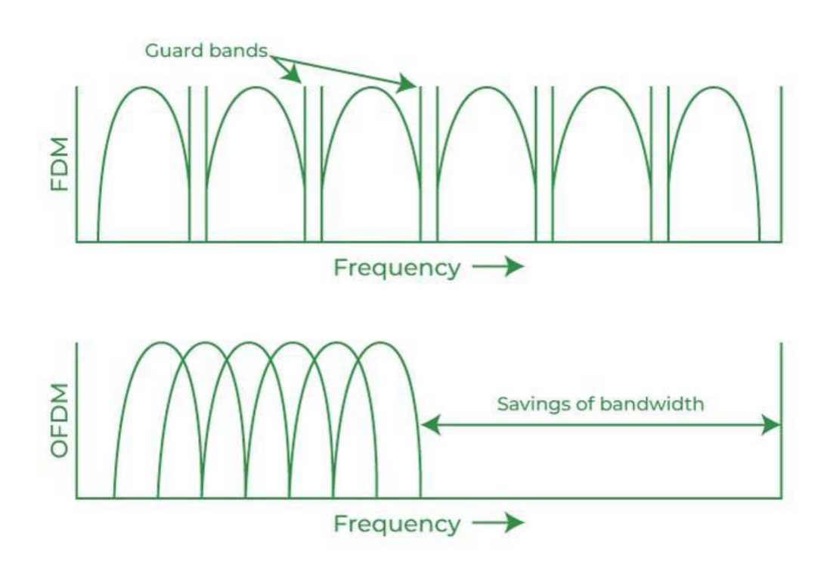
OFDM
44. What is a transparent bridge?
Transparent Bridge:
A transparent bridge automatically maintains a routing table and updates tables in response to maintaining changing topology. The transparent bridge mechanism consists of three mechanisms:
• Frame forwarding
• Address Learning
• Loop Resolution
The Transparent bridge is easy to use. Install the bridge and no software changes are needed in the hosts. In all the cases, transparent bridges flooded the broadcast and multicast frames.
Juniper Business Use Only

Slide 125
45. What is the minimum size of the icmpV4 packet what is the maximum size of the icmpv4 packet?
• Minimum size ICMPv4 packet = 28 bytes
• Maximum size ICMPv4 packet = 2068 bytes
46. Why do we OSPF a protocol that is faster than our RIP?
OSPF stands for Open Shortest Path First which uses a link-state routing algorithm. This protocol is faster than RIP because:
• Using the link-state information which is available in routers, it constructs the topology of Bluetooth which Bluetooth the topology determines the routing table for routing decisions.
• It supports both variable-length subnet masking and classless interdomain routing addressing models.
• Since it uses Dijkstra’s algorithm, it computes the shortest path tree for each route.
• OSPF (Open Shortest Path First) is handling the error detection by itself and it uses multicast addressing for routing in a broadcast domain
47. What are the two main categories of DNS messages?
The two categories of DNS messages are queries and replies.
48. Why do we need the pop3 protocol for e-mail?
Need of POP3: The Post Office Protocol (POP3) is the most widely used protocol and is supported by most email clients. It provides a convenient and standard way for users to access mailboxes and download messages. An important advantage of this is that the mail messages get delivered to the client’s PC and they can be read with or without accessing the web.
49. Define the term Jitter?
Jitter is a “packet delay variance”. It can simply mean that jitter is considered a problem when different packets of data face different delays in a network and the data at the receiver application is time-sensitive, i.e. audio or video data. Jitter is measured in milliseconds(ms). It is defined as an interference in the normal order of sending data packets.
Juniper Business Use Only

Slide 126
50. Why Bandwidth is important to network performance parameters?
Bandwidth is characterized as the measure of data or information that can be transmitted in a fixed measure of time. The term can be used in two different contexts with two distinctive estimating values. In the case of digital devices, the bandwidth is measured in bits per second(bps) or bytes per second. In the case of analog devices, the bandwidth is measured in cycles per second, or Hertz (Hz). Bandwidth is only one component of what an individual sees as the speed of a network. True internet speed is actually the amount of data you receive every second and that has a lot to do with latency too.
Juniper Business Use Only

Slide 127
Juniper Business Use Only

