Slide 1
Networking Fundamentals
Guide
Rahul Vaddimukkala

Slide 2

What is Computer Network?
Computer Network is a group of computers connected with each other through wires, optical fibers or optical links so that various devices can interact with each other through a network.
A node can be computer, printer, or any other device capable of sending or receiving the data. The links connecting the nodes are known as communication channels.
The main function of networking is to transfer the data from one computer to another computer for communication purpose.

Slide 3
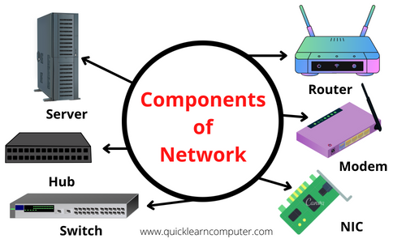
Components Of Computer Network:

Slide 4
Major components of a computer network
NIC(Network interface card):
NIC is a device that helps the computer to communicate with another device. The network interface card contains the hardware addresses, the data-link layer protocol use this address to identify the system on the network so that it transfers the data to the correct destination.
Hub:
Hub is a central device that splits the network connection into multiple devices. When computer requests for information from a computer, it sends the request to the Hub. Hub distributes this request to all the interconnected computers.
Hubs transmit data to all connected devices, they use the available network bandwidth extremely. This inefficiency can lead to packet loss, reduced performance, slower network speeds and other problems.

Slide 5
Switches: It is a networking device that groups all the devices over the network to transfer the data to another device. A switch is better than Hub as it does not broadcast the message over the network, i.e., it sends the message to the device for which it belongs to. Therefore, we can say that switch sends the message directly from source to the destination.
Cables and connectors: Cable is a transmission media that transmits the communication signals. There are three types of cables:
Twisted pair cable: It is a high-speed cable that transmits the data over 1Gbps or more.
Coaxial cable: Coaxial cable resembles like a TV installation cable. Coaxial cable is more
expensive than twisted pair cable, but it provides the high data transmission speed.
Fiber optic cable: Fiber optic cable is a high-speed cable that transmits the data using
light beams. It provides high data transmission speed as compared to other cables. It is
more expensive as compared to other cables.
Router: it is a device that connects the LAN to the internet. The router is mainly used to connect the distinct networks or connect the internet to multiple computers.

Slide 6
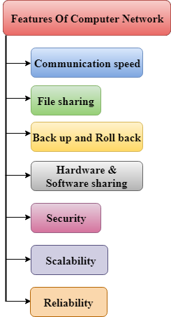
Features Of Computer network
Communication speed
File sharing
Back up and Roll back is easy
Software and Hardware sharing
Security
Scalability
Reliability

Slide 7
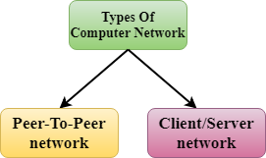
Computer Network Architecture ?
Computer Network Architecture is defined as the physical and logical design of the software, hardware, protocols, and media of the transmission of data. Simply we can say that how computers are organized and how tasks are allocated to the computer.

Slide 8
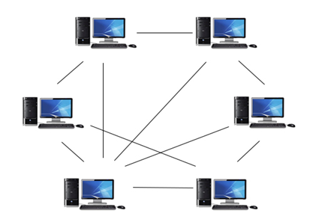
Peer-to-peer networks ?
Peer-To-Peer network is a network in which all the computers are linked together with equal privilege and responsibilities for processing the data.
Peer-To-Peer network is useful for small environments, usually up to 10 computers.
Peer-To-Peer network has no dedicated server.
Special permissions are assigned to each computer for sharing the resources, but this can lead to a problem if the computer with the resource is down.

Slide 9
Advantages Of Peer-To-Peer Network:
It is less costly as it does not contain any dedicated server.
If one computer stops working but, other computers will not stop working.
It is easy to set up and maintain as each computer manages itself.
Disadvantages Of Peer-To-Peer Network:
In the case of Peer-To-Peer network, it does not contain the centralized system . Therefore, it cannot back up the data as the data is different in different locations.
It has a security issue as the device is managed itself.

Slide 10
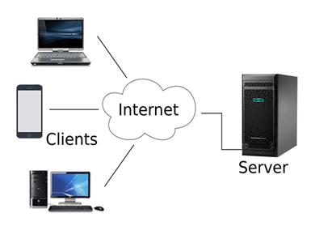
Client-server networks ?
Client/Server network is a network model designed for the end users called clients, to access the resources from a central computer known as Server.
The central controller is known as a server while all other computers in the network are called clients.
A server performs all the major operations such as security and network management.
A server is responsible for managing all the resources such as files, directories, printer, etc.
All the clients communicate with each other through a server. For example, if client1 wants to send some data to client 2, then it first sends the request to the server for the permission. The server sends the response to the client 1 to initiate its communication with the client 2.

Slide 11
Advantages Of Client/Server network:
A Client/Server network contains the centralized system. Therefore we can back up the data easily.
A Client/Server network has a dedicated server that improves the overall performance of the whole system.
Security is better in Client/Server network as a single server administers the shared resources.
It also increases the speed of the sharing resources.
Disadvantages Of Client/Server network:
Client/Server network is expensive as it requires the server with large memory.
A server has a Network Operating System(NOS) to provide the resources to the clients, but the cost of NOS is very high.
It requires a dedicated network administrator to manage all the resources.

Slide 12
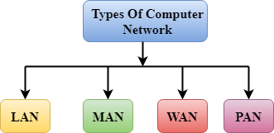
Computer Network Types
A computer network is a group of computers linked to each other that enables the computer to communicate with another computer and share their resources, data, and applications.
A computer network can be categorized by their size. A computer network is mainly of four types:
LAN(Local Area Network)
PAN(Personal Area Network)
MAN(Metropolitan Area Network)
WAN(Wide Area Network)

Slide 13
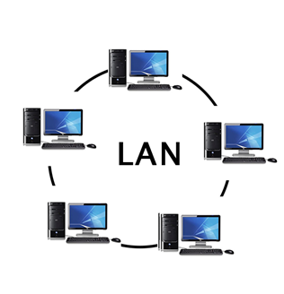
LAN(Local Area Network)
Local Area Network is a group of computers connected to each other in a small area such as building, office.
LAN is used for connecting two or more personal computers through a communication medium such as twisted pair, coaxial cable, etc.
It is less costly as it is built with inexpensive hardware such as hubs, network adapters, and ethernet cables.
The data is transferred at an extremely faster rate in Local Area Network.
Local Area Network provides higher security.

Slide 14
WLAN
WLAN stands for Wireless Local Area Network. WLAN is a local area network that uses radio communication to provide mobility to the network users while maintaining the connectivity to the wired network. A WLAN basically, extends a wired local area network. WLAN’s are built by attaching a device called the access point(AP) to the edge of the wired network. Clients communicate with the AP using a wireless network adapter which is similar in function to an ethernet adapter.

Slide 15
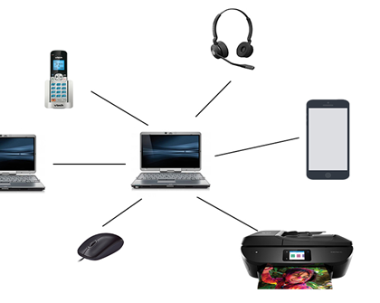
PAN(Personal Area Network)
Personal Area Network is a network arranged within an individual person, typically within a range of 10 meters.
Personal Area Network is used for connecting the computer devices of personal use is known as Personal Area Network.
Thomas Zimmerman was the first research scientist to bring the idea of the Personal Area Network.
Personal Area Network covers an area of 30 feet.
Personal computer devices that are used to develop the personal area network are the laptop, mobile phones, media player and play stations.

Slide 16
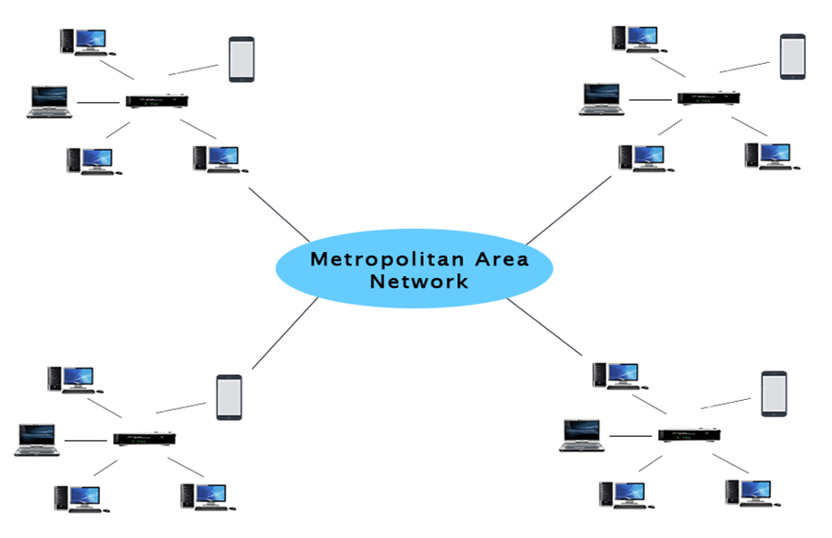
MAN(Metropolitan Area Network)
A metropolitan area network is a network that covers a larger geographic area by interconnecting a different LAN to form a larger network.
Government agencies use MAN to connect to the citizens and private industries.
In MAN, various LANs are connected to each other through a telephone exchange line.
The most widely used protocols in MAN are RS-232, Frame Relay, ATM, ISDN, OC-3, ADSL, etc.
It has a higher range than Local Area Network(LAN).

Slide 17
Uses Of Metropolitan Area Network:
MAN is used in communication between the banks in a city.
It can be used in an Airline Reservation.
It can be used in a college within a city.
It can also be used for communication in the military.

Slide 18
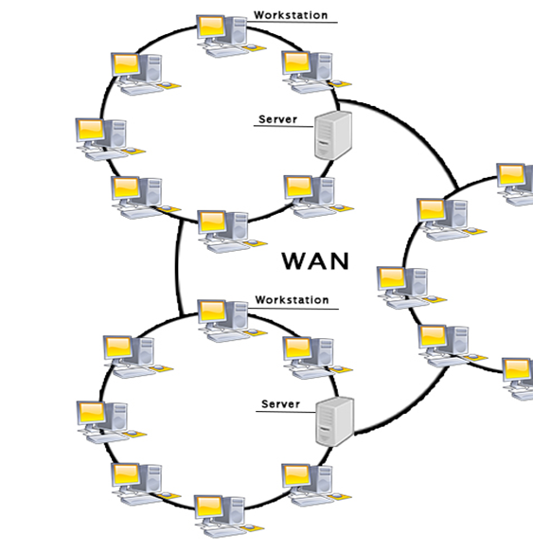
WAN(Wide Area Network)
A Wide Area Network is a network that extends over a large geographical area such as states or countries.
A Wide Area Network is quite bigger network than the LAN.
A Wide Area Network is not limited to a single location, but it spans over a large geographical area through a telephone line, fibre optic cable or satellite links.
The internet is one of the biggest WAN in the world.
A Wide Area Network is widely used in the field of Business, government, and education.

Slide 19
Examples Of Wide Area Network:
Mobile Broadband: A 4G network is widely used across a region or country.
Last mile: A telecom company is used to provide the internet services to the customers in hundreds of cities by connecting their home with fiber.
Private network: A bank provides a private network that connects the 44 offices. This network is made by using the telephone leased line provided by the telecom company.

Slide 20
Advantages Of Wide Area Network:
Geographical area: A Wide Area Network provides a large geographical area. Suppose if the branch of our office is in a different city then we can connect with them through WAN. The internet provides a leased line through which we can connect with another branch.
Centralized data: In case of WAN network, data is centralized. Therefore, we do not need to buy the emails, files or back up servers.
Get updated files: Software companies work on the live server. Therefore, the programmers get the updated files within seconds.
Exchange messages: In a WAN network, messages are transmitted fast. The web application like Facebook, Whatsapp, Skype allows you to communicate with friends.
Sharing of software and resources: In WAN network, we can share the software and other resources like a hard drive, RAM.
Global business: We can do the business over the internet globally.
High bandwidth: If we use the leased lines for our company then this gives the high bandwidth. The high bandwidth increases the data transfer rate which in turn increases the productivity of our company.
Disadvantages of Wide Area Network:
Security issue: A WAN network has more security issues as compared to LAN and MAN network as all the technologies are combined together that creates the security problem.
Needs Firewall & antivirus software: The data is transferred on the internet which can be changed or hacked by the hackers, so the firewall needs to be used. Some people can inject the virus in our system so antivirus is needed to protect from such a virus.
High Setup cost: An installation cost of the WAN network is high as it involves the purchasing of routers, switches.
Troubleshooting problems: It covers a large area so fixing the problem is difficult.

Slide 21
Internetwork
An internetwork is defined as two or more computer network LANs or WAN or computer network segments are connected using devices, and they are configured by a local addressing scheme. This process is known as internetworking.
An interconnection between public, private, commercial, industrial, or government computer networks can also be defined as internetworking.
An internetworking uses the internet protocol.
The reference model used for internetworking is Open System Interconnection(OSI).

Slide 22
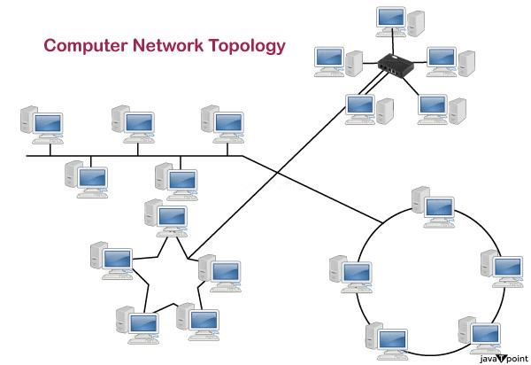
What is Network Topology?
Topology defines the structure of the network of how all the components are interconnected to each other. There are two types of topology: physical and logical topology.
Types of Network Topology
Bus Topology
Ring Topology
Star Topology
Tree Topology
Mesh Topology
Hybrid Topology

Slide 23
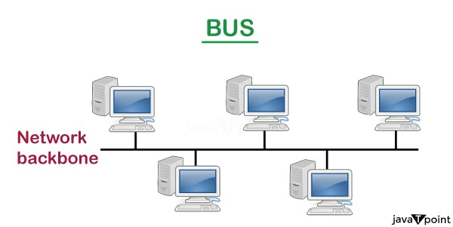
Bus Topology
The bus topology is designed in such a way that all the stations are connected through a single cable known as a backbone cable.
Each node is either connected to the backbone cable by drop cable or directly connected to the backbone cable.
When a node wants to send a message over the network, it puts a message over the network. All the stations available in the network will receive the message whether it has been addressed or not.
The configuration of a bus topology is quite simpler as compared to other topologies.
The backbone cable is considered as a "single lane" through which the message is broadcast to all the stations.

Slide 24
Advantages of Bus topology:
Low-cost cable: In bus topology, nodes are directly connected to the cable without passing through a hub. Therefore, the initial cost of installation is low.
Moderate data speeds: Coaxial or twisted pair cables are mainly used in bus-based networks that support upto 10 Mbps.
Familiar technology: Bus topology is a familiar technology as the installation and troubleshooting techniques are well known, and hardware components are easily available.
Limited failure: A failure in one node will not have any effect on other nodes.
Disadvantages of Bus topology:
Extensive cabling: A bus topology is quite simpler, but still it requires a lot of cabling.
Difficult troubleshooting: It requires specialized test equipment to determine the cable faults. If any fault occurs in the cable, then it would disrupt the communication for all the nodes.
Signal interference: If two nodes send the messages simultaneously, then the signals of both the nodes collide with each other.
Reconfiguration difficult: Adding new devices to the network would slow down the network.
Attenuation: Attenuation is a loss of signal leads to communication issues. Repeaters are used to regenerate the signal.

Slide 25
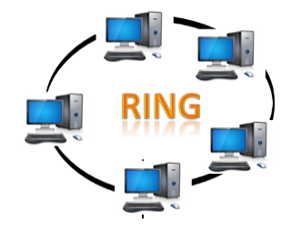
Ring Topology
Ring topology is like a bus topology, but with connected ends.
The node that receives the message from the previous computer will retransmit to the next node.
The data flows in one direction, i.e., it is unidirectional.
The data flows in a single loop continuously known as an endless loop.
It has no terminated ends, i.e., each node is connected to other node and having no termination point.
The data in a ring topology flow in a clockwise direction.
The most common access method of the ring topology is token passing.
Token passing: It is a network access method in which token is passed from one node to another node.
Token: It is a frame that circulates around the network.

Slide 26
Advantages of Ring topology:
Network Management: Faulty devices can be removed from the network without bringing the network down.
Product availability: Many hardware and software tools for network operation and monitoring are available.
Cost: Twisted pair cabling is inexpensive and easily available. Therefore, the installation cost is very low.
Reliable: It is a more reliable network because the communication system is not dependent on the single host computer.
Disadvantages of Ring topology:
Difficult troubleshooting: It requires specialized test equipment to determine the cable faults. If any fault occurs in the cable, then it would disrupt the communication for all the nodes.
Failure: The breakdown in one station leads to the failure of the overall network.
Reconfiguration difficult: Adding new devices to the network would slow down the network.
Delay: Communication delay is directly proportional to the number of nodes. Adding new devices increases the communication delay.

Slide 27
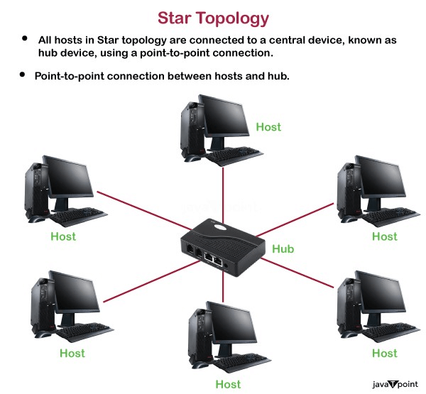
Star Topology

Slide 28
Star topology is an arrangement of the network in which every node is connected to the central hub, switch or a central computer.
The central computer is known as a server, and the peripheral devices attached to the server are known as clients.
Coaxial cable or RJ-45 cables are used to connect the computers.
Hubs or Switches are mainly used as connection devices in a physical star topology.
Star topology is the most popular topology in network implementation.

Slide 29
Advantages of Star topology:
Efficient troubleshooting: Troubleshooting is quite efficient in a star topology as compared to bus topology. In a bus topology, the manager has to inspect the kilometers of cable. In a star topology, all the stations are connected to the centralized network. Therefore, the network administrator has to go to the single station to troubleshoot the problem.
Network control: Complex network control features can be easily implemented in the star topology. Any changes made in the star topology are automatically accommodated.
Limited failure: As each station is connected to the central hub with its own cable, therefore failure in one cable will not affect the entire network.
Familiar technology: Star topology is a familiar technology as its tools are cost-effective.
Easily expandable: It is easily expandable as new stations can be added to the open ports on the hub.
Cost effective: Star topology networks are cost-effective as it uses inexpensive coaxial cable.
High data speeds: It supports a higher bandwidth of speed to a networks.
Disadvantages of Star topology:
A Central point of failure: If the central hub or switch goes down, then all the connected nodes will not be able to communicate with each other.
Cable: Sometimes cable routing becomes difficult when a significant amount of routing is required.

Slide 30
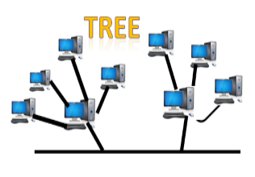
Tree topology
Tree topology combines the characteristics of bus topology and star topology.
A tree topology is a type of structure in which all the computers are connected with each other in hierarchical fashion.
The top-most node in tree topology is known as a root node, and all other nodes are the descendants of the root node.
There is only one path exists between two nodes for the data transmission. Thus, it forms a parent-child hierarchy.

Slide 31
Advantages of Tree topology:
Support for broadband transmission: Tree topology is mainly used to provide broadband transmission, i.e., signals are sent over long distances without being attenuated.
Easily expandable: We can add the new device to the existing network. Therefore, we can say that tree topology is easily expandable.
Easily manageable: In tree topology, the whole network is divided into segments known as star networks which can be easily managed and maintained.
Error detection: Error detection and error correction are very easy in a tree topology.
Limited failure: The breakdown in one station does not affect the entire network.
Point-to-point wiring: It has point-to-point wiring for individual segments.
Disadvantages of Tree topology:
Difficult troubleshooting: If any fault occurs in the node, then it becomes difficult to troubleshoot the problem.
High cost: Devices required for broadband transmission are very costly.
Failure: A tree topology mainly relies on main bus cable and failure in main bus cable will damage the overall network.
Reconfiguration difficult: If new devices are added, then it becomes difficult to reconfigure.

Slide 32
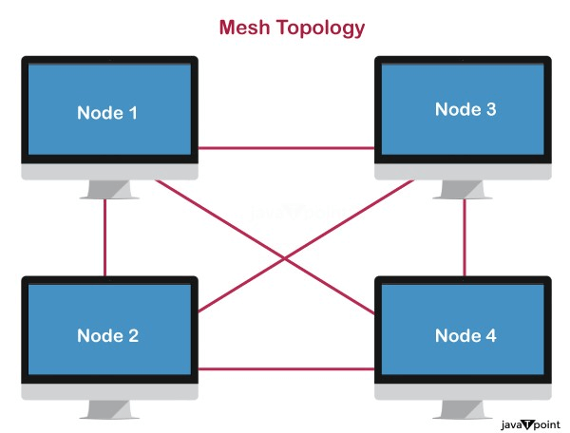
Mesh topology
Mesh technology is an arrangement of the network in which computers are interconnected with each other through various redundant connections.
There are multiple paths from one computer to another computer.
It does not contain the switch, hub or any central computer which acts as a central point of communication.
The Internet is an example of the mesh topology.
Mesh topology is mainly used for WAN implementations where communication failures are a critical concern.
Mesh topology is mainly used for wireless networks.

Slide 33
Advantages of Mesh topology:
Reliable: The mesh topology networks are very reliable as if any link breakdown will not affect the communication between connected computers.
Fast Communication: Communication is very fast between the nodes.
Easier Reconfiguration: Adding new devices would not disrupt the communication between other devices.
Disadvantages of Mesh topology:
Cost: A mesh topology contains a large number of connected devices such as a router and more transmission media than other topologies.
Management: Mesh topology networks are very large and very difficult to maintain and manage. If the network is not monitored carefully, then the communication link failure goes undetected.
Efficiency: In this topology, redundant connections are high that reduces the efficiency of the network.

Slide 34
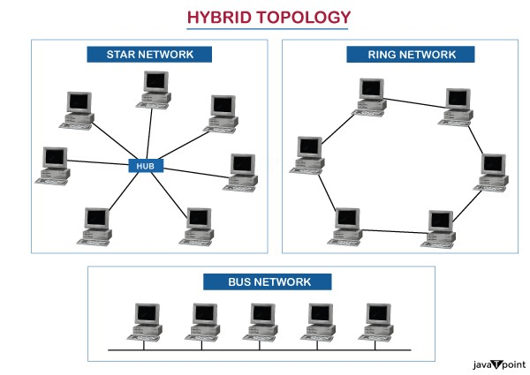
Hybrid Topology
The combination of various different topologies is known as Hybrid topology.
A Hybrid topology is a connection between different links and nodes to transfer the data.
When two or more different topologies are combined together is termed as Hybrid topology and if similar topologies are connected with each other will not result in Hybrid topology. For example, if there exist a ring topology in one branch of bank and bus topology in another branch of bank, connecting these two topologies will result in Hybrid topology.

Slide 35
Advantages of Hybrid Topology:
Reliable: If a fault occurs in any part of the network will not affect the functioning of the rest of the network.
Scalable: Size of the network can be easily expanded by adding new devices without affecting the functionality of the existing network.
Flexible: This topology is very flexible as it can be designed according to the requirements of the organization.
Effective: Hybrid topology is very effective as it can be designed in such a way that the strength of the network is maximized and weakness of the network is minimized.
Disadvantages of Hybrid topology:
Complex design: The major drawback of the Hybrid topology is the design of the Hybrid network. It is very difficult to design the architecture of the Hybrid network.
Costly Hub: The Hubs used in the Hybrid topology are very expensive as these hubs are different from usual Hubs used in other topologies.
Costly infrastructure: The infrastructure cost is very high as a hybrid network requires a lot of cabling, network devices, etc.

Slide 36
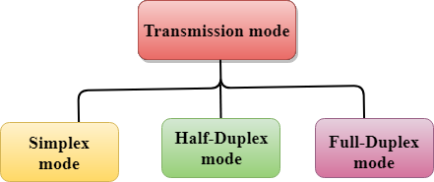
Transmission modes
The way in which data is transmitted from one device to another device is known as transmission mode.
The transmission mode is also known as the communication mode.
Each communication channel has a direction associated with it, and transmission media provide the direction. Therefore, the transmission mode is also known as a directional mode.
The transmission mode is defined in the physical layer.
The Transmission mode is divided into three categories:
Transmission modes:
Simplex mode
Half-duplex mode
Full-duplex mode

Slide 37

Simplex mode
In Simplex mode, the communication is unidirectional, i.e., the data flow in one direction.
A device can only send the data but cannot receive it or it can receive the data but cannot send the data.
This transmission mode is not very popular as mainly communications require the two-way exchange of data. The simplex mode is used in the business field as in sales that do not require any corresponding reply.
The radio station is a simplex channel as it transmits the signal to the listeners but never allows them to transmit back.
Keyboard and Monitor are the examples of the simplex mode as a keyboard can only accept the data from the user and monitor can only be used to display the data on the screen.
The main advantage of the simplex mode is that the full capacity of the communication channel can be utilized during transmission.

Slide 38
Advantage of Simplex mode:
In simplex mode, the station can utilize the entire bandwidth of the communication channel, so that more data can be transmitted at a time.
Disadvantage of Simplex mode:
Communication is unidirectional, so it has no inter-communication between devices.

Slide 39
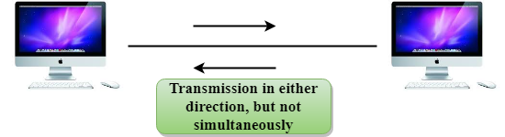
Half-Duplex mode
In a Half-duplex channel, direction can be reversed, i.e., the station can transmit and receive the data as well.
Messages flow in both the directions, but not at the same time.
The entire bandwidth of the communication channel is utilized in one direction at a time.
In half-duplex mode, it is possible to perform the error detection, and if any error occurs, then the receiver requests the sender to retransmit the data.
A Walkie-talkie is an example of the Half-duplex mode. In Walkie-talkie, one party speaks, and another party listens. After a pause, the other speaks and first party listens. Speaking simultaneously will create the distorted sound which cannot be understood.

Slide 40
Advantage of Half-duplex mode:
In half-duplex mode, both the devices can send and receive the data and also can utilize the entire bandwidth of the communication channel during the transmission of data.
Disadvantage of Half-Duplex mode:
In half-duplex mode, when one device is sending the data, then another has to wait, this causes the delay in sending the data at the right time.

Slide 41

Full-duplex mode
In Full duplex mode, the communication is bi-directional, i.e., the data flow in both the directions.
Both the stations can send and receive the message simultaneously.
Full-duplex mode has two simplex channels. One channel has traffic moving in one direction, and another channel has traffic flowing in the opposite direction.
The Full-duplex mode is the fastest mode of communication between devices.
The most common example of the full-duplex mode is a telephone network. When two people are communicating with each other by a telephone line, both can talk and listen at the same time.

Slide 42
Advantage of Full-duplex mode:
Both the stations can send and receive the data at the same time.
Disadvantage of Full-duplex mode:
If there is no dedicated path exists between the devices, then the capacity of the communication channel is divided into two parts.

Slide 43
OSI Model
OSI stands for Open System Interconnection is a reference model that describes how information from a software application in one computer moves through a physical medium to the software application in another computer.
OSI consists of seven layers, and each layer performs a particular network function.
OSI model was developed by the International Organization for Standardization (ISO) in 1984, and it is now considered as an architectural model for the inter-computer communications.
OSI model divides the whole task into seven smaller and manageable tasks. Each layer is assigned a particular task.
Each layer is self-contained, so that task assigned to each layer can be performed independently.

Slide 44
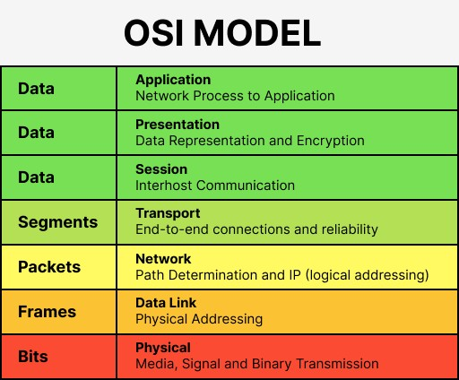

Slide 45
Characteristics of OSI Model:
The OSI model is divided into two layers: upper layers and lower layers.
The upper layer of the OSI model mainly deals with the application related issues, and they are implemented only in the software. The application layer is closest to the end user. Both the end user and the application layer interact with the software applications. An upper layer refers to the layer just above another layer.
The lower layer of the OSI model deals with the data transport issues. The data link layer and the physical layer are implemented in hardware and software. The physical layer is the lowest layer of the OSI model and is closest to the physical medium. The physical layer is mainly responsible for placing the information on the physical medium.

Slide 46
7 Layers of OSI Model
There are the seven OSI layers. Each layer has different functions. A list of seven layers are given below:
Physical Layer
Data-Link Layer
Network Layer
Transport Layer
Session Layer
Presentation Layer
Application Layer

Slide 47
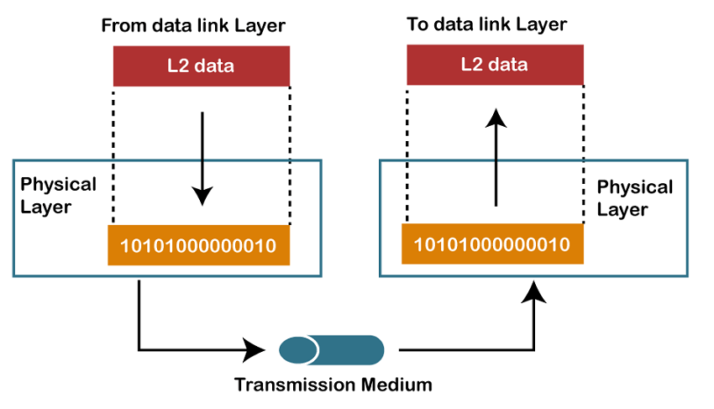
Physical layer
The main functionality of the physical layer is to transmit the individual bits from one node to another node.
It is the lowest layer of the OSI model.
It establishes, maintains and deactivates the physical connection.
It specifies the mechanical, electrical and procedural network interface specifications.
Functions of a Physical layer:
Line Configuration: It defines the way how two or more devices can be connected physically.
Data Transmission: It defines the transmission mode whether it is simplex, half-duplex or full-duplex mode between the two devices on the network.
Topology: It defines the way how network devices are arranged.
Signals: It determines the type of the signal used for transmitting the information.

Slide 48
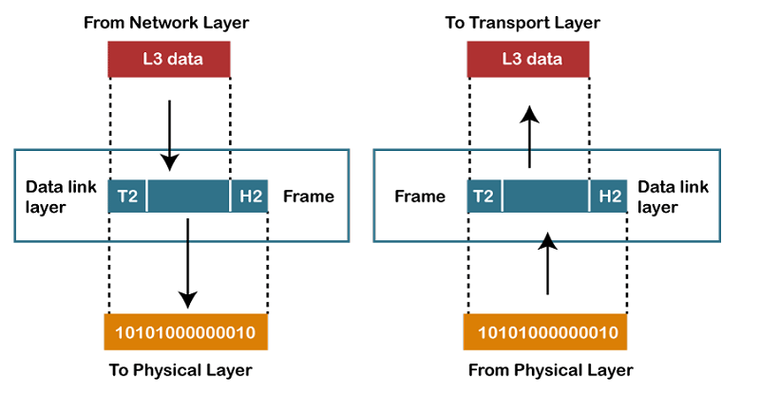
Data-Link Layer
This layer is responsible for the error-free transfer of data frames.
It defines the format of the data on the network.
It provides a reliable and efficient communication between two or more devices.
It is mainly responsible for the unique identification of each device that resides on a local network.

Slide 49
It contains two sub-layers:
  Logical Link Control Layer
    It is responsible for transferring the packets to the Network layer of the receiver that is receiving.
    It identifies the address of the network layer protocol from the header.
    It also provides flow control.
  Media Access Control Layer
    A Media access control layer is a link between the Logical Link Control layer and the network's physical layer.
    It is used for transferring the packets over the network.

Slide 50

Functions of the Data-link layer
Framing: The data link layer translates the physical's raw bit stream into packets known as Frames. The Data link layer adds the header and trailer to the frame. The header which is added to the frame contains the hardware destination and source address.

Slide 51
Physical Addressing: The Data link layer adds a header to the frame that contains a destination address. The frame is transmitted to the destination address mentioned in the header.
Flow Control: Flow control is the main functionality of the Data-link layer. It is the technique through which the constant data rate is maintained on both the sides so that no data get corrupted. It ensures that the transmitting station such as a server with higher processing speed does not exceed the receiving station, with lower processing speed.
Error Control: Error control is achieved by adding a calculated value CRC (Cyclic Redundancy Check) that is placed to the Data link layer's trailer which is added to the message frame before it is sent to the physical layer. If any error seems to occurr, then the receiver sends the acknowledgment for the retransmission of the corrupted frames.
Access Control: When two or more devices are connected to the same communication channel, then the data link layer protocols are used to determine which device has control over the link at a given time.

Slide 52
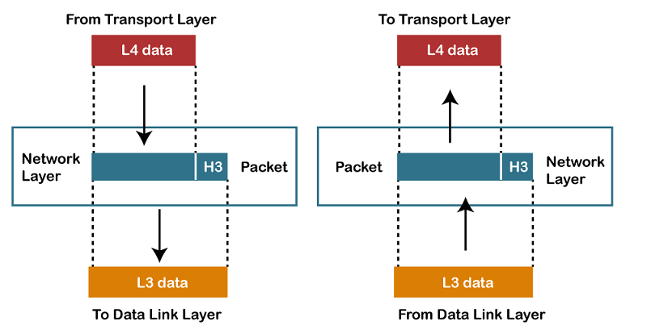
Network Layer
It is a layer 3 that manages device addressing, tracks the location of devices on the network.
It determines the best path to move data from source to the destination based on the network conditions, the priority of service, and other factors.
The Network layer is responsible for routing and forwarding the packets.
Routers are the layer 3 devices, they are specified in this layer and used to provide the routing services within an internetwork.
The protocols used to route the network traffic are known as Network layer protocols. Examples of protocols are IP and Ipv6.

Slide 53
Functions of Network Layer:
Internetworking: An internetworking is the main responsibility of the network layer. It provides a logical connection between different devices.
Addressing: A Network layer adds the source and destination address to the header of the frame. Addressing is used to identify the device on the internet.
Routing: Routing is the major component of the network layer, and it determines the best optimal path out of the multiple paths from source to the destination.
Packetizing: A Network Layer receives the packets from the upper layer and converts them into packets. This process is known as Packetizing. It is achieved by internet protocol (IP).

Slide 54
What is ip fragmentation and at which layer it occurs?
IP fragmentation is an Internet Protocol (IP) process that breaks packets into smaller pieces (fragments), so that the resulting pieces can pass through a link with a smaller maximum transmission unit (MTU) than the original packet size. The fragments are reassembled by the receiving host.
Fragmentation helps to reduce the impact of large data packets on network bandwidth utilization by breaking them down into smaller fragments that can be transmitted more efficiently.
The network layer
Fragmentation is done by the network layer when the maximum size of datagram is greater than maximum size of data that can be held in a frame
i.e., its Maximum Transmission Unit (MTU).
The network layer divides the datagram received from the transport layer into fragments so that data flow is not disrupted.

Slide 55
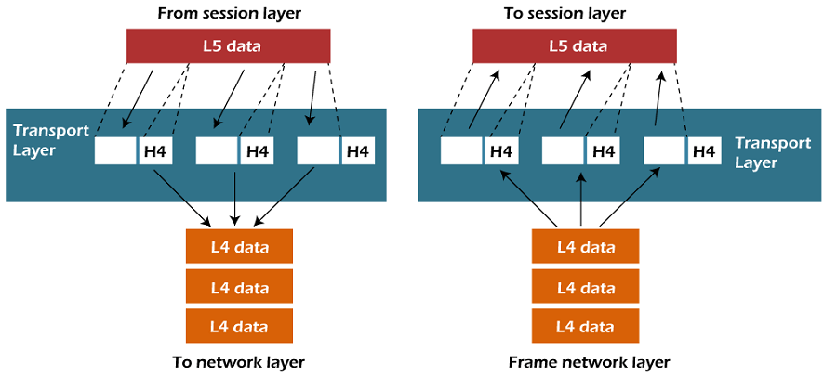
Transport Layer
The Transport layer is a Layer 4 ensures that messages are transmitted in the order in which they are sent and there is no duplication of data.
The main responsibility of the transport layer is to transfer the data completely.
It receives the data from the upper layer and converts them into smaller units known as segments.
This layer can be termed as an end-to-end layer as it provides a point-to-point connection between source and destination to deliver the data reliably.

Slide 56
The two protocols used in this layer are:
Transmission Control Protocol
  It is a standard protocol that allows the systems to communicate over the internet.
  It establishes and maintains a connection between hosts.
  When data is sent over the TCP connection, then the TCP protocol divides the data into smaller units known as segments. Each segment travels over the internet using multiple routes, and they arrive in different orders at the destination. The transmission control protocol reorders the packets in the correct order at the receiving end.
User Datagram Protocol
  User Datagram Protocol is a transport layer protocol.
  It is an unreliable transport protocol as in this case receiver does not send any acknowledgment when the packet is received, the sender does not wait for any acknowledgment. Therefore, this makes a protocol unreliable.

Slide 57
Functions of Transport Layer:
Service-point addressing: Computers run several programs simultaneously due to this reason, the transmission of data from source to the destination not only from one computer to another computer but also from one process to another process. The transport layer adds the header that contains the address known as a service-point address or port address. The responsibility of the network layer is to transmit the data from one computer to another computer and the responsibility of the transport layer is to transmit the message to the correct process.
Segmentation and reassembly: When the transport layer receives the message from the upper layer, it divides the message into multiple segments, and each segment is assigned with a sequence number that uniquely identifies each segment. When the message has arrived at the destination, then the transport layer reassembles the message based on their sequence numbers.
Connection control: Transport layer provides two services Connection-oriented service and connectionless service. A connectionless service treats each segment as an individual packet, and they all travel in different routes to reach the destination. A connection-oriented service makes a connection with the transport layer at the destination machine before delivering the packets. In connection-oriented service, all the packets travel in the single route.
Flow control: The transport layer also responsible for flow control but it is performed end-to-end rather than across a single link.
Error control: The transport layer is also responsible for Error control. Error control is performed end-to-end rather than across the single link. The sender transport layer ensures that message reach at the destination without any error.

Slide 58
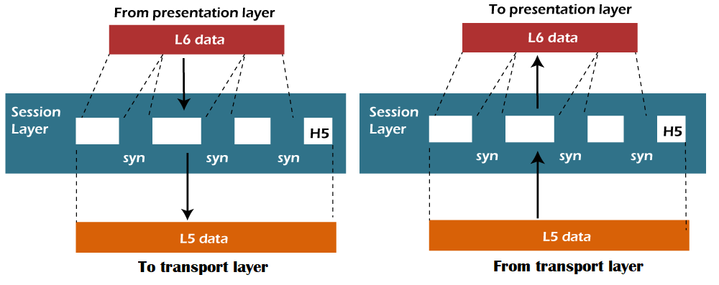
Session Layer
The Session layer is used to establish, maintain and synchronizes the interaction between communicating devices.
Functions of Session layer:
Dialog control: Session layer acts as a dialog controller that creates a dialog between two processes or we can say that it allows the communication between two processes which can be either half-duplex or full-duplex.
Synchronization: Session layer adds some checkpoints when transmitting the data in a sequence. If some error occurs in the middle of the transmission of data, then the transmission will take place again from the checkpoint. This process is known as Synchronization and recovery.

Slide 59
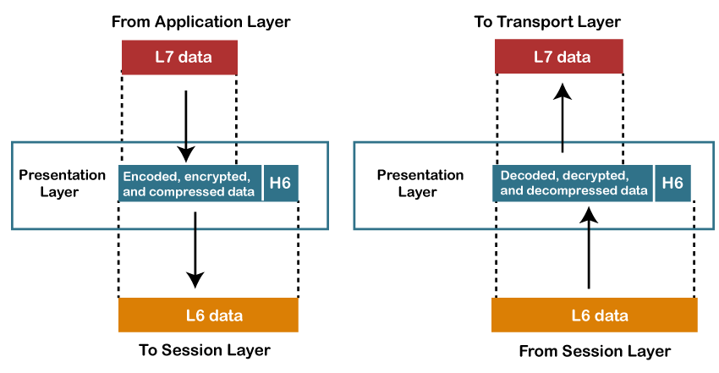
Presentation Layer
A Presentation layer is mainly concerned with the syntax and semantics of the information exchanged between the two systems.
It acts as a data translator for a network.
This layer is a part of the operating system that converts the data from one presentation format to another format.
The Presentation layer is also known as the syntax layer.

Slide 60
Functions of Presentation layer:
Translation: The processes in two systems exchange the information in the form of character strings, numbers and so on. Different computers use different encoding methods, the presentation layer handles the interoperability between the different encoding methods. It converts the data from sender-dependent format into a common format and changes the common format into receiver-dependent format at the receiving end.
Encryption: Encryption is needed to maintain privacy. Encryption is a process of converting the sender-transmitted information into another form and sends the resulting message over the network.
Compression: Data compression is a process of compressing the data, i.e., it reduces the number of bits to be transmitted. Data compression is very important in multimedia such as text, audio, video.

Slide 61
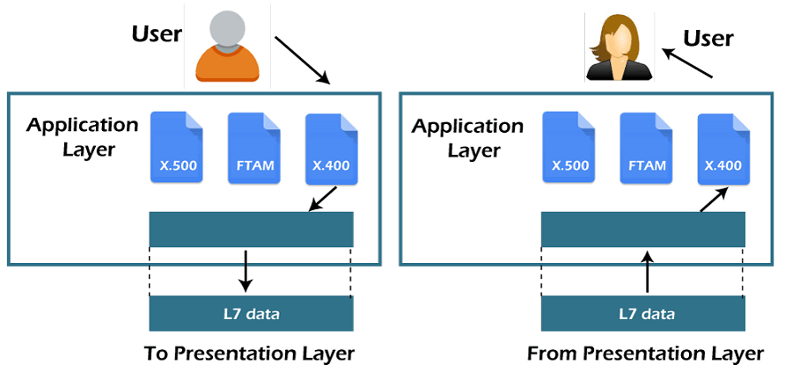
Application Layer
An application layer serves as a window for users and application processes to access network service.
It handles issues such as network transparency, resource allocation, etc.
An application layer is not an application, but it performs the application layer functions.
This layer provides the network services to the end-users.

Slide 62
Functions of Application layer:
File transfer, access, and management (FTAM): An application layer allows a user to access the files in a remote computer, to retrieve the files from a computer and to manage the files in a remote computer.
Mail services: An application layer provides the facility for email forwarding and storage.
Directory services: An application provides the distributed database sources and is used to provide that global information about various objects.

Slide 63
TCP/IP model
The TCP/IP model was developed prior to the OSI model.
The TCP/IP model is not exactly similar to the OSI model.
The TCP/IP model consists of five layers: the application layer, transport layer, network layer, data link layer and physical layer.
The first four layers provide physical standards, network interface, internetworking, and transport functions that correspond to the first four layers of the OSI model and these four layers are represented in TCP/IP model by a single layer called the application layer.
TCP/IP is a hierarchical protocol made up of interactive modules, and each of them provides specific functionality.
Here, hierarchical means that each upper-layer protocol is supported by two or more lower-level protocols.

Slide 64
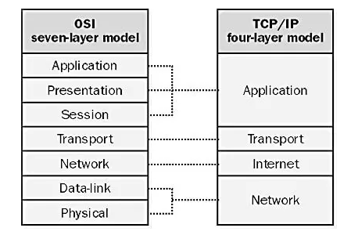

Slide 65
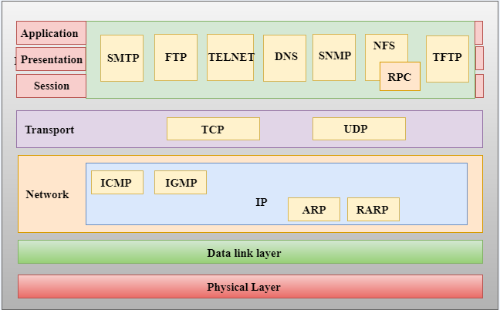
Functions of TCP/IP layers:

Slide 66
Network Access Layer
A network layer is the lowest layer of the TCP/IP model.
A network layer is the combination of the Physical layer and Data Link layer defined in the OSI reference model.
It defines how the data should be sent physically through the network.
This layer is mainly responsible for the transmission of the data between two devices on the same network.
The functions carried out by this layer are encapsulating the IP datagram into frames transmitted by the network and mapping of IP addresses into physical addresses.
The protocols used by this layer are ethernet, token ring, FDDI, X.25, frame relay.

Slide 67
Internet Layer
An internet layer is the second layer of the TCP/IP model.
An internet layer is also known as the network layer.
The main responsibility of the internet layer is to send the packets from any network, and they arrive at the destination irrespective of the route they take.

Slide 68
IP Protocol
IP Protocol: IP protocol is used in this layer, and it is the most significant part of the entire TCP/IP suite.
Following are the responsibilities of this protocol:
IP Addressing: This protocol implements logical host addresses known as IP addresses. The IP addresses are used by the internet and higher layers to identify the device and to provide internetwork routing.
Host-to-host communication: It determines the path through which the data is to be transmitted.

Slide 69
Data Encapsulation and Formatting: An IP protocol accepts the data from the transport layer protocol. An IP protocol ensures that the data is sent and received securely, it encapsulates the data into message known as IP datagram.
Fragmentation and Reassembly: The limit imposed on the size of the IP datagram by data link layer protocol is known as Maximum Transmission unit (MTU). If the size of IP datagram is greater than the MTU unit, then the IP protocol splits the datagram into smaller units so that they can travel over the local network. Fragmentation can be done by the sender or intermediate router. At the receiver side, all the fragments are reassembled to form an original message.
Routing: When IP datagram is sent over the same local network such as LAN, MAN, WAN, it is known as direct delivery. When source and destination are on the distant network, then the IP datagram is sent indirectly. This can be accomplished by routing the IP datagram through various devices such as routers.

Slide 70
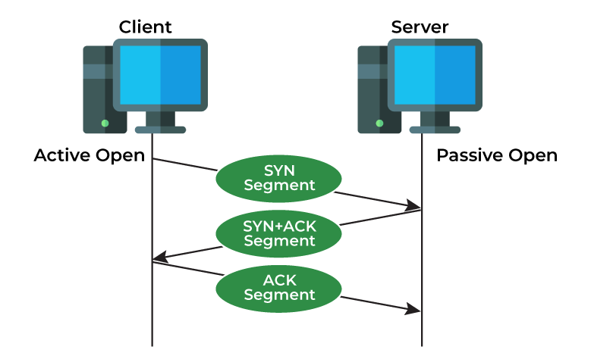
Transmission Control Protocol (TCP)
TCP (Transmission Control Protocol) is one of the main protocols of the Internet protocol suite. It lies between the Application and Network Layers which are used in providing reliable delivery services. It is a connection-oriented protocol for communications that helps in the exchange of messages between different devices over a network. The Internet Protocol (IP), which establishes the technique for sending data packets between computers, works with TCP.

Slide 71
Features of TCP
TCP keeps track of the segments being transmitted or received by assigning numbers to every single one of them.
Flow control limits the rate at which a sender transfers data. This is done to ensure reliable delivery.
TCP implements an error control mechanism for reliable data transfer.
TCP takes into account the level of congestion in the network.

Slide 72
Advantages of TCP
It is reliable for maintaining a connection between Sender and Receiver.
It is responsible for sending data in a particular sequence.
Its operations are not dependent on OS.
It allows and supports many routing protocols.
It can reduce the speed of data based on the speed of the receiver.
Disadvantages of TCP
It is slower than UDP and it takes more bandwidth.
Slower upon starting of transfer of a file.
Not suitable for LAN and PAN Networks.
It does not have a multicast or broadcast category.
It does not load the whole page if a single data of the page is missing.

Slide 73
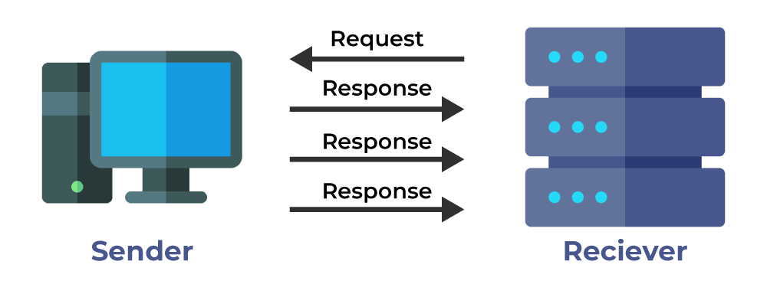
User Datagram Protocol (UDP)
User Datagram Protocol (UDP) is a Transport Layer protocol. UDP is a part of the Internet Protocol suite, referred to as the UDP/IP suite. Unlike TCP, it is an unreliable and connectionless protocol. So, there is no need to establish a connection before data transfer. The UDP helps to establish low-latency and loss-tolerating connections establish over the network. The UDP enables process-to-process communication.

Slide 74
Features of UDP
Used for simple request-response communication when the size of data is less and hence there is lesser concern about flow and error control.
It is a suitable protocol for multicasting as UDP supports packet switching.
UDP is used for some routing update protocols like RIP(Routing Information Protocol).
Normally used for real-time applications which can not tolerate uneven delays between sections of a received message.

Slide 75
Advantages of UDP
It does not require any connection for sending or receiving data.
Broadcast and Multicast are available in UDP.
UDP can operate on a large range of networks.
UDP has live and real-time data.
UDP can deliver data if all the components of the data are not complete.
Disadvantages of UDP
We can not have any way to acknowledge the successful transfer of data.
UDP cannot have the mechanism to track the sequence of data.
UDP is connectionless, and due to this, it is unreliable to transfer data.
In case of a Collision, UDP packets are dropped by Routers in comparison to TCP.
UDP can drop packets in case of detection of errors.

Slide 76
Basis | Transmission Control Protocol (TCP) | User Datagram Protocol (UDP)
Type of Service | TCP is a connection-oriented protocol. Connection orientation means that the communicating devices should establish a connection before transmitting data and should close the connection after transmitting the data. | UDP is the Datagram-oriented protocol. This is because there is no overhead for opening a connection, maintaining a connection, or terminating a connection. UDP is efficient for broadcast and multicast types of network transmission.
Reliability | TCP is reliable as it guarantees the delivery of data to the destination router. | The delivery of data to the destination cannot be guaranteed in UDP.
Error checking mechanism | TCP provides extensive error-checking mechanisms. It is because it provides flow control and acknowledgment of data. | UDP has only the basic error-checking mechanism using checksums.
Acknowledgment | An acknowledgment segment is present. | No acknowledgment segment.
Sequence | Sequencing of data is a feature of Transmission Control Protocol (TCP). this means that packets arrive in order at the receiver. | There is no sequencing of data in UDP. If the order is required, it has to be managed by the application layer.
Speed | TCP is comparatively slower than UDP. | UDP is faster, simpler, and more efficient than TCP.

Slide 77
Retransmission | Retransmission of lost packets is possible in TCP, but not in UDP. | There is no retransmission of lost packets in the User Datagram Protocol (UDP).
Header Length | TCP has a (20-60) bytes variable length header. | UDP has an 8 bytes fixed-length header.
Weight | TCP is heavy-weight. | UDP is lightweight.
Handshaking Techniques | Uses handshakes such as SYN, ACK, SYN-ACK | It’s a connectionless protocol i.e. No handshake
Broadcasting | TCP doesn’t support Broadcasting. | UDP supports Broadcasting.
Protocols | TCP is used by HTTP, HTTPs, FTP, SMTP and Telnet. | UDP is used by DNS, DHCP, TFTP, SNMP, RIP, and VoIP.
Stream Type | The TCP connection is a byte stream. | UDP connection is a message stream.
Overhead | Low but higher than UDP. | Very low.
Applications | This protocol is primarily utilized in situations when a safe and trustworthy communication procedure is necessary, such as in email, on the web surfing, and in military services. | This protocol is used in situations where quick communication is necessary but where dependability is not a concern, such as VoIP, game streaming, video, and music streaming, etc.

Slide 78
Few important concepts before going to protocols
Bandwidth
Traffic
Traffic Generator
Types of Traffic
or data
MAC
IP
NAT
Subnetting
LAG
CRC
DNS
Ports & Numbers

Slide 79
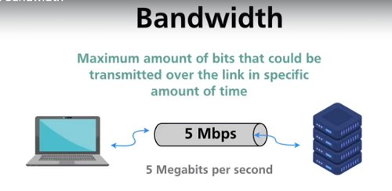
Bandwidth
Bandwidth, or precisely network bandwidth, is the maximum rate at which data transfer occurs across any particular path of the network. Bandwidth is basically a measure of the amount of data that can be sent and received at any instance of time. That simply means that the higher the bandwidth of a network, the larger the amount of data the network can be sending to and from across its path.

Slide 80
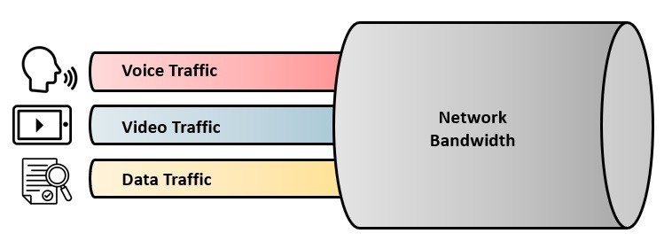
Traffic
Network traffic is the amount of data moving across a computer network at any given time. Network traffic, also called data traffic, is broken down into data packets and sent over a network before being reassembled by the receiving device or computer.

Slide 81
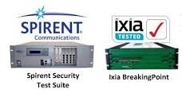
Traffic Generator
A network traffic generator is a tool that feeds traffic onto a network to test and optimize the performance of network devices, protocols, and topologies.
Using a traffic generator allows you to choose the specific type of traffic you would like to test against in your lab. By controlling the packets and payloads being sent with a packet sender, you can gain insight into how the device under test (DUT) will perform under real-world conditions.
Examples of Traffic Generators are Spirent and IXIA etc…

Slide 82
Types of Traffic or data ?
Network traffic is the amount of data moving across a computer network at any given time. Network traffic, also called data traffic, is broken down into data packets and sent over a network before being reassembled by the receiving device or computer.
Usually, we have 3 types of data:
Unicast Data
Multicast Data
Broadcast Data

Slide 83
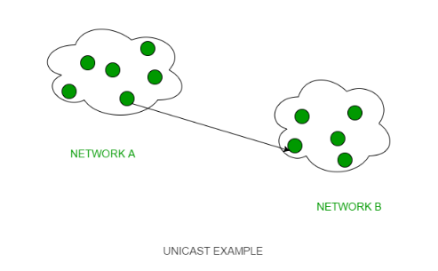
1. Unicast:
This type of information transfer is useful when there is a participation of a single sender and a single recipient. So, in short, you can term it a one-to-one transmission.

Slide 84
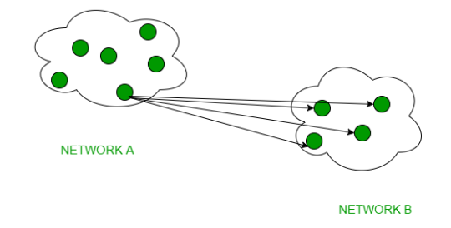
2.Multicast:
A communication where a message is sent from one sender to a group of receivers. Which means data is sent to a group of recipients
In multicasting, one/more senders and one/more recipients participate in data transfer traffic.

Slide 85
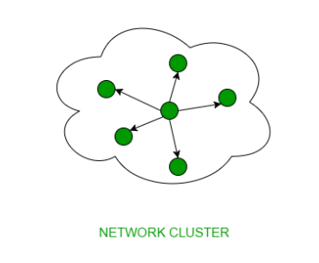
3. Broadcast:
A communication where a message is sent from one sender to all receivers. Which means Data is sent to all recipients in a network, you can term it a one-to-all transmission

Slide 86
MAC (Media Access Control) Address
MAC Addresses are unique 48-bit hardware numbers of a computer that are embedded into a network card (known as a Network Interface Card) during manufacturing.
The MAC Address is also known as the Physical Address of a network device.
MAC Address is a 12-digit hexadecimal number (6-bytes), which is mostly represented by Colon-Hexadecimal notation.
The First 6 digits or 24bits or 3 bytes of the MAC Address identify the manufacturer, called the OUI (Organizational Unique Identifier).
The rightmost six digits or 24bits or 3 bytes represent Network Interface Controller, which is assigned by the manufacturer.

Slide 87
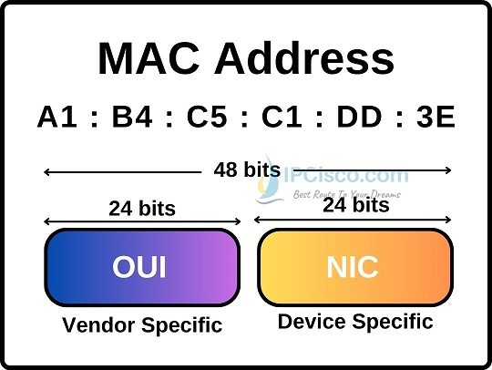
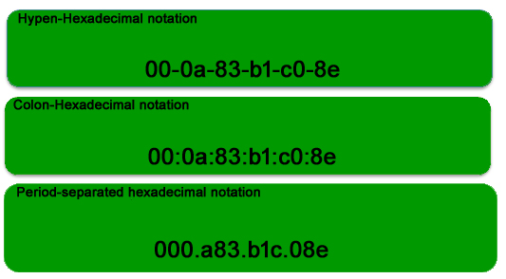
Example of MAC

Slide 88
What is an IP Address ?
An Internet Protocol address (IP address) is a numerical label such as 192.0.2.1 that is assigned to a device connected to a computer network that uses the Internet Protocol for communication. IP addresses serve two main functions: network interface identification, and location addressing.
Internet Protocol version 4 (IPv4) defines an IP address as a 32-bit number. However, because of the growth of the Internet and the depletion of available IPv4 addresses, a new version of IP (IPv6), using 128 bits for the IP address, was standardized in 1998

Slide 89
IPv4 Address
An IPv4 address has a size of 32 bits, which limits the address space to 4294967296 (2^32) addresses. Of this number, some addresses are reserved for special purposes such as private networks and multicast addressing.
IPv4 addresses are usually represented in dot-decimal notation, consisting of four decimal numbers, each ranging from 0 to 255, separated by dots, e.g., 192.0.2.1.
Each part represents a group of 8 bits (an octet) of the address.

Slide 90
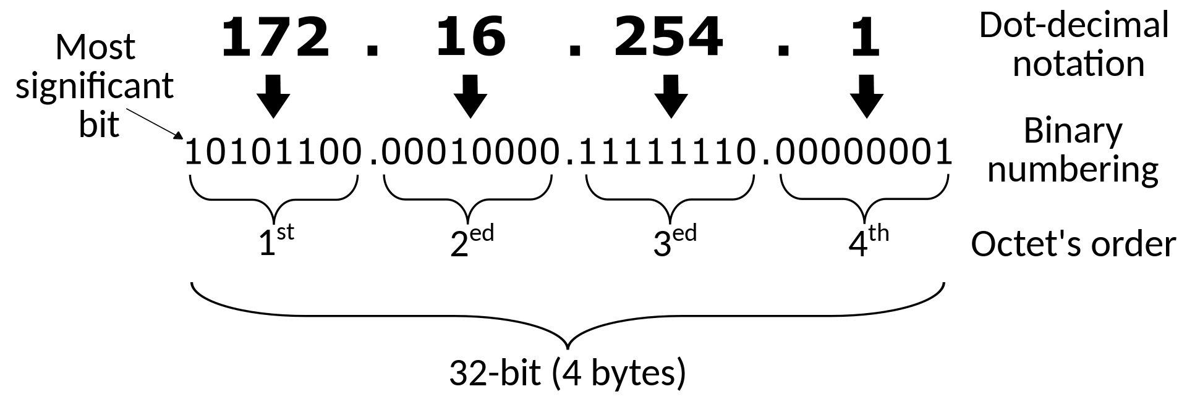
IPv4 Address

Slide 91
IP Classes & Range
The 32-bit IP address is divided into five sub-classes. These are given below:
Class A
Class B
Class C
Class D
Class E
Each of these classes has a valid range of IP addresses. Classes D and E are reserved for multicast and experimental purposes respectively. The order of bits in the first octet determines the classes of the IP address. The IPv4 address is divided into two parts:
Network ID
Host ID
The class of IP address is used to determine the bits used for network ID and host ID and the number of total networks and hosts possible in that particular class. Each ISP or network administrator assigns an IP address to each device that is connected to its network.

Slide 92
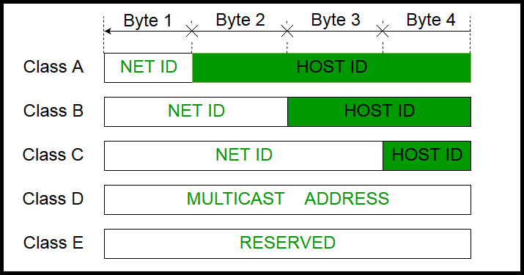

Slide 93
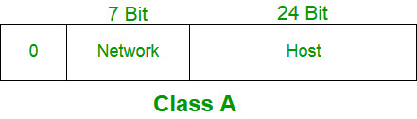
Class A
IP addresses belonging to class A are assigned to the networks that contain a large number of hosts.
The network ID is 8 bits long.
The host ID is 24 bits long.
The higher-order bit of the first octet in class A is always set to 0. The remaining 7 bits in the first octet are used to determine network ID. The 24 bits of host ID are used to determine the host in any network. The default subnet mask for Class A is 255.x.x.x. Therefore, class A has a total of: 2^24 – 2 = 16,777,214 host ID
IP addresses belonging to class A ranges from 0.0.0.0 – 127.255.255.255.

Slide 94
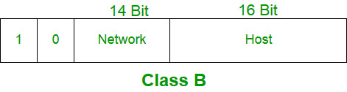
Class B
IP address belonging to class B is assigned to networks that range from medium-sized to large-sized networks.
The network ID is 16 bits long and host ID is 16 bits long.
The higher-order bits of the first octet of IP addresses of class B are always set to 10. The remaining 14 bits are used to determine the network ID. The 16 bits of host ID are used to determine the host in any network. The default subnet mask for class B is 255.255.x.x. Class B has a total of:
2^14 = 16384 network address
2^16 – 2 = 65534 host address
IP addresses belonging to class B ranges from 128.0.0.0 – 191.255.255.255.

Slide 95
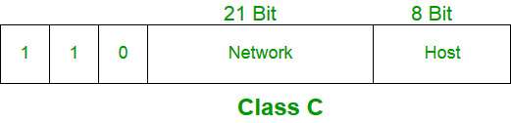
Class C
IP addresses belonging to class C are assigned to small-sized networks.
The network ID is 24 bits long.
The host ID is 8 bits long.
The higher-order bits of the first octet of IP addresses of class C is always set to 110. The remaining 21 bits are used to determine the network ID. The 8 bits of host ID are used to determine the host in any network. The default subnet mask for class C is 255.255.255.x. Class C has a total of:
2^21 = 2097152 network address
2^8 – 2 = 254 host address
IP addresses belonging to class C range from 192.0.0.0 – 223.255.255.255.

Slide 96
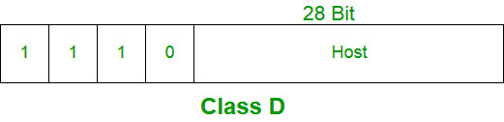
Class D
IP address belonging to class D is reserved for multi-casting. The higher-order bits of the first octet of IP addresses belonging to class D is always set to 1110. The remaining bits are for the address that interested hosts recognize.
Class D does not possess any subnet mask. IP addresses belonging to class D range from 224.0.0.0 – 239.255.255.255.

Slide 97
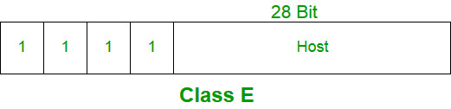
Class E
IP addresses belonging to class E are reserved for experimental and research purposes. IP addresses of class E range from 240.0.0.0 – 255.255.255.254.
This class doesn’t have any subnet mask. The higher-order bits of the first octet of class E are always set to 1111.

Slide 98
Private IP
In Internet networking, a private network is a computer network that uses a private address space of IP addresses. These addresses are commonly used for local area networks (LANs) in residential, office, and enterprise environments. Both the IPv4 and the IPv6 specifications define private IP address ranges.
Private network addresses are not allocated to any specific organization. Anyone may use these addresses without approval from regional or local Internet registries. Private IP address spaces were originally defined to assist in delaying IPv4 address exhaustion. IP packets originating from or addressed to a private IP address cannot be routed through the public Internet.
Private IPv4 addresses
The Internet Engineering Task Force (IETF) has directed the Internet Assigned Numbers Authority (IANA) to reserve the following IPv4 address ranges for private networks

Slide 99
Private IP Ranges
RFC 1918 name | IP address range | Number of addresses | Subnet Mask | Host ID size | Mask bits | Classful description
24-bit block | 10.0.0.0 – 10.255.255.255 | 16777216 | 10.0.0.0/8 (255.0.0.0) | 24 bits | 8 bits | single class A network
20-bit block | 172.16.0.0 – 172.31.255.255 | 1048576 | 172.16.0.0/12 (255.240.0.0) | 20 bits | 12 bits | 16 contiguous class B networks
16-bit block | 192.168.0.0 – 192.168.255.255 | 65536 | 192.168.0.0/16 (255.255.0.0) | 16 bits | 16 bits | 256 contiguous class C networks

Slide 100
Dedicated space for carrier-grade NAT deployment
In April 2012, IANA allocated the 100.64.0.0/10 block of IPv4 addresses specifically for use in carrier-grade NAT scenarios.
This address block should not be used on private networks or on the public Internet. The size of the address block was selected to be large enough to uniquely number all customer access devices for all of a single operator's points of presence in a large metropolitan area such as Tokyo.
IP address range | Number of addresses | Subnet Mask | Host ID size | Mask bits
100.64.0.0 – 100.127.255.255 | 4194304 | 100.64.0.0/10 (255.192.0.0) | 22 bits | 10 bits

Slide 101
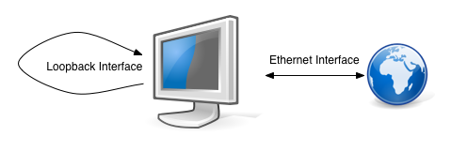
Loopback interface
A special case of private link-local addresses is the loopback interface. These addresses are private and link-local by definition, since packets never leave the host device.
IPv4 reserves the entire class A address block 127.0.0.0/8 for use as private loopback addresses. IPv6 reserves the single address ::1.
As the loopback address never changes, it is the best way to identify a device in the network. The loopback interface is always up and reachable as long as the route to that IP address is available in the IP routing table. Hence, you can use the loopback interface for diagnostics and troubleshooting purposes.

Slide 102
IPv6 Address
An Internet Protocol Version 6 address (IPv6 address) is a numeric label that is used to identify and locate a network interface of a computer or a network node participating in a computer network using IPv6. IP addresses are included in the packet header to indicate the source and the destination of each packet. The IP address of the destination is used to make decisions about routing IP packets to other networks.
IPv6 is the successor to the first addressing infrastructure of the Internet, Internet Protocol version 4 (IPv4). In contrast to IPv4, which defined an IP address as a 32-bit value, IPv6 addresses have a size of 128 bits. Therefore, in comparison, IPv6 has a vastly enlarged address space.

Slide 103
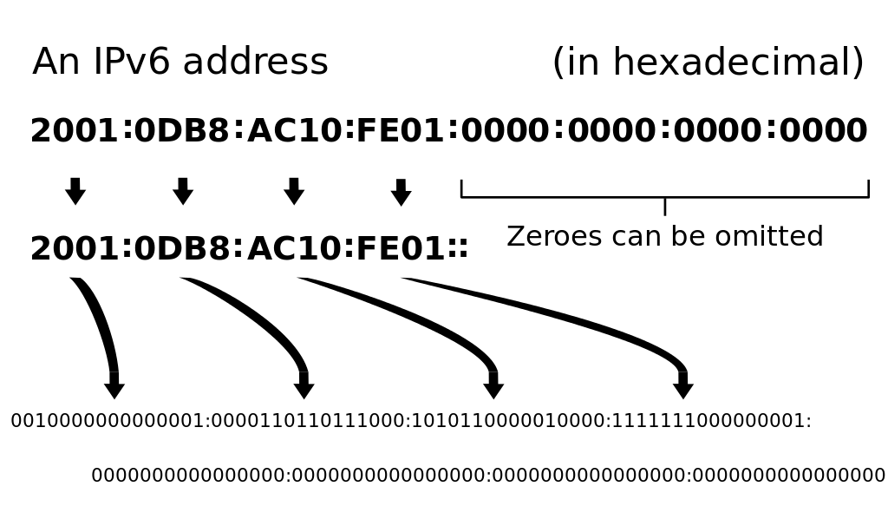
IPv6 Format

Slide 104
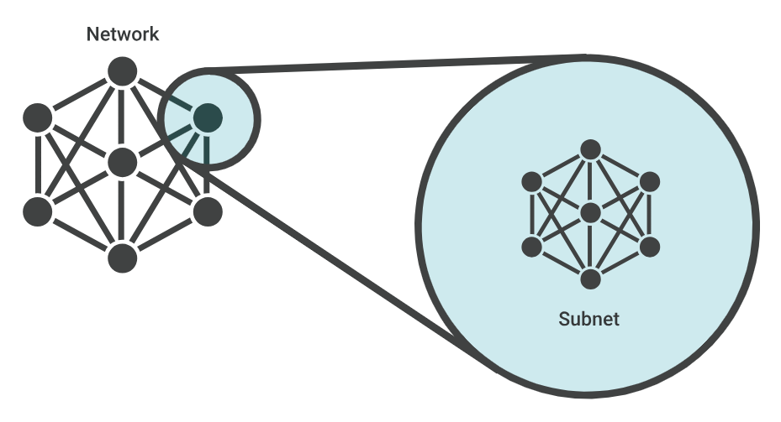
Subnetting
When a bigger network is divided into smaller networks, to maintain security, then that is known as Subnetting. So, maintenance is easier for smaller networks. For example, if we consider a class A address, the possible number of hosts is 224 for each network, it is obvious that it is difficult to maintain such a huge number of hosts, but it would be quite easier to maintain if we divide the network into small parts.
The network can be divided into two parts: To divide a network into two parts, you need to choose one bit for each Subnet from the host ID part.

Slide 105
Uses of Subnetting
Subnetting helps in organizing the network in an efficient way which helps in expanding the technology for large firms and companies.
Subnetting is used for specific staffing structures to reduce traffic and maintain order and efficiency.
Subnetting divides domains of the broadcast so that traffic is routed efficiently, which helps in improving network performance.
Subnetting is used in increasing network security.
The network can be divided into two parts: To divide a network into two parts, you need to choose one bit for each Subnet from the host ID part.

Slide 106
What is a subnet mask?
A subnet mask is like an IP address, but for only internal usage within a network. Routers use subnet masks to route data packets to the right place. Subnet masks are not indicated within data packets traversing the Internet — those packets only indicate the destination IP address, which a router will match with a subnet.
IP packet is addressed to the IP address 192.0.2.15. This IP address is a Class C network, so the network is identified by "192.0.2" (or to be technically precise, 192.0.2.0/24). Network routers forward the packet to a host on the network indicated by "192.0.2."
Once the packet arrives at that network, a router within the network consults its routing table. It does some binary mathematics using its subnet mask of 255.255.255.0

Slide 107
S.NO | Classful Routing | Classless Routing
1. | In classful routing, VLSM (Variable Length Subnet Mask) is not supported. | While in classless routing, VLSM (Variable Length Subnet Mask) is supported.
2. | Classful routing requires more bandwidth. | While it requires less bandwidth.
3. | In classful routing, hello messages are not used. | While in classless routing, hello messages are used.
4. | Classful routing does not import subnet mask. | Whereas it imports subnet mask.
5. | In classful routing, address is divided into three parts which are: Network, Subnet and Host. | While in classless routing, address is divided into two parts which are: Subnet and Host.
6. | In classful routing, regular or periodic updates are used. | Whereas in this, triggered updates are used.
7. | In classful routing, CIDR(Classless Inter-Domain Routing) is not supported. | While in classless routing, CIDR(Classless Inter-Domain Routing) is supported.
8. | In classful routing, subnets are not displayed in other major subnet. | While in classless routing, subnets are displayed in other major subnet..
9. | In classful routing, fault can be detected easily. | While in classless routing, fault detection is little tough.

Slide 109
Interview Questions
Explain OSI in detail?
What is framing ?
What is flow control ?
what is Access Control ?
What is Error Control ?
What is Physical Addressing ?
What is Internetworking ?
What is Addressing ?
What is Routing ?
What is Packetizing ?
What is Segmentation and reassembly ?
What is Dialog control ?
What is Synchronization ?
What is Translation ?
What is Encryption ?
What is Compression ?
What is ip fragmentation and when it occurs and at which layer it occurs?
ping
Copy and shallow copy
udp
Snmp
Netstat
SDLC
STLC
performance function smoke testing
about bugs
about bug life cycle
udp/tcp
performance testing
few unix commands used daily

Slide 110
Interview Questions
Static routing vs Dynamic routing
Classful vs Classless routing
VLSM (Variable Length Subnet Mask)
CIDR (Classless Inter-Domain Routing).
daily

Slide 111
Interview Questions
Ospf
ospf,ospf packets,ospf states
what protocols you have worked under tcp/udp
what is diff btw function and regression testing
all unix commands how to count lines in file in unix(wc)
bgp states
how to get o/p of ifconfig after delay of 10sec features of router
Arp
Stp

