Slide 1
POE
Power Over Ethernet(PoE)

Slide 2
What is POE ?
Power over Ethernet (PoE) enables electric power, along with data, to be passed over a copper Ethernet LAN cable.
Powered devices—such as VoIP telephones, wireless access points, video cameras, and point-of-sale devices—that support PoE can receive power safely from the same access ports that are used to connect personal computers to the network.
This reduces the amount of wiring in a network, and also eliminates the need to position a powered device near an AC power outlet, making network design more flexible and efficient.

Slide 3
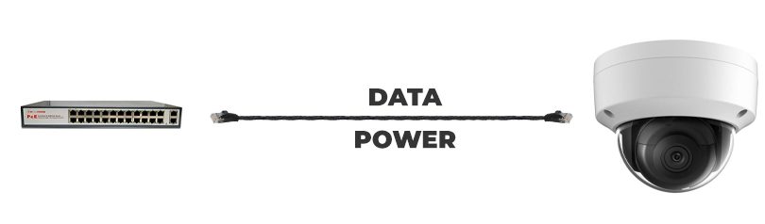
Real Time Example

Slide 4
PoE Versions
PoE was first defined in the IEEE 802.3af standard, which supplied up to 15.4 W of power to a connected powered device. Subsequent versions increased the amount of power that can be supplied to a powered device, as follows:
Enhanced PoE Supplies up to 18.6 W of power.
This is a Juniper Networks extension to the IEEE 802.3af standard introduced in Junos OS Release 11.1.

Slide 5
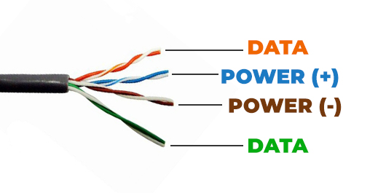
IEEE 802.3at (PoE+) Supplies up to 30 W of power.
The PoE+ standard provides support for legacy PoE devices—an IEEE 802.3af powered device can operate normally when connected to IEEE 802.3at (PoE+) power sourcing equipment.

Slide 6
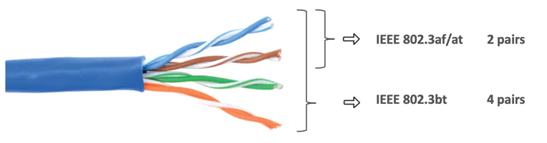
Four-pair PoE (PoE-4P) Supplies to up 90 W of power.
This is a Juniper Networks extension to the IEEE 802.3at standard introduced in Junos OS Release 18.2. PoE-4P delivers more power by utilizing all four pairs of wire in a standard RJ-45 Ethernet cable. In addition to providing more power, PoE-4P improves energy efficiency by reducing the amount of power lost during cable transmission. PoE-4P can deliver up to 60 W (high power PoE) or 90 W (ultra-high power PoE).

Slide 7
IEEE 802.3bt (PoE-bt) Supplies to up 90 W of power.
The IEEE 802.3bt standard for four-pair PoE, introduced in Junos OS Release 19.3. PoE-bt introduces two new power types: Type 3 and Type 4, which deliver up to 60_W and 90_W of power, respectively.

Slide 8
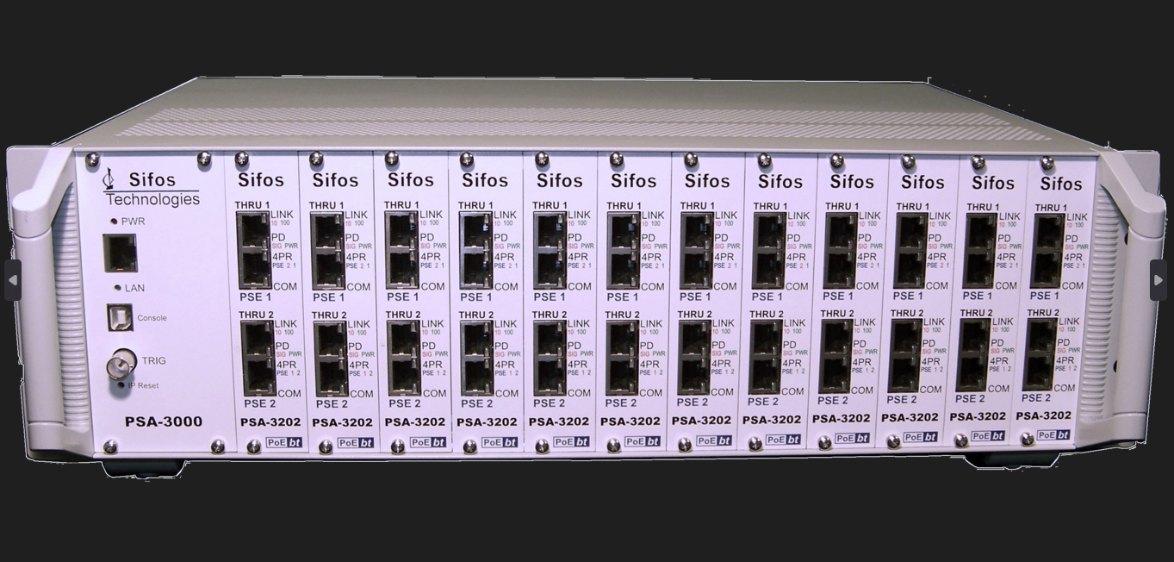
Sifos/Powered Device(PD)/Power Device Analyzer

Slide 9
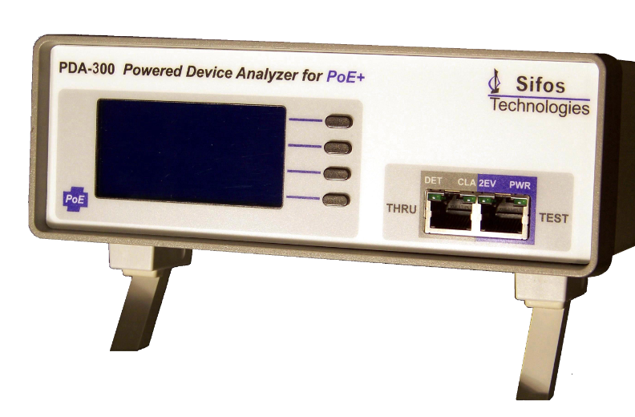
Sifos/Powered Device(PD)/Power Device Analyzer

Slide 10
POE Powered Device Analyzer key features:
Automated Testing
PD Load Monitoring like Current Voltage Power
Informative Pop-Up Spreadsheet Reports & Statistics
Thru Port for External PD Control, Packet Test & LLDP Test
Optional User-Defined Test and Limits

Slide 11
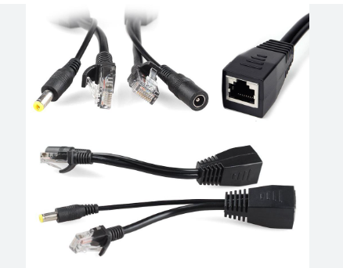
POE Injector Splitter separator Cable

Slide 12
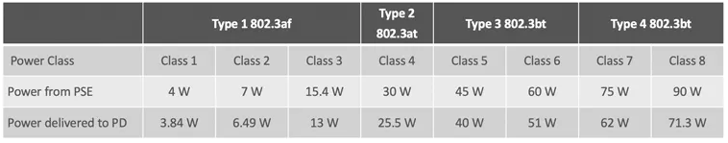
Power handing Ranges

Slide 13
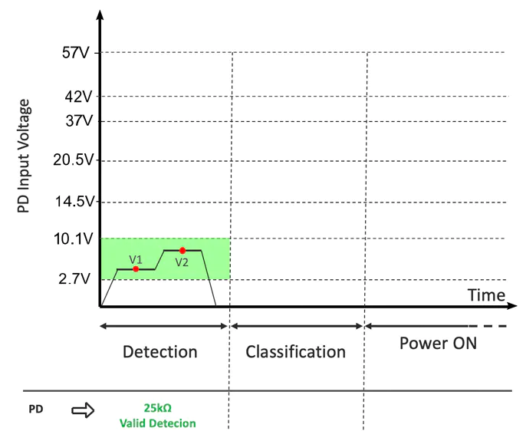

Slide 14
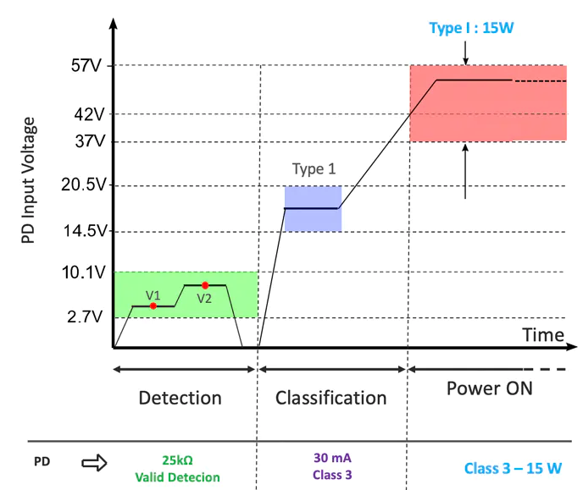

Slide 15
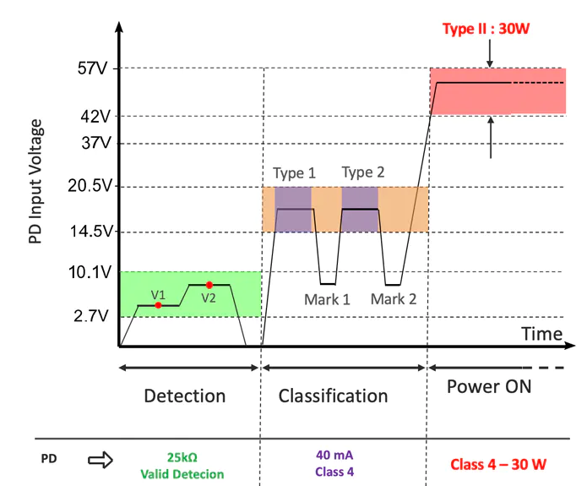

Slide 16
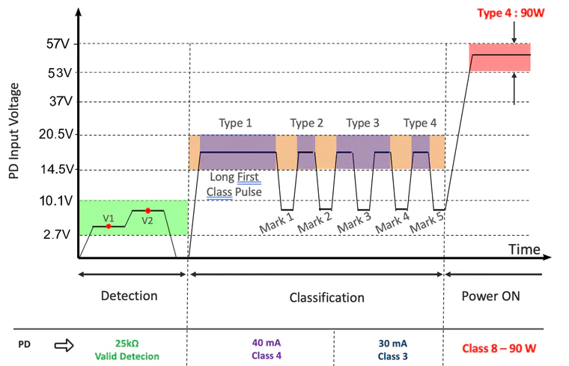

Slide 17
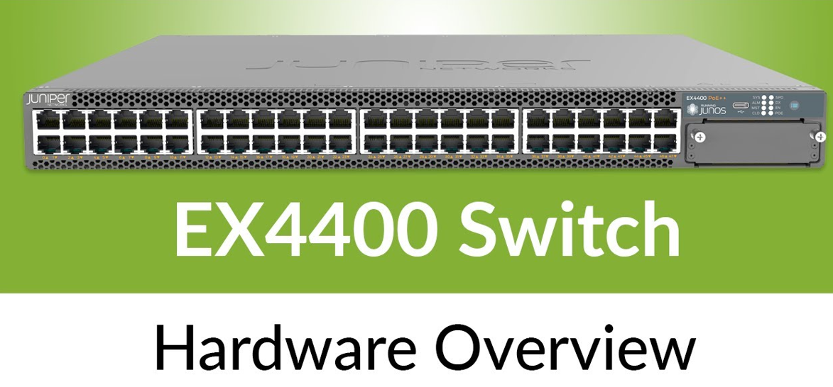
The EX4400 switches can be configured to deliver fast PoE capability, which enables the switches to deliver PoE power to connected PoE devices within a few seconds of power being applied to the switches. In addition, the EX4400 switches support perpetual PoE, which provides uninterrupted power to connected PoE powered devices (PDs) even when the switch is rebooting.

Slide 18
sifospoe-linux2
Ci-SIFOS
EX4400
DATA+POWER
POWER
TOPOLOGY

Slide 19
sifospoe-linux
The PowerShell PSA Scripting Environment provides a high level, interactive means to control and program
automated test sequences for the PSL-3000 PowerSync Programmable Load. PowerShell PSA enables fully
automated testing suites that span multiple ports, blades, and instruments.

Slide 20
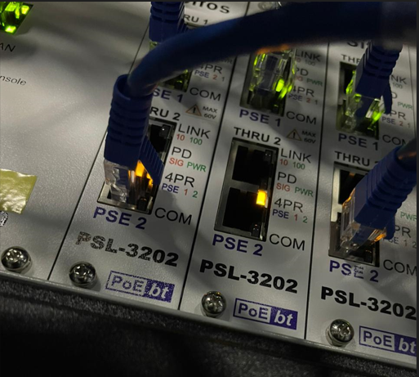
The EX4400

Slide 21
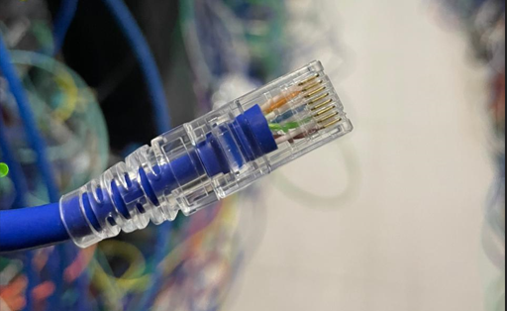
The EX4400

Slide 22
Possible issues or challenges while debugging ?
PD is not powered
Sifos configuration failed
Power Dropped
Configuration not supported
Average power is zero
Etc….

Slide 23
Thanks

