Slide 1
Spanning Tree Protocol(STP)
IEEE 802.1D

Slide 2
INTRODUCTION
What is the Redundancy ?
What is Spanning Tree Protocol ?
How Spanning Tree protocol works ?
How STP prevent formation of loops in network ?

Slide 3
REDUNDANCY
Redundancy means it is used to provide a Redundant Links as a Backup Path When one link goes down.
But these links can sometimes cause a switching loops.
These loops formation can be prevent by STP.

Slide 4
Spanning Tree Protocol
STP is an open standard IEEE 802.1D.
STP is used to make a loop-free network.
By monitoring the network, we can track all the links.
The main purpose of Spanning tree Protocol is to ensure that we do not create loops, When you have redundant paths in the network.

Slide 5
How STP Works
Selecting the Root Bridge
Selecting the Root Port
Selecting the least cost path(shortest path)
Blocking the unwanted Links

Slide 6
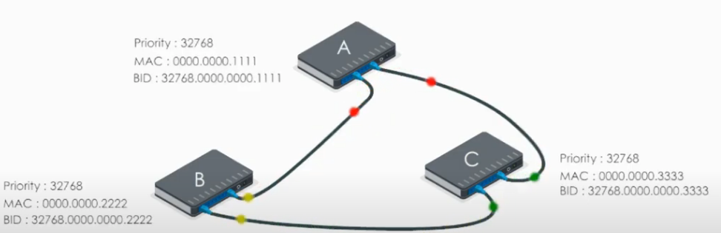
Network
A Network is formed by the multiple interconnections of devices.

Slide 7
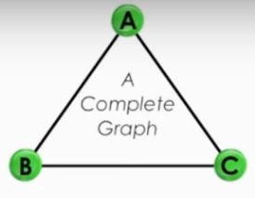
What Is A Complete Graph
So, the network is considered as a complete graph.
A complete graph consists all the nodes and vertices that are in the networks.
Here, Nodes means devices and the vertices means the links.
In the network field, a complete graph is a fully meshed network .

Slide 8
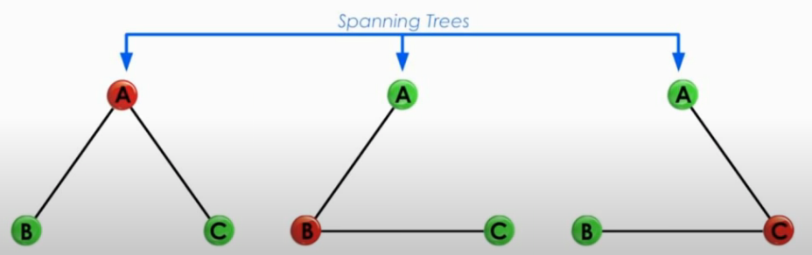
Spanning Tree
A Spanning Tree is also a graph with no-loop.
A Spanning Tree Consists of all the nodes/devices of that network.
A Complete Graph will form a closed loop, but the Spanning Tree will not form a loop.

Slide 9
Selecting the Root Bridge
All the switches in the network declare themselves as root bridges and start exchanging their own BPDU(Bridge Priority Data Unit it contains the bridge ID, Sender’s Bridge ID)
The BPDU with the lowest bridge ID will be considered as superior. Now the switch receiving the superior BPDU makes changes in its own BPDU and carriers forward to its neighbor.
It changes the value of root Bridge ID with its superior BPDU bridge ID.
This process goes on until all the switches are satisfied with which bridge has the lowest bridge ID and hence that switch will be declared as the Root bridge.

Slide 10
Bridge Priority Data Unit (BPDU)
All switches exchange information by using Bridge Protocol data Units.
Hello = BPDUs are sent every 2 seconds.
MAX age(dead) = 20 seconds.
Forward Delay (Listening/learning time) = 15 seconds.
BPDU contains information regarding ports switches, port priority and addresses.
Incase of any link fails it will start using alternate link which is in blocking state ,Default conversation time incase of spanning will be around 50 seconds.

Slide 11
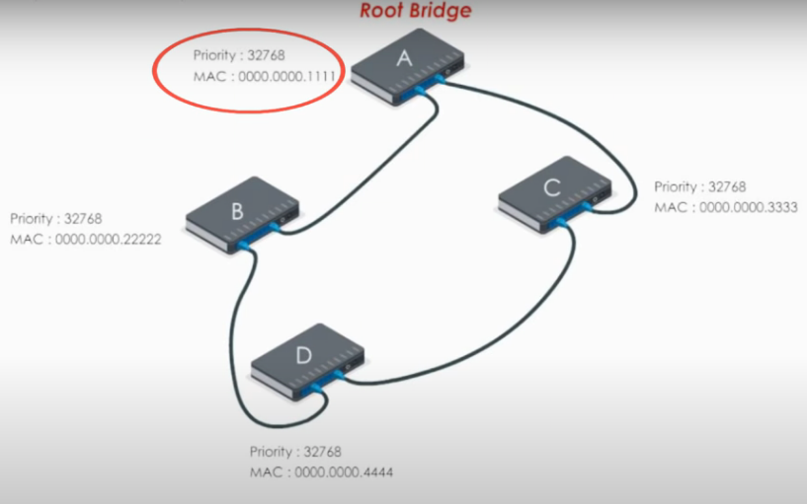
ROOT BRIDGE
The Device with the lowest Bridge ID.
Bridge ID= priority + Mac address of the switch
Every LAN will have only one Root Bridge and all the remaining switches will be considered as Non-root Bridges.

Slide 12
Selecting The Shortest path
LINK SPEED (BANDWIDTH) | PORT COST
10 mbps | 100
100 mbps | 19
1 gbps | 4
10 gbps | 2
The cost of the path is based on the link speed (i.e) Bandwidth.
If the Bandwidth is higher, then the Cost of path is lower.
If the Bandwidth is lower, then the Cost of path is higher.

Slide 13
Root Port
Shortest path to the Root bridge
Every Non-root Bridge looks the best way to communicate with Root-bridge
Least cost(speed)
The lowest forwarding switch ID(priority +MAC)
For every non-root bridge there is only one root port.

Slide 14
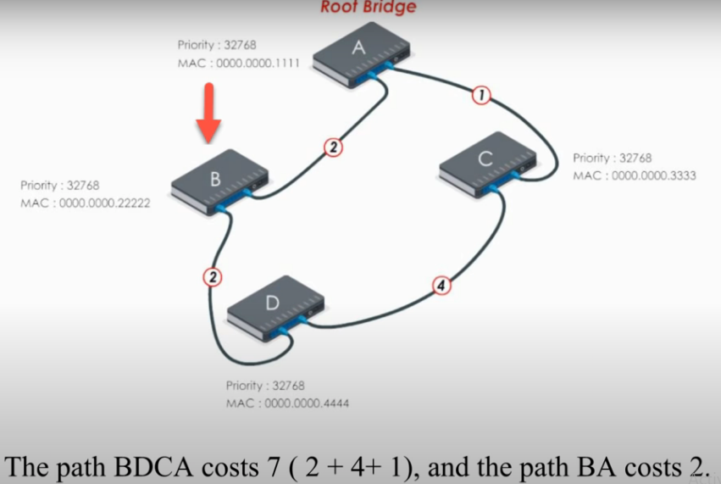

Slide 15
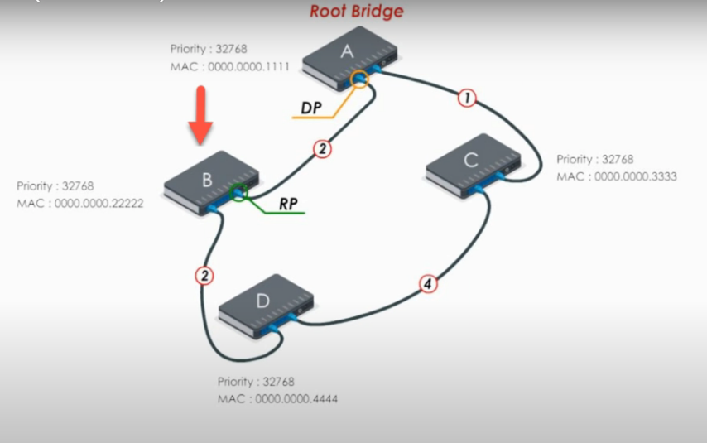

Slide 16
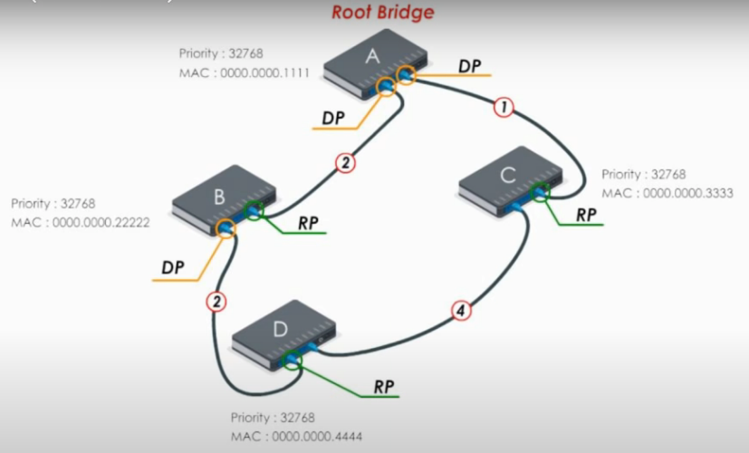

Slide 17
Blocking the unwanted Links
After selecting the shortest path, STP will Block the unwanted or redundant links to make the network loop-free.
So, STP will make the unwanted link state to the blocking state.
The port will be marked as the blocking port, where it will drop the traffic or the message.

Slide 18
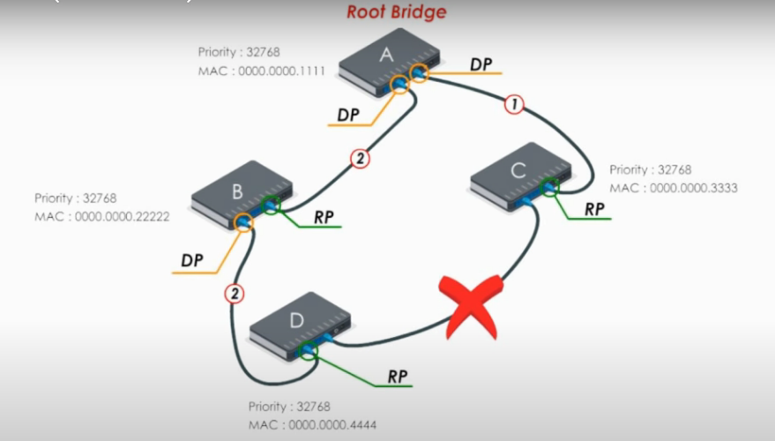

Slide 19
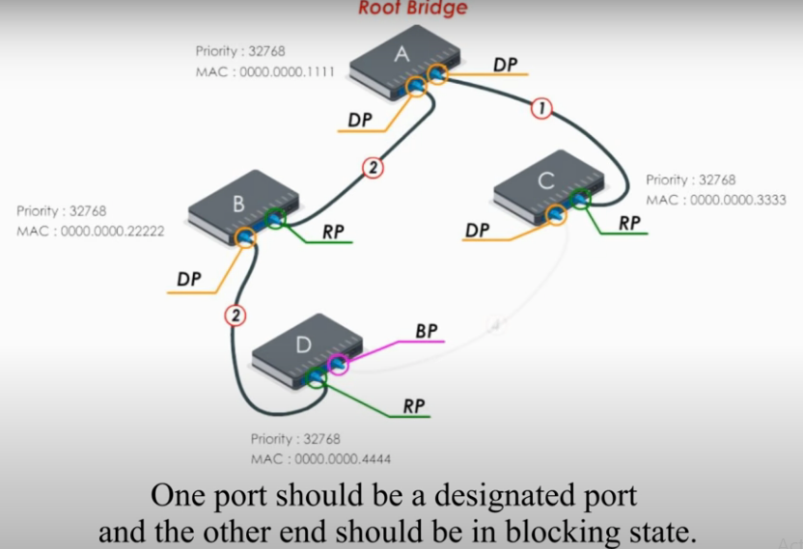

Slide 20
STP Fault Tolerance
If any link breaks, then the corresponding device will stop receiving the message.
The device cannot respond immediately but, it waits for 20 sec as the default time of BPDU timer is 20 seconds. Because the switch maximum waiting time is
20 seconds.
Now the STP will take the action and make the blocked link to the working state.
Then the fault link will be discarded and the HELLO BPDU message is send to the corresponding Device.

Slide 21
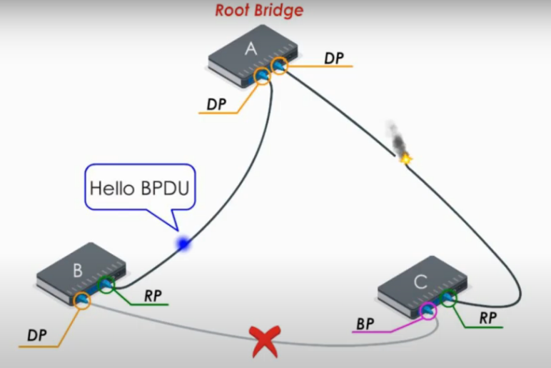

Slide 22
STP Fault Tolerance
The Blocked port set to listening state.
Listening state lasts for 15 sec. Which are default time in forward delay.
Then the Blocked port is set to learning state. Port in the learning state will not forward any message but it starts learning MAC address and updating the MAC Address Table.
Learning state is lasts for 15 sec before going to forwarding state. Which is the default time in forward delay.
This self healing process will take the 50 sec time.
Finally, the Blocked port is set to Root port. At the same time the original root port is set to blocked port.
So that a loop free network is created with fault tolerance.

Slide 23
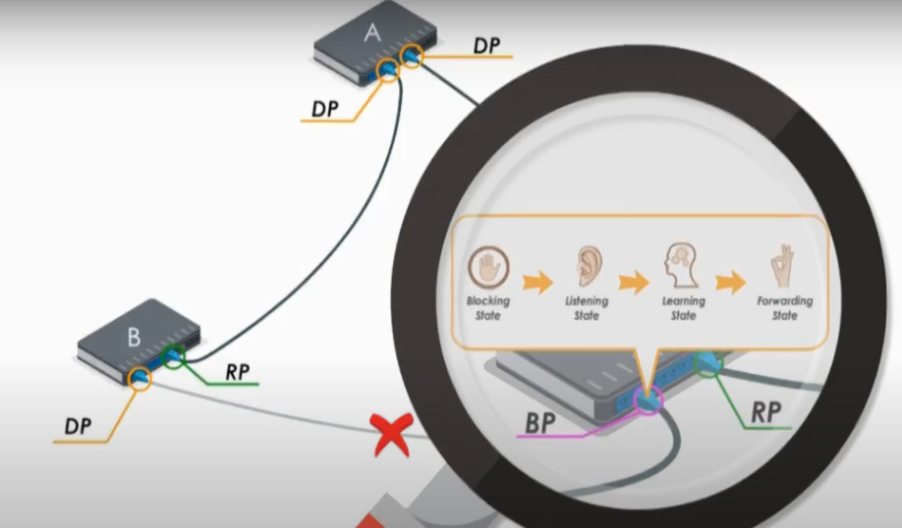

Slide 24
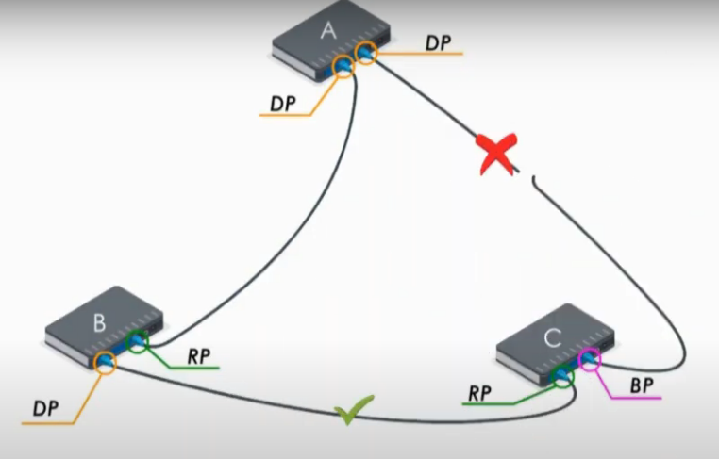

Slide 25
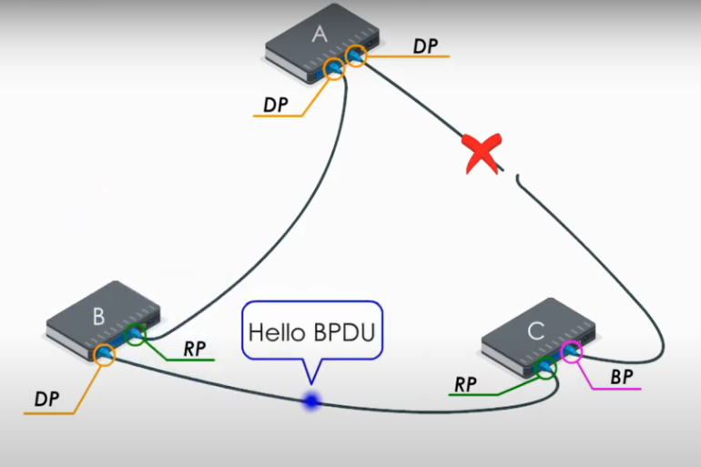

Slide 26
Summary
When we have redundant paths in the network, STP will make the network loop-free.
STP can activate the blocked link if any active link break.
STP will provide the fault tolerance for a network using the redundant paths.
Fault Recovery time is more (i.e) 50 seconds.
We can reduce the time by using the Rapid Spanning Tree Protocol (RSTP).

Slide 27

THANK YOU

