Slide 1
SpiRobs
Overview

Slide 2
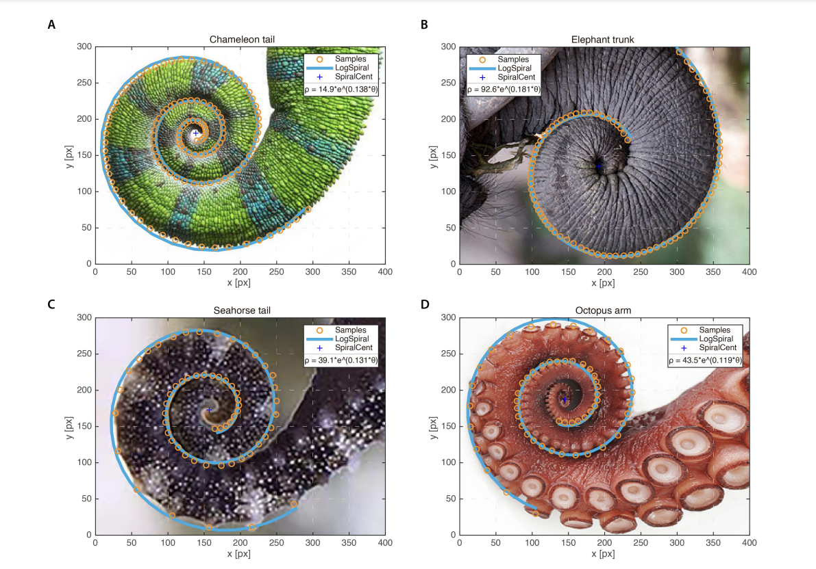

Slide 3
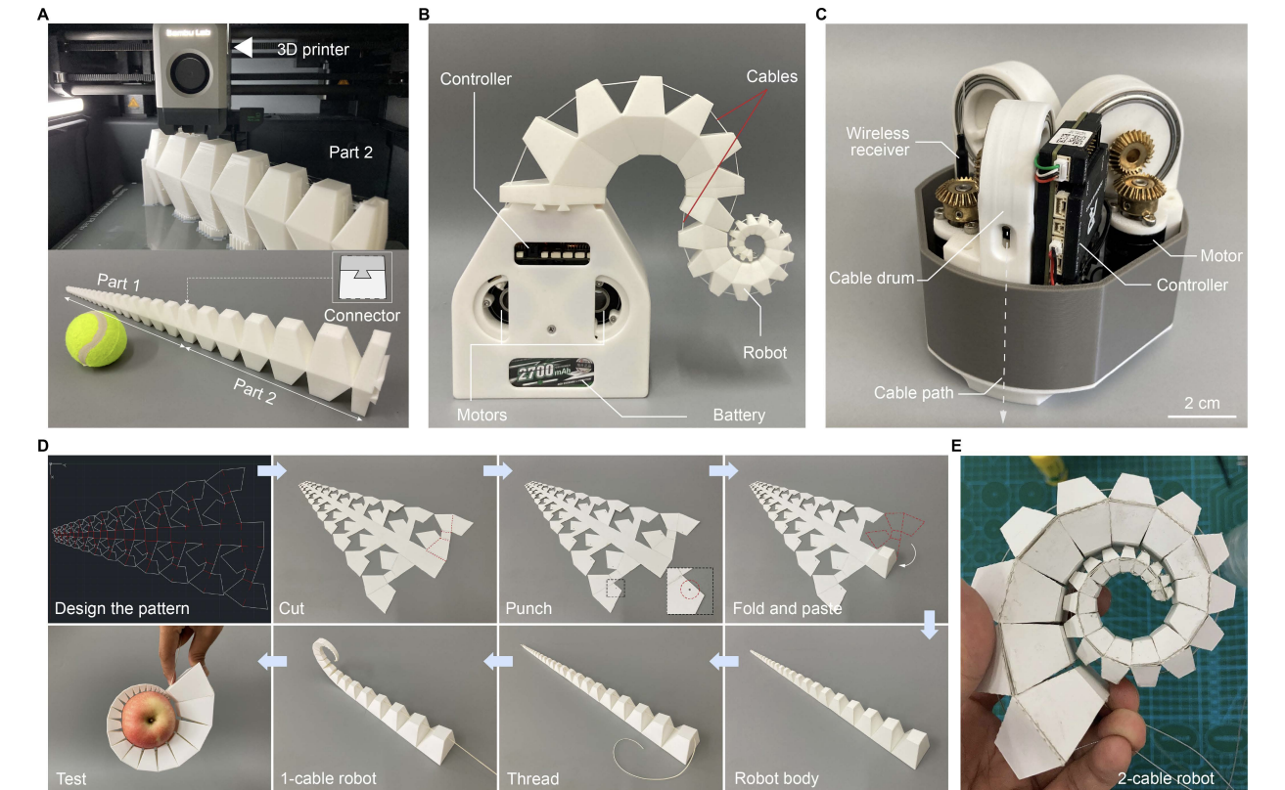

Slide 4
Paper 1 Overview
replicate the logarithmic spiral
actuated by cables, which allows for fast and life-like movements.
miniaturized gripper, a manipulator mounted on a drone, and multi-robot arrays.

Slide 5
Existing Designs Problems
different actuation methods, including pneumatic16–18 and cable driven, most of these prototypes can only produce arc-shaped bends with a limited curvature at the tip.
use of soft materials (such as silicone) can increase the bending range and improve flexibility, this may result in wrinkling and buckling under large actuation forces, which, in turn, means failure to maintain a firm grasp.
passive deformation caused by interacting with objects, However, these robots can typically only produce a single repetitive pattern (such as bend and release).

Slide 6
What is required
passive deformation caused by interacting with objects.
‘‘universal’’ strategies for reaching, grasping, and transporting objects of different shapes and from different positions (in contrast to rigid robots, albeit at the cost of high complexity for planning and control).

Slide 7
Two Principles
universal (across scales) design based on discretizing and uncurling the logarithmic spiral.
Discretizing the Spiral - Instead of treating the spiral as a continuous smooth curve, the researchers break it into small connected sections (or discrete segments).
Uncurling Mechanism - When the spiral is uncurling, these discrete segments move relative to each other in a coordinated manner.
grasping strategy, inspired by the octopus
controlling the curling/uncurling motion using cables
passive deformation upon contact to adapt to objects of variable shapes and sizes (e.g., cup, pen, egg, strawberry, pineapple, and more;

Slide 8
Design of SpiRobs
Logarithmic Spiral
Discretization
Elastic Layer
Taper Angle
Conclusions are drawn for fixed length and tip diameter
The smaller the taper angle, the larger the workspace
At the same time, the larger the taper angle, the smaller the diameter of the smallest object that can be grasped and the larger the maximum load capacity.
Taking the robot with a taper angle of 15 as an example, it can grasp objects whose diameters vary by two orders of magnitude (from 5.6 to 115 mm) and weigh roughly 260 times the weight of the robot (38.4 g selfweight and 10 kg load capacity

Slide 9
Bioinspired grasping strategy
Octopus- it progressively uncurls and straightens curled arms to reach the target. After making contact with the object, the arm keeps uncurling on the surface of the object to align the suckers.

Slide 10
Automation
To automate the grasping, they propose a method to detect contact with an object as well as a simple rule (piece-wise linear actuation) to control the cable forces by relating them directly to the object’s position.
The threshold for detection was set through multiple experiments, and this simple mechanism was shown to be capable of detecting even the slightest contact; e.g., with a feather.

