Slide 1
Database Design

Slide 2
Entity Model
Entity-Relationship (ER) models are conceptual diagrams used to represent the structure of a database in terms of entities, their attributes, and the relationships between them.
ER models are widely used in the database design process to visualize and communicate the database schema.
Here are the key components of an ER model:

Slide 3
Entities:
An entity is a real-world object or concept that is distinguishable from other objects. In an ER model, entities are represented as rectangles. Each entity has a name, which describes the type of object it represents.
Example: "Student," "Department," "Book," "Employee."
Attributes:
Attributes are the properties or characteristics of entities. They describe the various features of an entity and provide additional information about it. Attributes are represented as ovals connected to their respective entities.
Example: For the "Student" entity, attributes could include "Student_ID," "Name," "DOB," "Batch."

Slide 4
3.Relationships:
Relationships describe the associations and dependencies between entities. They represent how entities interact with each other and capture the connections between them. Relationships are represented as diamond shapes connecting related entities.
Example: A "Student" entity may have a relationship with a "Department" entity, indicating that students belong to specific departments. This relationship could be labeled as "Belongs to."

Slide 5
4.Cardinality and Multiplicity:
Cardinality and multiplicity define the number of instances of one entity that are associated with a single instance of another entity in a relationship.
Cardinality describes the maximum number of occurrences of one entity that can be associated with a single occurrence of another entity.
Multiplicity describes the minimum and maximum number of occurrences of one entity that are associated with a single occurrence of another entity.
Cardinality and multiplicity are often denoted using notation such as "1" (one), "M" (many), or "0..1" (zero or one).

Slide 6
There are three main types of cardinality:
One-to-One (1:1):
In a one-to-one relationship, each instance of one entity is associated with at most one instance of another entity, and vice versa.
Example: A person can have only one passport, and a passport can belong to only one person.
One-to-Many (1:M):
In a one-to-many relationship, each instance of one entity can be associated with zero or more instances of another entity, but each instance of the other entity can be associated with at most one instance of the first entity.
Example: A department can have many employees, but an employee can belong to only one department.

Slide 7
Many-to-Many (M:N):
In a many-to-many relationship, each instance of one entity can be associated with zero or more instances of another entity, and vice versa.
Example: A student can enroll in multiple courses, and a course can have multiple students enrolled in it.
Cardinality is typically represented graphically in Entity-Relationship (ER) diagrams using notation such as "1" (one), "M" (many), or numerical ranges (e.g., "0..1" for zero or one). It helps database designers understand the nature of the relationships between entities and enforce constraints to maintain data integrity. Properly defining cardinality ensures that the database accurately reflects the real-world relationships between entities and meets the requirements of the application domain

Slide 8
5.Primary Keys:
A primary key is a unique identifier for each instance of an entity. It uniquely identifies each record in the entity set and ensures data integrity.
Primary keys are underlined in ER diagrams to indicate their uniqueness and importance.
6.Foreign Keys:
A foreign key is an attribute in one entity that refers to the primary key of another entity. It establishes a relationship between the two entities.
Foreign keys represent the links between related entities and are used to enforce referential integrity.

Slide 9
ER models provide a high-level abstraction of the database structure and serve as a blueprint for designing the database schema.
They help database designers visualize the relationships between entities and ensure that the database meets the requirements of the application domain.

Slide 10
Why use ER Diagrams?
Helps you to define terms related to entity relationship modeling
Provide a preview of how all your tables should connect, what fields are going to be on each table
Helps to describe entities, attributes, relationships
ER diagrams are translatable into relational tables which allows you to build databases quickly
ER diagrams can be used by database designers as a blueprint for implementing data in specific software applications
The database designer gains a better understanding of the information to be contained in the database with the help of ERP diagram
ERD Diagram allows you to communicate with the logical structure of the database to users

Slide 11
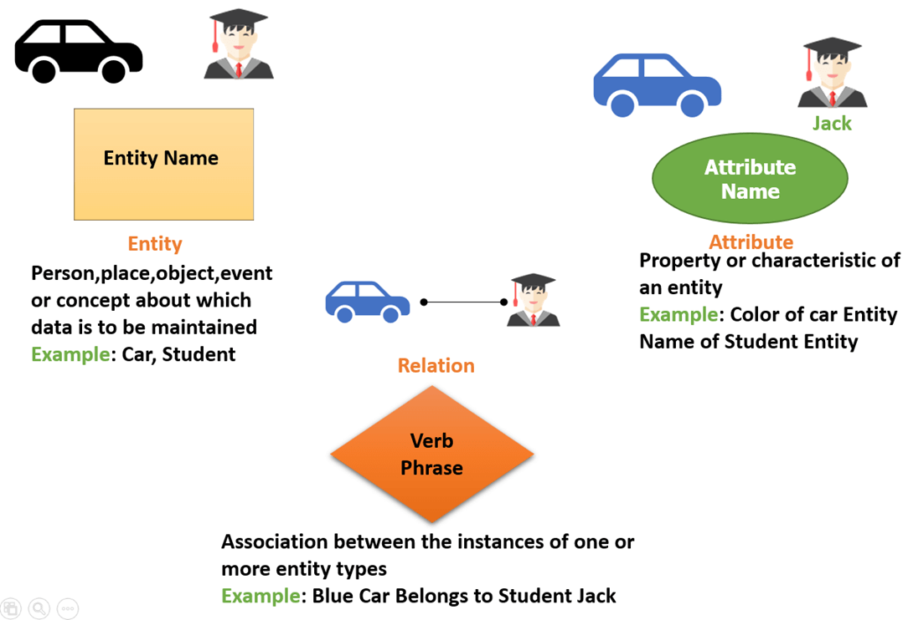

Slide 12
Normalization
Normalization is the process of organizing data in a database to reduce redundancy and dependency, thereby improving data integrity and minimizing anomalies during data manipulation.
The normalization process involves applying a set of rules called normal forms to decompose larger tables into smaller, well-structured tables.
Here are the common normal forms and the normalization process:

Slide 13
First Normal Form (1NF):
Requirements: Each attribute value must be atomic (indivisible), and each column must contain only one value.
Process: Split multi-valued attributes into separate columns, and ensure that each column contains atomic values.
Example: Splitting a "Phone Numbers" column containing multiple phone numbers into separate columns for each phone number.

Slide 14
2.Second Normal Form (2NF):
Requirements: The table must be in 1NF, and no non-prime attribute should be functionally dependent on only part of the primary key.
Process: Remove partial dependencies by creating separate tables for related attributes.
Example: Moving attributes that are functionally dependent on only part of the primary key to a separate table.

Slide 15
3.Third Normal Form (3NF):
Requirements: The table must be in 2NF, and no non-prime attribute should be transitively dependent on the primary key.
Process: Remove transitive dependencies by creating separate tables for attributes that are dependent on other non-key attributes.
Example: Moving attributes that are dependent on other non-key attributes to a separate table.

Slide 16
4.Boyce-Codd Normal Form (BCNF):
Requirements: The table must be in 3NF, and every determinant must be a candidate key.
Process: Eliminate all non-trivial functional dependencies where the determinant is not a superkey.
Example: Decomposing tables to ensure that every determinant is a candidate key.

Slide 17
5.Fourth Normal Form (4NF):
Requirements: The table must be in BCNF, and it must not have any multi-valued dependencies.
Process: Eliminate multi-valued dependencies by decomposing the table into smaller tables.
Example: Splitting tables to remove multi-valued dependencies.

Slide 18
5.Fifth Normal Form (5NF):
Requirements: The table must be in 4NF, and it must not have any join dependencies.
Process: Decompose the table into smaller tables to remove join dependencies.
Example: Splitting tables to remove join dependencies.
The normalization process aims to minimize redundancy, improve data integrity, and simplify data manipulation operations. It helps to ensure that the database is well-structured, efficient, and resilient to anomalies during updates, deletions, and insertions. However, it's essential to strike a balance between normalization and performance, as overly normalized databases may lead to increased query complexity and decreased performance in some cases.

