Slide 1
Digital Portfolio
STUDENT NAME: RAHUL.S
REGISTER NO AND NMID: 2426J1547& asbruaz2426j1547
DEPARTMENT: B.SC.Information Technology
COLLEGE: KPR College Of Arts Science And Reasearch/Bharathiyar University

Slide 2
PROJECT TITLE
Personal Resume Website

Slide 3


AGENDA
Problem Statement
Project Overview
End Users
Tools and Technologies
Portfolio design and Layout
Features and Functionality
Results and Screenshots
Conclusion
Github Link
3/21/2024 Annual Review

Slide 4

PROBLEM STATEMENT
In today’s competitive job market, traditional resumes in PDF or paper format often fail to effectively showcase an individual’s full range of skills, projects, and experiences.
These static documents are limited in interactivity, accessibility, and personalization. Recruiters and potential employers increasingly expect dynamic, engaging, and easily accessible portfolios that reflect not only professional qualifications but also technical proficiency and creativity.
Thus, there is a need for a Personal Resume Website that provides a centralized, interactive, and customizable platform for individuals to present their skills, achievements, projects, and contact information in a professional manner.

Slide 5

PROJECT OVERVIEW
The Personal Resume Website project aims to create a digital platform that represents an individual’s professional identity in a modern, interactive, and accessible manner. Unlike traditional resumes, this website will provide a dynamic portfolio where users can showcase their skills, education, work experience, projects, certifications, and achievements with enhanced visual appeal.
The website will serve as a centralized hub for recruiters, employers, and collaborators to easily access detailed information, contact details, and professional links (such as LinkedIn, GitHub, or email). It will be responsive and user-friendly, ensuring accessibility across devices such as desktops, tablets, and smartphones.
By integrating modern web design technologies (e.g., HTML, CSS, JavaScript, frameworks), the project not only highlights professional content but also demonstrates the individual’s technical capabilities in web development. Additionally, the website can include features like downloadable resumes, project showcases, contact forms, and social media integration to enhance engagement.

Slide 6

WHO ARE THE END USERS?
Recruiters / Hiring Managers: Primary users who review the candidate’s profile, skills, and portfolio.They use the website to evaluate suitability for job opportunities.
Potential Employers / Companies: Organizations looking for candidates with specific qualifications.They may use the website to assess both technical knowledge and creativity.
Professional Network / Collaborators: Colleagues, industry peers, or project partners.They can explore the candidate’s background for collaboration or partnerships.
Academic Institutions / Professors / Mentors: Used to evaluate student portfolios for higher education, internships, or research opportunities.
The Individual (Website Owner): The candidate themselves is also an end user.They use the site as a self-marketing tool to maintain and present their personal brand.

Slide 7
TOOLS AND TECHNIQUES
Programming Language:
HTML, CSS, JavaScript
Database Management System (DBMS):
Firebase / MySQL (optional – only if storing form data or user inputs)
Version Control:
Git, GitHub
Development Environment:
VS Code (Visual Studio Code)
Deployment Platform:
GitHub Pages / Netlify / Vercel

Slide 8
POTFOLIO DESIGN AND LAYOUT
Home / Hero Section
Shows your name, tagline, and a short intro
Creates the first impression and tells who you are at a glance
About Me Section
Contains bio, education, and career goal
Helps recruiters understand your background & personality
Skills & Projects Section
Lists technical + soft skills and showcases projects with demos/GitHub links
Proves your abilities with real work examples
Experience & Education Section
Timeline of jobs, internships, and academic history
Shows your growth and qualifications clearly
Contact Section (with Footer)
Provides contact form, email, phone, LinkedIn/GitHub links
Makes it easy for employers to reach you anytime
8

Slide 9
FEATURES AND FUNCTIONALITY
Homepage / Hero Section – Name, tagline, and a short professional introduction.
About Me – Profile photo, personal bio, education background, and career goal.
Skills Section – Highlights technical and soft skills with icons or progress bars.
Projects / Portfolio – Showcases projects with descriptions, images, and GitHub/live demo links.
Experience Section – Work experience, internships, and key responsibilities.
Education Section – Academic qualifications presented in a clear timeline.
Achievements & Certifications – Awards, certificates, and recognitions.
Contact Section – Contact form, email, phone, and professional links (LinkedIn, GitHub).
Additional Features – Downloadable resume, responsive design, smooth navigation, and animations.

Slide 10
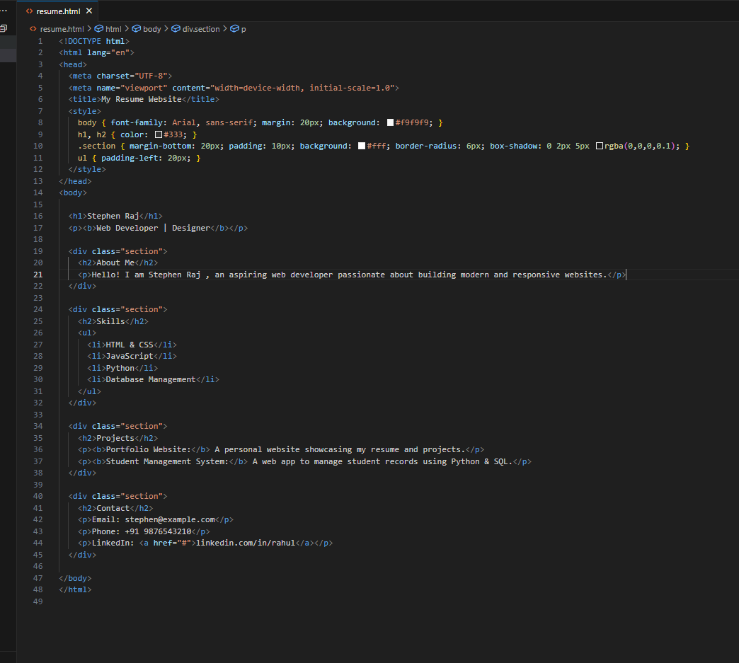
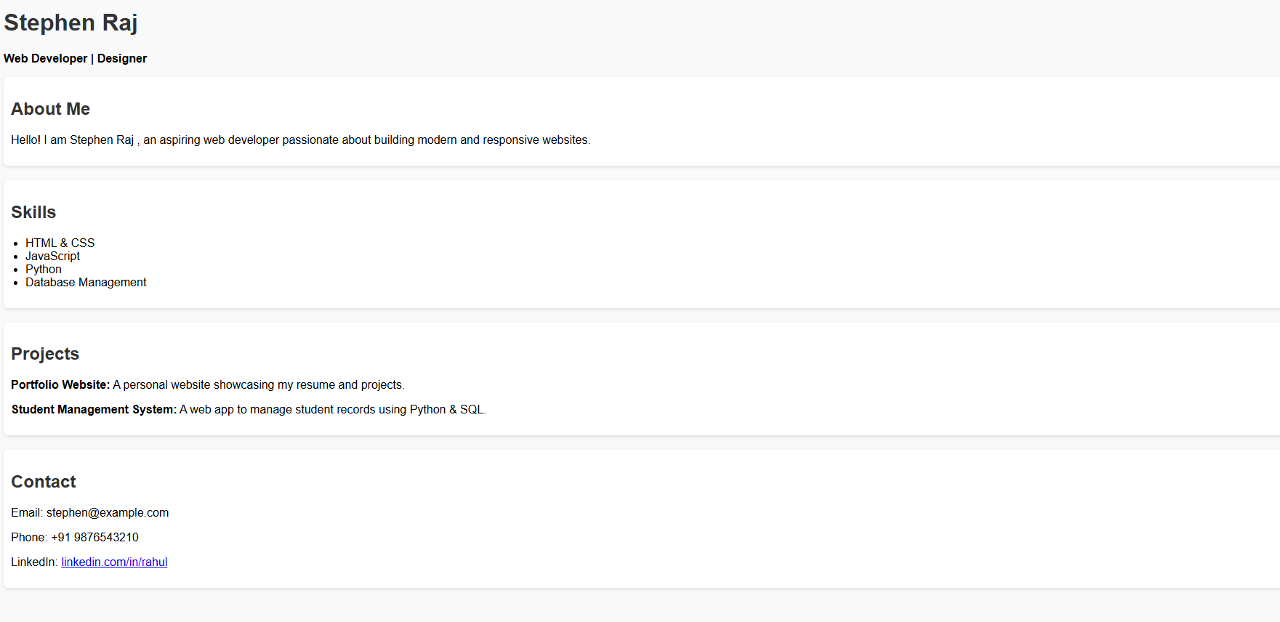
RESULTS AND SCREENSHOTS
3/21/2024 Annual Review
10

Slide 11
CONCLUSION
The Personal Resume Website serves as a digital portfolio that highlights professional skills, projects, and achievements in a clean and accessible way. Unlike a traditional paper resume, it provides an interactive and easily shareable platform for employers, recruiters, and peers to view one’s profile. By using simple web technologies like HTML, CSS, and optional JavaScript, the website ensures responsiveness and user-friendliness. Overall, it not only strengthens personal branding but also demonstrates technical skills in web development, making it a valuable tool for career growth.
Git-Hub Link:
https://github.com/Rahul-creatorprog/personal-resume.git
11

