Slide 1




DAILY NEWS CONTENT GENERATOR
MetaMinds.AI
Powered By:

Slide 2
CONTENTS
01
Problem Statement
Pg. No 03
02
Technical Architecture
Pg. No 04
03
News Summarization with References
Pg. No 05
04
Social Media Posts
Pg. No 06
05
Image Generation
Pg. No 07
06
Meme Generation
Pg. No 08
07
Future Scope
Pg. No 09

Slide 3
Solution Powered by Generative AI
PROBLEM STATEMENT
OBJECTIVE
The goal of this project is to build a Daily News Content Generator using AI agents, leveraging Retrieval-Augmented Generation (RAG).
The system generates fresh, relevant, and personalized daily news summaries from various sources based on user preferences.
The solution allows user to generate creative content such as Social Media Posts (LinkedIn, Twitter, etc.), Image generation related to news summary, Meme generation, and short video generation.
To develop a daily news content generator that based on user’s input, gathers content from various news sources, generate comprehensive summaries based, support dynamic generation of text summaries, social media posts, images, memes and short videos using AI Agents framework.
Enhanced Customer Experience
Reduced Time and Resource Analysis
BUSINESS IMPACT
Scalable Personalization Solution
Automated Content Creation
Real-Time News
Multi-format content creation

Slide 4












TECHNICAL ARCHITECTURE
BACKEND
FRONTEND
AI AGENT FRAMEWORK
WEB APPLICATION
ASK QUERY
SUMMARIZATION
USERS
MIDDLEWARE
Load Service
FEEDBACK
Query Service
CONTENT GENERATION

Slide 5
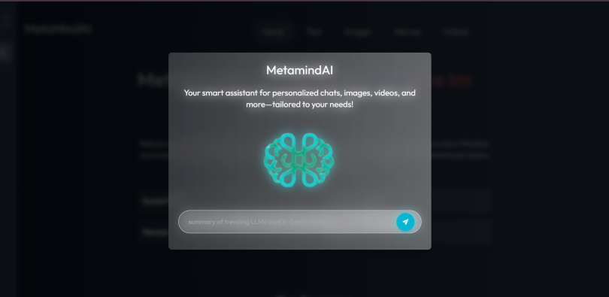

Slide 6
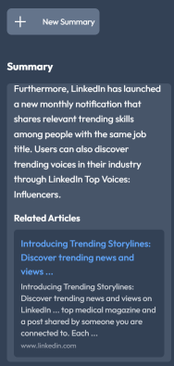
News Summarization with References
📰 Generates concise, comprehensive summaries
from lengthy news articles or user-provided content.
✍️ Supports various formats, including bullet points,
paragraph summaries, or key highlights.
✍️ Allows customization of summary length based on
user preferences.
📰 Utilizes AI to extract critical information and
eliminate redundancy for clarity
🔗 Provides multi-source integration to ensure well-
rounded and unbiased summaries

Slide 7
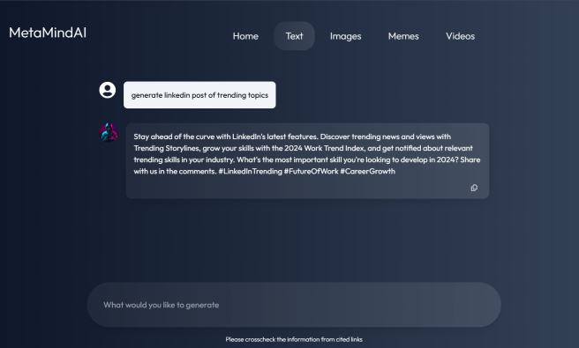
Social Media Posts
💬 Automatically creates concise and engaging posts
tailored to user input.
✍️ Supports tone customization (e.g., formal, casual,
humorous) for different audiences
#️⃣ Integrates hashtags and keywords for improved
visibility and reach.
📱 Enables scheduling and previewing posts for various
social media platforms
🌐 Leverages AI to align posts with trending topics and
user preferences.

Slide 8
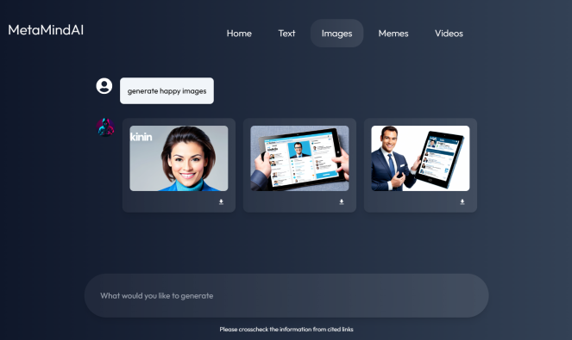
Image Generation
🎨 Generates visually appealing images based on textual
descriptions or keywords.
🎨 Supports multiple styles (e.g., professional,
artistic, minimalist) for diverse use cases
📷 Ensures high-resolution output suitable for web,
social media, and print.
🖼️ Dynamically adds branding elements like logos,
text overlays, and color themes
🖼️ Powered by advanced AI models to create unique,
copyright-free visuals.

Slide 9
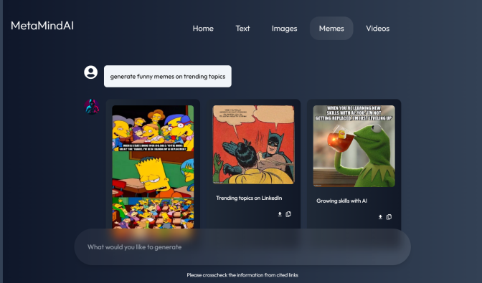
Meme Generation
😂 Instantly creates memes based on popular
templates or user-defined input
🖌️ Allows customization of text, font styles, and
humor levels.
🎭 Provides a library of trending templates to
keep content fresh and relatable.
🌐 Ensures compatibility with different social
media platforms for easy sharing.
🌐 Encourages creativity by offering AI-
generated witty captions.

Slide 10
Future Scope
🌟 Advanced Personalization: Using deep learning for better content personalization
📹 Video Generation API Integration: Automating video generation using external APIs (e.g., Lumen5, Synthesia, Pictory).
🌐 Social Media Integration: Share personalized news on social platforms.
🌟 Automated Sentiment Analysis: Sentiment-based dynamic summaries.
🌐 Multi-Language Support: Expanding to support global languages.

Slide 11

Developers
Rahul Singh
Sanket Bodake
Fahad Abbas
Sadam Barkat

Slide 12
Thank You!
MetaMinds.AI

