Slide 1
🌿
AGRI SCAN
AI-Powered Plant Disease Detection System
38+
95%+
AI
Diseases
Accuracy
Powered
MobileNetV2 • Flask • TensorFlow • Gemini AI • Python

Slide 2
The Problem
❌
Manual Detection is Slow
40%
Farmers wait days for expert diagnosis
💰
Expert Consultation is Costly
Small farmers can't afford agronomists
of crop yield lost
every year due to
plant diseases
📍
Limited Expert Availability
Rural areas have no agricultural experts
⏰
Late Detection = More Loss
🌍 Global Problem
Disease spreads before treatment begins

Slide 3
💡 Our Solution
AGRI SCAN
Instant plant disease detection using
Deep Learning & Gemini AI
📸 Upload a leaf photo — get instant diagnosis
🧠 AI detects disease with 95%+ accuracy
💊 Treatment & prevention advice from Gemini AI
🌦️ Real-time Weather Forecast for farmers
📄 Download full PDF diagnosis report
🌐 Works in Hindi & English

Slide 4
Technology Stack
🧠
🐍
📱
TensorFlow
Python / Flask
HTML / CSS / JS
AI Model Training
Backend API
Frontend UI
✨
📊
🌦️
Gemini AI
MobileNetV2
OpenWeather API
Smart Descriptions
CNN Architecture
Weather Forecast

Slide 5
AI Model — MobileNetV2
Input
Image
MobileNetV2
Backbone
Global Avg
Pooling
Dense
Layers
Output
38 Classes
▶
▶
▶
▶
224×224px
ImageNet
Pretrained
Feature
Extraction
512→256
Dropout 0.3
Softmax
Activation
Two-Phase Training Strategy
Phase 1 — Feature Extraction
Phase 2 — Fine Tuning
✓ Base MobileNetV2 frozen
✓ Last 30 layers unfrozen
✓ Train classification head only
✓ End-to-end fine tuning
✓ 15 epochs • LR: 1e-4
✓ 25 epochs • LR: 1e-5

Slide 6
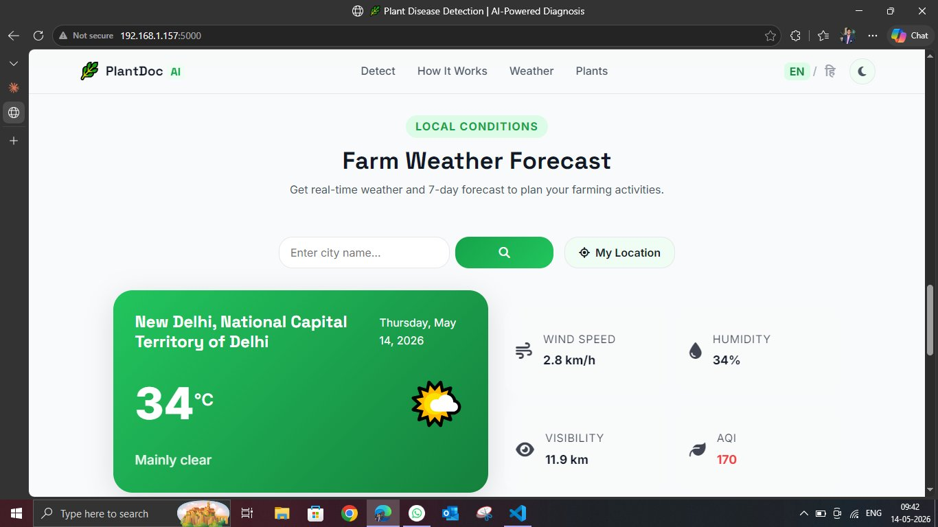
🌦️ Farm Weather Forecast Feature
Weather Features
🌡️ Real-time temperature
💨 Wind speed & direction
💧 Humidity levels
👁️ Visibility distance
🍃 AQI (Air Quality Index)
📍 Auto My Location detect
🔍 Search any city worldwide

Slide 7
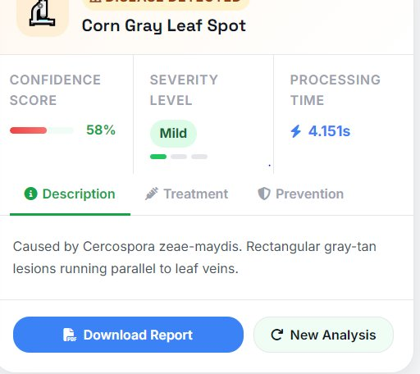
🔬 Disease Detection Result
What the App Shows
🏷️
Disease Name
Corn Gray Leaf Spot detected
📊
Confidence Score
58% confidence with progress bar
⚡
Severity Level
Mild / Moderate / Severe badge
⏱️
Processing Time
4.15 seconds — real-time result
💊
Treatment Tab
Exact steps to treat the disease
🛡️
Prevention Tab
How to prevent future outbreaks
📄
Download Report
Full PDF report in one click!

Slide 8
📄 PDF Report Download
One-click complete diagnosis report for farmers
📄
What PDF Report Includes
🏷️ Disease name & plant species
AGRI SCAN
Diagnosis Report
📊 Confidence score & severity level
📋 Detailed disease description
Disease: Corn Gray Leaf Spot
Confidence: 58% (Mild)
💊 Step-by-step treatment plan
Description: ...
🛡️ Prevention tips for next season
Treatment: ...
Prevention: ...
📅 Date & time of diagnosis
Generated: May 14, 2026
🌿 AGRI SCAN branding & logo

Slide 9
Model Performance & Results
95.95%
38
<1s
87K+
Validation Accuracy
Disease Classes
Inference Time
Training Images
After Phase 1 Training
Across 14 Plant Species
Per Image Prediction
PlantVillage Dataset
Training Configuration
Parameter | Value
Base Model | MobileNetV2 (ImageNet pretrained)
Phase 1 Epochs | 15 epochs — frozen base layers
Phase 2 Epochs | 25 epochs — fine-tuned top 30 layers
Batch Size | 32 | Optimizer: Adam
Dataset | PlantVillage — 87,000+ images

Slide 10
🌿
Conclusion
AGRI SCAN —
Making Agriculture Smarter
✅ 95%+ accuracy with MobileNetV2 Transfer Learning
✅ Bilingual (Hindi + English) interface
✅ Gemini AI powered smart descriptions
✅ Real-time Farm Weather Forecast
✅ One-click PDF Diagnosis Report download
Built with 🐍 Python • 🧠 TensorFlow • 🌐 Flask • ✨ Gemini AI • By Rahul Jagdale

