Slide 1

GHOST
PROTOCOL
Whisper to the Void. Watch it Fade.
Members Name | Registration No.
Rahul Kumar | 24BCE10727
Nikhil Raj | 24BCE11306
Krish Tolani | 24BCE11181
VibeHack '26
Code Crew

Slide 2
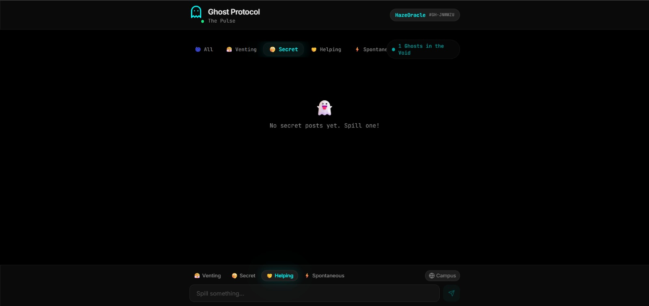
Visit Github Repo for Demo video

Slide 3
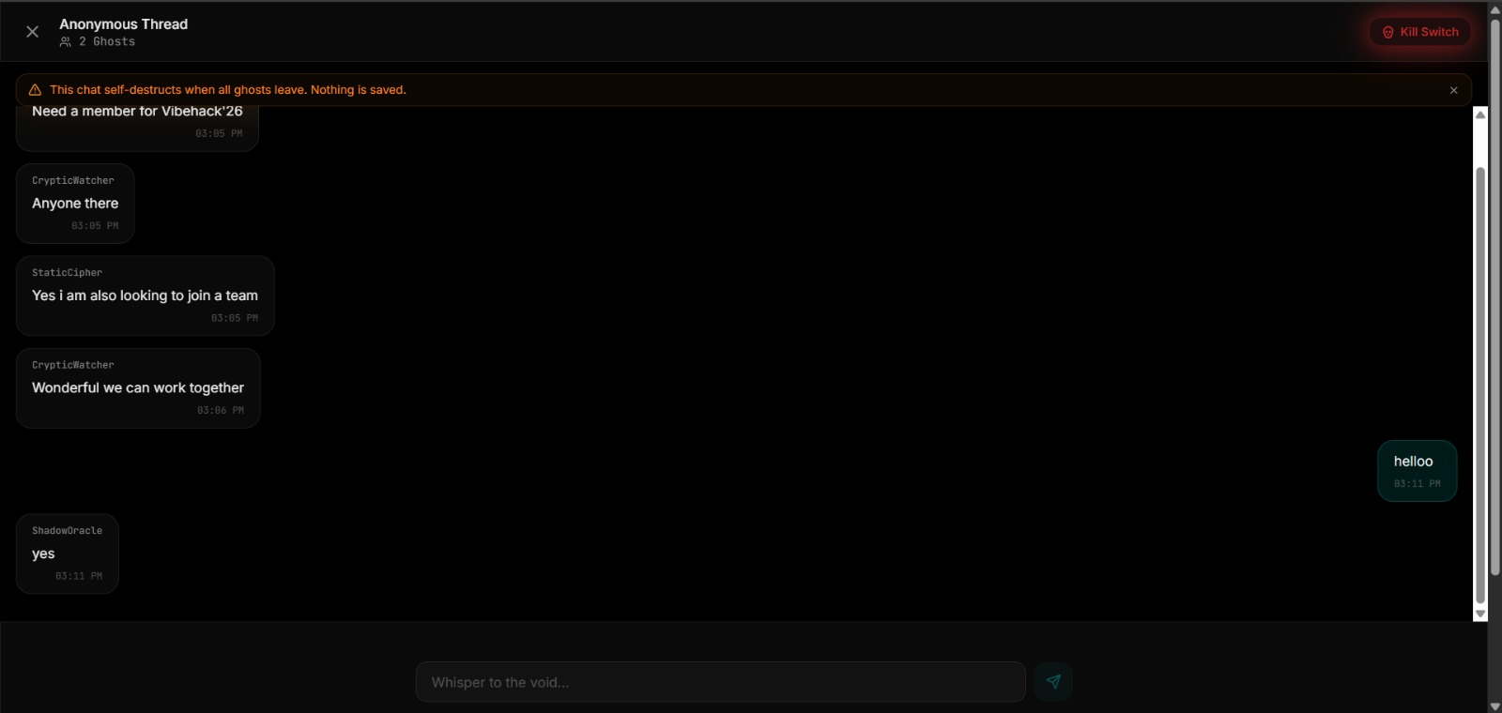
Visit Github Repo for Demo video

Slide 4



THE PROBLEM
Why does this need to exist?
The Digital Tattoo
Anxiety of Expression
No "Middle Ground"
Everything we post online is permanent and tied to our professional identity — LinkedIn, Twitter, and beyond.
Students fear ranting, sharing secrets, or asking 'stupid' questions due to the looming fear of being judged later.
Social media is either too formal (LinkedIn) or too toxic/permanent (X/Facebook). There's nothing in between.

Slide 5
THE SOLUTION
Anonymous & Real-Time
A social platform where your thoughts live temporarily — you whisper, the void listens.
Privacy by Design
We don't just hide your name; we delete your traces entirely. No PII stored, ever.
Zero Barrier to Entry
No Sign-ups. No Logins. No Databases full of user data. Open the tab, you're in.

Slide 6



CORE FEATURES
The "Wow" Factor
Ephemeral Spills
Spectral Identity
Posts auto self-destruct after 2 hours. Nothing sticks around.
Random alias per session (e.g. ShadowHustler). Identity erased on tab close.
Whisper Threads
Boss Key (Esc)
Real-time chat via Socket.io with typing indicators: "Ghost is whispering..."
Hit [Esc] to hide behind a fake Google Scholar page. Perfect for classrooms!

Slide 7



TECH ARCHITECTURE
FRONTEND
Fast, lightweight, cyberpunk aesthetic
React + Vite + Tailwind CSS
BACKEND
Scalable REST API layer
Node.js & Express
REAL-TIME
Bi-directional live communication
Socket.io
DATABASE
Ephemeral spills + thread history
MongoDB Atlas
DEPLOYMENT
Global CDN, zero config deploys
Vercel (Frontend) + Render (Backend)

Slide 8
PRIVACY & SECURITY
Session-Only Tracking
We use SessionStorage, not Cookies. Tab close = Identity gone permanently.
No User Logs
IP addresses and device IDs are never stored. You are invisible to us.
Automated Purge
When a post expires, its entire chat history is wiped from the MongoDB cluster.

Slide 9


FUTURE ROADMAP
PHASE 01
PHASE 02
PHASE 03
End-to-End Encryption
Media Spills
Campus-Only Voids
Ultra-secure whispering with full E2E encryption on all whisper threads.
Support for disappearing images and ephemeral voice notes.
Geofenced boards for specific universities — e.g. a VIT Bhopal exclusive void.

Slide 10

Be Human Again. Without the Permanent Record.
"Ghost Protocol isn't just an app; it's a safe space for the digital generation to be human again — without the fear of a permanent record."
Scan to enter the void:
Visit Github Repo for Demo video

