Slide 1

ST.ANDREW`S INSTITUTE OF TECHNOLOGY AND MANAGEMENT
PRESENTATION FOR WEB DEVELOPMENT
Presented By- Mr. Rahul Jaiswal
Roll No.-229061
Under The Guidance Of –Mr. Garvit Verma

Slide 2
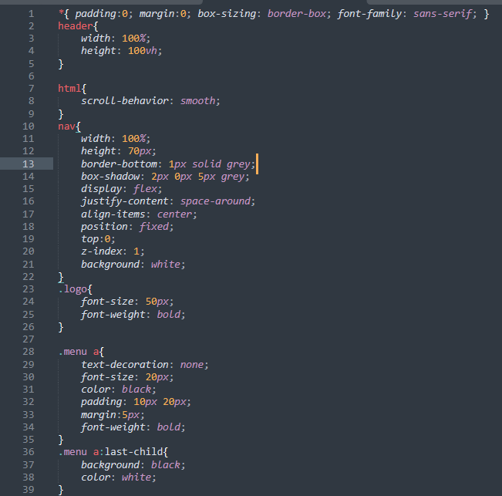
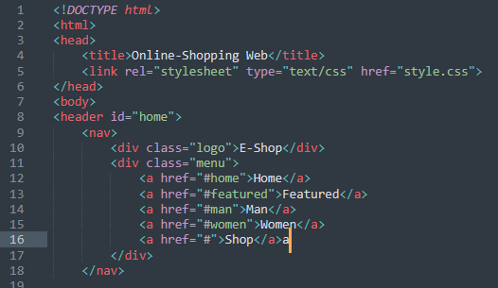
Navbar
CSS
HTML

Slide 3
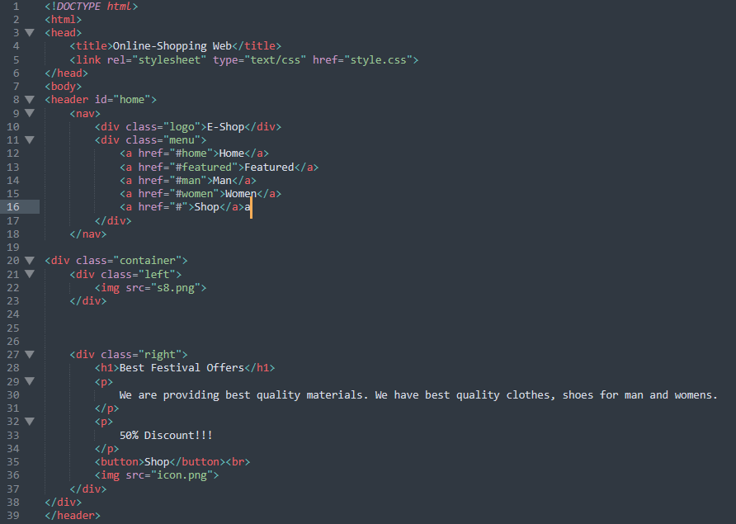
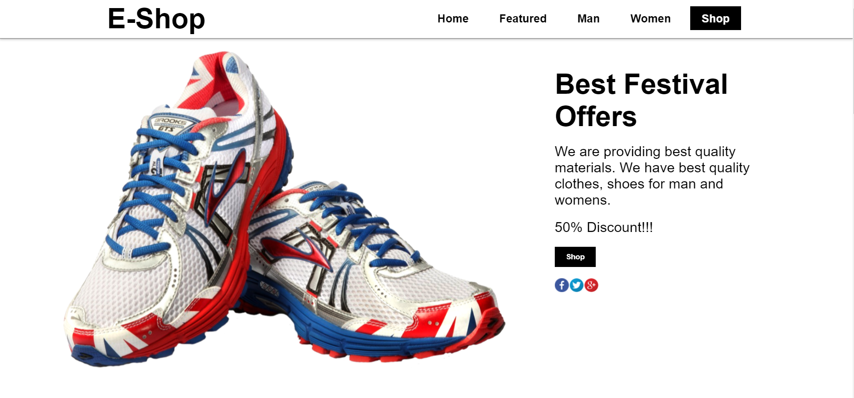
HTML
Nav And Banner
CSS

Slide 4
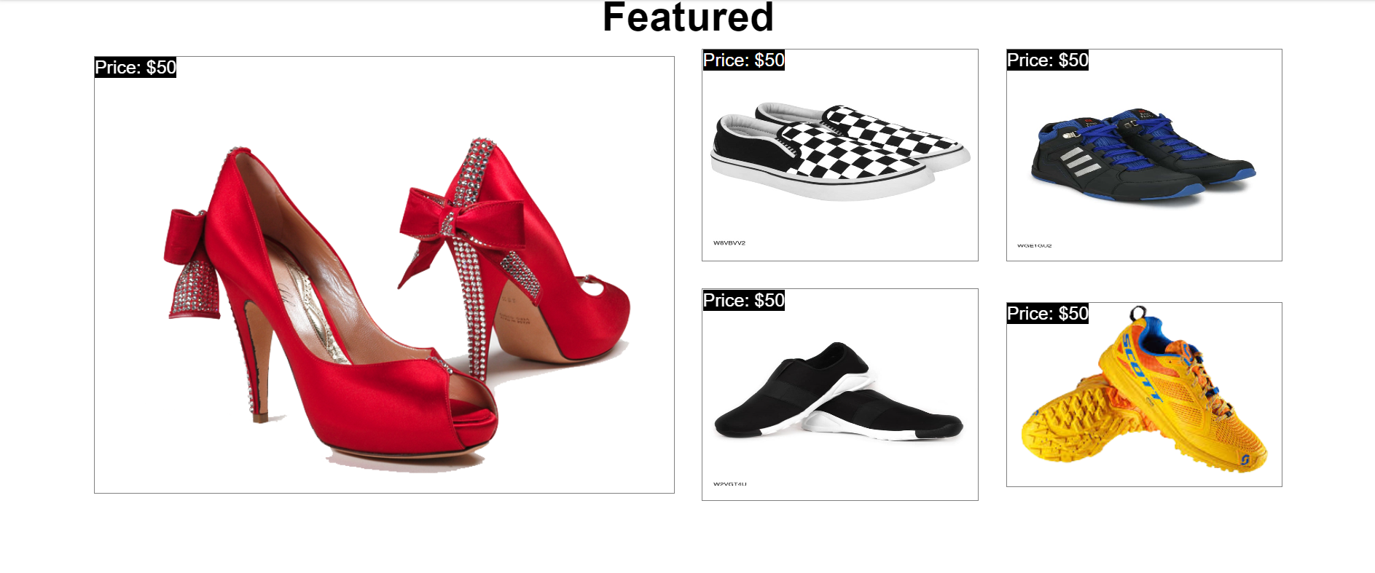
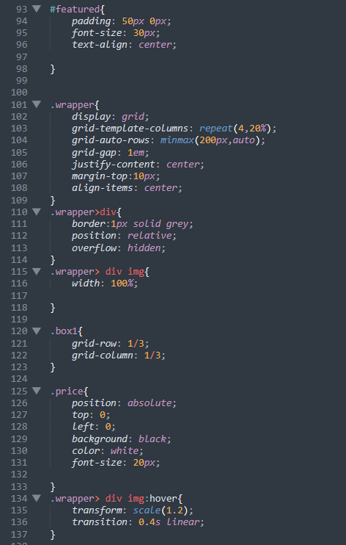
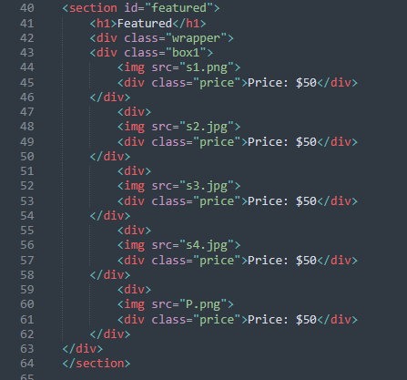
HTML
Featured
CSS

Slide 5
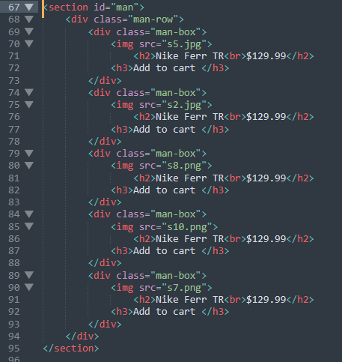
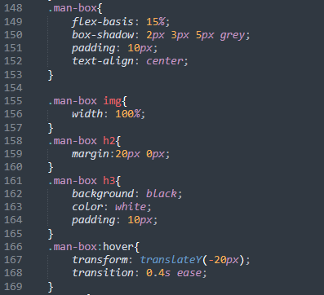
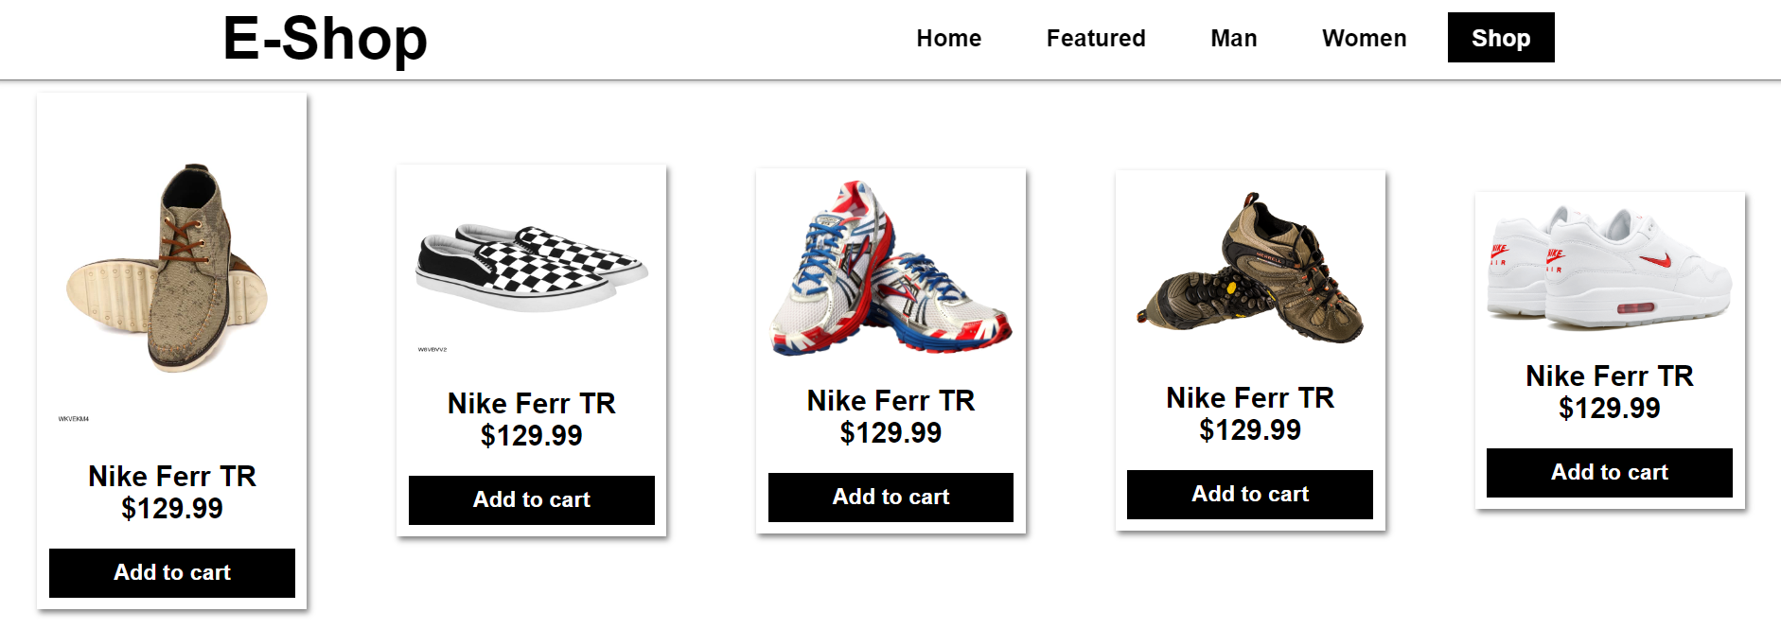
HTML
Man
CSS

Slide 6
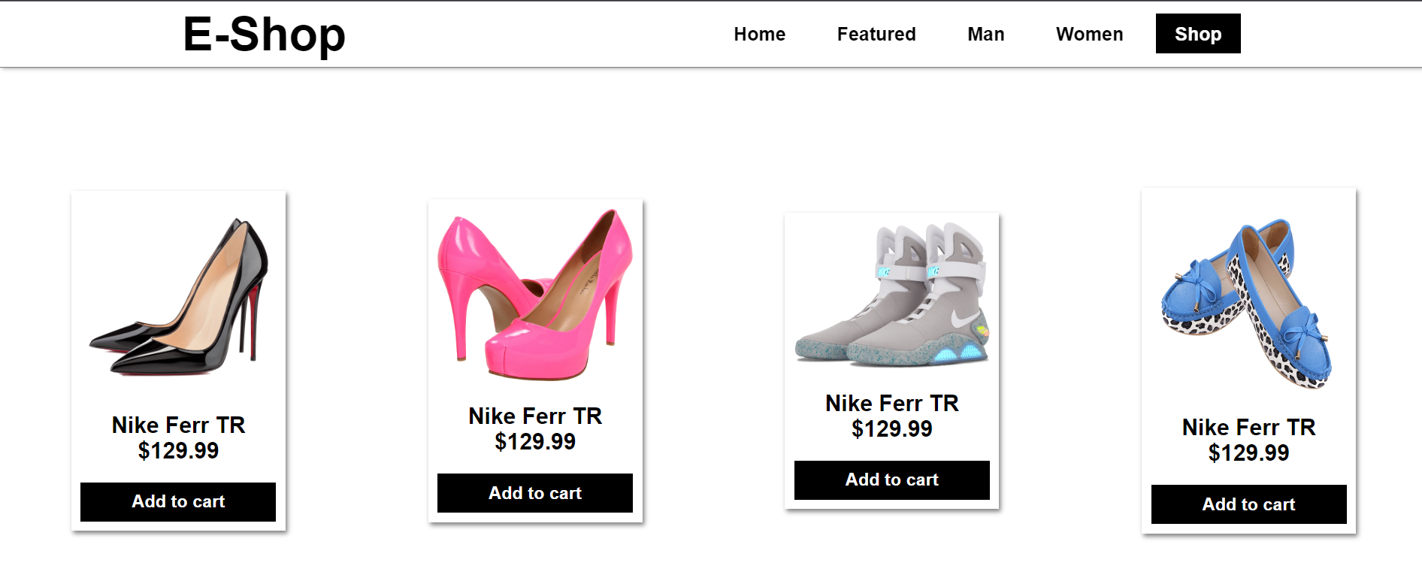
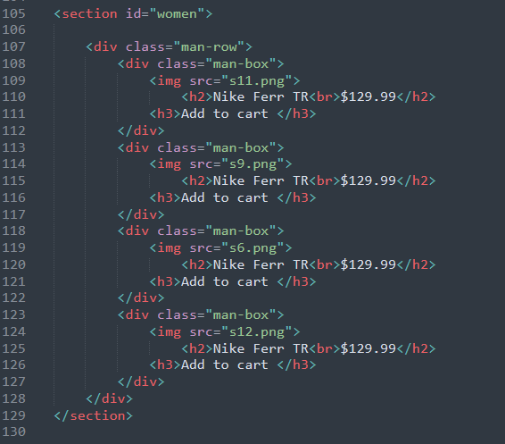
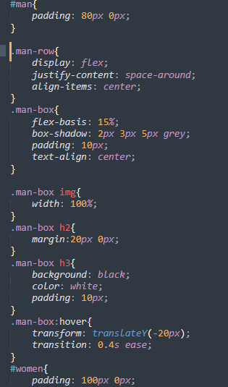
HTML
About
CSS

Slide 7
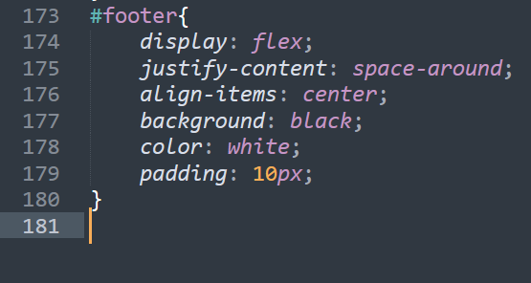
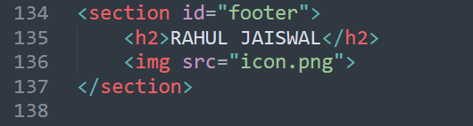
CSS
HTML

Slide 8
THANK YOU

