Slide 1
BOOK-RECOMMENDATION-SYSTEM

Slide 2
GROUP MEMBERS
Rahul M
Jithin C
Abhijith K K
Mohammed Zayyan Shareef
Swapnajeet Boopathy
Hariharan Jayaraj
Divya Teja j

Slide 3
CONTENTS
Business objective
Data summary
EDA/ Data Cleaning
Popularity Filtering
Collaborative Filtering
Recommendation model
Deployment

Slide 4
BUSINESS Objective :
Generate the features from the dataset and use them to recommend the books accordingly to the users
Data Summary:
Book Dataset : Shape (271360, 8)
1) ISBN 2) Year-Of-Publication
3) Book-Title 4) Publisher
5) Book-Author 6) Image-URL-M
7) Image-URL-S 8) Image-URL-L
Rating Dataset : Shape (278858, 3) 1) User-ID 2) Location 3) Age
User Dataset : Shape (1149780, 3) 1) User-ID 2) ISBN 3) Book-Rating

Slide 5
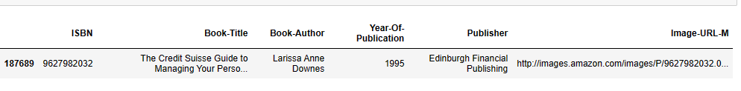
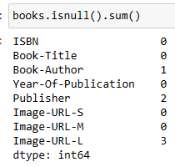

EDA :
Book Dataset : Replacing NULL values with Publisher and Author Name
Replacing Author Name
->
Replacing Publisher

Slide 6
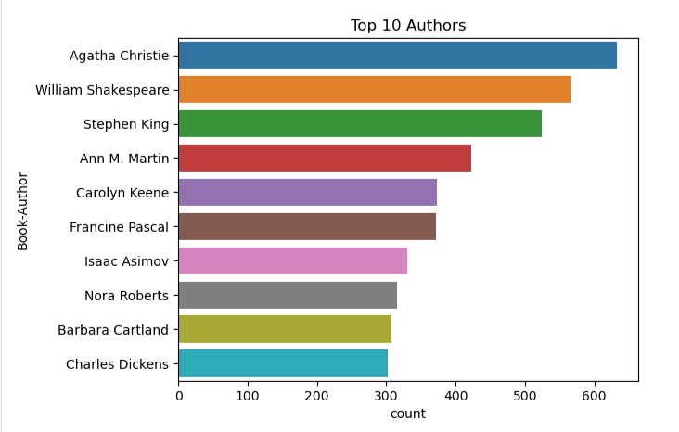
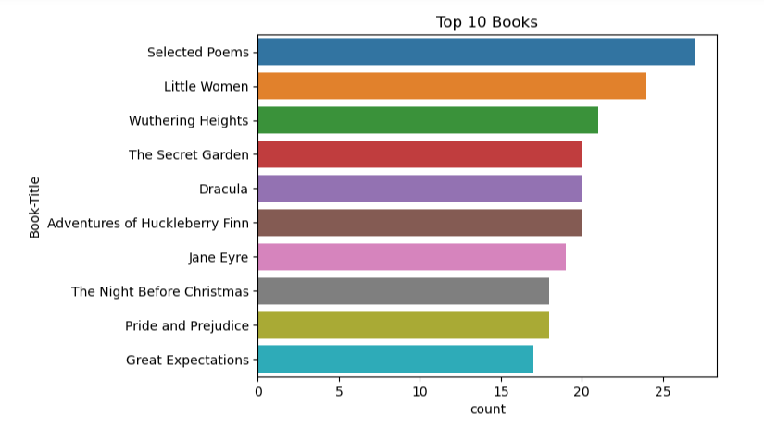
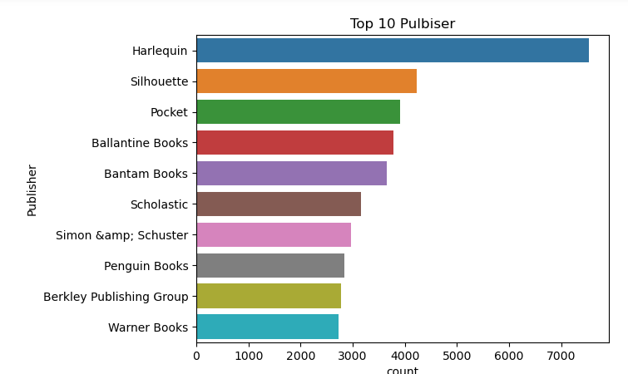
Vishualisation Of Book Dataset

Slide 7
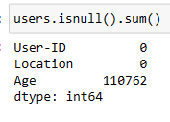

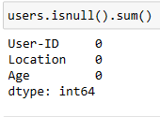
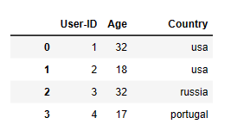
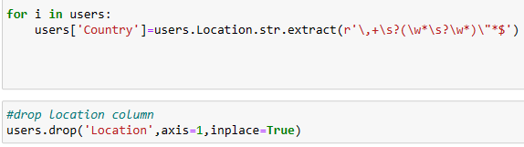
User Dataset : Replacing NULL values with Median value
->
Drop Location column and Replace with Location column :
->

Slide 8
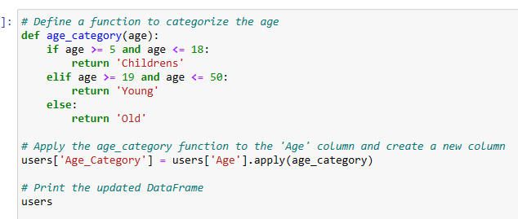
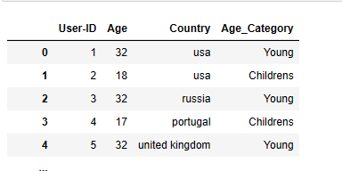
We Created Different Age Category for Age column
->

Slide 9
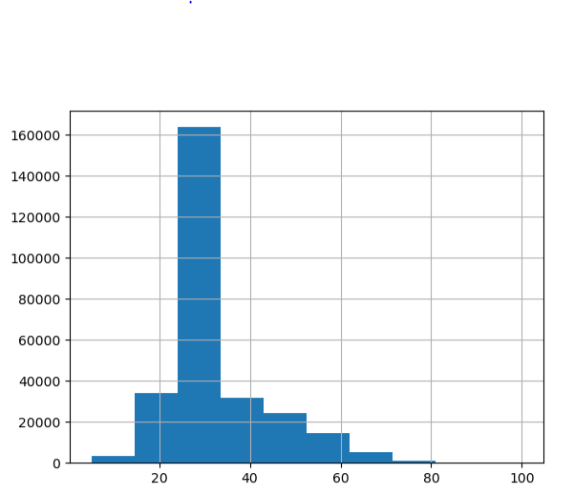
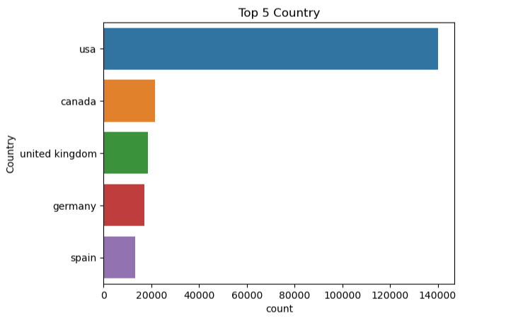

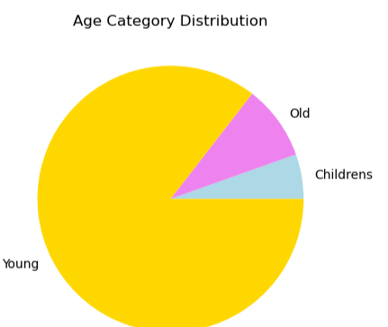
Vishualisation Of User Dataset
Age between most users
Age Outliers

Slide 10
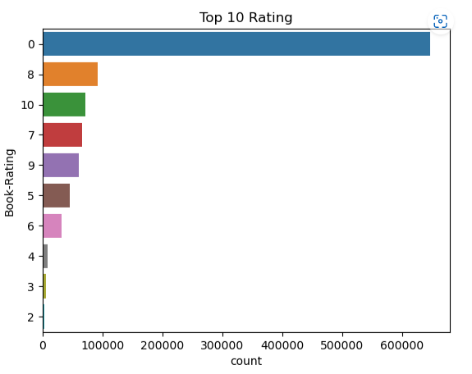
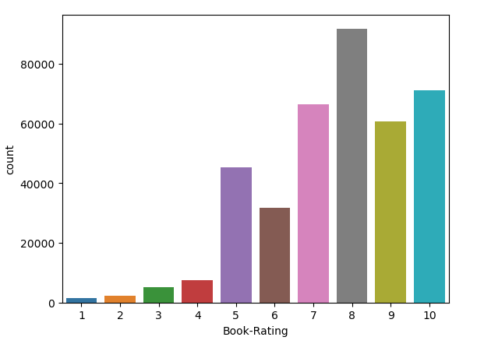
Rating Dataset: it has not NULL Values
Vishualisation Of Rating Dataset
Explicit Book Rating

Slide 11
Popularity Filtering
Popularity-based filtering is a technique used in book recommendation systems to recommend books based on their popularity or the number of times they have been viewed, rated, or purchased by users. There are several reasons why popularity-based filtering is important in book recommendation systems:
It is a simple and effective way to recommend books to users who are not sure what they want to read. By recommending popular books, the system increases the chances that the user will find something they like.
Popularity-based filtering can help new users discover books that they may not have found otherwise. When a user is new to a book recommendation system, they may not know what to search for or where to start. By recommending popular books, the system can introduce them to a variety of genres and authors.

Slide 12
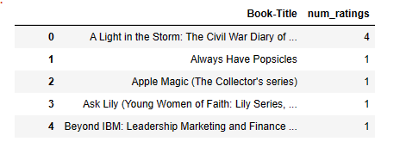
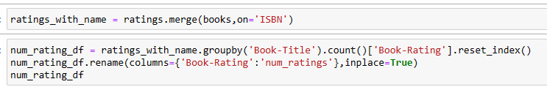
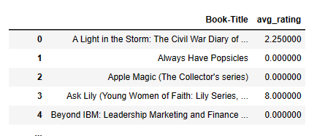

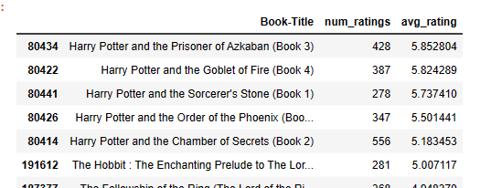
Popularity Filtering On Number of Ratings:
->
Popularity Filtering On Number of Ratings:
->
Popularity Filtering On Number of Ratings more than 250:
->

Slide 13
Collaborative Filtering
Collaborative filtering is another technique used in book recommendation systems to recommend books to users. In contrast to popularity-based filtering, collaborative filtering uses information about the preferences of other users to make recommendations. There are several reasons why collaborative filtering is important in book recommendation systems:
It can help to personalize recommendations for individual users. Collaborative filtering looks at the preferences of other users who have similar tastes to the current user and recommends books that they have enjoyed. This can help to ensure that the recommendations are more relevant to the user's individual interests.
Collaborative filtering can also help to recommend books that may not be as popular but are still highly relevant to the user's interests. For example, if a user has a very specific interest in a niche topic, collaborative filtering can recommend books on that topic that may not have a high overall popularity.

Slide 14
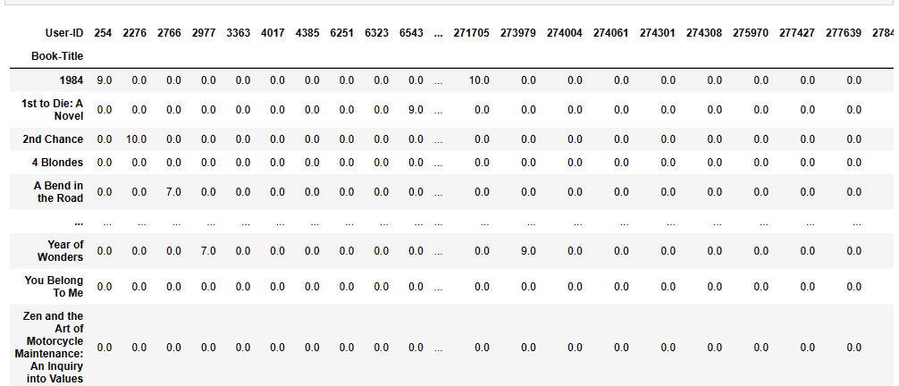
To perform Collaborative Filtering convert dataset into pivot table

Slide 15
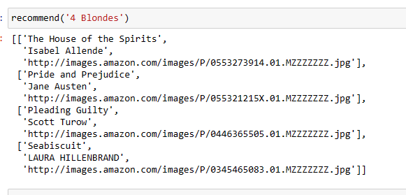
Recommendation Model

Slide 16


Deployment
Delpoyment using Pickle

Slide 17
Challenges
Decision making on missing value imputation and outlier treatment was
Quite challenging
Understanding the metric for evaluation was challenge as well
Data cleaning also quite challenging

Slide 18
Conclusion
A recommendation system helps an organization to create loyal customers. The recommendation system today are very powerful that they can handle the new customer too who has visited the site for the first time. They recommend the products which are currently trending or highly rated and they can also recommend the products which bring maximum profit to the company.

