Slide 1
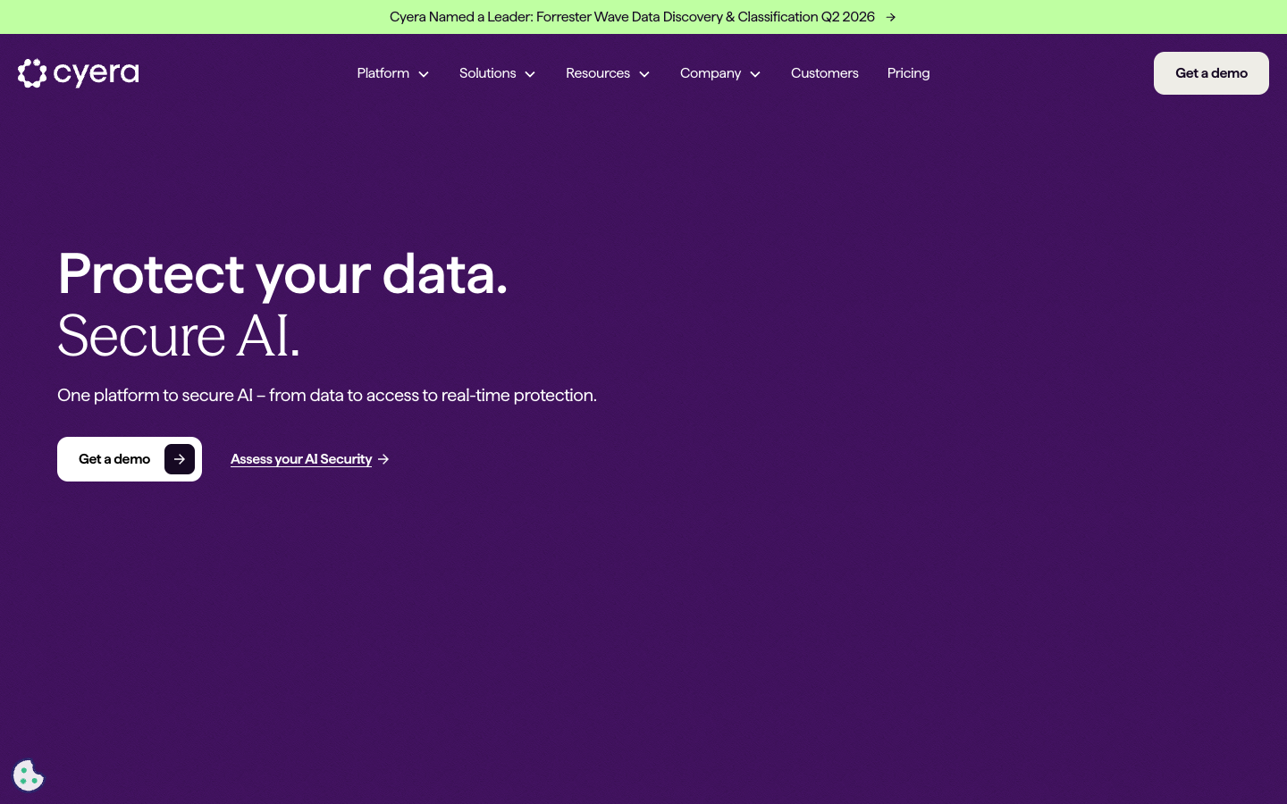
Protect your data. Secure AI.
cyera.com
Website Decode

Slide 2
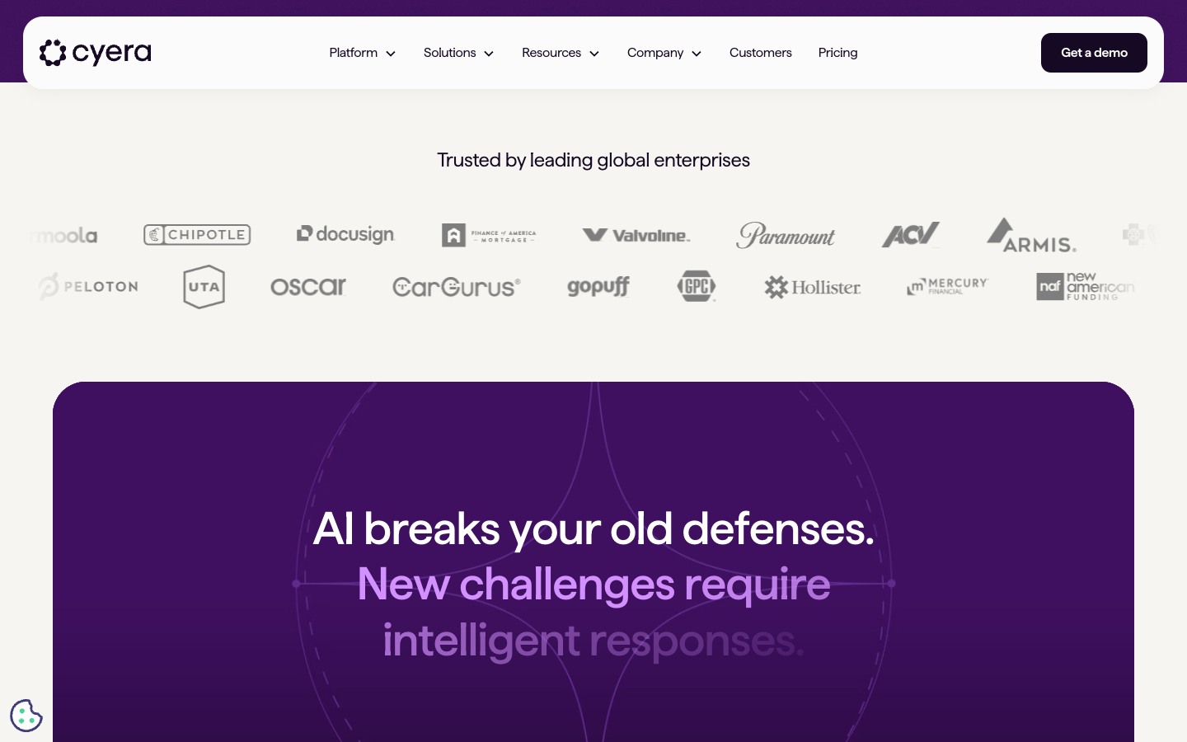
Brand Identity at a Glance
Precise
Authoritative
Intelligent
Urgent
Premium
Visual style: dark-mode enterprise editorial
First impression: controlled confidence

Slide 3
Core Positioning
One-liner: AI-native data security for enterprises in every environment
ICP: Enterprise CISOs and security leaders in regulated industries
Pain point: AI breaks your old defenses — legacy tools weren't built for this
Category: DSPM expanding toward AI Security platform ownership

Slide 4
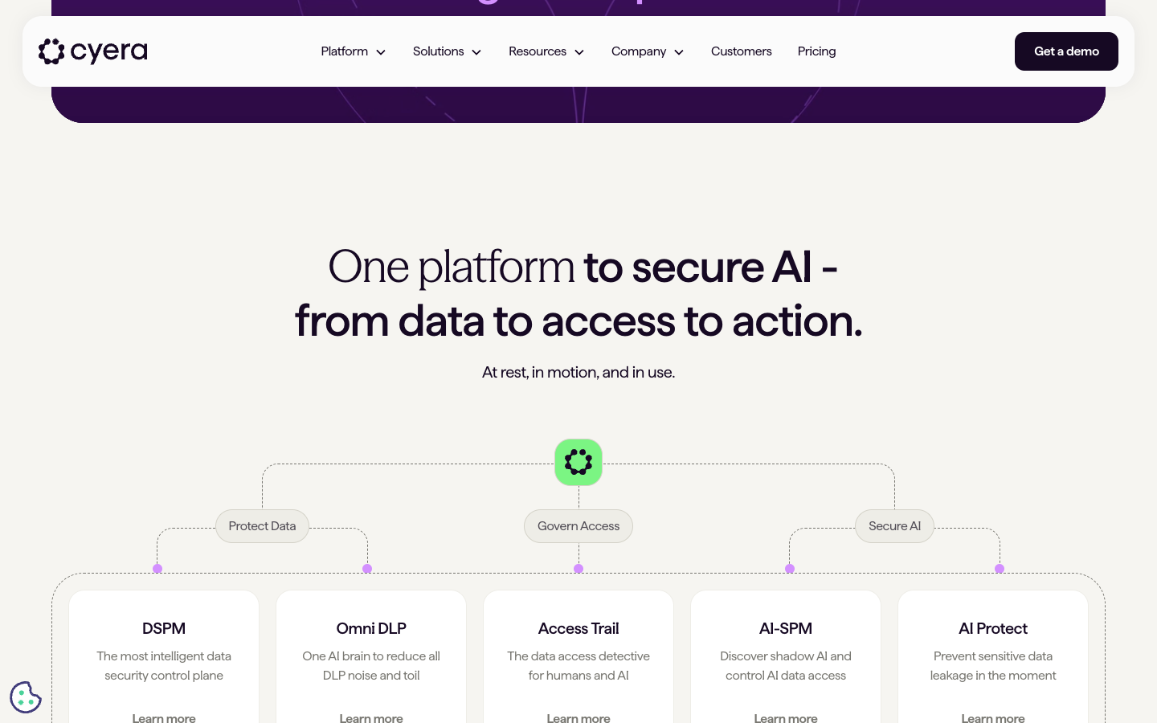
Messaging Architecture
H1: Protect your data. Secure AI.
H2: AI breaks your old defenses
H2: One platform to secure AI — from data to access to action
H2: Protect and comply at scale by making data and AI security highly actionable

Slide 5
GTM Motion & CTA Strategy
GTM type: Enterprise Sales-Led (SLG) with thin PLG hook
Primary CTA: Get a demo — pure account-based motion
Funnel signal: AI Security Pulse Check warms cold ICPs before demo ask
Trust approach: Paramount case study before conversion request
Friction level: 10+ field form — high intent qualification

Slide 6
Brand Color System
#160923
#2A1043
#6D2D93
#7E5BB1
#D390FF
#E8C6FF
#BBFAA4
#F6F5F1
Dark Violet (Base)
Primary Dark
Deep Purple
Primary Purple
Heliotrope
Lavender
Pale Green (Success)
Alabaster (Light BG)

Slide 7
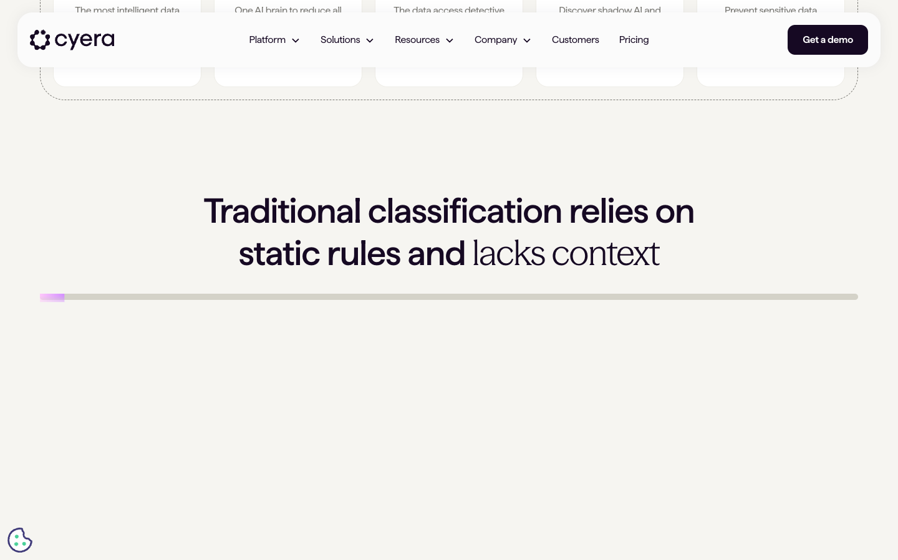
Visual Identity
Illustration style: Abstract data visualization — nodes, flows, classification layers
Animation intent: Ambient intelligence — make invisible security feel alive
Emotional register: Controlled confidence, premium enterprise
Visual weight: Light to medium — nothing jarring or dramatic

Slide 8
Animation Stack
Primary library: GSAP + GSAP ScrollTrigger + GSAP SplitText
Also: Lottie for feature illustrations, Swiper for carousels
Scroll animations: ~70% of all animations fire on scroll entry
Load animations: ~20% hero entrance sequence on page load
Easing: cubic-bezier(.4,0,.2,1) — Material Design standard, no spring physics

Slide 9
3 Animation Techniques to Steal
1. SplitText word reveal — each word enters staggered, makes headlines feel like revelation
2. Lavender hover feedback — brand color fills interactive surfaces on hover at .4s ease
3. Dark wedge section — scroll past hero into threat framing breaks visitor's mental model

Slide 10
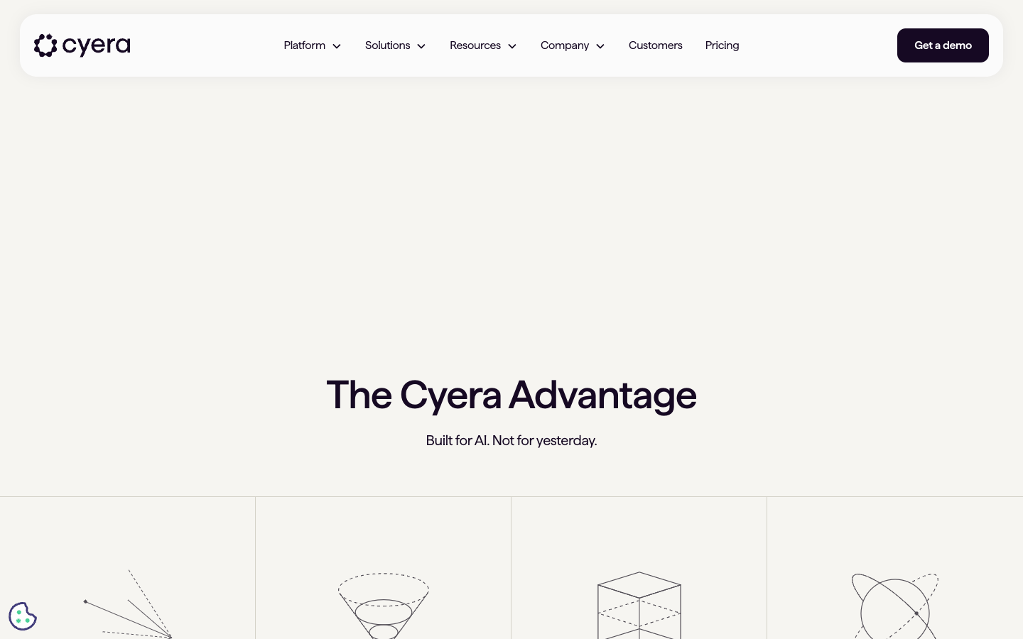
Illustration System Deep Dive
Style: Abstract geometric — network nodes and data flows, no literal UI screenshots
Color usage: 5-7 hues, all from brand token system — illustrations ARE the brand palette
Built for animation: Yes — Lottie files built in After Effects with named pre-comps
Depth technique: Opacity-layered pale-purple fills over dark-violet base

Slide 11
What to Steal / What to Avoid
✓ Steal: Dual-CTA architecture — demo + free assessment meets buyers at different funnel stages
✓ Steal: Deep violet + heliotrope color system — distinctive in a sea of blue enterprise SaaS
✓ Steal: AI breaks your old defenses wedge — category repositioning through named threat
✗ Avoid: 10+ field demo form — high friction kills conversion even in enterprise
✗ Avoid: Headline spaces lost in SplitText animation — legibility risk on mobile

Slide 12
How to Replicate This Design System
Style rule: Abstract geometric forms — nodes, connections, no human characters or UI screenshots
Color system: 1 dark anchor + 1 luminous glow + 2 pale tints + 1 success accent
Animation rule: Lottie for hero, GSAP ScrollTrigger snap for scroll reveals, nothing faster than 300ms
Tool: Figma for SVGs, After Effects + Bodymovin for Lottie, GSAP Club for ScrollTrigger + SplitText
Build first: One hero Lottie animation — this delivers 60% of the total visual impact

Slide 13
Competitive Signals
Category owned: DSPM — expanding narrative toward AI Security before competitors pivot
Benchmarks: Wiz (aesthetic + one platform), Varonis (data security), BigID (DSPM), Securiti.ai
JTBD framing: Show the board we are AI-ready without slowing the business down
Key differentiator: Only platform securing both data AND AI in a single unified surface

Slide 14
“
Cyera is the AI-native data security platform built for a world where AI makes old defenses obsolete — targeting enterprise security leaders who need to govern data and AI risk simultaneously from a single intelligent platform.
— cyera.com

