Slide 1
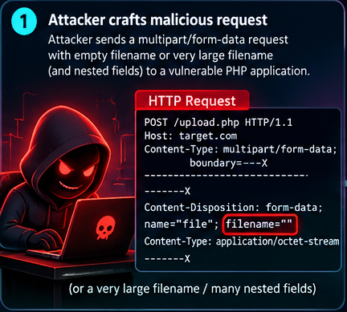
1. Attacker crafts the request
Presenter notes
The attacker controls parts of a multipart/form-data request, including upload metadata. An empty or unusual filename is input—not an exploit by itself.
Key point
Treat the diagram as a conceptual chain. The filename alone does not cause OOM or RCE.
PHP2Shell · Conceptual attack-chain walkthrough · 1 / 10

Slide 2
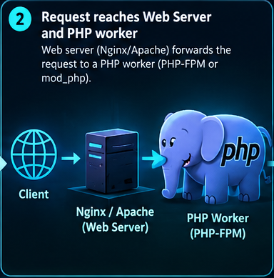
2. Request reaches the PHP worker
Presenter notes
The web server receives the HTTP request and routes PHP work to the configured handler, such as PHP-FPM or mod_php.
Key point
Treat the diagram as a conceptual chain. The filename alone does not cause OOM or RCE.
PHP2Shell · Conceptual attack-chain walkthrough · 2 / 10

Slide 3
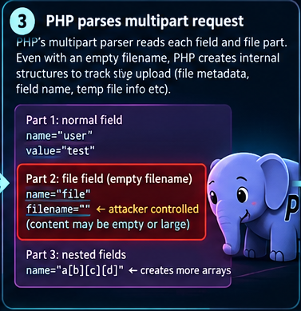
3. PHP parses multipart data
Presenter notes
PHP parses form fields and file-part metadata. The request parser and upload-progress/session behavior are relevant to the broader attack chain.
Key point
Treat the diagram as a conceptual chain. The filename alone does not cause OOM or RCE.
PHP2Shell · Conceptual attack-chain walkthrough · 3 / 10

Slide 4
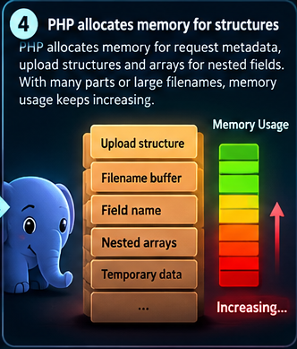
4. Memory use increases
Presenter notes
Request processing allocates internal structures. A long filename or many fields does not automatically trigger the vulnerability; exact conditions matter.
Key point
Treat the diagram as a conceptual chain. The filename alone does not cause OOM or RCE.
PHP2Shell · Conceptual attack-chain walkthrough · 4 / 10

Slide 5
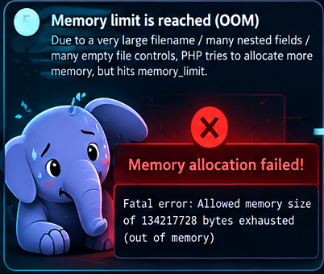
5. Out-of-memory condition
Presenter notes
OOM means PHP cannot allocate memory for an operation. An OOM error alone is not proof of memory corruption or remote code execution.
Key point
Treat the diagram as a conceptual chain. The filename alone does not cause OOM or RCE.
PHP2Shell · Conceptual attack-chain walkthrough · 5 / 10

Slide 6
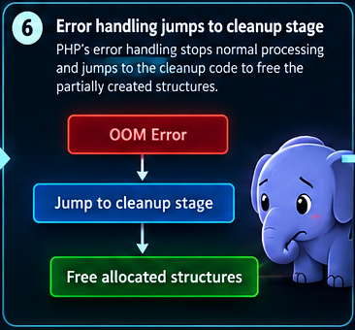
6. Error handling enters cleanup
Presenter notes
When processing fails, PHP must release partially created resources. A vulnerable cleanup path may mishandle internal state.
Key point
Treat the diagram as a conceptual chain. The filename alone does not cause OOM or RCE.
PHP2Shell · Conceptual attack-chain walkthrough · 6 / 10

Slide 7
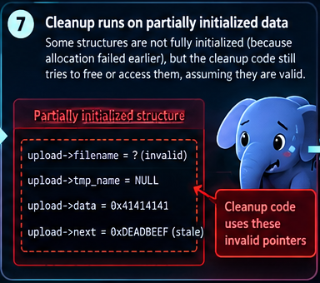
7. Cleanup sees invalid state
Presenter notes
The core danger is cleanup operating on partially initialized or otherwise invalid internal data. This is a conceptual illustration, not a literal memory dump.
Key point
Treat the diagram as a conceptual chain. The filename alone does not cause OOM or RCE.
PHP2Shell · Conceptual attack-chain walkthrough · 7 / 10

Slide 8
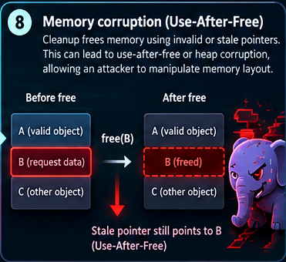
8. Memory corruption / use-after-free
Presenter notes
A use-after-free occurs when code uses memory after it has been freed. Depending on exploitability, memory bugs can cause crashes, disclosure, or more serious effects.
Key point
Treat the diagram as a conceptual chain. The filename alone does not cause OOM or RCE.
PHP2Shell · Conceptual attack-chain walkthrough · 8 / 10

Slide 9
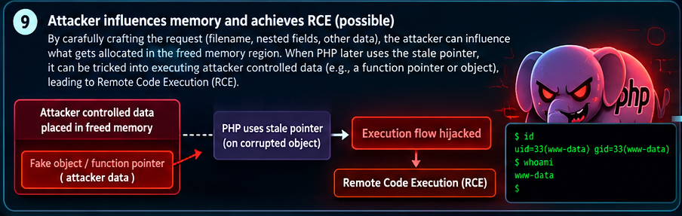
9. Memory corruption may enable RCE
Presenter notes
Successful RCE requires additional exploit conditions: the attacker must turn the memory error into controlled execution. It is not guaranteed by a malformed upload.
Key point
Treat the diagram as a conceptual chain. The filename alone does not cause OOM or RCE.
PHP2Shell · Conceptual attack-chain walkthrough · 9 / 10

Slide 10
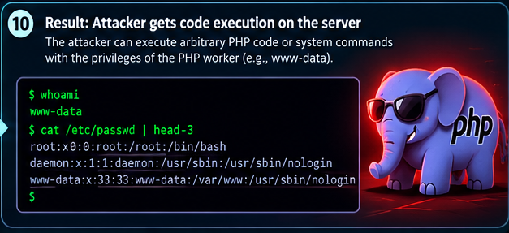
10. Possible impact and defense
Presenter notes
If exploited, code runs with the PHP worker's privileges—not automatically as root. Patch PHP to a supported fixed release and review vendor guidance.
Key point
Treat the diagram as a conceptual chain. The filename alone does not cause OOM or RCE.
PHP2Shell · Conceptual attack-chain walkthrough · 10 / 10

