Slide 1

Threat Research and Brand Protection
rs
by Rahul sai (N190081)

Slide 2
Table of Contents
Abstract
Introduction
Background and Inspiration
Design and Development Approach
Brand Reputation Monitoring
Strategic Monitoring Areas
Brand Threat Highlights
Proof of Concept (PoC) Reports
Future Enchancement
Conclusion
References
Thank you Q & A

Slide 3

Abstract
Brand Protection & Threat Hunting
Vulnerability Assessment & Pen Testing
Identified fake apps, impostor accounts, exposed credentials, and risky mentions online to strengthen client reputation.
Utilized OSINT, Burp Suite, and Nessus to detect API flaws like IDOR and misconfigurations to secure web applications.
Attack Surface Mapping
Proof of Concept Reports
Performed subdomain enumeration and service detection to reveal digital exposure and potential entry points.
Delivered detailed findings including impact and mitigation strategies to enhance client security measures.

Slide 4
Introduction
In today’s evolving threat landscape, cybersecurity is critical to protect digital assets from phishing attacks, data breaches, and API vulnerabilities.
Brand Reputation Monitoring
Vulnerability Assessment & Penetration Testing (VAPT)
API Security Testing
As a Threat Researcher at Foresiet, I focus on strengthening brand security through:
Proof of Concept Reporting
For example, incidents like Uber’s 2022 breach — where attackers exploited hardcoded credentials found in exposed code repositories — clearly highlight the importance of early threat detection and strong brand protection strategies.

Slide 5

Background and Inspiration
The rise in cyber threats — from impersonation attacks to credential leaks — highlighted the urgent need for continuous brand protection.
In my daily work as a Threat Researcher at Foresiet, I have seen how lack of proactive intelligence leads to reputational damage and regulatory risks.
This experience drives my commitment to building stronger, smarter defenses against evolving digital threats.

Slide 6
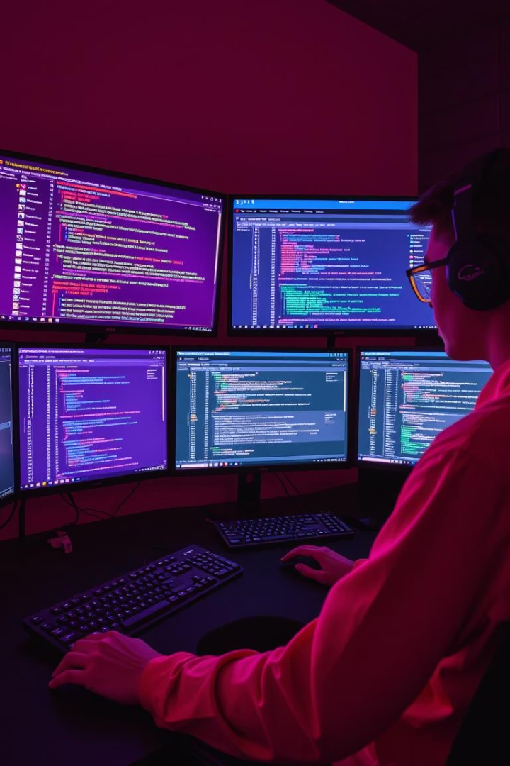
Design and Development Approach
1
Daily OSINT Intelligence Gathering
Employing advanced google dorking and data mining techniques to identify threats and leaks.
2
Brand Keyword & Domain Monitoring
Tracking domain variants and brand mentions across digital and app store platforms.
3
Manual Profile and Code Repository Inspection
Identifying impostor accounts and exposed credentials through hands-on analysis.
4
Comprehensive VAPT on Client Domains
Including API penetration testing to discover security weaknesses and misconfigurations.

Slide 7
Brand Reputation Monitoring
Daily OSINT investigations focus on detecting fake social media accounts, cloned mobile apps, and leaked sensitive data in public repositories. Techniques include searching GitHub for exposed tokens and reviewing app stores for fraudulent branding.
Fake accounts detection and takedown
Logo and brand impersonation monitoring
Public repository scanning for credential leaks
App store fake and cloned app surveillance
Proactive measures such as filing DMCA takedown requests are initiated to counteract identified threats, preserving brand integrity and preventing data misuse effectively.

Slide 8

Real Time Example
Brand monitoring on the RGUKT Nuzvid
Impersonated Social Media account

Slide 9
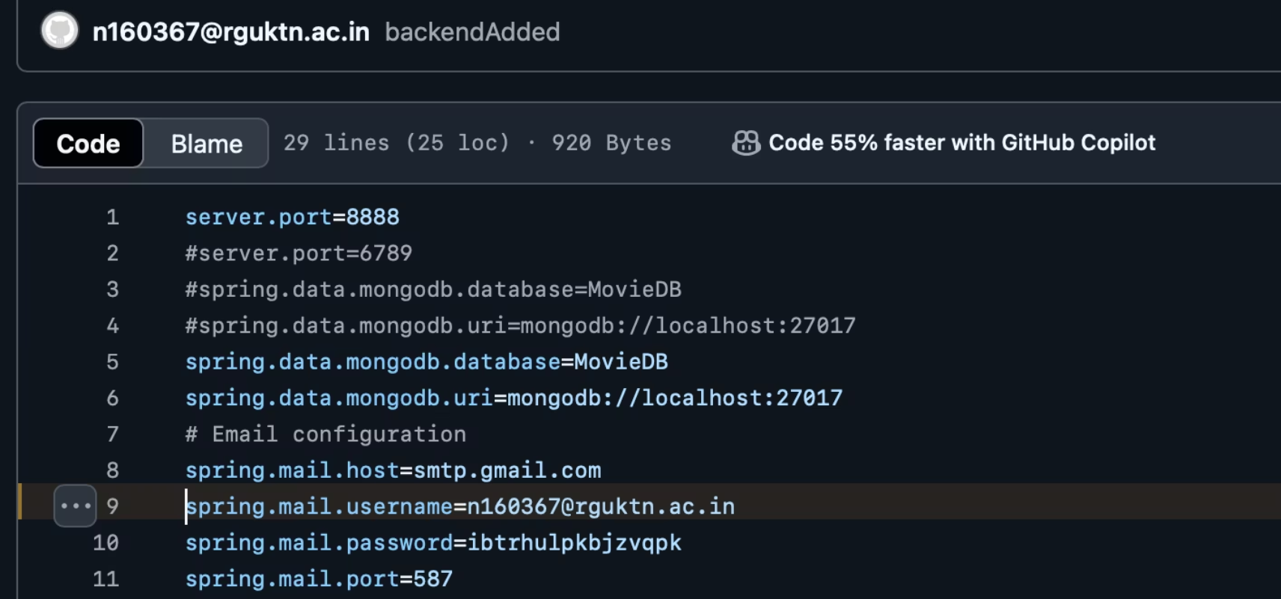
Credentials exposed in the github

Slide 10
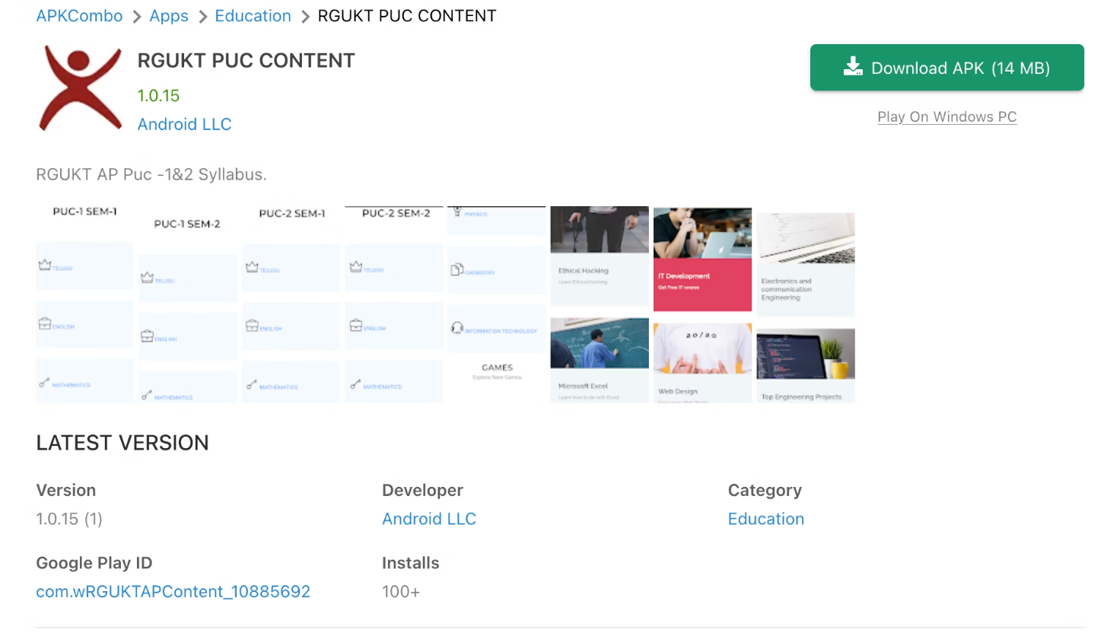
Fake app

Slide 11
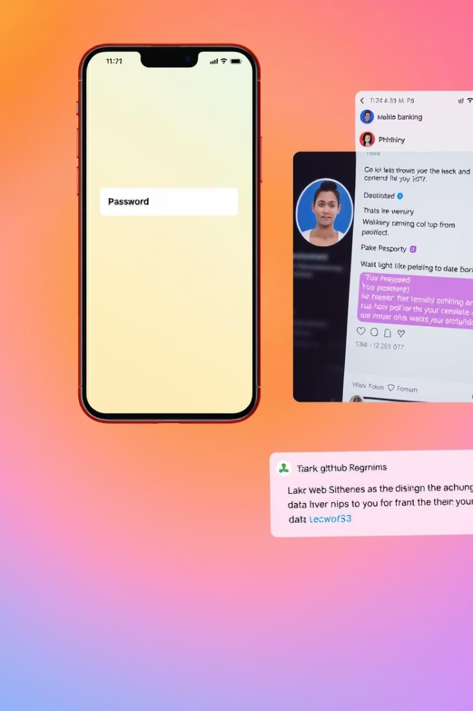




Strategic Monitoring Areas
Fake Mobile Applications
Detection of fraudulent apps imitating client branding to steal user data or damage reputation.
Fake Social Media Accounts
Identification and takedown of impostor profiles used for phishing or misinformation campaigns.
Code Repositories
Discovery of leaked credentials, tokens, and sensitive code posted publicly on platforms like GitHub.
Keyword & Threat Mentions
Tracking negative SEO campaigns, spoofed domains, and brand threats on dark web, forums, and social sites.

Slide 12
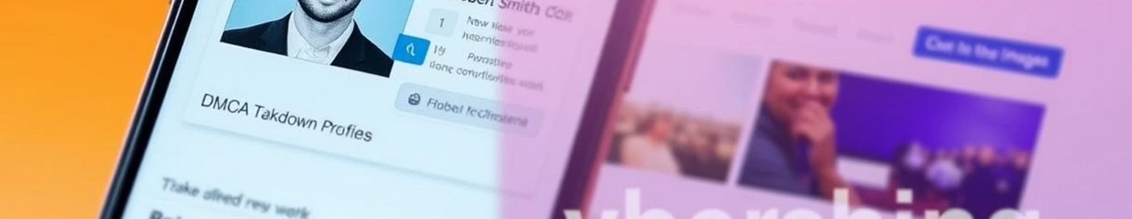
Brand Threat Highlights
Phishing Mobile App
Fake LinkedIn Account
DMCA Takedown Actions
A fraudulent app replicating a banking client’s legitimate interface to harvest credentials.
Impostor profile targeting internal employees for social engineering purposes.
Successful removal of copyright-infringing apps threatening brand authenticity.

Slide 13




Proof of Concept (PoC) Reports
Executive Summary
Organisation Risk Score
Overview of threat discovery and identification techniques.
1
Assessment of threat severity and potential business impact.
2
Detailed Findings along with mitigations techniques
Overall Incident Summary
Comprehensive scan results exposing security gaps, especially in API implementations.
4
3
Comprehensive scan results exposing security gaps, especially in API implementations.

Slide 14
Future Enchancement
Expand detection to dark web threat intelligence
Use AI for anomaly-based keyword tracking
Integrate alerting with SIEM/SOAR platforms
Automate DMCA and abuse report submissions
Extend penetration testing to web/mobile apps

Slide 15
Conclusion
Through continuous threat monitoring, vulnerability assessments, and proactive defensive actions, we have strengthened client security visibility and protected their brand integrity.
Using scalable, adaptive methodologies ensures we stay resilient against evolving cyber threats.

Slide 16
References
Takedown Guidelines: https://docs.github.com/en/site-policy/content-removal-policies/dmca-takedown-policy.

Slide 17
Thank You and Q&A
Thank you for your attention.
Open for discussion, feedback, and collaborative next steps.

