Slide 1

Check
Two Arrays are Equal Or not,
If Equal then return true otherwise return false.

Slide 2
How two Array are Equal?
Size of both array must be equal.
Both the contain same set of elements.
If array are in unsorted order then we have to sort the both array using any sorting algorithm.
Then linearly compare elements of both the array
If all element are same then return true otherwise return false.

Slide 3
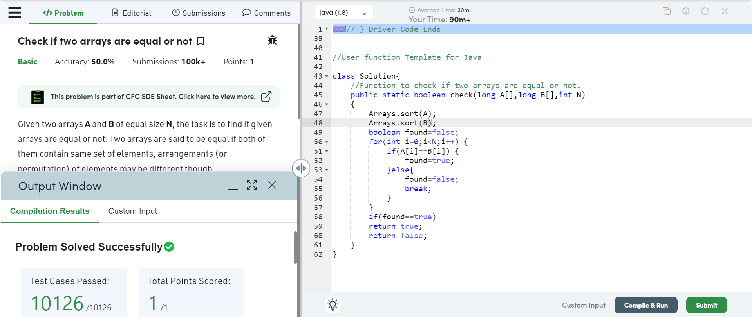
Practice On Geeks of Geeks

Slide 4
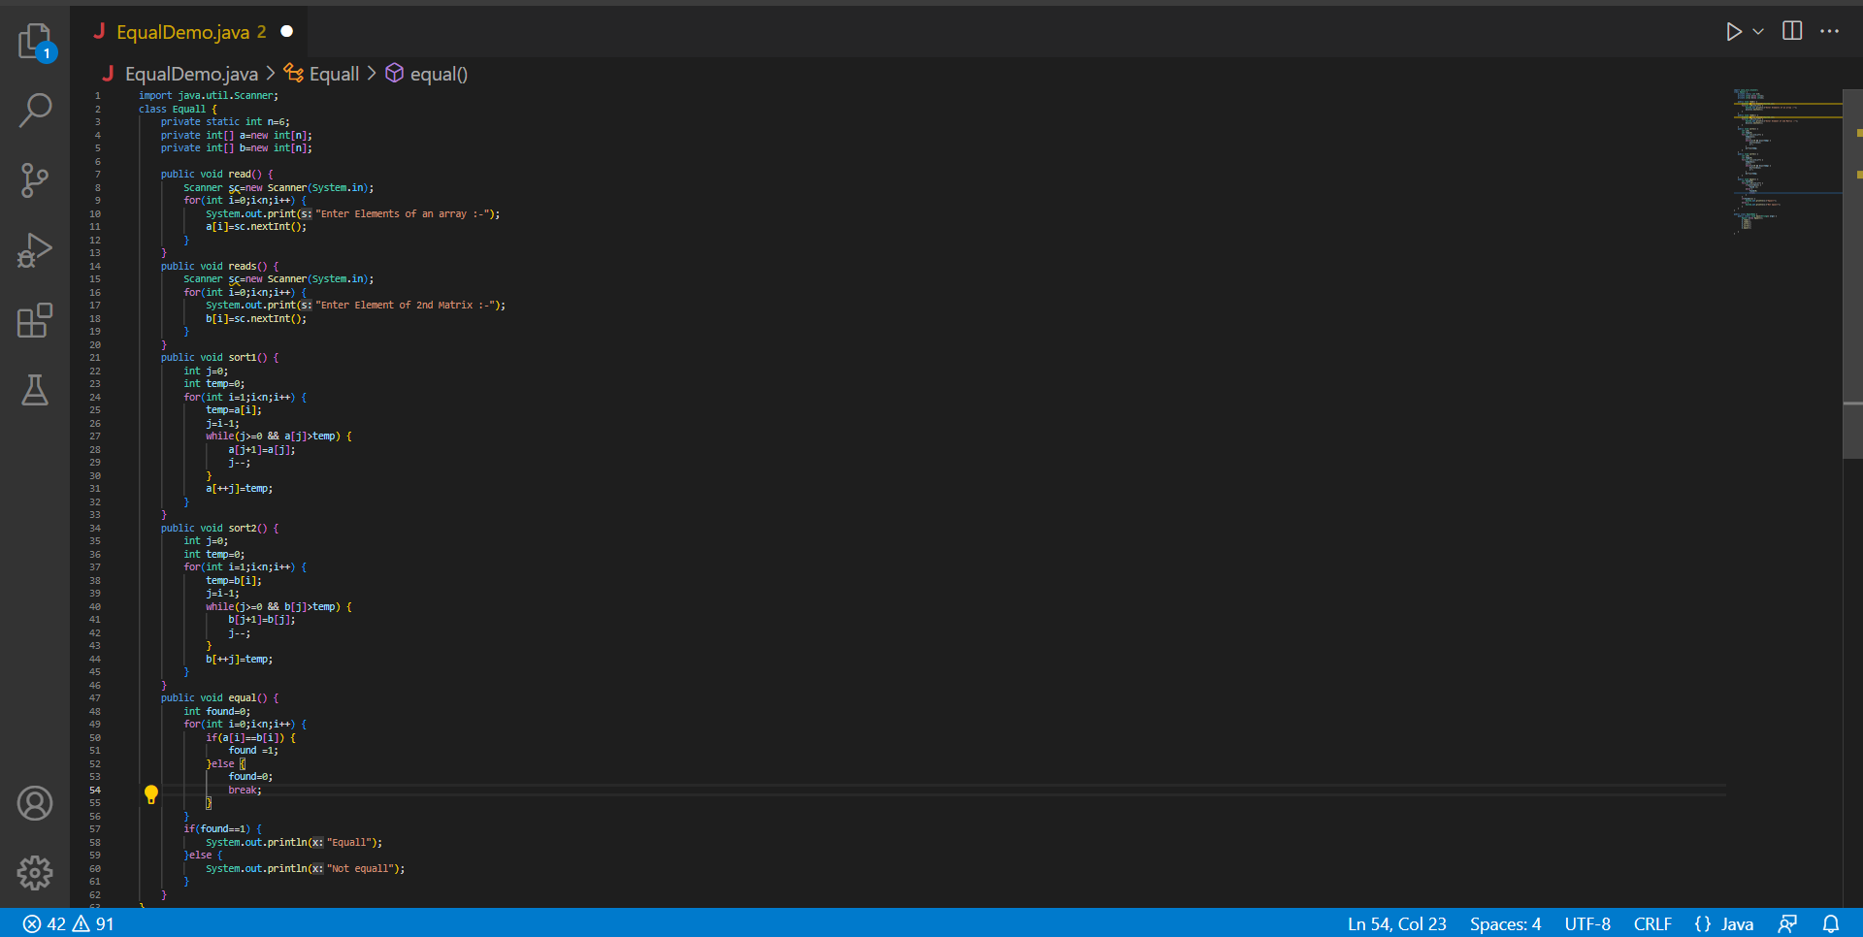
Practice on vs Code

