Slide 1


T.E CSE (IOT & CS)
Batch: 2023/2024
Project Guide:
Dr.Sheeba P.S
Team Members:
IOTE09 Shivam Dubey
IOTE12 Rahul Gummula
IOTE19 Ashish Kumar Jha
IOTE48 Salmani Shamsad
Medical Store Web Application

Slide 2

The Medical Store Web Software is a comprehensive web application designed to facilitate the efficient management of a medical store's inventory, sales, and related operations. The system is built to provide a user-friendly interface for medical professionals, ensuring seamless navigation and robust functionality.

Slide 3
LITERATURE SURVEY
NO | TITLE | AUTHER AND YEAR | CONTENT
1 | "Technological Landscape of Medical Store Web Applications." | 1)Written by Johnson, A. & Smith, B. 2)Published in year 2020 | The article by Johnson and Smith (2020) provides an overview of the technological aspects prevalent in medical store web applications.
2 | "User Experience Design in Medical Store Web Applications: A Review." | 1)Written by Patel, C., & Gupta, D. 2)Published in year 2019 | The article by Patel and Gupta (2019) explores the intricacies of user experience design within medical store web applications.
3 | "Security Measures in Medical Store Web Applications: A Comprehensive Analysis." | 1)Written by Khan, M. S., & Ahmed, S. 2)Published in year 2021 | It offers insights into the various strategies and technologies used to safeguard sensitive data, ensuring the protection of patient information, prescriptions, and payment details.

Slide 4
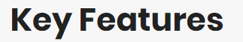
Medicine Management
Add, edit, and delete medicines with details such as name, company, single pack quantity, category, and location rack. Dynamic selection of options for company, category, and location rack based on data retrieved from the database.
Inventory Tracking
Real-time monitoring of inventory levels to prevent stockouts or overstock situations. Detailed tracking of medicine information, including company, category, and location rack.
Sales Management
Record and manage sales transactions with information on medicines sold, quantities, and prices. Keep a record of sales for analysis and revenue tracking.
User-Friendly Dashboard
Intuitive dashboard providing quick access to essential functionalities. Breadcrumb navigation for easy tracking and accessibility.
Authentication and Authorization
Secure user authentication mechanisms to protect sensitive information.
Dynamic Data Interaction
Utilization of Flask and MySQL for dynamic data interaction between the web application and the MySQL database. Responsive and seamless user experience.

Slide 5
Technologies Used
Backend
Database
Flask (Python web framework)
HTML, CSS, JavaScript -
Bootstrap (Frontend framework for responsive design)-
MySQL for data storage and retrieval
SQL (Database Management)
Frontend
Ganache & Truffle

Slide 6
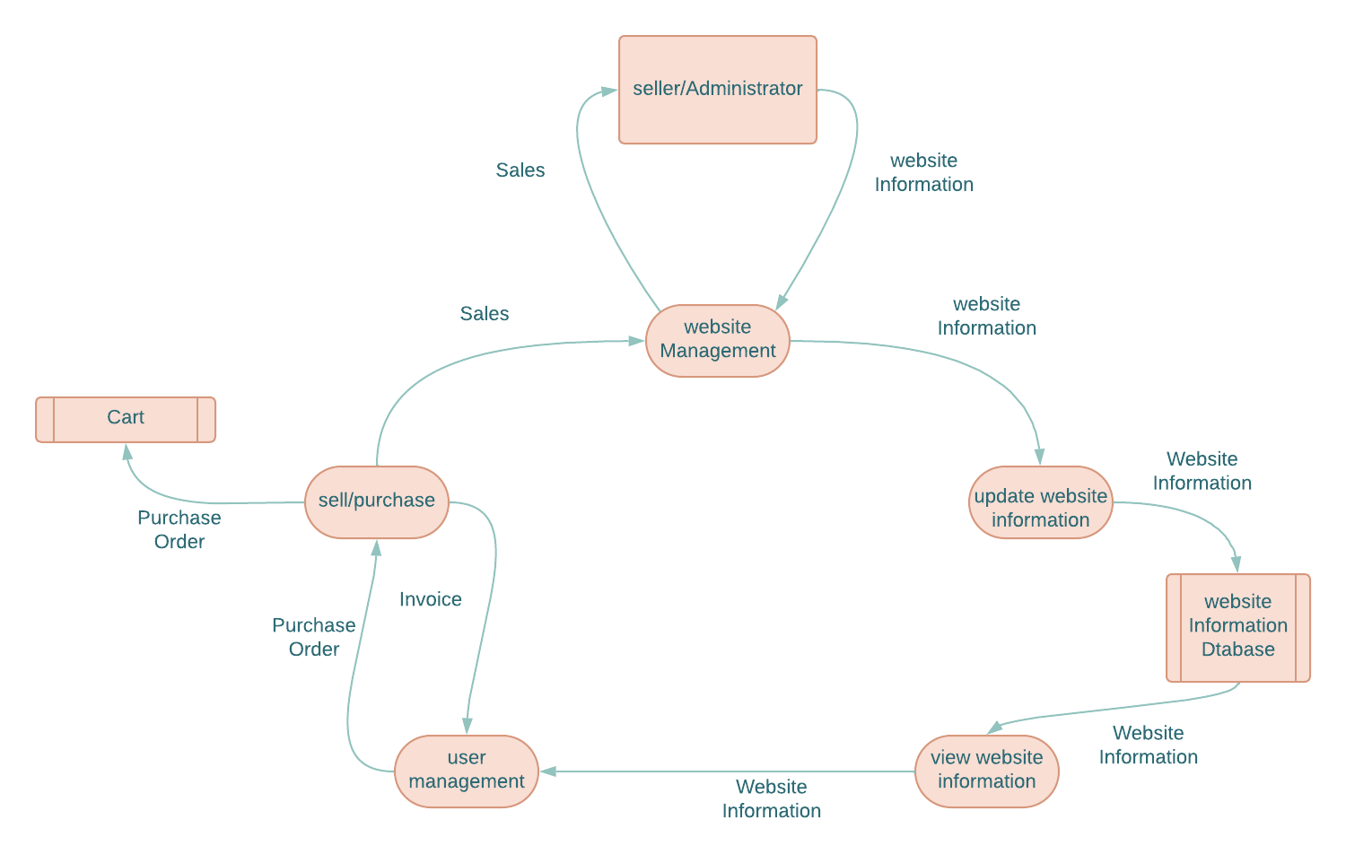
Flow chart

Slide 7

Accessibility
Owners can easily access the medical store's inventory and place bulk orders from the comfort of their homes. This is particularly beneficial for individuals with mobility issues.
Convenience
Owners can browse through a wide range of products, and place orders at any time of the day, eliminating the need to visit physical warehouse during specific operating hours.
Improved Inventory Management:
The software facilitates real-time inventory tracking, enabling store owners to monitor stock levels, track expiration dates, and optimize procurement processes more efficiently.
Streamlined Operations
Automation of routine tasks such as order processing, invoicing, and payment processing streamlines operations, reducing manual errors and saving time for store staff.
With reduced dependency on physical infrastructure and manpower for order processing, medical store web software can lead to cost savings in the long run.
Scalability
As the business grows, the web software can easily scale to accommodate increased demand and expand its functionalities to meet evolving needs.
Cost Savings

Slide 8
Future Enhancements:
Enhanced Reporting
Supplier Management
Notifications
User Roles and Permissions
Implement advanced reporting features to analyze sales trends and inventory patterns.
Integrate a module for managing and tracking medicine suppliers.
Implement notification features for low stock levels or important updates.
Extend authorization controls to include more granular user roles and permissions.
Include features where customer can order medicines at their place.
E-commercial Website

Slide 9

1. https://getbootstrap.com/docs/5.3/examples/
2. https://www.tutorialspoint.com/sql/index.htm
3. https://stackoverflow.com/questions
4. https://flask.palletsprojects.com/en/3.0.x/#user-s-guide
5. https://www.geeksforgeeks.org/javascript/?ref=lbp
6. https://web3py.readthedocs.io/en/stable/web3.contracts.html

Slide 10

The Medical Store Web Software is designed to be a robust and scalable solution for medical store management. Its features and technologies provide a foundation for further enhancements and customization based on evolving requirements.

Slide 11


