Slide 1
Retail Sales Analysis
Automated report generated by Python (sample data)

Slide 2
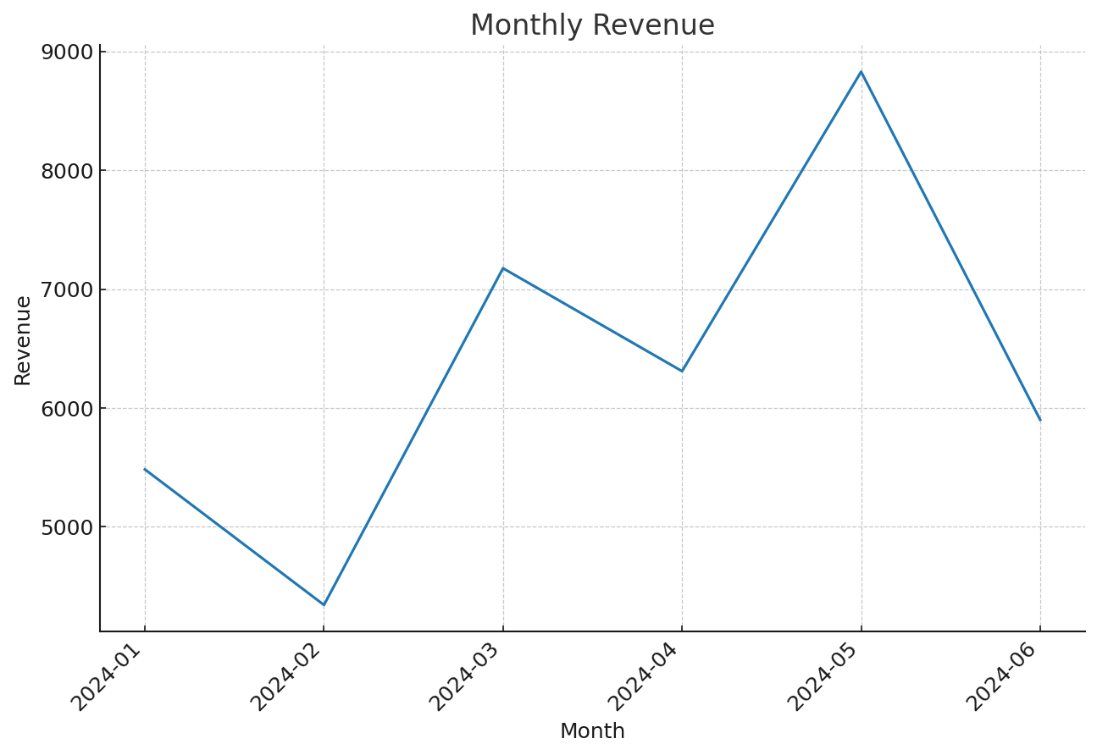
Monthly Revenue

Slide 3
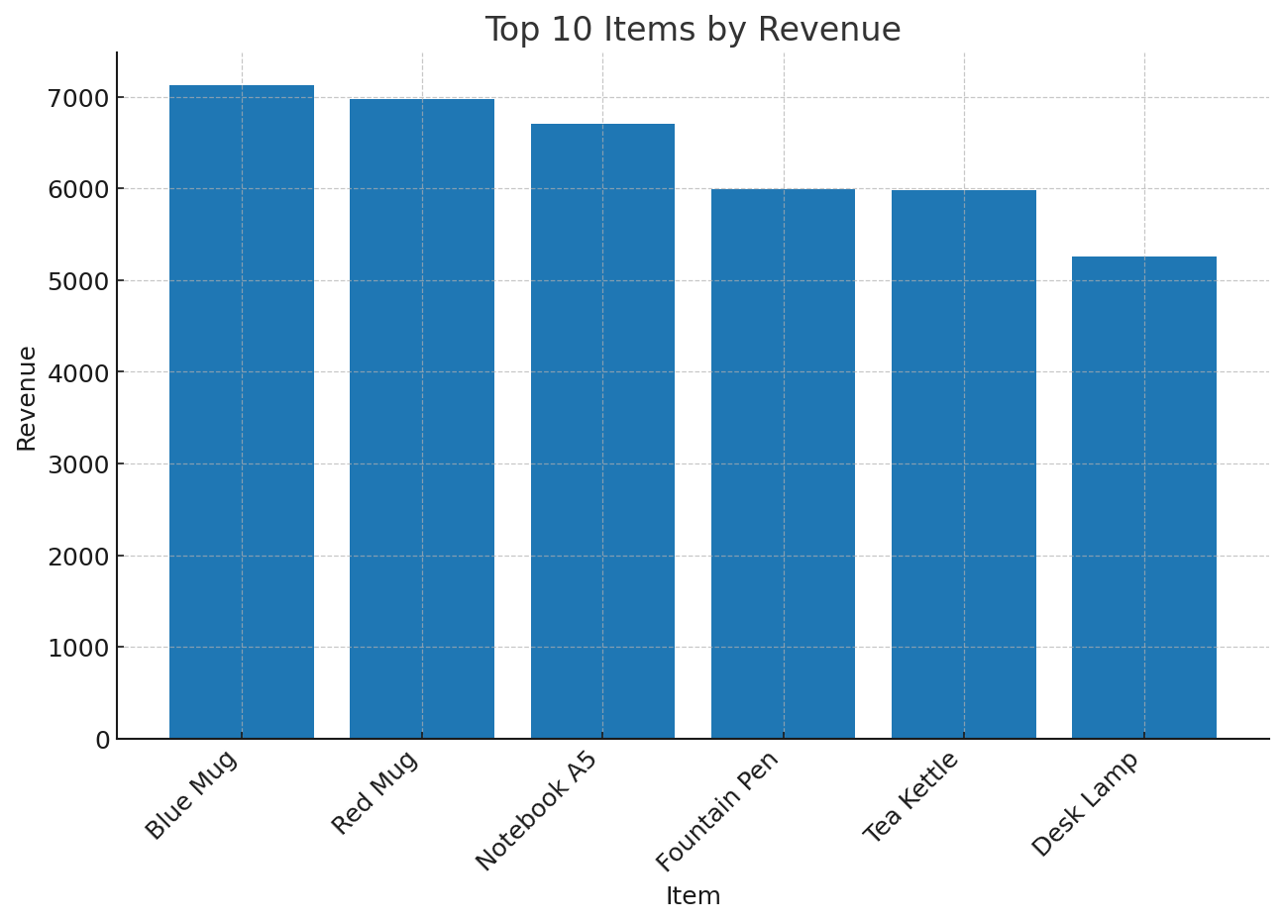
Top Items by Revenue

Slide 4
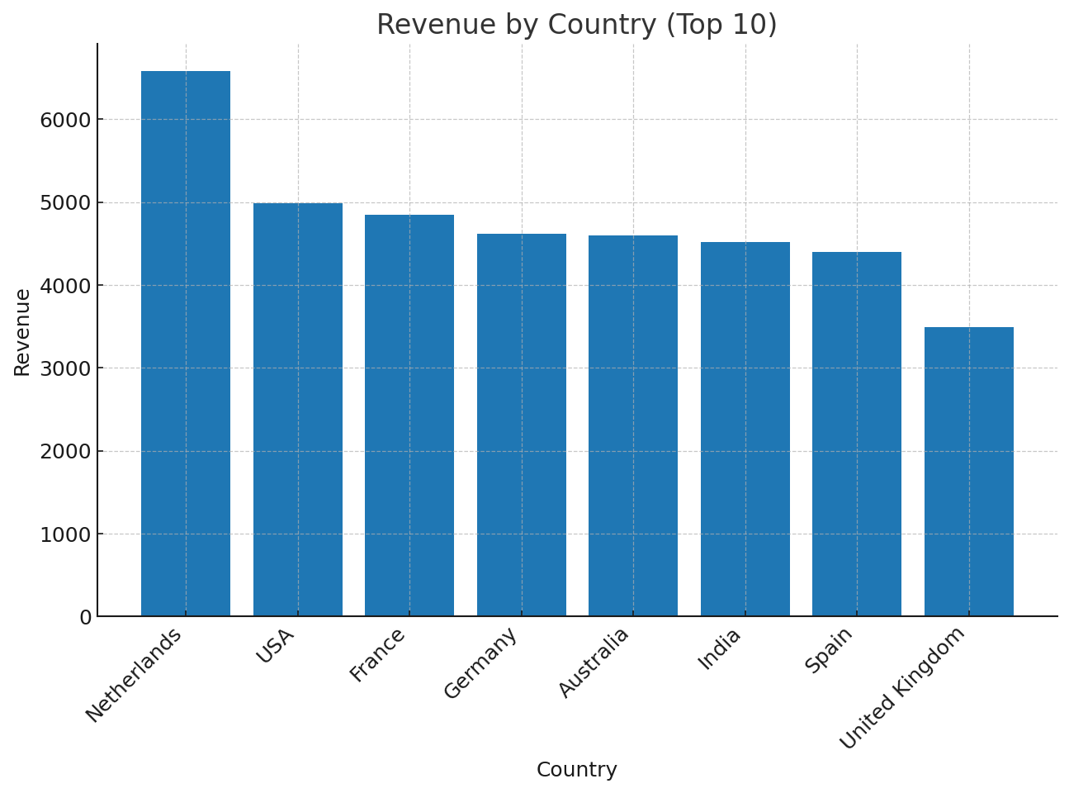
Revenue by Country

Slide 5
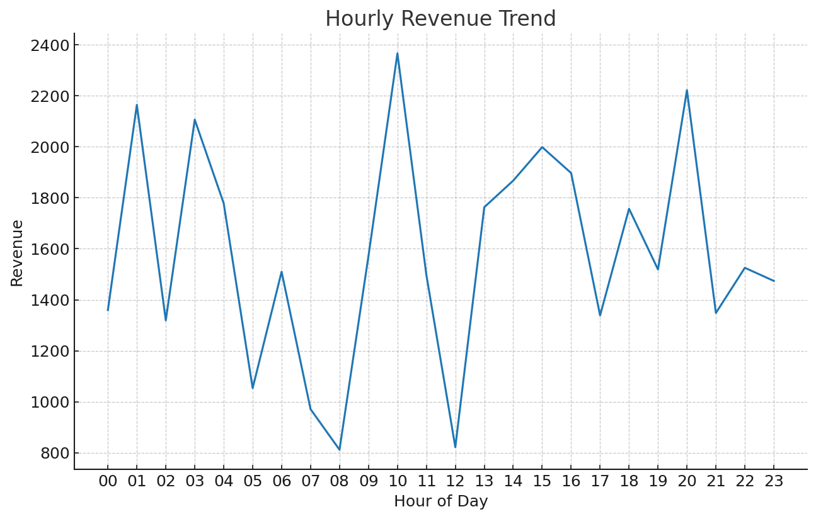
Hourly Revenue Trend

