Slide 1

School of
Information Technology and Engineering
ITE-1003
DATA BASE MANAGEMENT SYSTEM
Project Review-1
Presenters:
Pritish Gupta MA Rahul
19BIT0361 19BIT0382

Slide 2
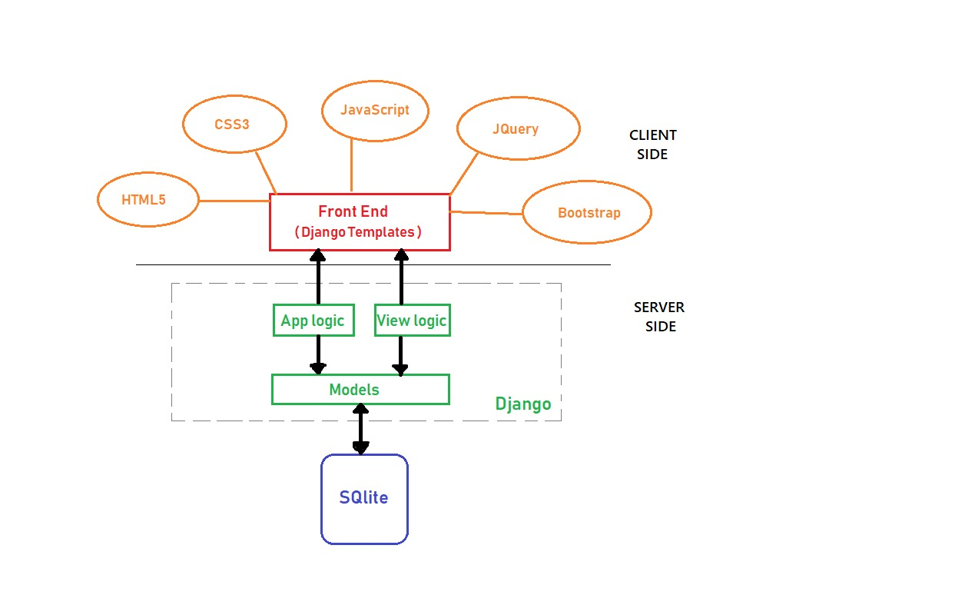
STRUCTURE

Slide 3
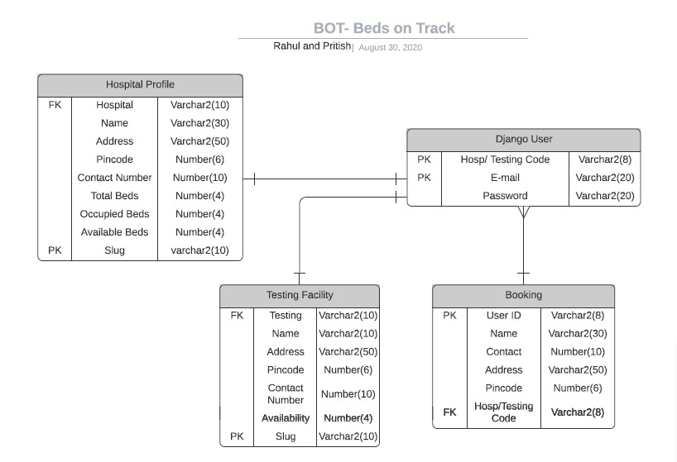
UML DIAGRAM

Slide 4
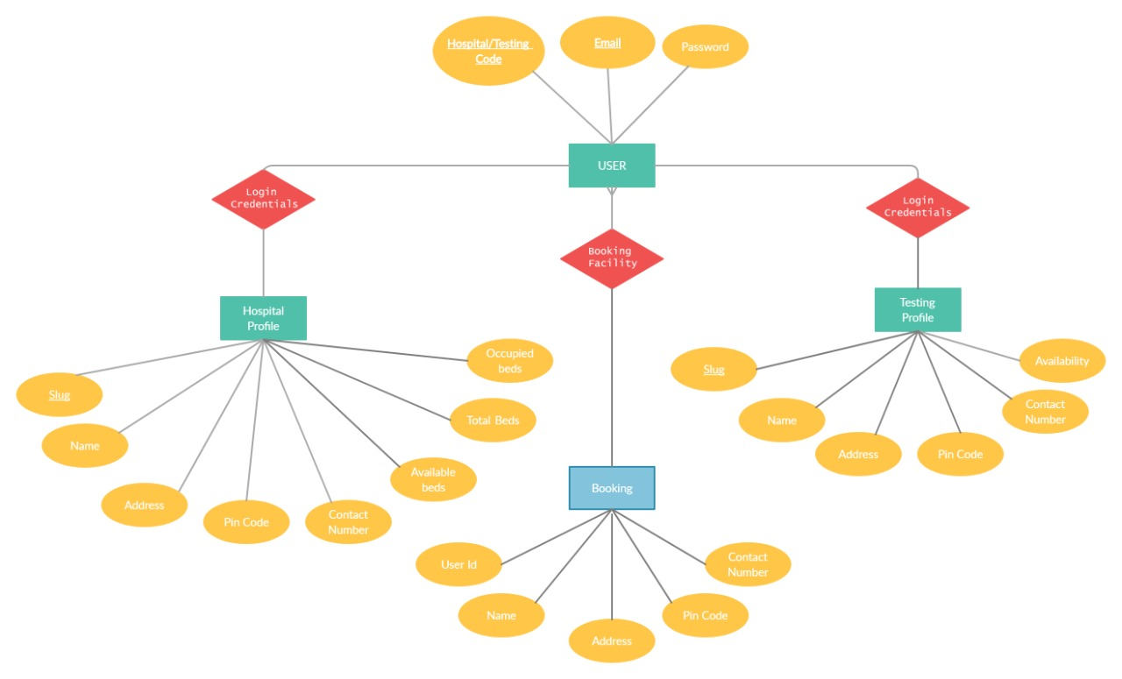
ER DIAGRAM

Slide 5
